Slide 1
Data Story from Arlington Housing Prices
By Gbatchin Kochoni

Slide 2
Introduction
Dataset: Zillow All Homes Data for Arlington, VA
Goal: Explore price trends and craft a data narrative
Audience: Mentor

Slide 3
Key Questions
What are the trends in home prices over time?
Are there seasonal or structural shifts?
What can we conclude for policy or investment?

Slide 4
Data Wrangling Summary
Dropped irrelevant columns (e.g., RegionID, Metro)
Transposed time series structure
Handled missing values and renamed columns

Slide 5
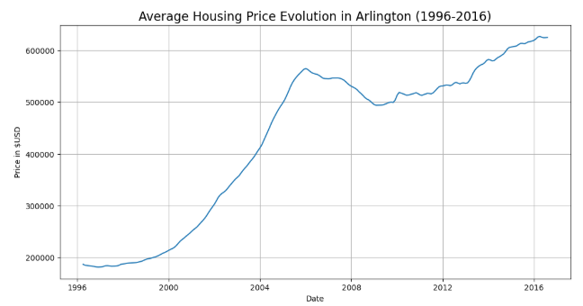
Price Trend Over Time
Visualized average monthly home prices in Arlington
Notable trends, e.g., growth since 2015, periodic dips

Slide 6
Observed Trends and Hypotheses
Observed steady increase in home prices
Hypothesis: Growth is seasonal and post-2015 sustained

Slide 7
Implications
Arlington shows housing investment potential
Possible drivers: economic activity, population, demand

Slide 8
Next Steps
Add more predictors (interest rates, amenities)
Build predictive models (regression, time-series)
Compare with nearby cities (e.g., D.C.) for broader insights

Slide 9
Conclusion
Insight: Arlington home prices show sustained growth
Further analysis can inform strategic investment decisions

