Slide 1
AsiaMRL: Controlling the Chemical Residues in Fruits and Vegetables
The Lab of Inter-disciplinary
跨領域研究室
KCY TTHT TJY JPW SAL
#bio #bio #bio #environmental #CS #info #art #agri #analysis #bioinfo

Slide 2
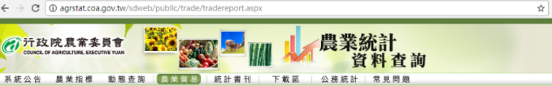
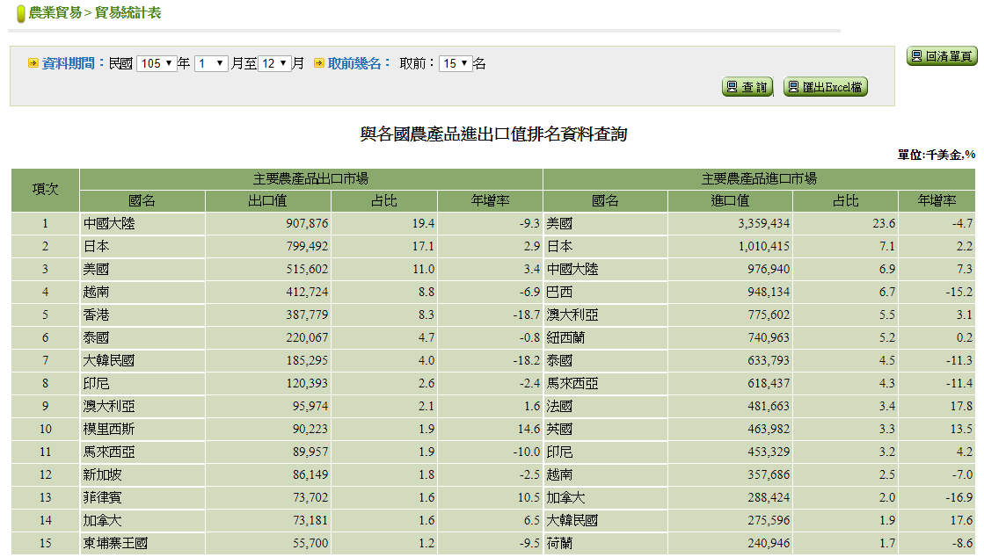
Taiwan 2016
Export
Import
Japan #2
Japan #2
Thailand #6
Korea #7
Thailand #7
Korea #14
http://agrstat.coa.gov.tw/sdweb/public/trade/tradereport.aspx

Slide 3
2015 fruits & vegetables
 | Import (from world to TW) | Export (from TW to world)
Fruit and Products | US$ 1 000 million / year | US$ 240 million / year
Vegetableand Products | US$ 300 million / year | US$ 170 million /year
[Data Source] http://www.coa.gov.tw/ws.php?id=2504748

Slide 4
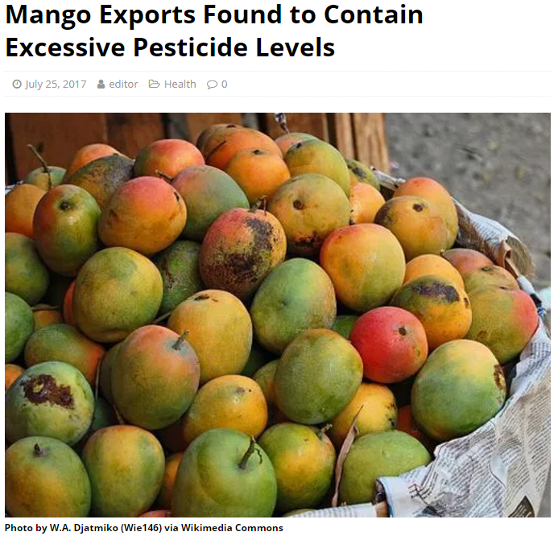
Iprodione
Chlorfenapyr
Korea MRL: Not Detected
Taiwan MRL: 0.5ppm
http://www.totaltaipei.com/mango-exports-excessive-pesticide-levels/

Slide 5
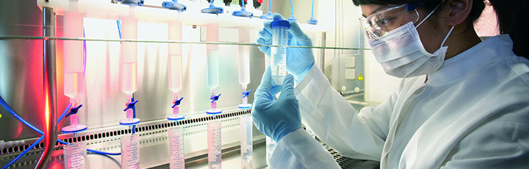
MRL: Maximum Residue limits
The standard of chemical (pesticides or herbicides) residues
No open access databases for multiple countries
http://www.fao.org/fao-who-codexalimentarius/standards/veterinary-drugs-mrls/en/
Notes:
esrc=s&source=images&cd=&cad=rja&uact=8&ved=0ahUKEwjSvbahj8HVAhXKmpQKHfMxDtwQjhwIBQ&url=http%3A%2F%2Fwww.fao.org%2Ffao-who-codexalimentarius%2Fstandards%2Fveterinary-drugs-mrls%2Fen%2F&psig=AFQjCNERLiZ86Px38mg1KXGFR5oS5MRJ2g&ust=1502057730031522

Slide 6
MRL: Different for different countries
# of Crops | Taiwan | Korea | Thailan | Japan
9 | > 0 ppm | Not Detected | Not Detected | Not Detected
203 | Not Detected | > 0 ppm | > 0 ppm | > 0 ppm

Slide 7





Flowchart
User Inout
Facebook
fans club
FB Development API
json
Server

Slide 8
Data Schema of Primary Datasets
DrugBook
Taiwan MRL
(drugName) (ComName)
(ProductName)
AsiaMRL
Thailand MRL
(drugName)
(Taiwan MRL)
(Thailand MRL) (Korea MRL)
(Japan MRL)
(cropName)
Korea MRL
PlantDisQA
(cropName) (question)
(answer)
Japan MRL
more MRL
BugBook
ImportTest
(cropName) (question)
(answer)
(cropName) (area)
(reason)

Slide 9
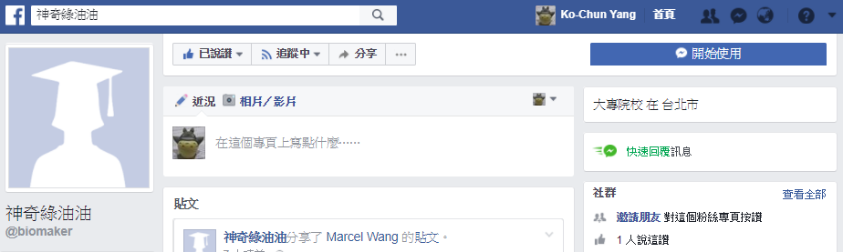
DEMO
https://www.facebook.com/biomaker/

Slide 10
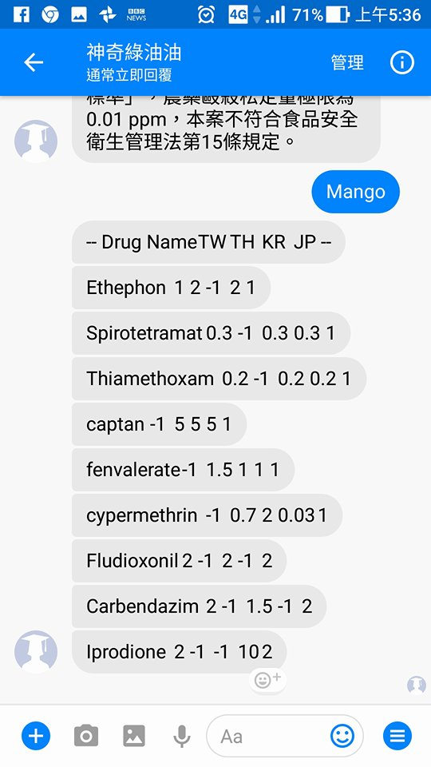
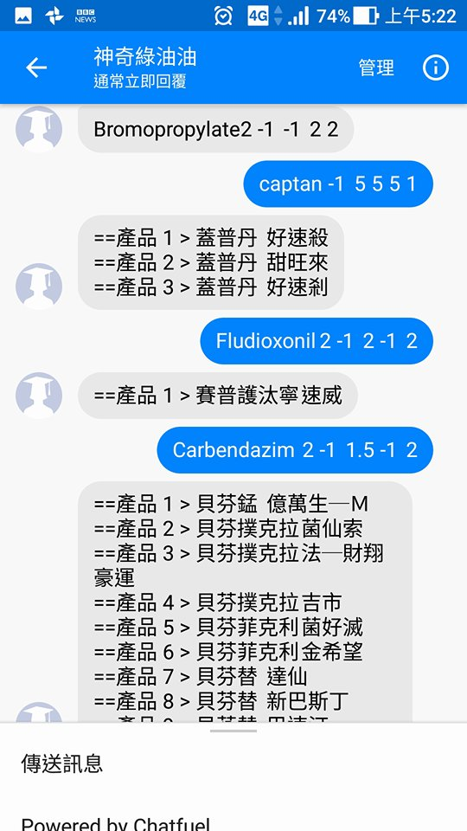

Slide 11
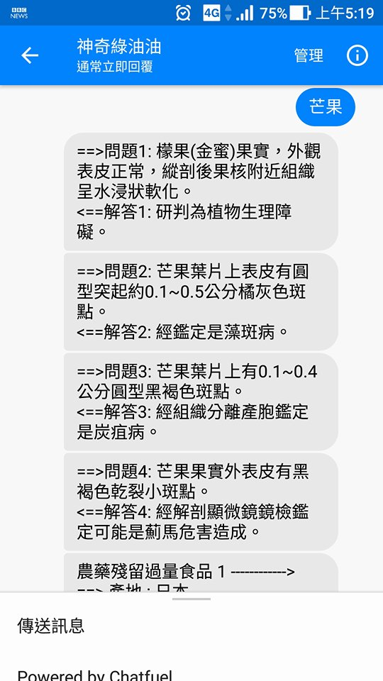
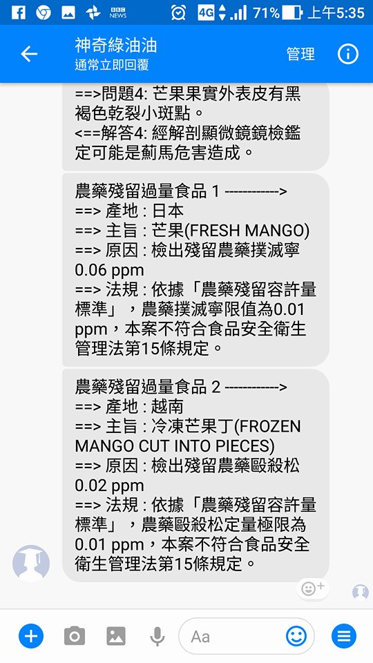

Slide 12
