Slide 1
AsiaMRL: Controlling the Chemical Residues in Fruits and Vegetables
The Lab of Inter-disciplinary
跨領域研究室
KCY TTHT TJY JPW SAL
#bio #bio #bio #environmental #CS #info #art #agri #analysis #bioinfo

Slide 2
2015 fruits & vegetables
 | Import (from world to TW) | Export (from TW to world)
Fruit and Products | US$ 1 000 million / year | US$ 240 million / year
Vegetableand Products | US$ 300 million / year | US$ 170 million /year
[Data Source] http://www.coa.gov.tw/ws.php?id=2504748

Slide 3
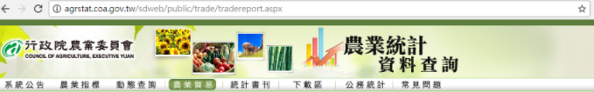
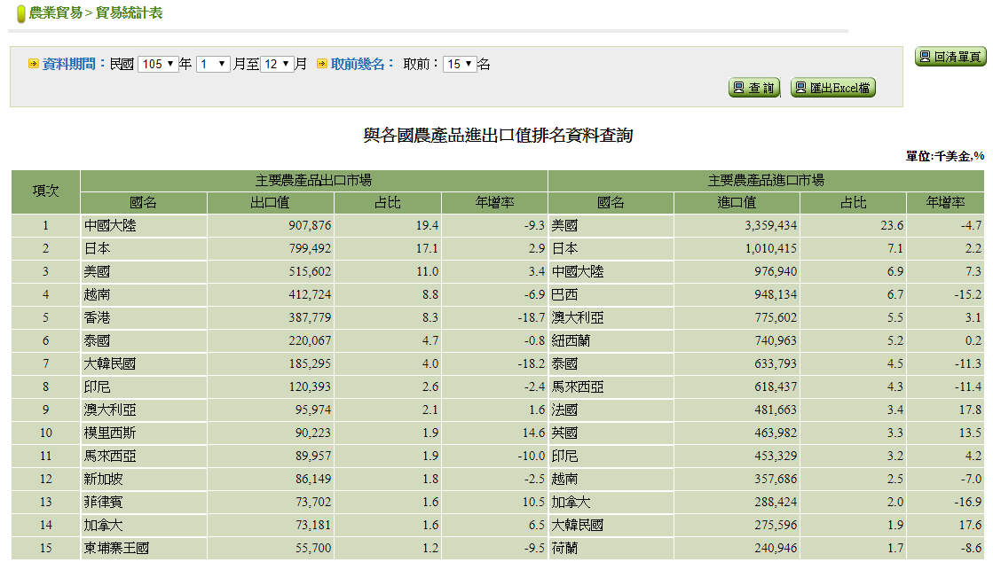
Taiwan 2016
Export
Import
Japan #2
Japan #2
Thailand #6
Korea #7
Thailand #7
Korea #14
http://agrstat.coa.gov.tw/sdweb/public/trade/tradereport.aspx

Slide 4
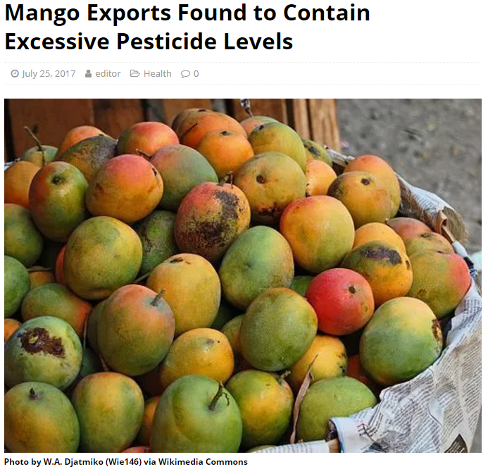
Iprodione
Chlorfenapyr
Korea MRL: Not Detected
Taiwan MRL: 0.5ppm
http://www.totaltaipei.com/mango-exports-excessive-pesticide-levels/

Slide 5
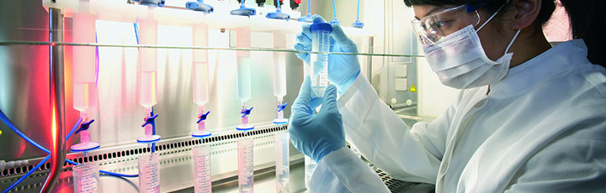
MRL: Maximum Residue limits
The standard of chemical (pesticides or herbicides) residues
No open access databases for multiple countries
http://www.fao.org/fao-who-codexalimentarius/standards/veterinary-drugs-mrls/en/
Notes:
esrc=s&source=images&cd=&cad=rja&uact=8&ved=0ahUKEwjSvbahj8HVAhXKmpQKHfMxDtwQjhwIBQ&url=http%3A%2F%2Fwww.fao.org%2Ffao-who-codexalimentarius%2Fstandards%2Fveterinary-drugs-mrls%2Fen%2F&psig=AFQjCNERLiZ86Px38mg1KXGFR5oS5MRJ2g&ust=1502057730031522

Slide 6
MRL: Different for different countries
# of Crops | Taiwan | Korea | Thailan | Japan
9 | > 0 ppm | Not Detected | Not Detected | Not Detected
203 | Not Detected | > 0 ppm | > 0 ppm | > 0 ppm
List crops with MRL different for at least 1 chemical

Slide 7





Flowchart
User Input
Facebook
fans club
FB Development API
json
Server

Slide 8
Data Schema of Primary Datasets
DrugBook
Taiwan MRL
(drugName) (ComName)
(ProductName)
AsiaMRL
Thailand MRL
(drugName)
(Taiwan MRL)
(Thailand MRL) (Korea MRL)
(Japan MRL)
(cropName)
Korea MRL
PlantDisQA
(cropName) (question)
(answer)
Japan MRL
more MRL
BugBook
ImportTest
(cropName) (question)
(answer)
(cropName) (area)
(reason)

Slide 9
Primary Dataset/Database
臺灣MRL查詢資料庫https://consumer.fda.gov.tw/Law/PesticideList.aspx?nodeID=520
日本MRL查詢資料庫http://www.m5.ws001.squarestart.ne.jp/foundation/search.html
韓國MRL查詢資料庫http://www.foodsafetykorea.go.kr/residue/prd/mrls/list.do?menuKey=1&subMenuKey=161
邊境檢驗不符合食品資訊查詢ttps://consumer.fda.gov.tw/Food/UnsafeFood.aspx?nodeID=170#consumer.fda.gov.tw/Food/UnsafeFood.aspx?nodeID=170#
農藥名稱手冊http://data.gov.tw/node/7281
病蟲害診斷服務問答集資料http://data.coa.gov.tw/Query/AdvSearch.aspx?id=022
重要農業害蟲診斷圖鑑資料http://data.coa.gov.tw/Query/AdvSearch.aspx?id=176
韓國MRL法規http://www.mfds.go.kr/eng/eng/index.do?nMenuCode=120&page=1&mode=view&boardSeq=71065
泰國MRL法規(TA9002-2013)http://extwprlegs1.fao.org/docs/pdf/tha161066.pdf
行政院農業統計資料庫http://agrstat.coa.gov.tw/sdweb/public/trade/tradereport.aspx
105年我國農產貿易概況http://www.coa.gov.tw/ws.php?id=2506389
臺灣MRL法規(英)
http://law.moj.gov.tw/Eng/LawClass/LawContent.aspx?PCODE=L0040083

Slide 10
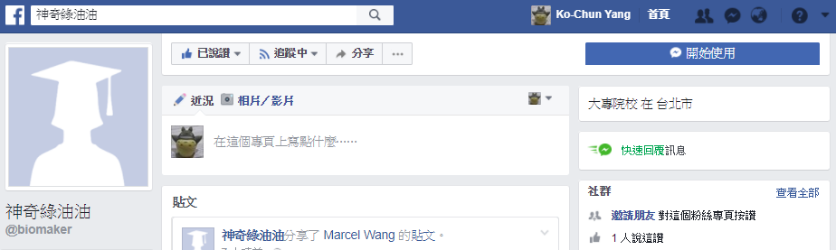
DEMO
https://www.facebook.com/biomaker/

Slide 11
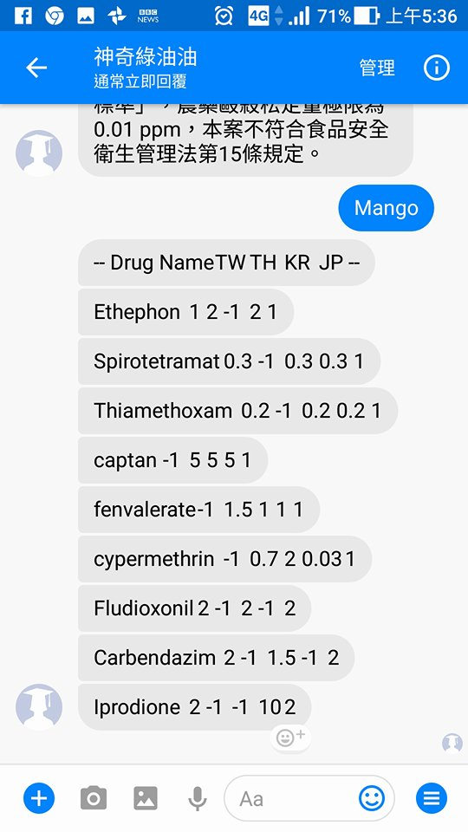
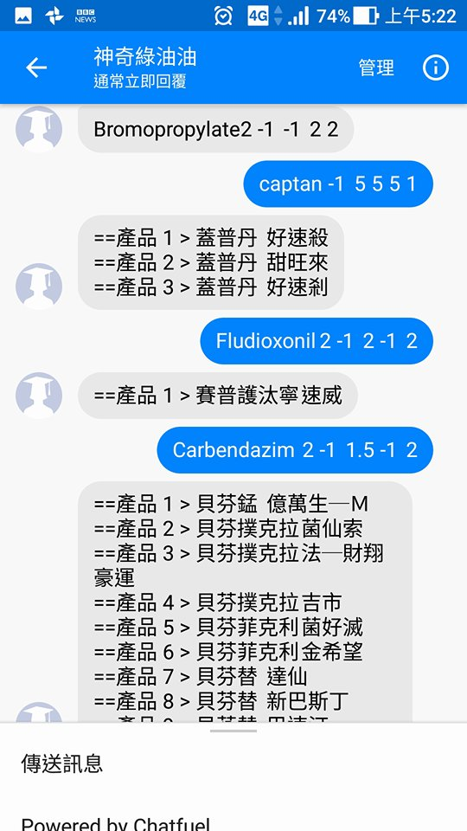

Slide 12
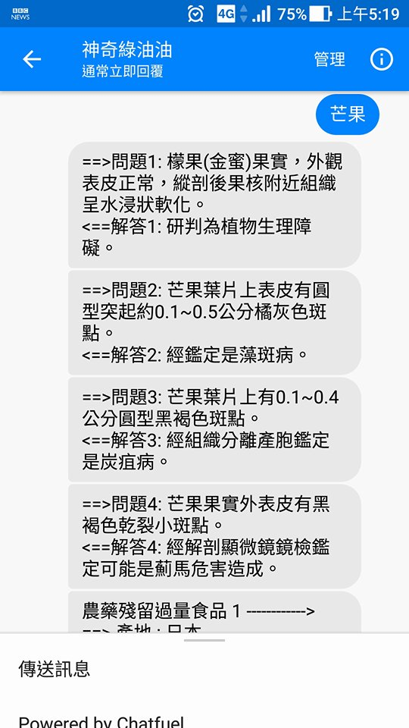
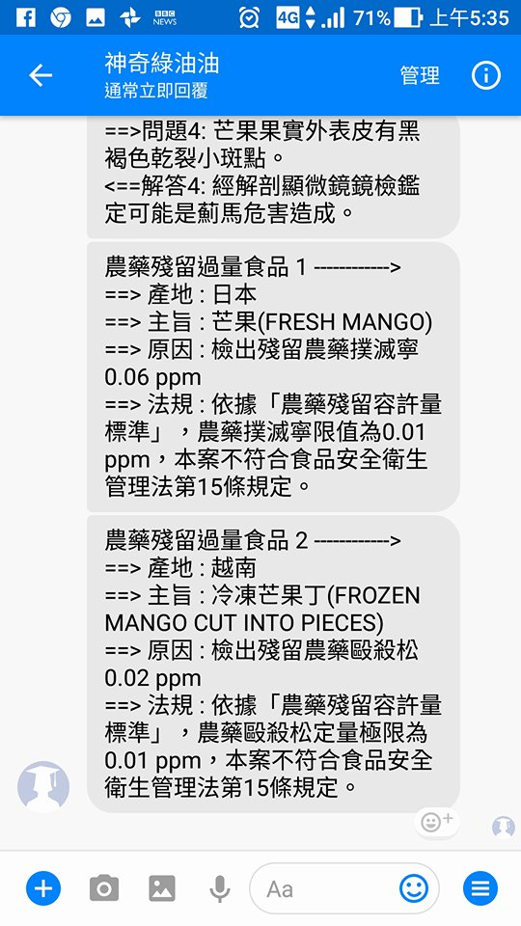

Slide 13
