Slide 1


























AsiaMRL: Controlling the Chemical Residues in Fruits and Vegetables
The Lab of Inter-disciplinary
跨領域研究室
Notes:
ICONS from https://www.flaticon.com/

Slide 2
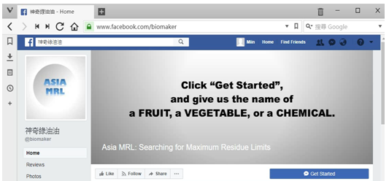
Chat with me
https://www.facebook.com/biomaker/
Chat with me

Slide 3
Taiwan Import & Export: ~ 4% is Bio-commodities
2015
 | Import (from world to TW) | Export (from TW to world)
Fruits | US$ 1000 million / year | US$ 240 million / year
Vegetables | US$ 300 million / year | US$ 170 million / year
[Data Source] http://www.coa.gov.tw/ws.php?id=2504748

Slide 4
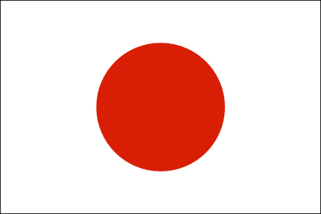
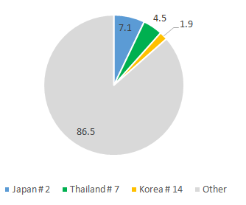
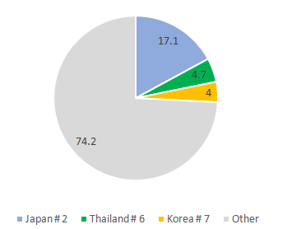
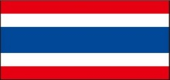
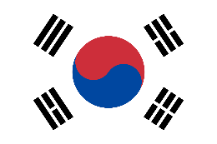
Taiwan's Agricultural Statistics
Export
Import
2015
Rank High in Our Trading Countries
http://agrstat.coa.gov.tw/sdweb/public/trade/tradereport.aspx
Notes:
esrc=s&source=images&cd=&cad=rja&uact=8&ved=0ahUKEwjSvbahj8HVAhXKmpQKHfMxDtwQjhwIBQ&url=http%3A%2F%2Fwww.fao.org%2Ffao-who-codexalimentarius%2Fstandards%2Fveterinary-drugs-mrls%2Fen%2F&psig=AFQjCNERLiZ86Px38mg1KXGFR5oS5MRJ2g&ust=1502057730031522

Slide 5
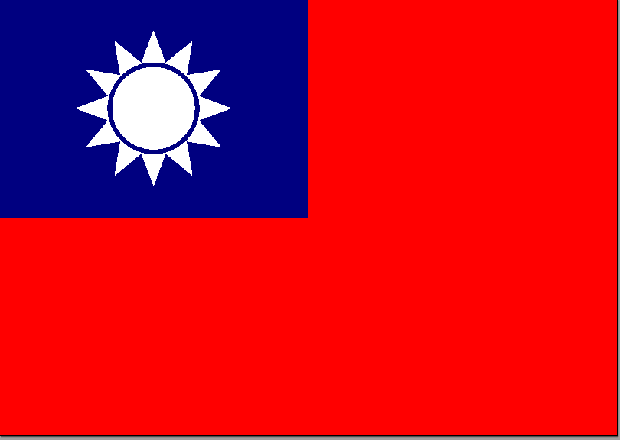
MRL: Maximum Residue Limits
The standard of maximum chemical (pesticides or herbicides) residues “allowed” for each countries
Different
Any searchable databases ?
Not open access
Not for multiple countries
# of Fruits & Vegetables
9 | > 0 ppm | Not Allowed | Not Allowed | Not Allowed
203 | Not Detected | > 0 ppm | > 0 ppm | > 0 ppm
http://www.fao.org/fao-who-codexalimentarius/standards/veterinary-drugs-mrls/en/
Notes:
esrc=s&source=images&cd=&cad=rja&uact=8&ved=0ahUKEwjSvbahj8HVAhXKmpQKHfMxDtwQjhwIBQ&url=http%3A%2F%2Fwww.fao.org%2Ffao-who-codexalimentarius%2Fstandards%2Fveterinary-drugs-mrls%2Fen%2F&psig=AFQjCNERLiZ86Px38mg1KXGFR5oS5MRJ2g&ust=1502057730031522

Slide 6
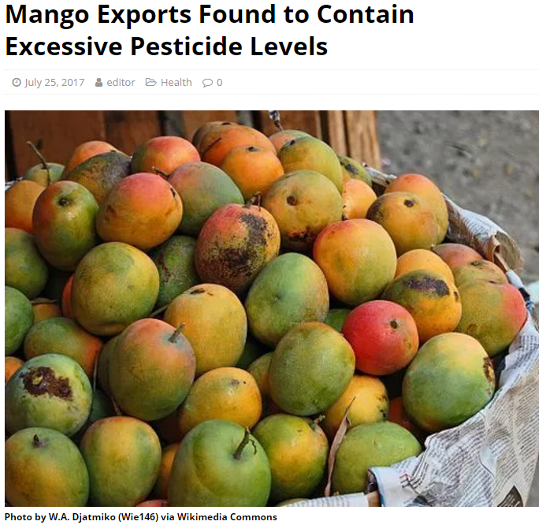
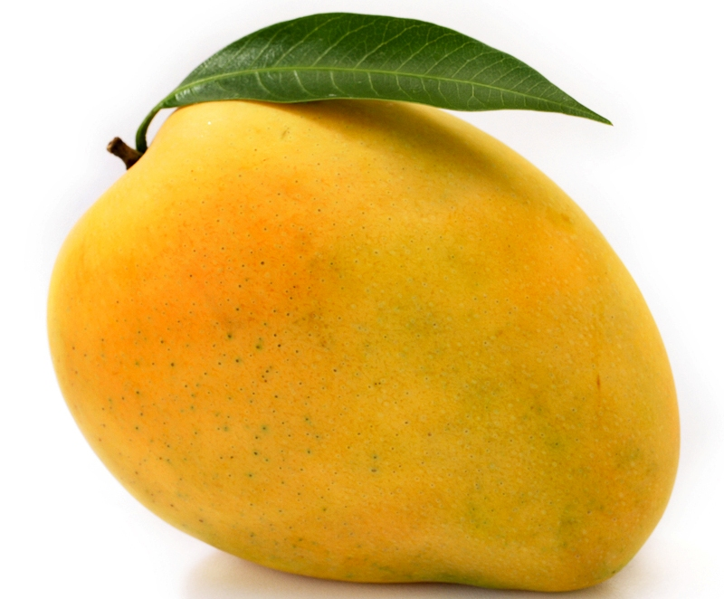
Iprodione
Chlorfenapyr
MRL standards
Korea < Taiwan
http://www.totaltaipei.com/mango-exports-excessive-pesticide-levels/

Slide 7





AsiaMRL: System Architecture
User Input
Facebook
fans club
Facebook
Development API
json
Server

Slide 8
Integrating 14 datasets/ databases from 4 countries
DrugBook
Taiwan MRL
AsiaMRL
(drugName) (ComName)
(ProductName)
(drugName)
(Taiwan MRL)
(Thailand MRL) (Korea MRL)
(Japan MRL)
(cropName)
Japan MRL
Korea MRL
PlantDisQA
Thailand MRL
(cropName) (question)
(answer)
more MRL
BugBook
ImportTest
(cropName) (question)
(answer)
(cropName) (area)
(reason)

Slide 9
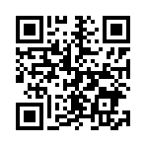
DEMO
https://www.facebook.com/biomaker/
Chat with me

Slide 10
INPUT
OUTPUT
Fruit Name (English/Chinese)
Chemical Name(English)
MRL Standards:
TW, TH, KR, JP
Short & Complete Lists
Pesticide/Herbicide: Brand
Plant Diseases
Records of MRL violation
Language:
English/Chinese

Slide 11



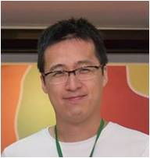

Thanks for your attention!
KCY
#bioinfo #art
TTHT
#bio #art
TJY
#bio #agri
JPW
#env #chem
SAL
#CS #Data scientist

