Slide 1

RESEARCH INTELLIGENCE
VISTA4D
Video Reshooting with 4D-Grounded Point Clouds
Eyeline Labs • Kuan Heng Lin • Jiajun Wu

Slide 2

Technical Foundations
Breaking down the limitations of prior methods and the Vista4D architectural shift.

Slide 3

IMPLICIT VS. EXPLICIT METHODS
Latent Instability
Geometric Noise
Implicit models (CamClone, TrajectoryCrafter) rely on latent camera conditioning. While visually clean, they cannot strictly enforce the target trajectory, leading to content drift in complex motions.
Explicit methods (EX-4D, GEN3C) provide better control but suffer from depth artifacts. Errors in 3D reconstruction are often baked into the output as unnatural visual glitches.

Slide 4

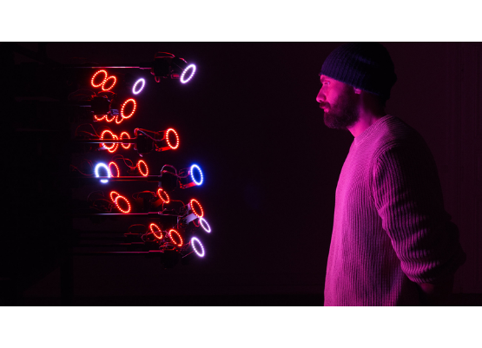
SYSTEM OVERVIEW
Vista4D grounds reshooting in a Temporally Persistent 4D Point Cloud to provide a rigid geometric anchor for generative synthesis.
Explicit Grounding: Visible scene geometry is encoded across time to guide the diffusion model.
Artifact Correction: The model is trained to recover from noisy 4D renders rather than copying them.

Slide 5
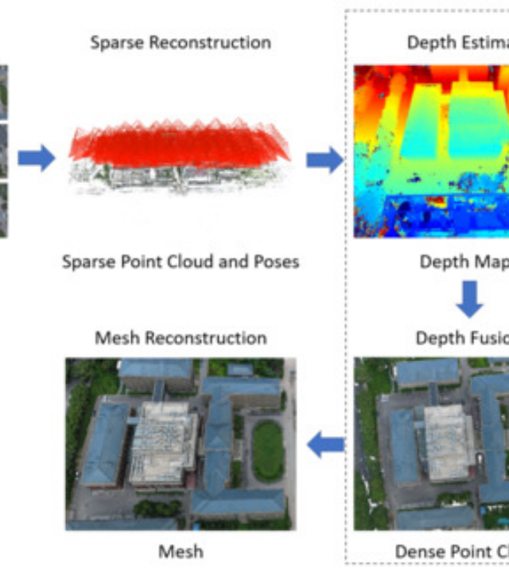

TEMPORAL PERSISTENCE
Unlike per-frame depth methods, Vista4D accumulates static scene context across the entire video sequence.
This allows for geometric grounding even when the target camera has zero pixel overlap with the current source frame, providing a stable spatial "anchor" for large viewpoint shifts.
Zero-Drift Spatial Mapping

Slide 6






CORE METHODOLOGY
Decomposition
Noisy Training
Plücker Rays
Separating dynamic actors from static background pixels to build persistent 4D context.
Training on artifact-laden renders to ensure robustness to imperfect geometric inputs at inference.
Injecting precise camera parameters as ray embeddings into every transformer block.

Slide 7
DATA & TRAINING SCALE
170K
Hybrid Data Strategy
Vista4D leverages 170,000 multi-camera clips (ground-truth targets) alongside large-scale 4D-reconstructed monocular internet video from the OpenVidHD-1.0 dataset.
Video Clips
This ensures the model generalizes across diverse visual content while maintaining precise trajectory adherence.

Slide 8
QUANTITATIVE BENCHMARKS
Method | RotE (Deg) ↓ | TransE ↓ | FVD ↓ | LPIPS ↓
ReCamMaster | 1.574 | 12.79 | 23.66 | 0.285
GEN3C | 1.309 | 4.751 | 12.99 | 0.228
Vista4D (Ours) | 1.251 | 4.647 | 7.504 | 0.214
Vista4D achieves state-of-the-art camera accuracy and video realism simultaneously.

Slide 9
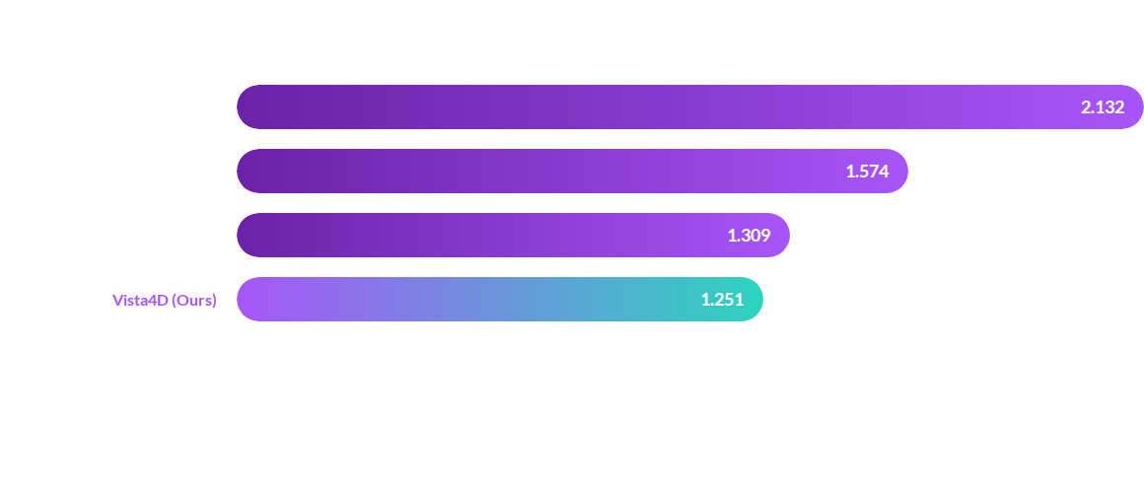
PRECISION: ROTATION ERROR (ROTE)
Lower rotation error reflects tighter adherence to the specified target camera path.

Slide 10


GENERATIVE TRANSFORMER BACKBONE
Wan2.1-T2V Scale
The model architecture is built on the 14B parameter Wan2.1 video diffusion prior. By fine-tuning the camera encoder and projector layers, Vista4D gains a deep understanding of spatial geometry while maintaining the base model's world-class motion synthesis capability.

Slide 11
"
"Vista4D resolves the fundamental tension between explicit geometric control and generative imagination in video reshooting."
— Eyeline Labs Research Briefing 2026

Slide 12

Questions?
Explore the 4D reshooting future.
github.com/vista4d
arXiv:2604.21915

Slide 13



IMAGE SOURCES
https://derivative.ca/sites/default/files/styles/project_teaser/public/field/image/Capture-Resemble-6.jpg
Source: derivative.ca
https://www.mdpi.com/remotesensing/remotesensing-16-00773/article_deploy/html/images/remotesensing-16-00773-g003-550.jpg
Source: www.mdpi.com
https://miro.medium.com/1*Kyc68FzwCa5zhGBePeK-lg.png
Source: medium.com

