Slide 1
A Persona-centered Information Security Awareness
By: Žiga Fon Faculty of Computer Science, Slovenia

Slide 2
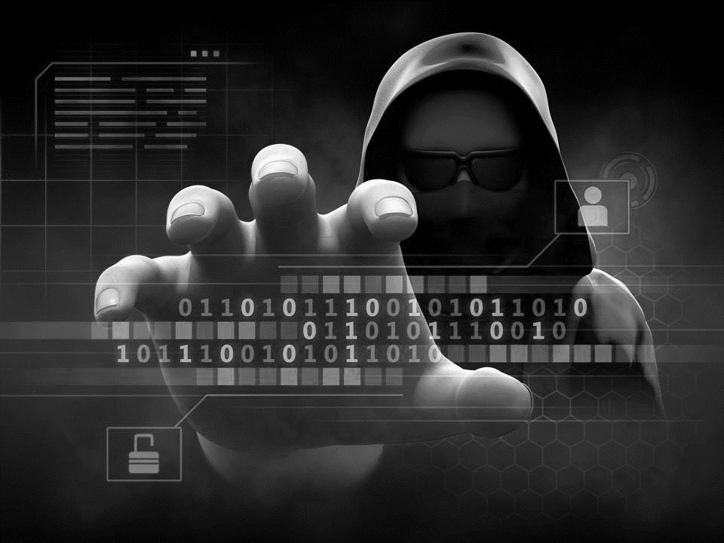
Importance of Information Security
Human factors cause most data breaches.
Personas improve security awareness.

Slide 3

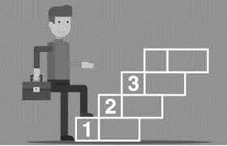


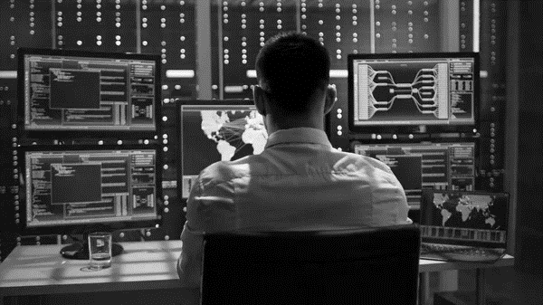
What are Personas?
Archetypes representing user groups.
Based on behavior, demographics.

Slide 4

Why Use Personas in Security?
Tailored content boosts relevance.
Adapts to specific user needs.

Slide 5

Role of Personas in Training
Generic content often fails.
Aligns training with user motivations.
Drives real behavioral change.

Slide 6

Opportunities with Personas
Interactive tools, games improve engagement.
Role-specific, practical training.
Needs positive, engaging approach.

Slide 7
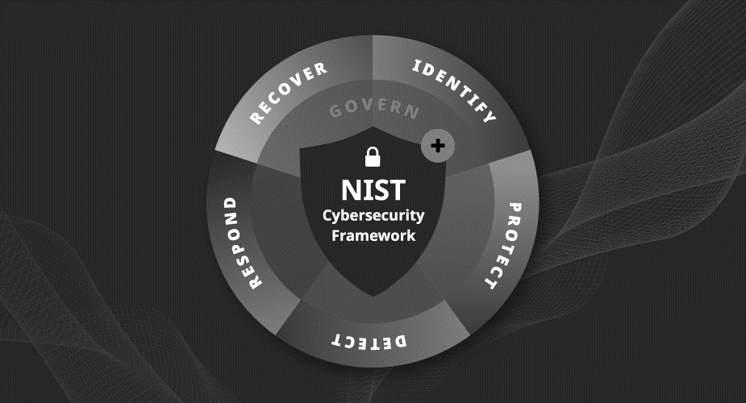
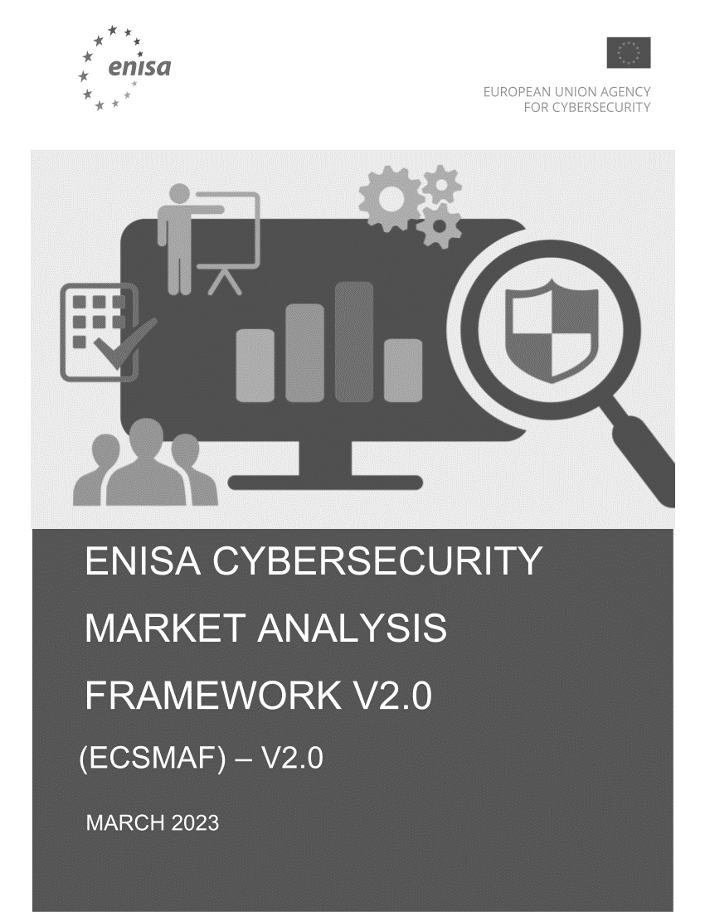
Security Awareness Frameworks
NIST, ENISA provide structure.
Frameworks ensure adaptive programs.

Slide 8

Conclusion
Persona-centered awareness reduces security risks.
Enhances training effectiveness through targeting.

