Slide 1
Group Report ITSS Software Development - IT3290E
Project: EcoBikeRental
Solution for Bike Renting Management

Slide 2
Outline
I. Overview
II. Interaction Diagram
III. Class Diagram
IV. Design Consideration

Slide 3
Overview
Programming Language: Dart
Framework: Flutter
Database Management System: PostgreSQL
Using Subsystem: Interbank System for Card Management, Database System for Getting Data from Database

Slide 4
Overview
Member of this project:
Vu Trung Dung - 20176727
Nguyen Xuan Hoang - 20176763
Nguyen Trung Nghia - 20176835
Nguyen Ngoc Quy - 20143712

Slide 5
Overview
Contribution:
SRS Documentation: Vu Trung Dung (20%), Nguyen Xuan Hoang (20%), Nguyen Trung Nghia (25%), Nguyen Ngoc Quy (35%)
SDD Documentation: Vu Trung Dung (20%), Nguyen Xuan Hoang (20%), Nguyen Trung Nghia (30%), Nguyen Ngoc Quy(30%)
Programming: Vu Trung Dung (40%), Nguyen Xuan Hoang (35%), Nguyen Trung Nghia (15%), Nguyen Ngoc Quy(10%)
Testing: Vu Trung Dung (20%), Nguyen Xuan Hoang(30%), Nguyen Ngoc Quy(30%), Nguyen Trung Nghia (20%)
Overall: Vu Trung Dung (35%), Nguyen Xuan Hoang (35%), Nguyen Ngoc Quy (15%), Nguyen Trung Nghia (15%)

Slide 6
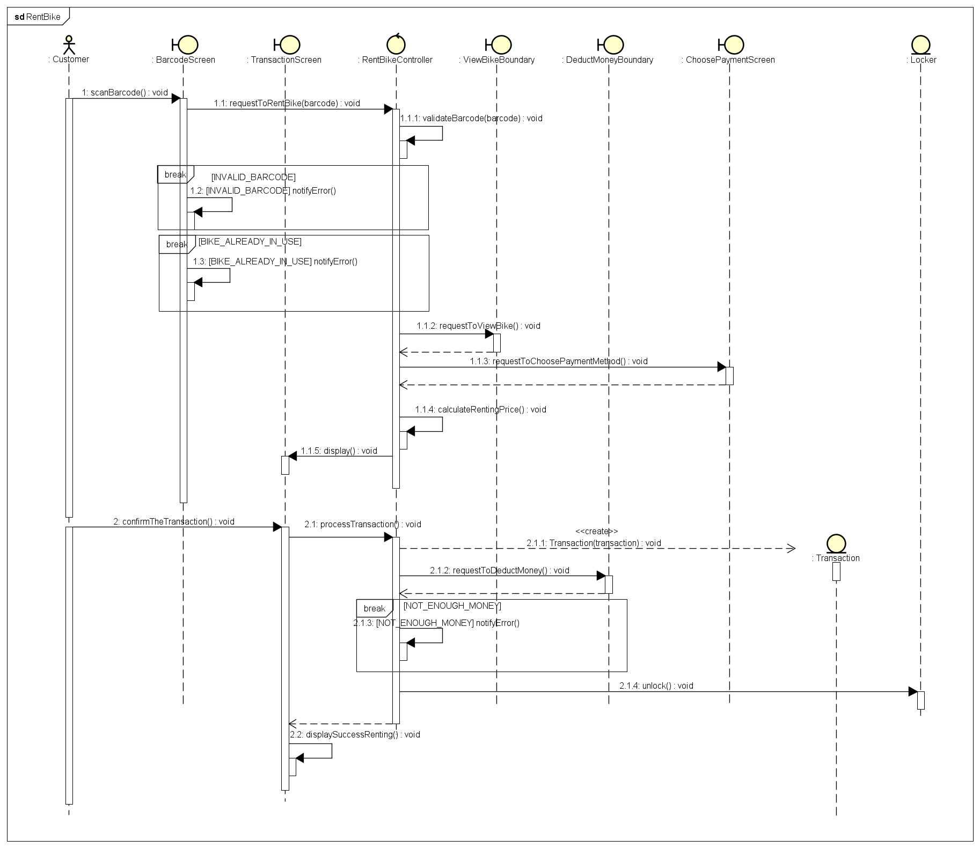
Interaction Diagram

Slide 7
General Class Diagram

Slide 8
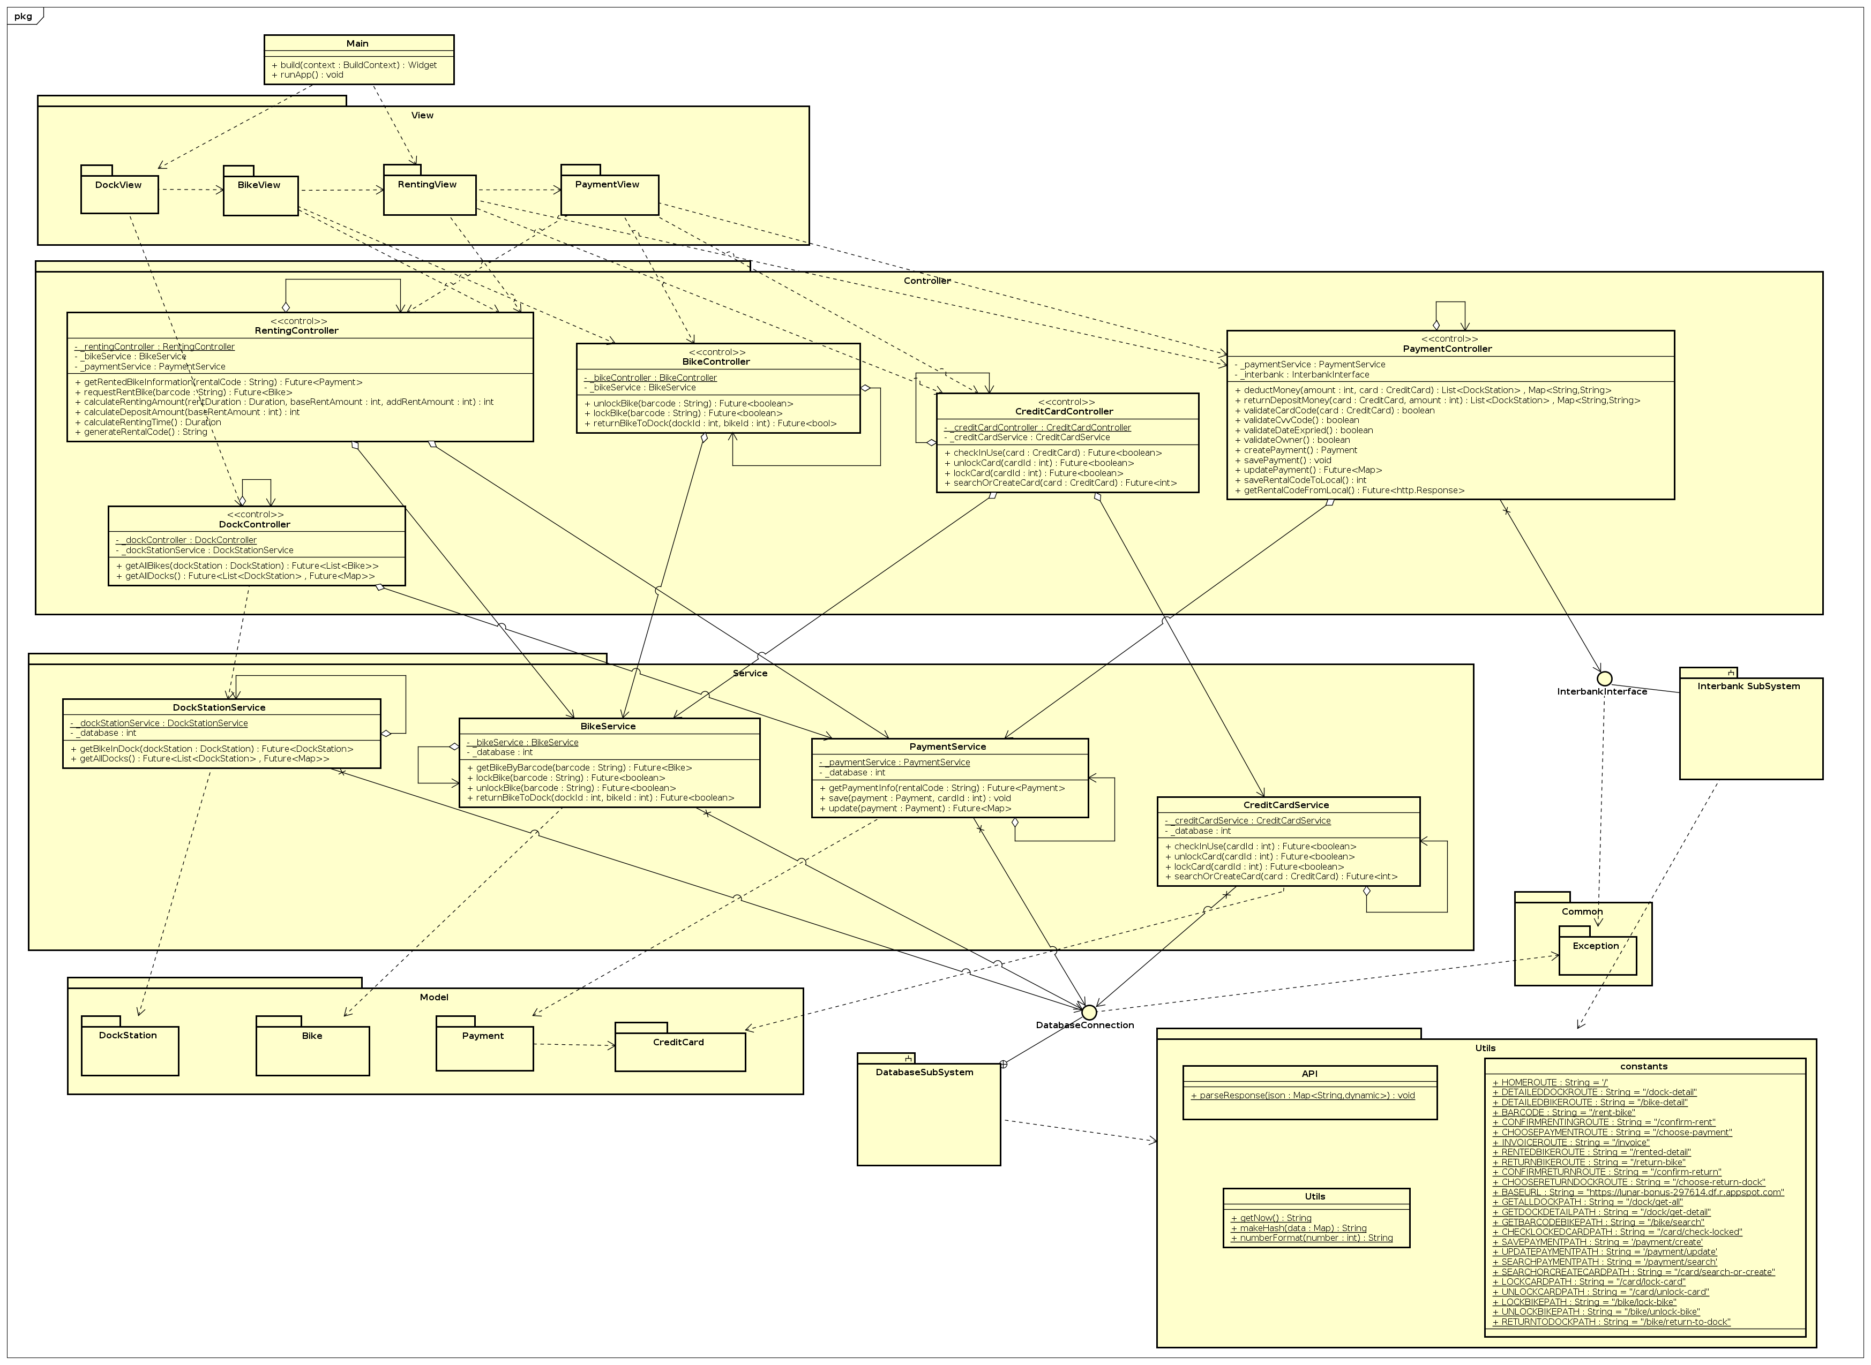

Slide 9
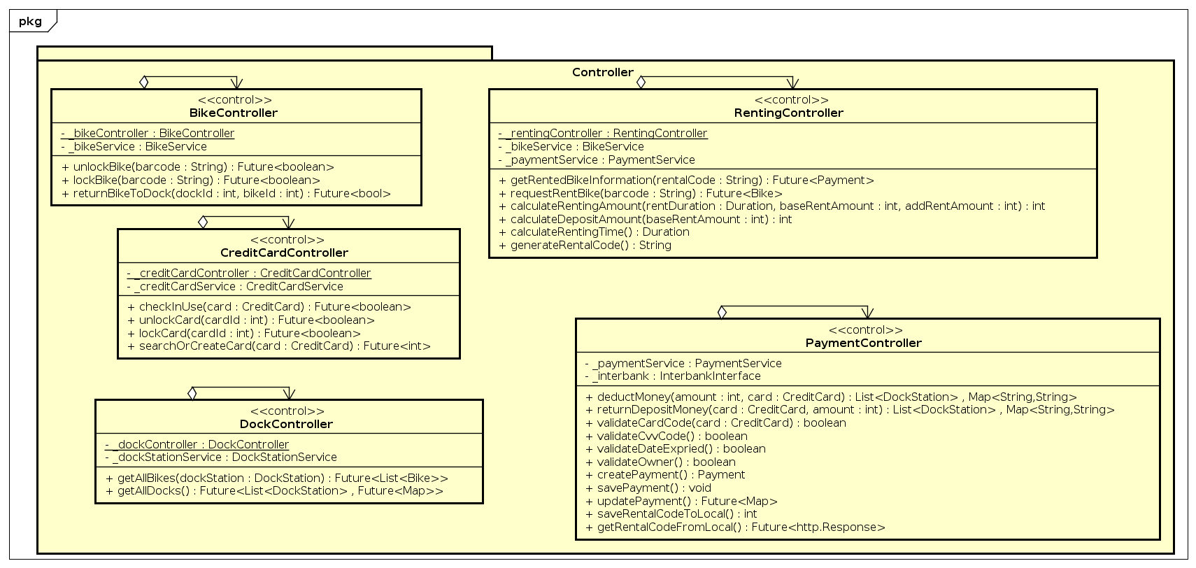
Detail Class Diagram

Slide 10
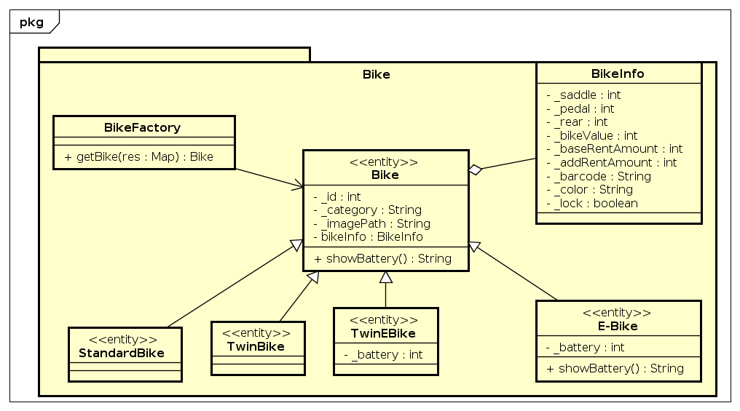
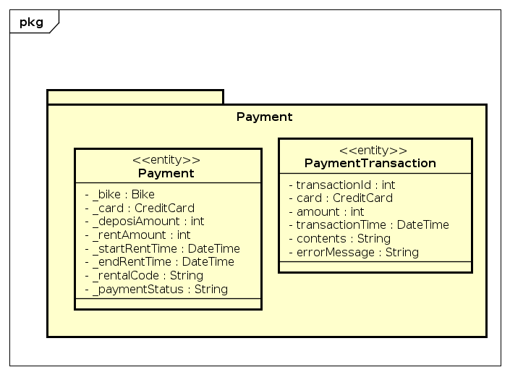
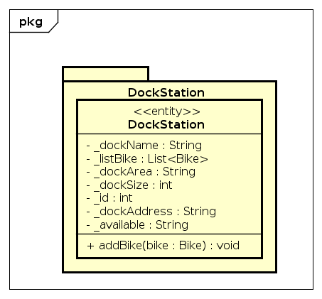
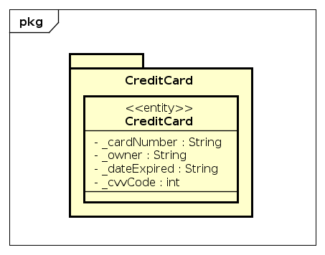
Detail Class Diagram

Slide 11
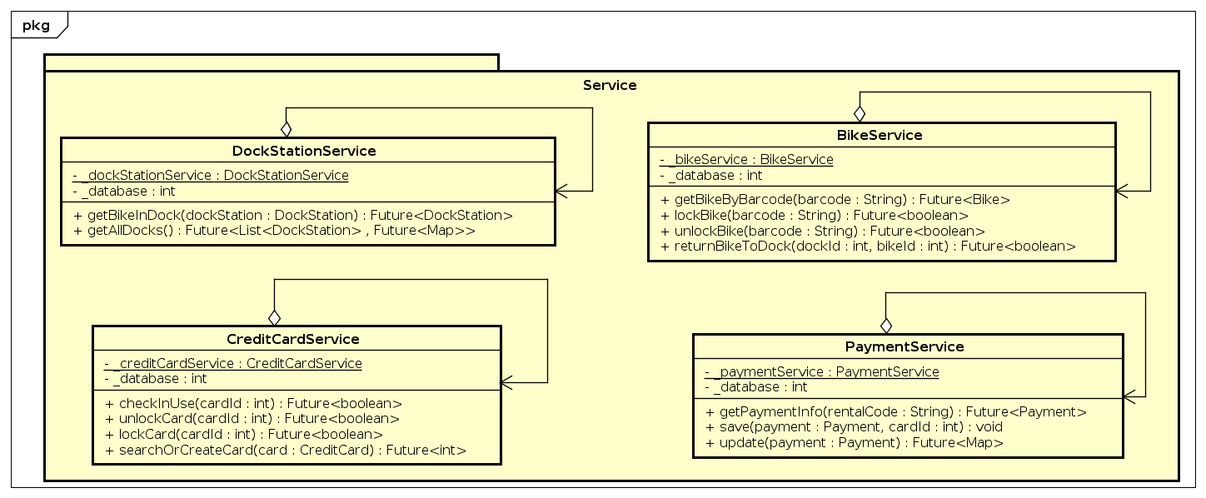
Detail Class Diagram

Slide 12
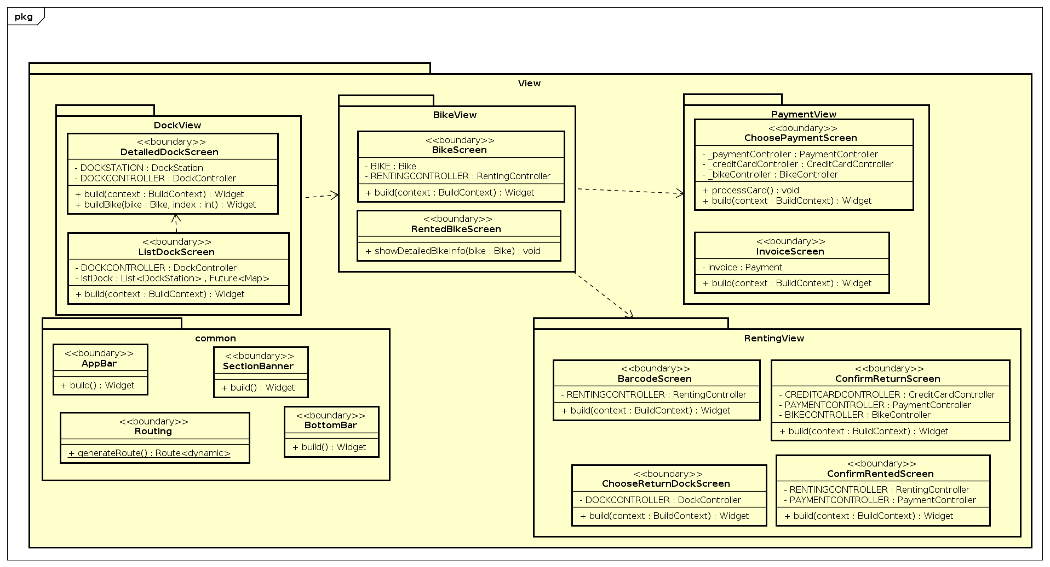
Detail Class Diagram

Slide 13
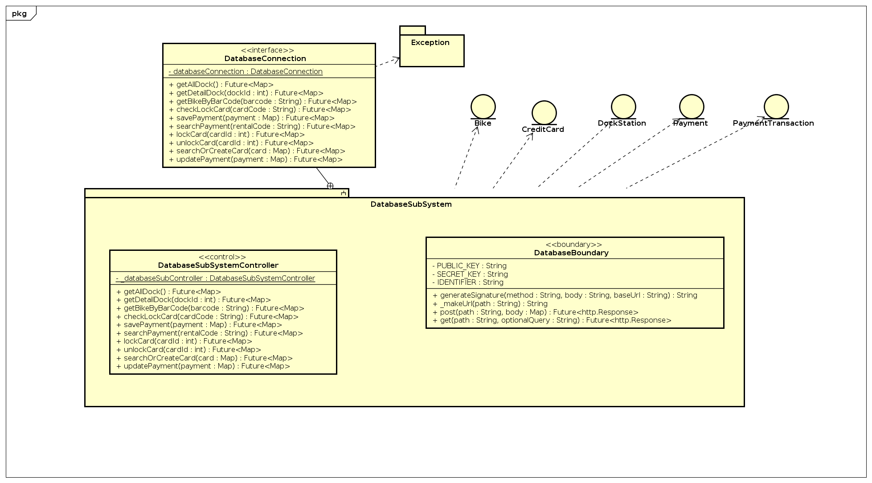
Detail Class Diagram

Slide 14
Design Consideration
Coupling: Our Project has Data Coupling, Control Coupling & Stamp Coupling:
Data Coupling: RentingController class only knows how to get data from Bike Entity class and use it for a totally different method to take it to the View package
Control Coupling: In class BikeFactory, we pass the parameter “category” string to know which category will be taken, then return the responding child class Ebike or Standardbike,…
Stamp Coupling: In class DetailDockScreen, we pass the Bike object as the input to the next screen is DetailBikeScreen.

Slide 15
Design Consideration
Cohesion: Our Project Use Functional Cohesion:
calculateRentingAmount method in RentingController class performs the calculation task and sends it to RentedBikeView. The RentedBikeView class only renders the returned value.

Slide 16
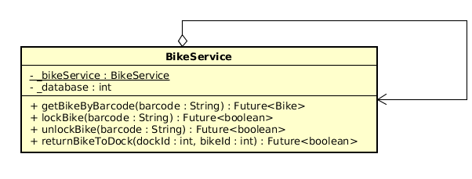
Design Consideration
Design Pattern:
Singleton:

Slide 17
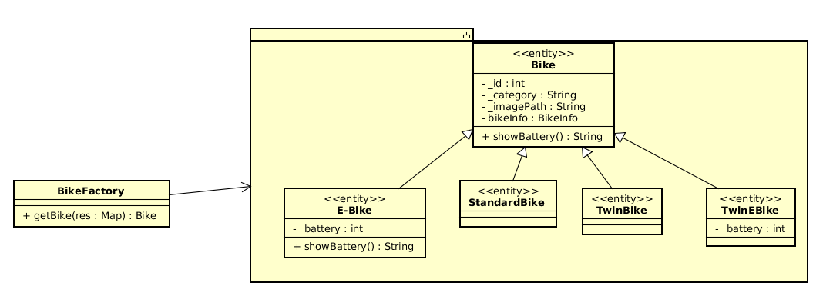
Design Consideration
Design Pattern:
Factory Method:

Slide 18
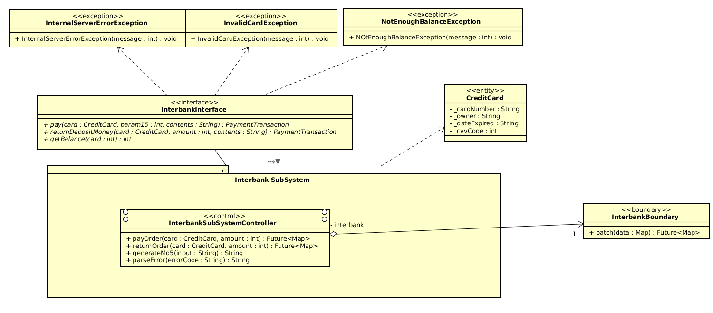
Design Consideration
Design Pattern:
Facade:

Slide 19
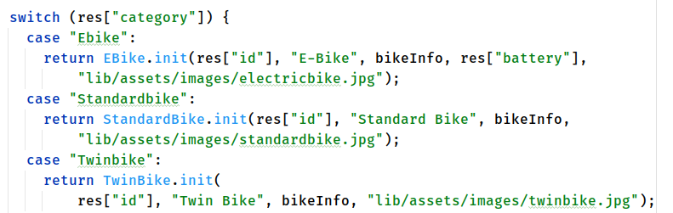
Design Consideration
Additional Requirement:
Add New Kind of Bike:

Slide 20
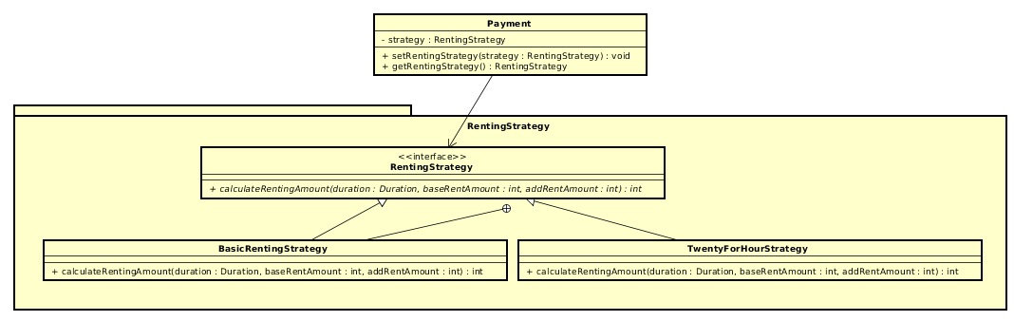
Design Consideration
Additional Requirement:
Add new Renting Type:

Slide 21
Design Consideration
Additional Requirement:
Add Pause Time Features:
In this additional requirement, we will consider in the Rented Bike View Screen to pause counting up the duration. Then the renting amount will not be counted until the user push the button to unlock the bike, the duration will continue.

Slide 22
THANK YOU!

