Slide 1
Group Report ITSS Software Development - IT3290E
Project: EcoBikeRental
Solution for Bike Renting Management

Slide 2
Outline
I. Overview
II. Interaction Diagram
III. Class Diagram
IV. Design Consideration

Slide 3
Overview
Programming Language: Dart
Framework: Flutter
Database Management System: PostgreSQL
Using Subsystem: Interbank System for Card Management, Database System for Getting Data from Database

Slide 4
Overview
Member of this project:
Vu Trung Dung - 20176727
Nguyen Xuan Hoang - 20176763
Nguyen Trung Nghia - 20176835
Nguyen Ngoc Quy - 20143712

Slide 5
Overview
Contribution:
SRS Documentation: Vu Trung Dung (20%), Nguyen Xuan Hoang (20%), Nguyen Trung Nghia (25%), Nguyen Ngoc Quy (35%)
SDD Documentation: Vu Trung Dung (20%), Nguyen Xuan Hoang (20%), Nguyen Trung Nghia (30%), Nguyen Ngoc Quy(30%)
Programming: Vu Trung Dung (40%), Nguyen Xuan Hoang (35%), Nguyen Trung Nghia (15%), Nguyen Ngoc Quy(10%)
Testing: Vu Trung Dung (20%), Nguyen Xuan Hoang(30%), Nguyen Ngoc Quy(30%), Nguyen Trung Nghia (20%)

Slide 6
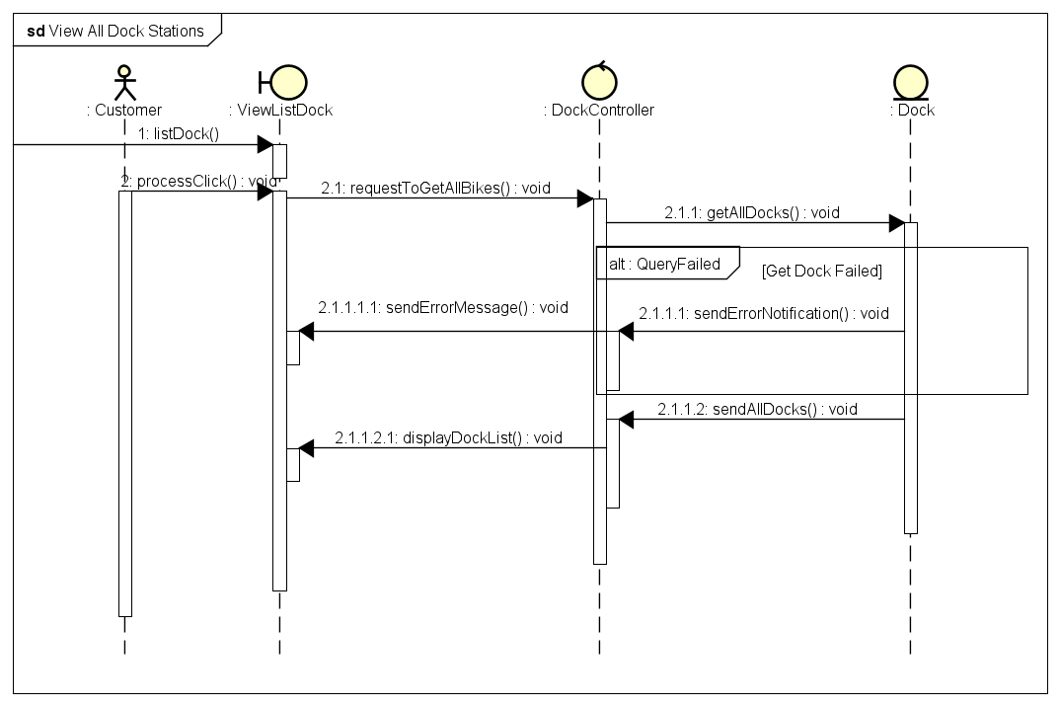
Interaction Diagram

Slide 7
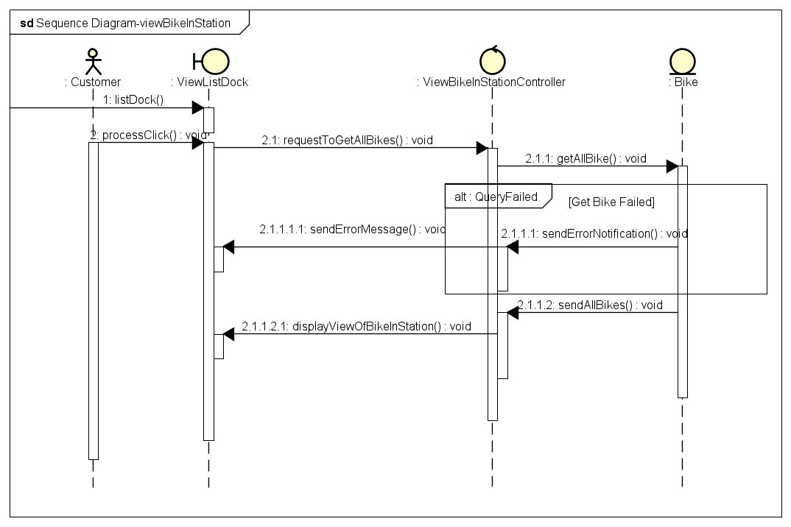
Interaction Diagram

Slide 8
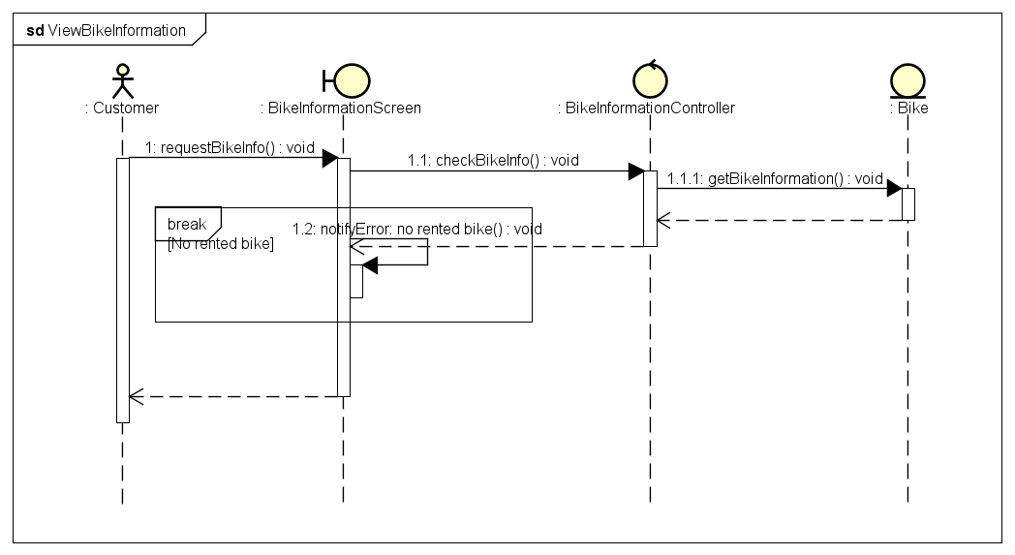
Interaction Diagram

Slide 9
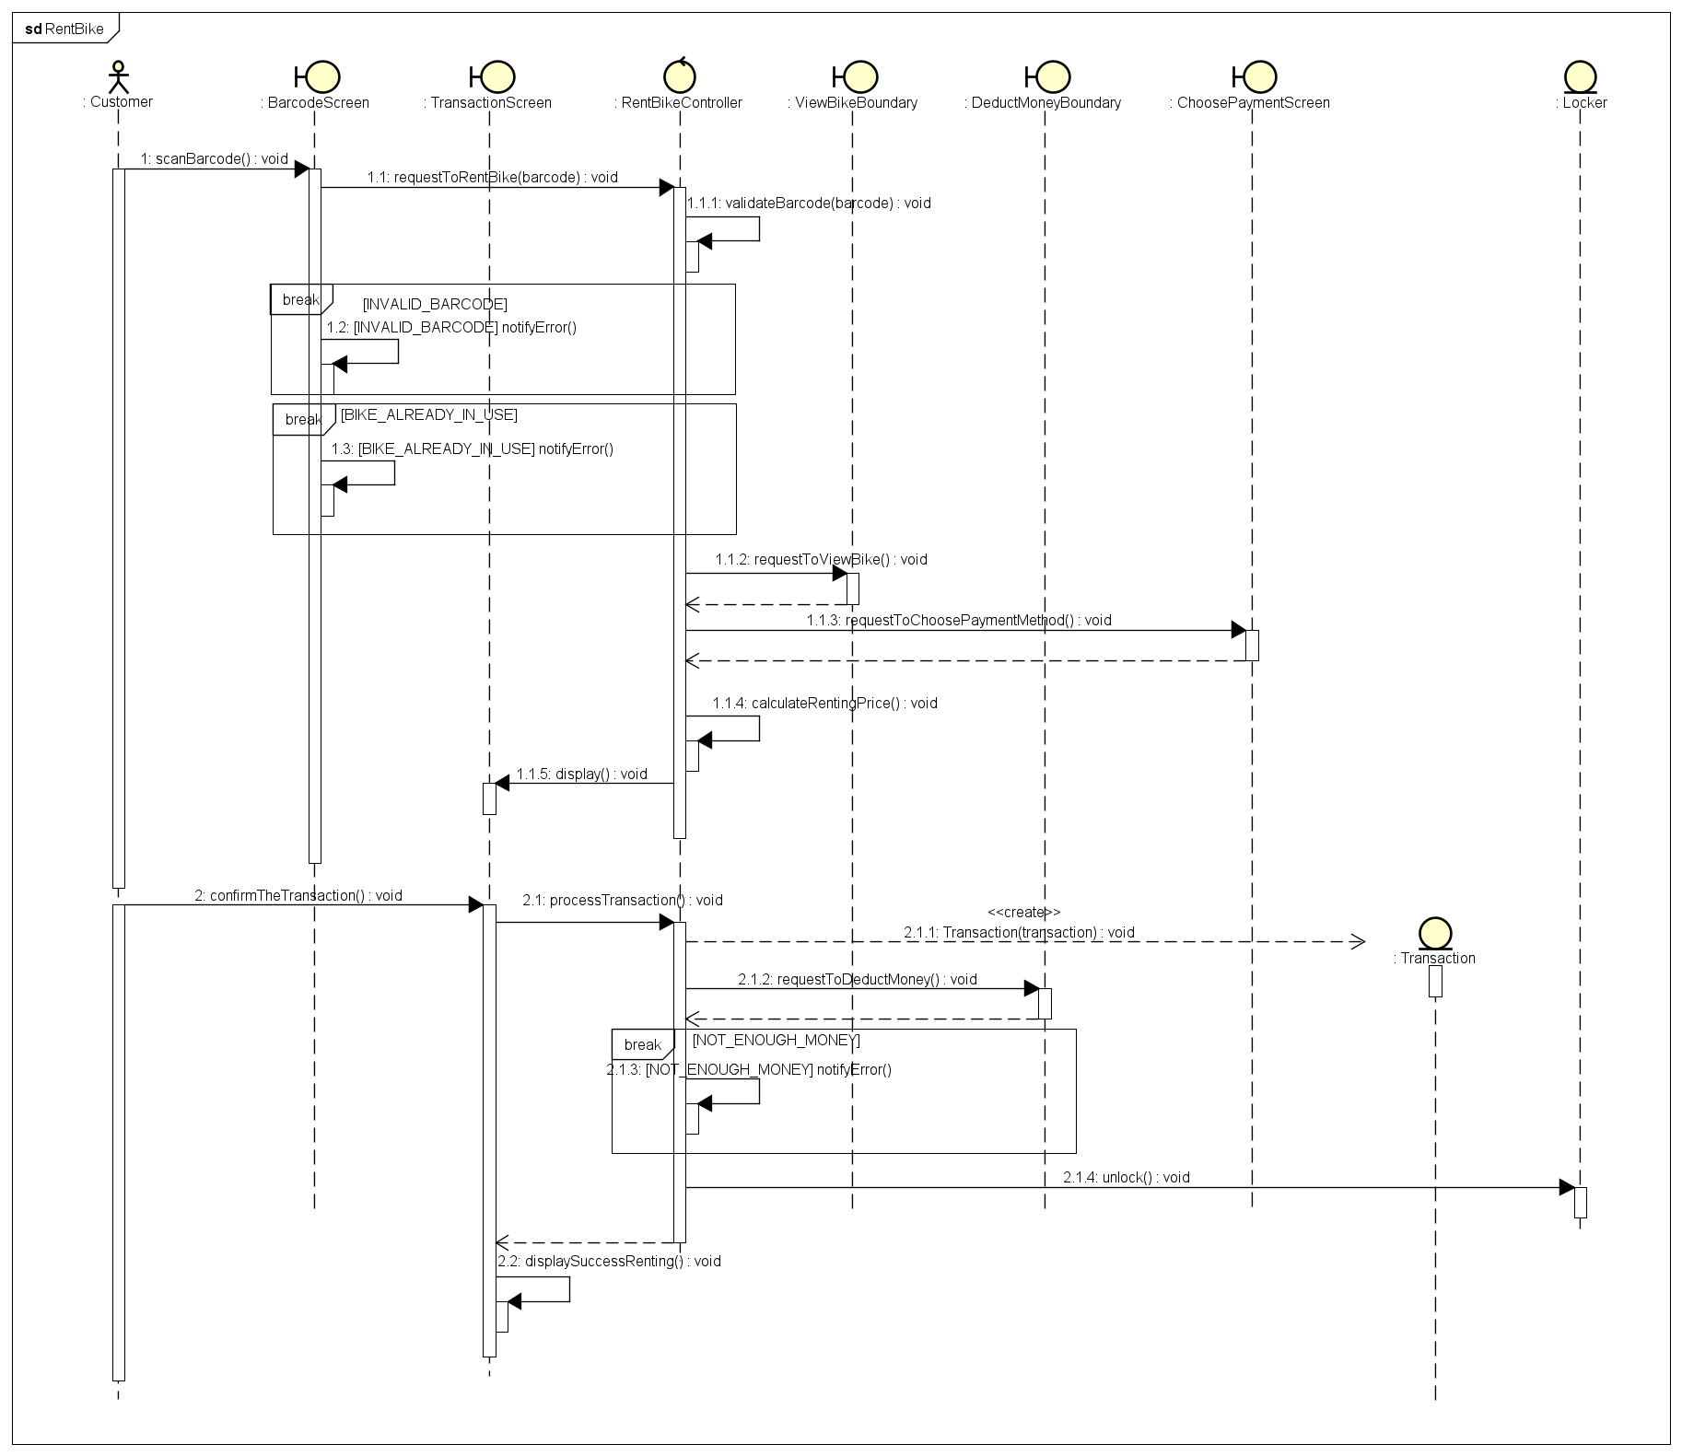
Interaction Diagram

Slide 10
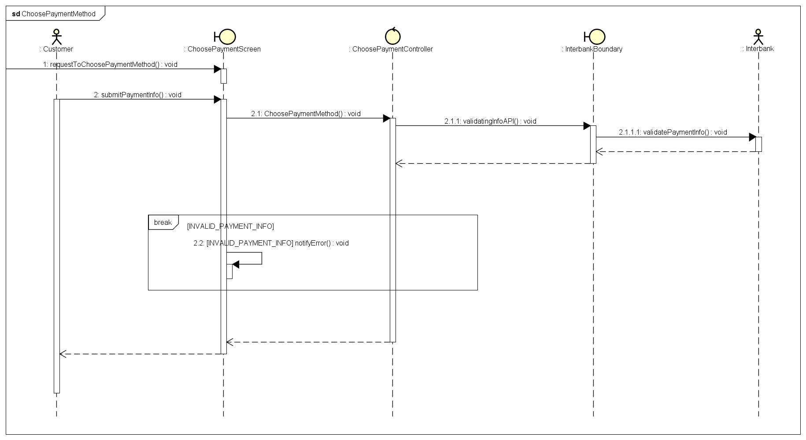
Interaction Diagram

Slide 11
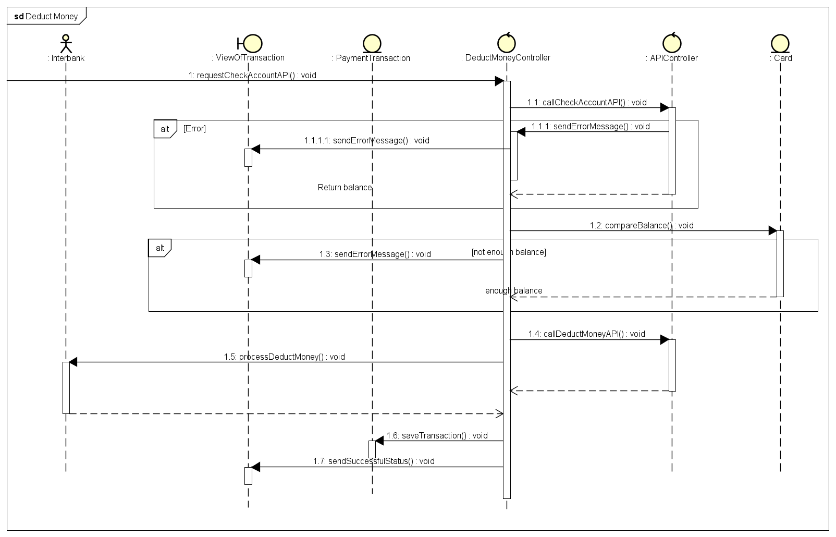
Interaction Diagram

Slide 12
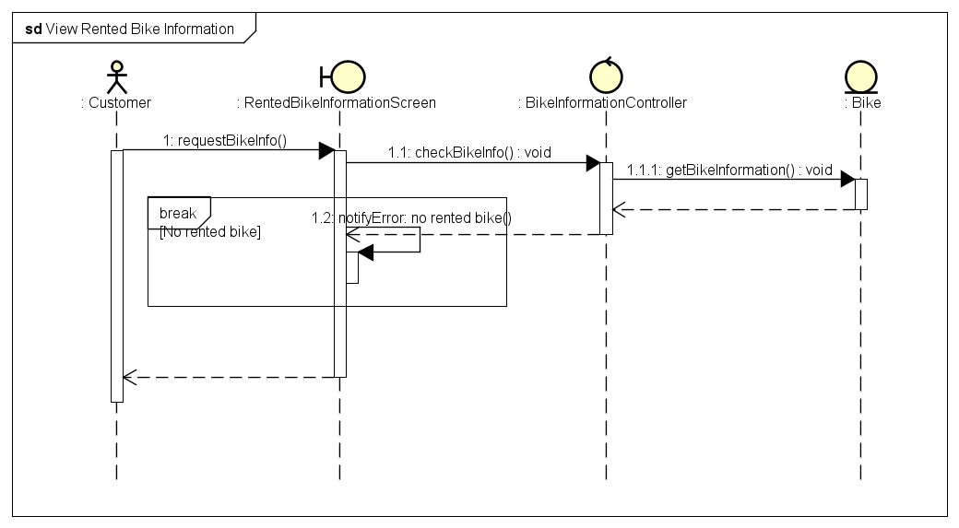
Interaction Diagram

Slide 13
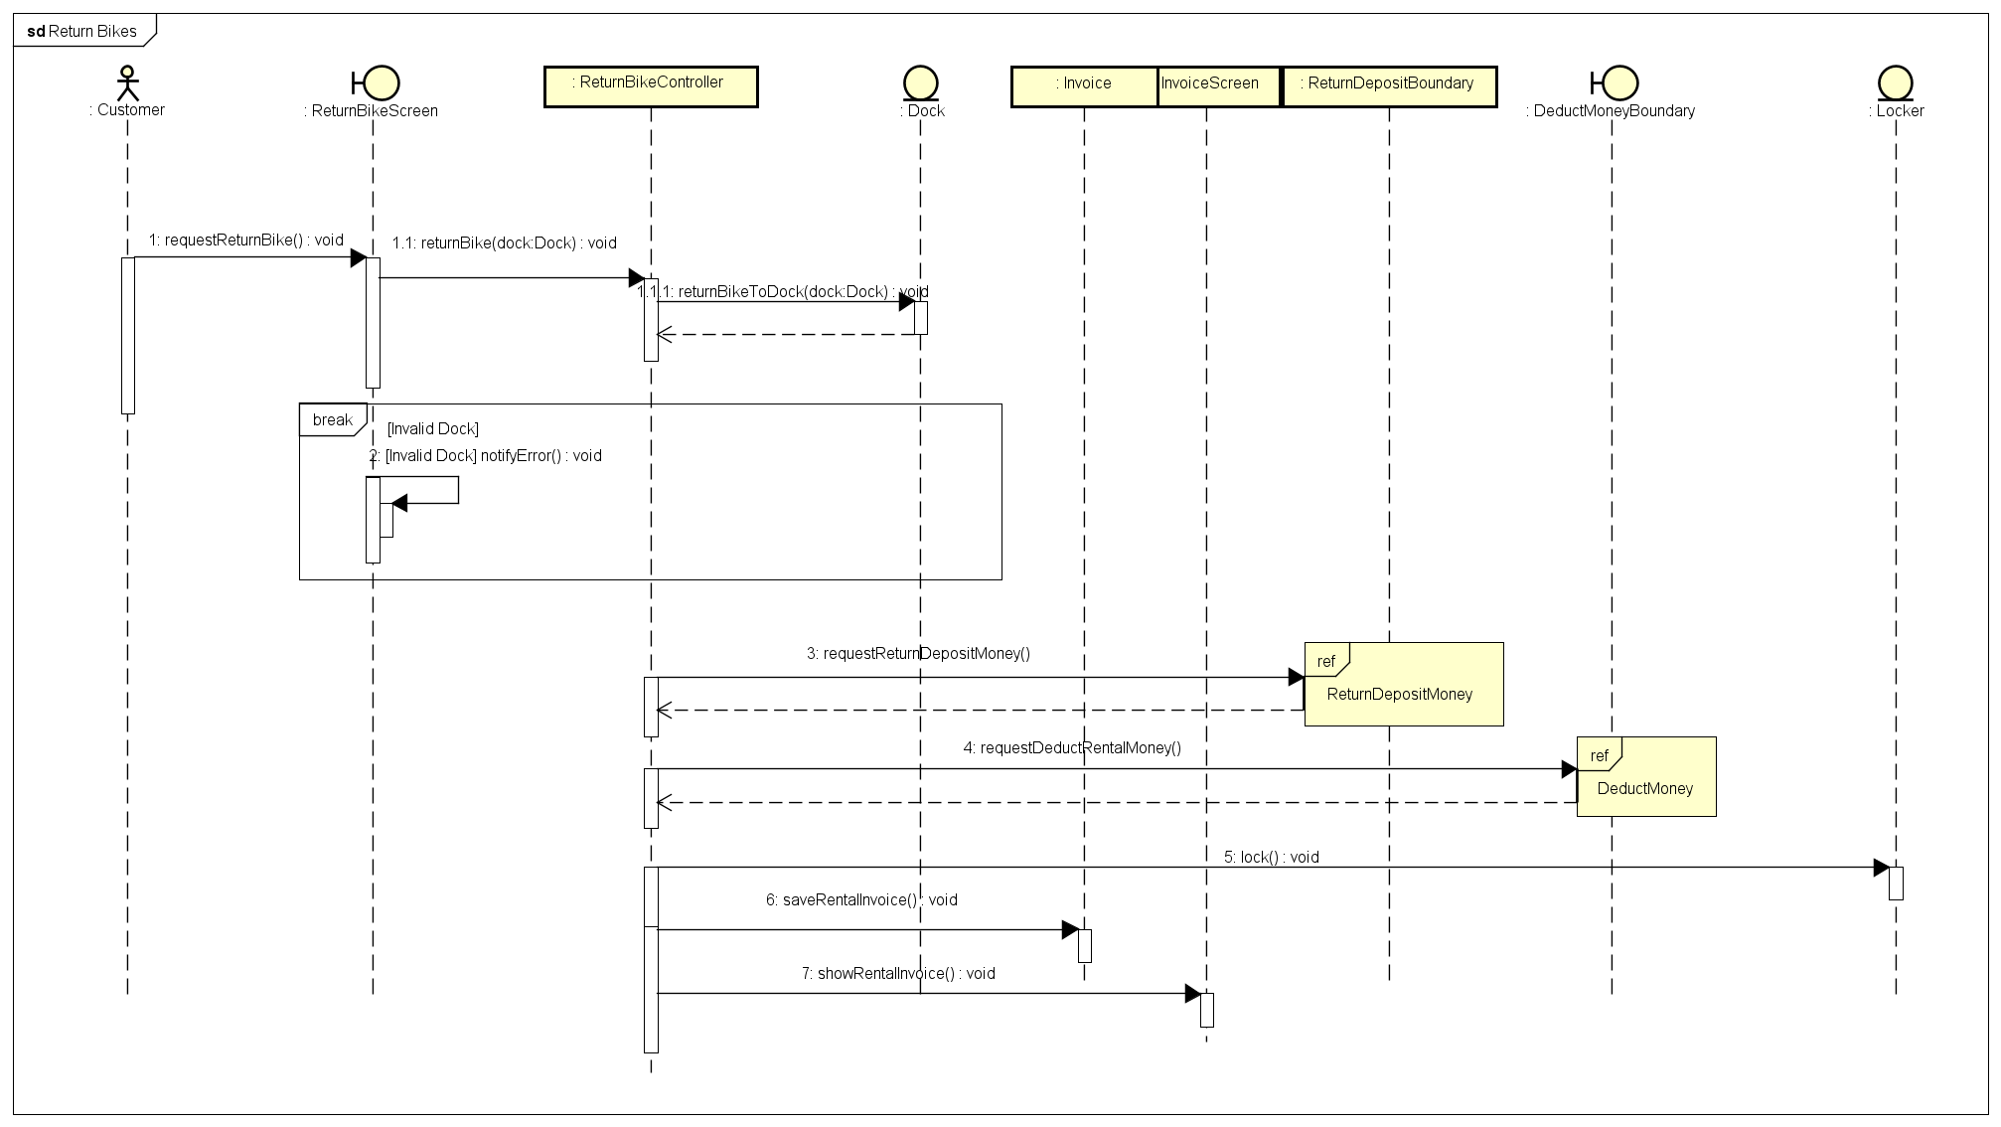
Interaction Diagram

Slide 14
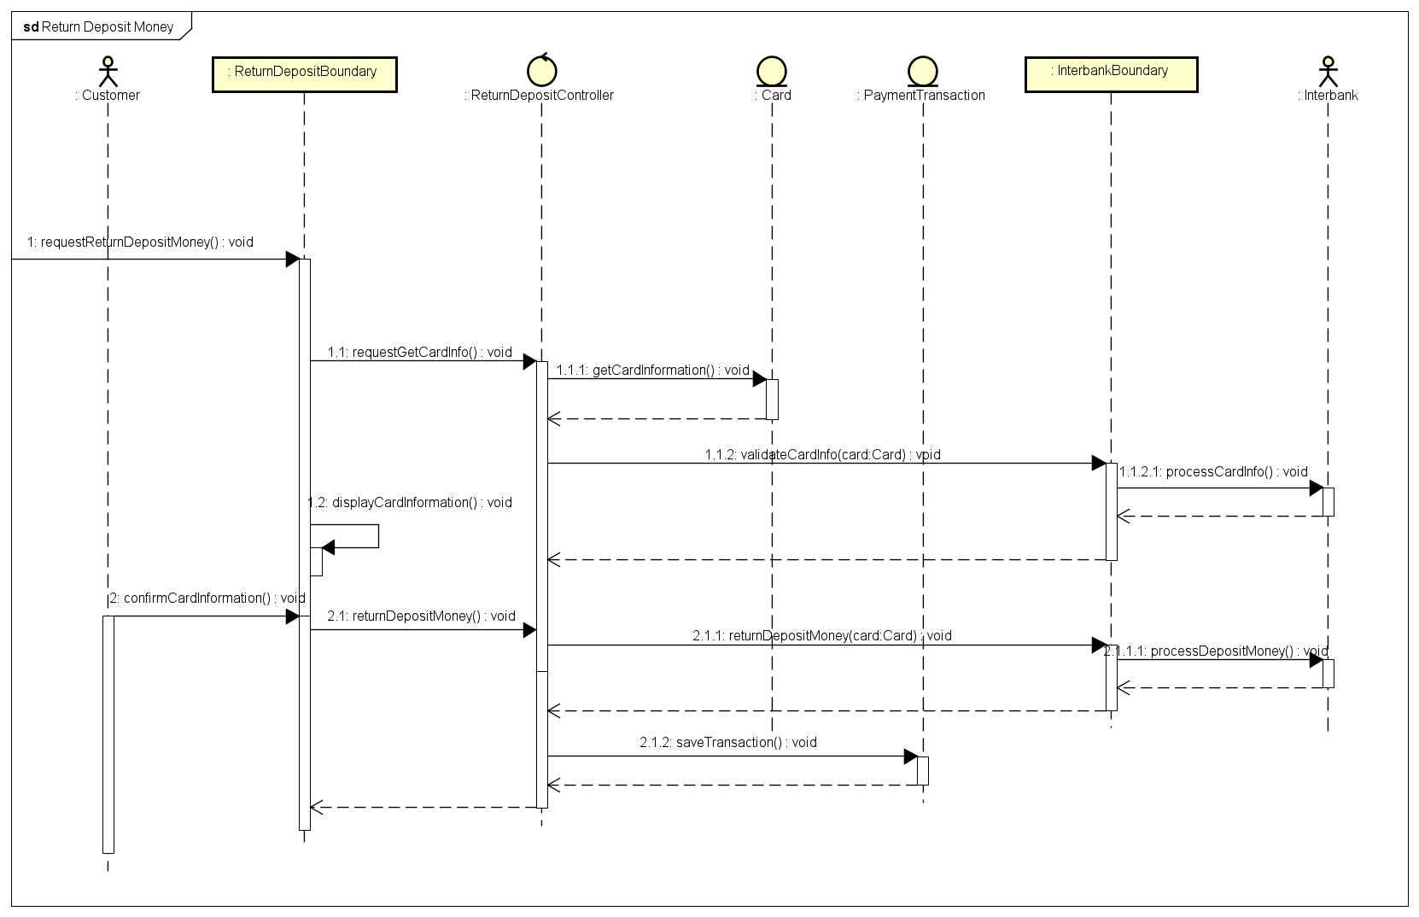
Interaction Diagram

Slide 15
General Class Diagram

Slide 16
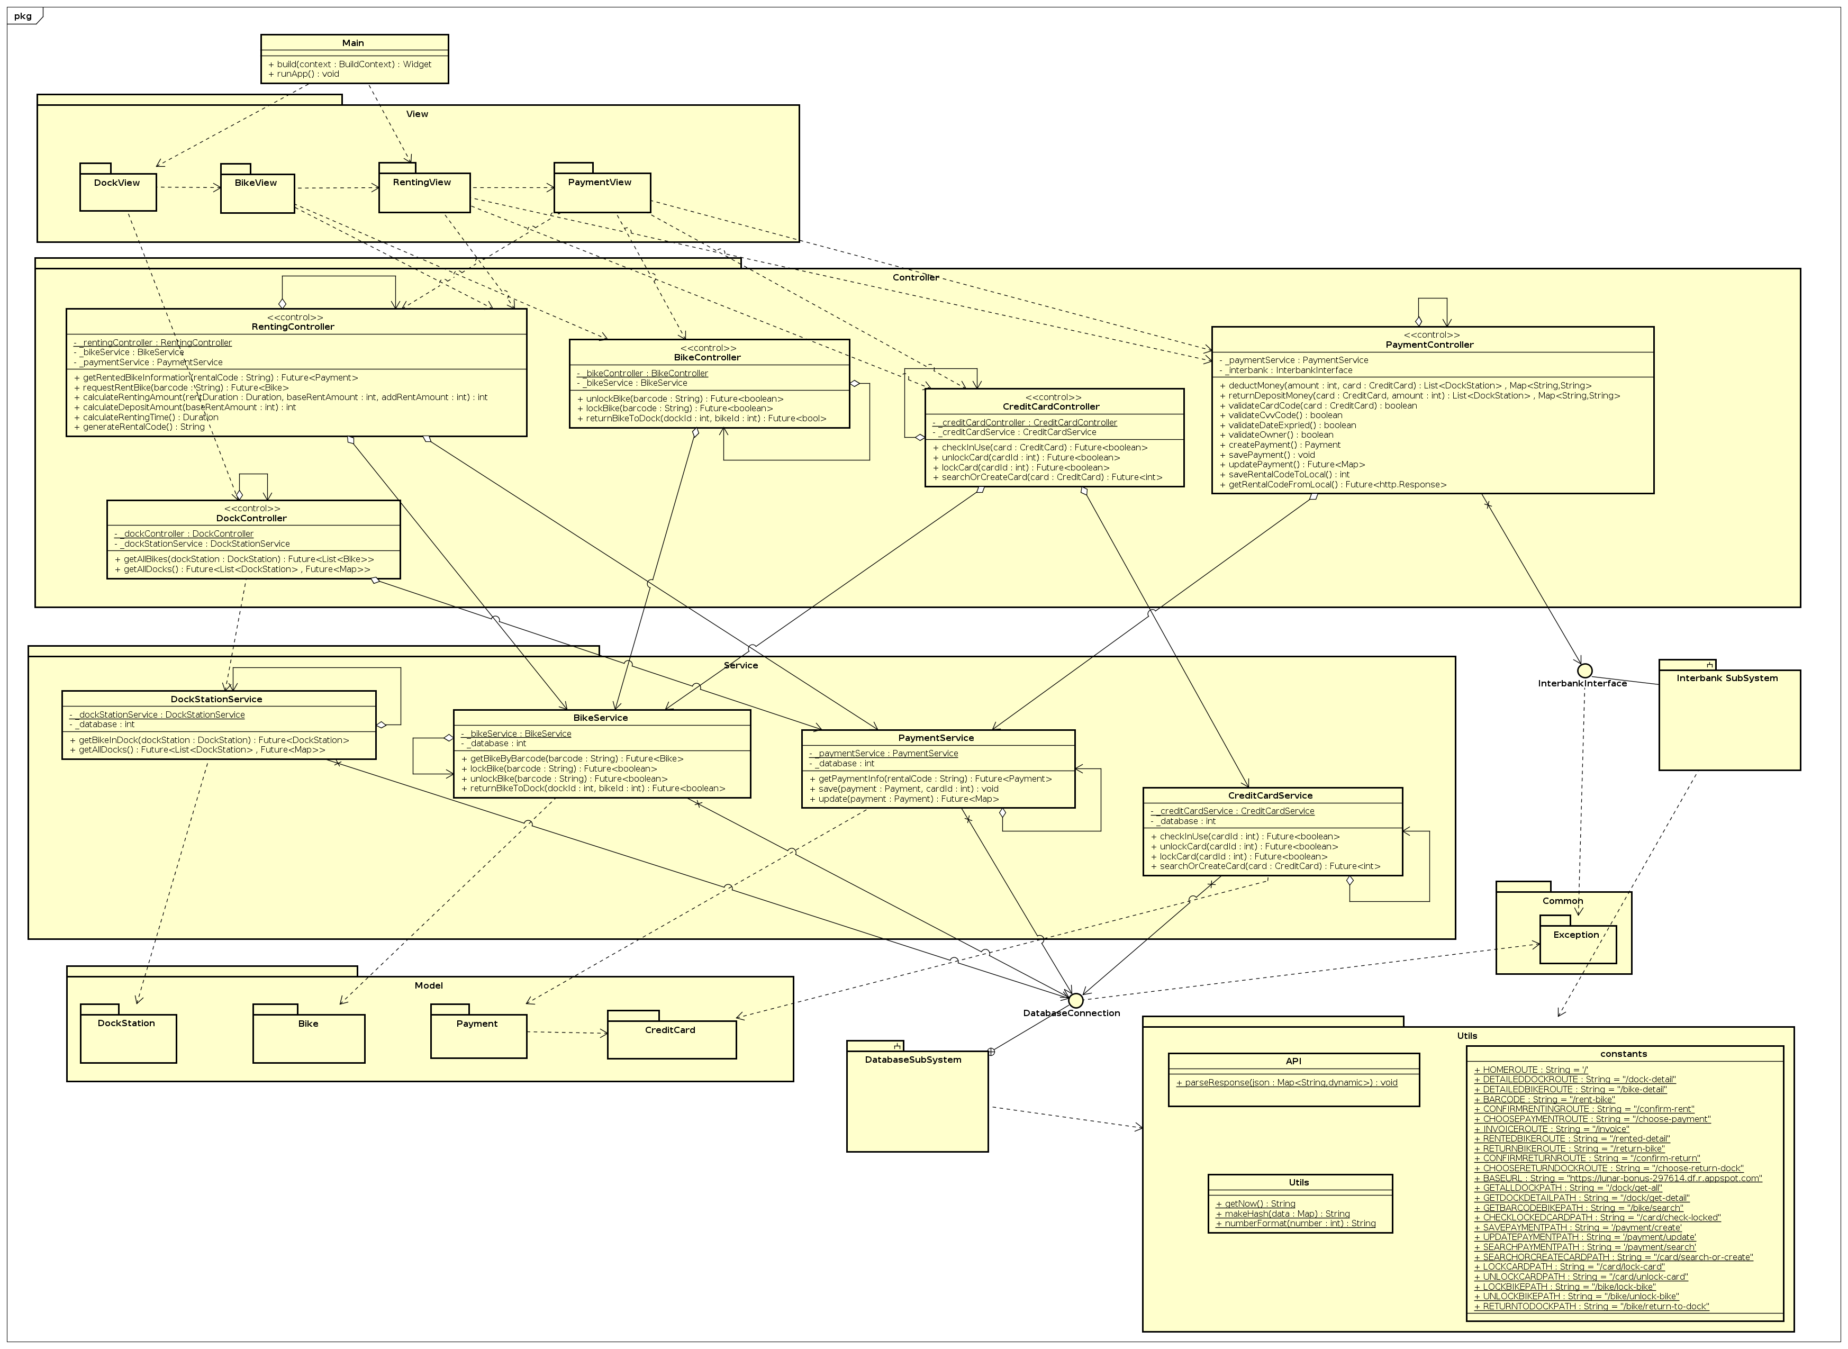

Slide 17
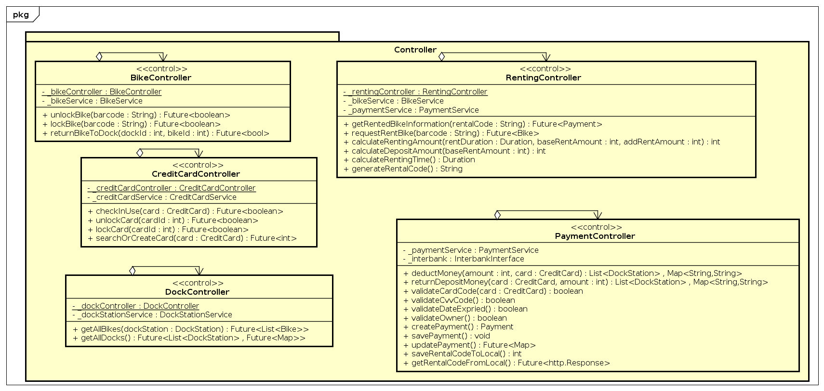
Detail Class Diagram

Slide 18
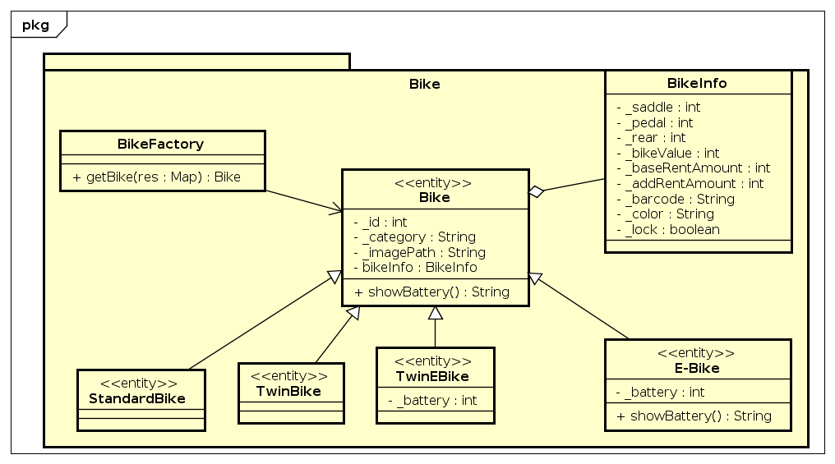
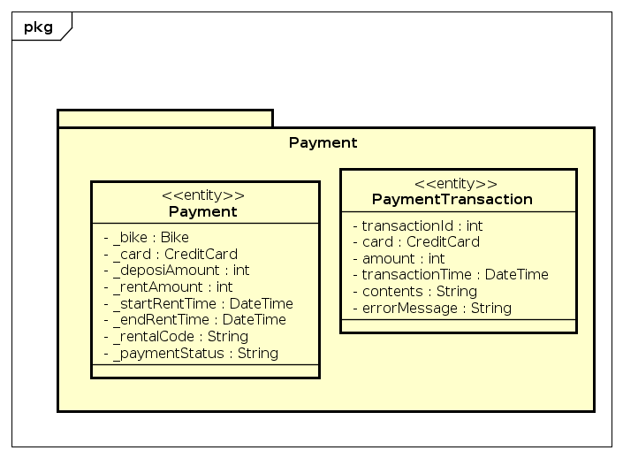
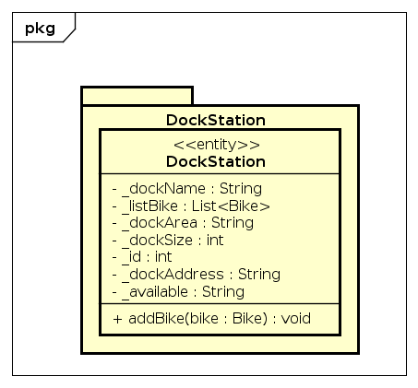
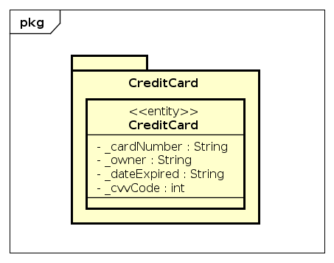
Detail Class Diagram

Slide 19
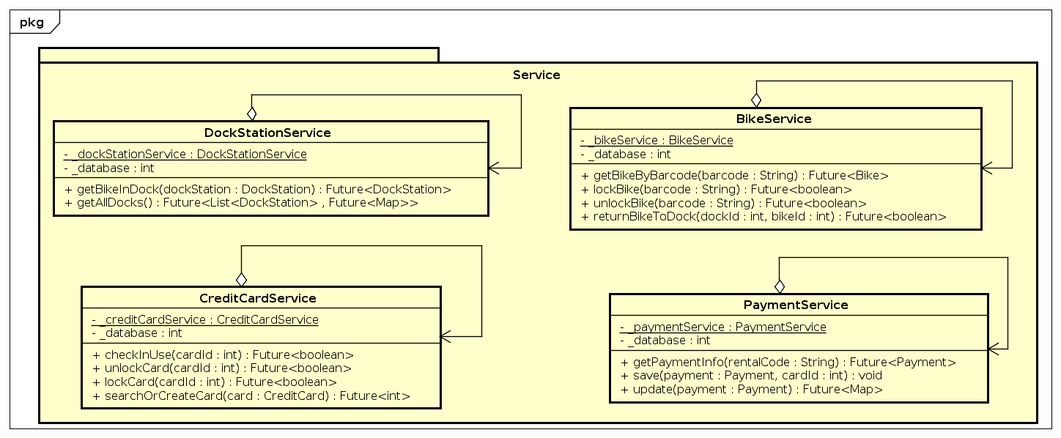
Detail Class Diagram

Slide 20
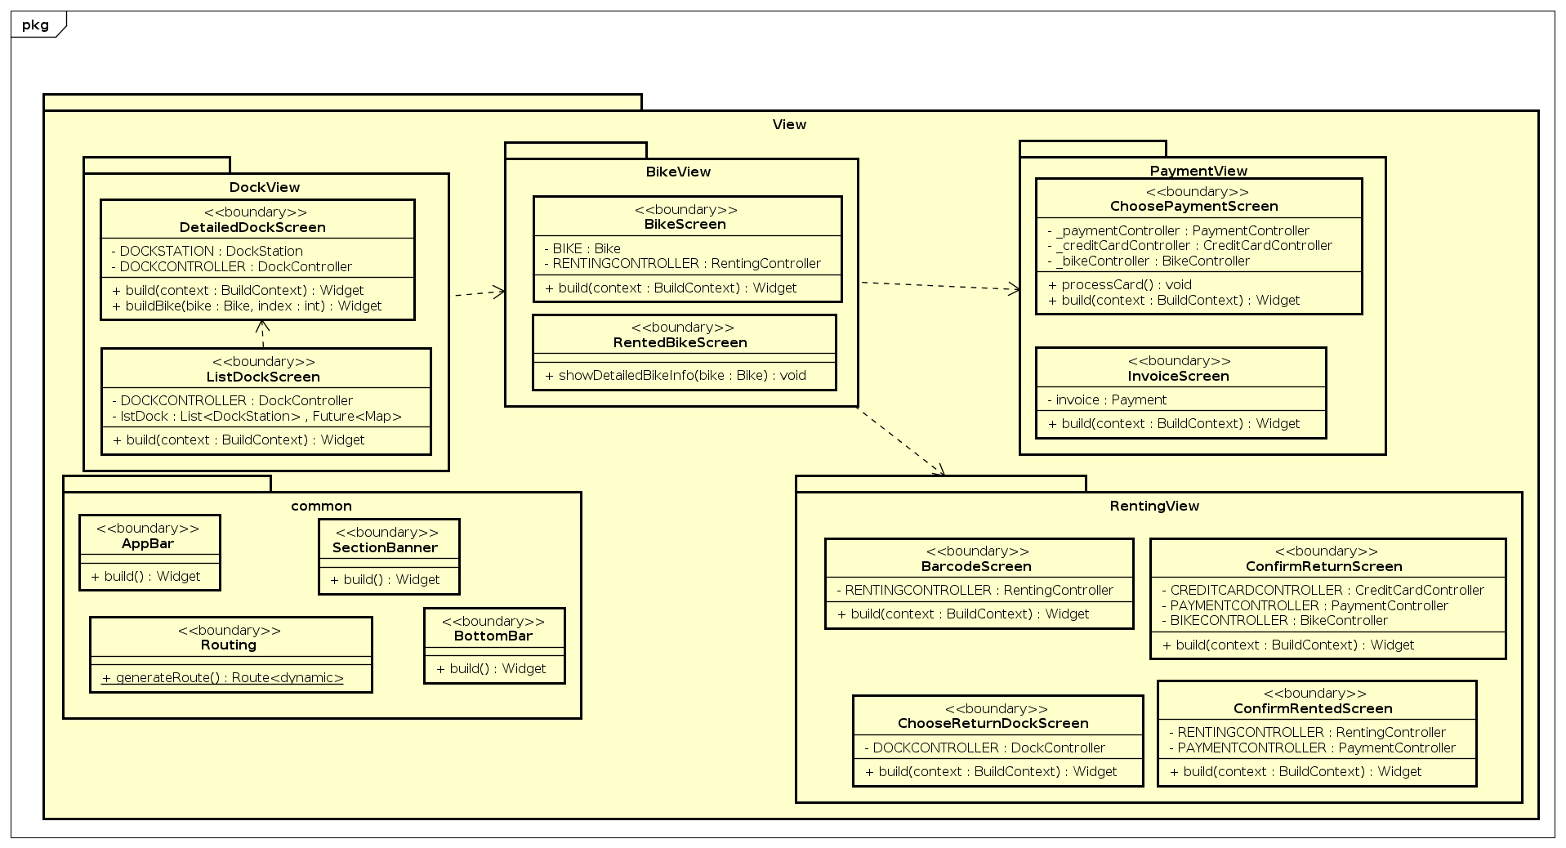
Detail Class Diagram

Slide 21
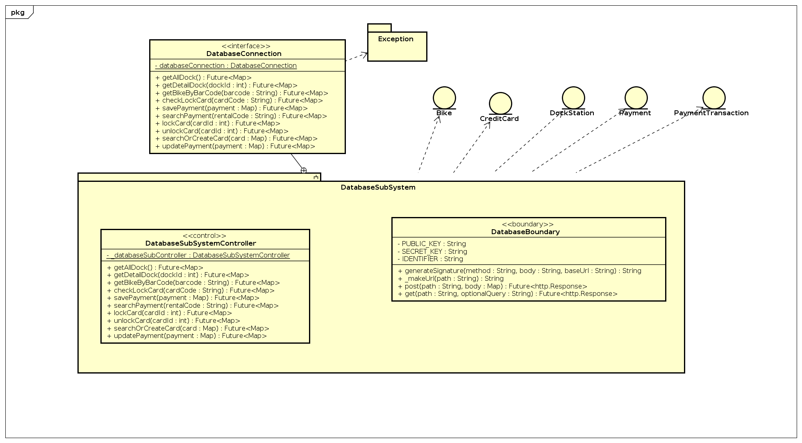
Detail Class Diagram

Slide 22
Design Consideration
Coupling: Our Project has both Data Coupling & Control Coupling:
Data Coupling: RentingController class only knows how to get data from Bike Entity class and use it for a totally different method to take it to the View package
Control Coupling: In class BikeFactory, we pass the parameter “category” string to know which category will be taken, then return the responding child class Ebike or Standardbike,...

Slide 23
Design Consideration
Cohesion: Our Project Use Functional Cohesion:
calculateRentingAmount method in RentingController class performs the calculation task and sends it to RentedBikeView. The RentedBikeView class only renders the returned value.

Slide 24
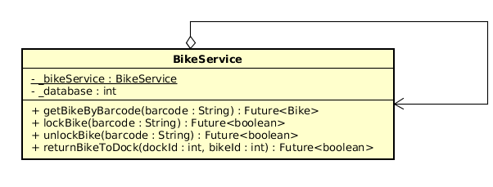
Design Consideration
Design Pattern:
Singleton:

Slide 25
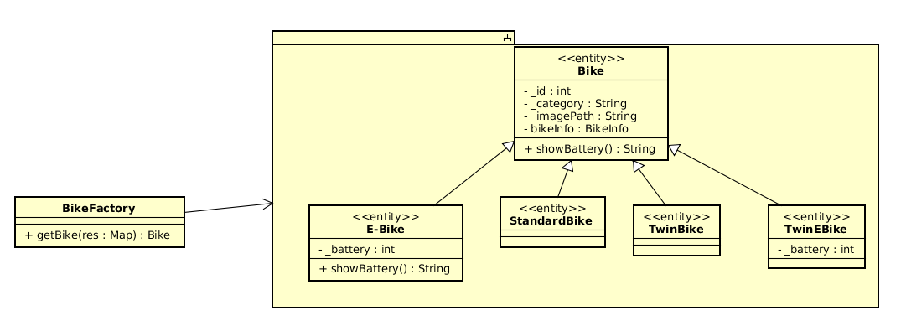
Design Consideration
Design Pattern:
Factory Method:

Slide 26
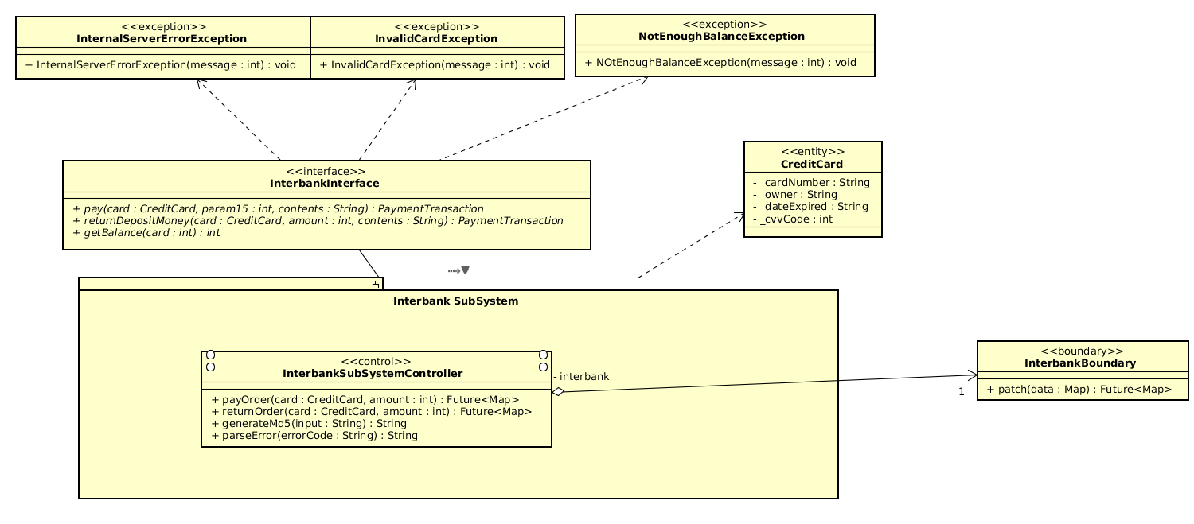
Design Consideration
Design Pattern:
Facade:

Slide 27
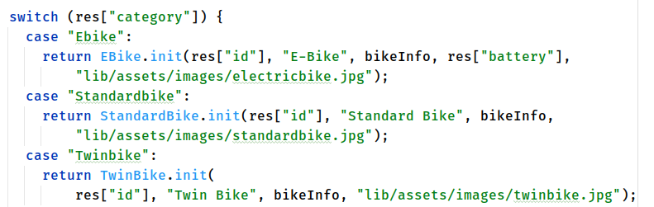
Design Consideration
Additional Requirement:
Add New Kind of Bike:

Slide 28
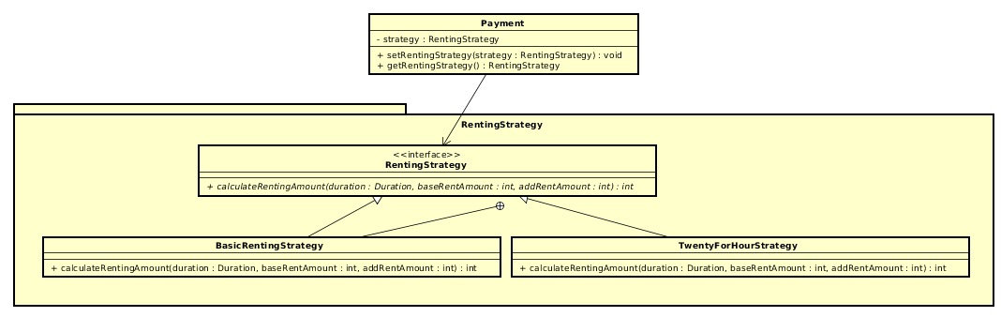
Design Consideration
Additional Requirement:
Add new Renting Type:

Slide 29
Design Consideration
Additional Requirement:
Add Pause Time Features:
In this additional requirement, we will consider in the Rented Bike View Screen to pause counting up the duration. Then the renting amount will not be counted until the user push the button to unlock the bike, the duration will continue.

Slide 30
THANK YOU!

