Slide 1
MedMentor_AI
An AI AgentOS-Powered Health Literacy Assistant

Slide 2
Problem Statement
Patients struggle to understand complex medical diagnoses, especially when language barriers exist.
Doctors often don't have time to explain thoroughly.
There is a need for a system that explains, translates, and summarizes medical information accessibly.

Slide 3
Target Users
- Patients receiving diagnoses in hospitals or clinics
- Rural populations speaking regional languages
- Doctors who want to improve patient understanding
- Health organizations aiming to boost medical literacy

Slide 4
Solution Overview
MedMentor_AI is a multi-agent system that:
- Interprets diagnoses
- Translates explanations into local languages
- Summarizes care instructions
- Generates structured follow-up plans

Slide 5
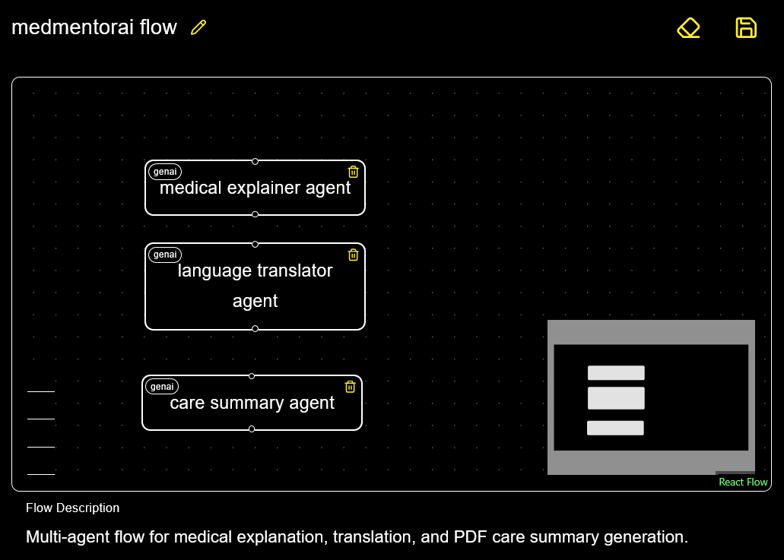
System Architecture

