Slide 1
Programming with Data
CEIS110
Monsiff zeizae

Slide 2
Introduction
This project will demonstrate how we can use Python to analyze data that is downloaded from a cloud date source.

Slide 3
Software Inventory
The two softwares that will be used is Python and Microsoft Excel

Slide 4
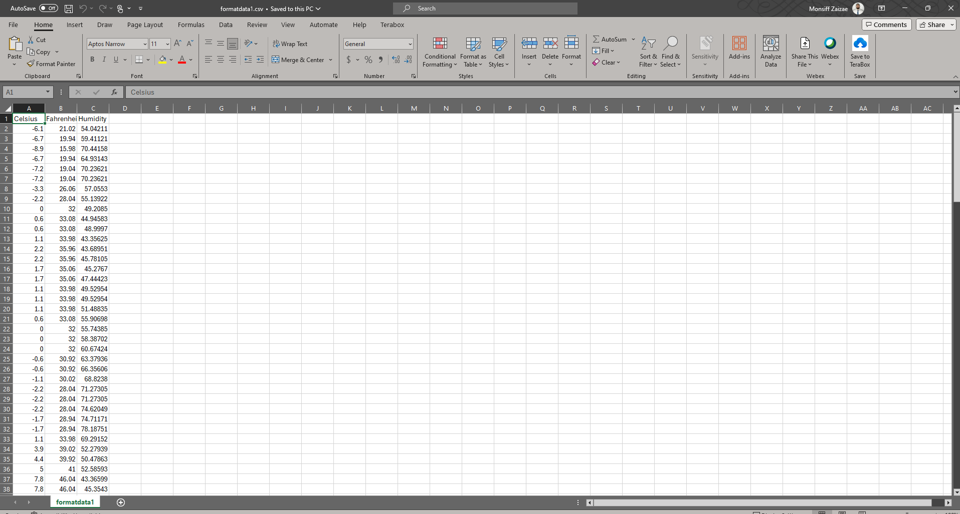
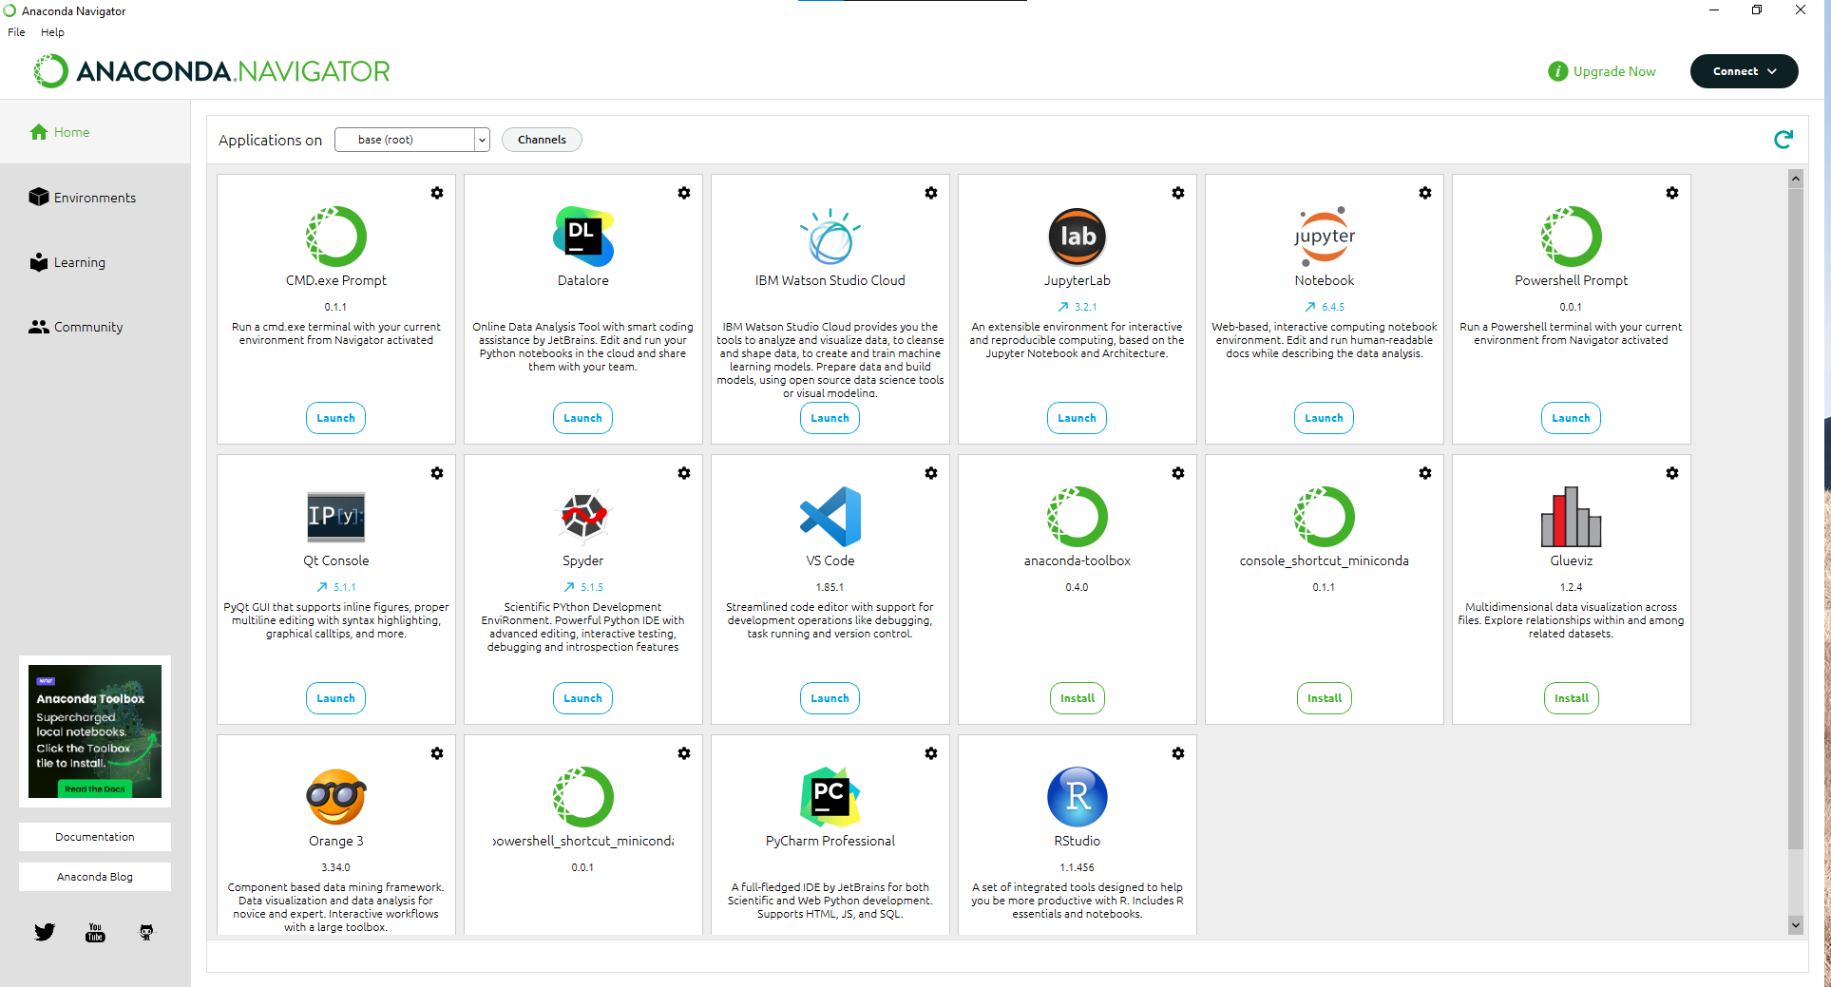
Examples of the software used
Anaconda Navigator with Spyder
Microsoft Excel

Slide 5
Planning & Design
To begin the planning and design of this project, a flow chart was created
It was vital to initiate the flow chart as it gave guidance on how to carry out the project
We will discuss what a flowchart is and how it can be beneficial

Slide 6
Expanding on Flowcharts
Simply put, a flowchart allows us to graphically illustrate a process, and
Workflows. Our flowchart displayed the process and output of the software development prokect

Slide 7
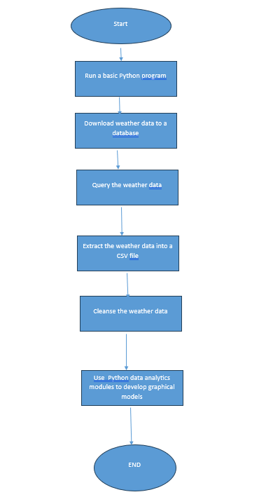
Flowchart
Processes in Our Flowchart:
Run a basic python program
Download weather data to a database.
Query the weather data
Extract weather data from database into a comma separated file with python
Cleanse weather data
Use python data analytics modules to develop graphical models

Slide 8
Introduction to Python
Python is a high-level, interpreted programming language known for its simplicity and readability. It was created by Guido van Rossum and first released in 1991. Python supports multiple programming paradigms, including procedural, object-oriented, and functional programming styles.

Slide 9
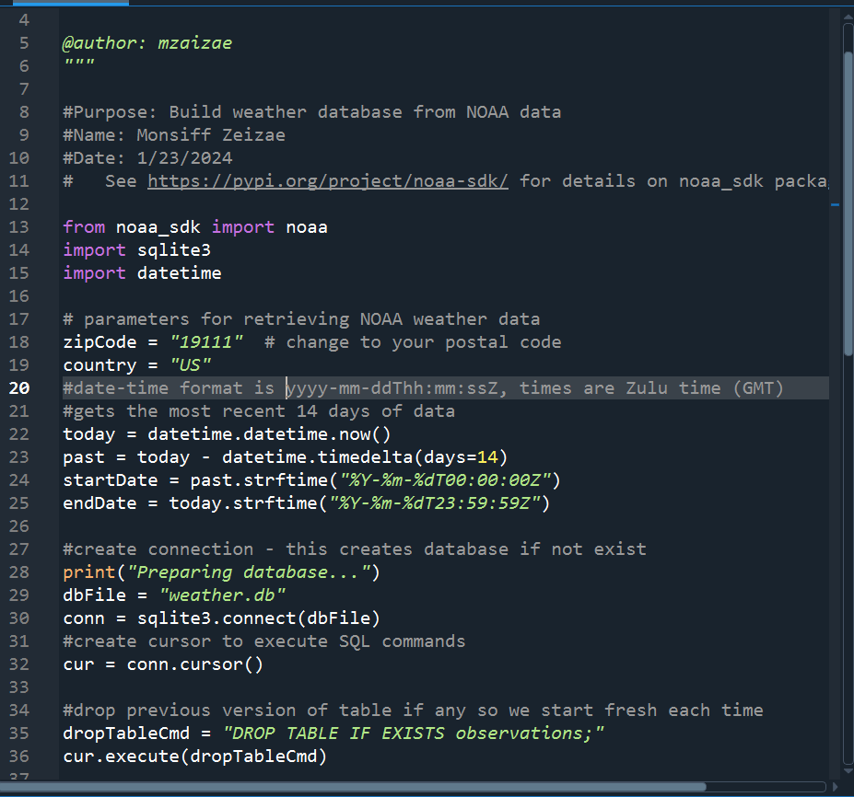
BuildWeatherDb.py Code (Screenshot)
This code will create a table named observations with the fields: timestamps, windspeed, temperature, relativeHumidity, windDirection, barometricPressure, visibility, & textDescription
Furthermore, the database will be named weather.db and store in the same directory as the python code.

Slide 10
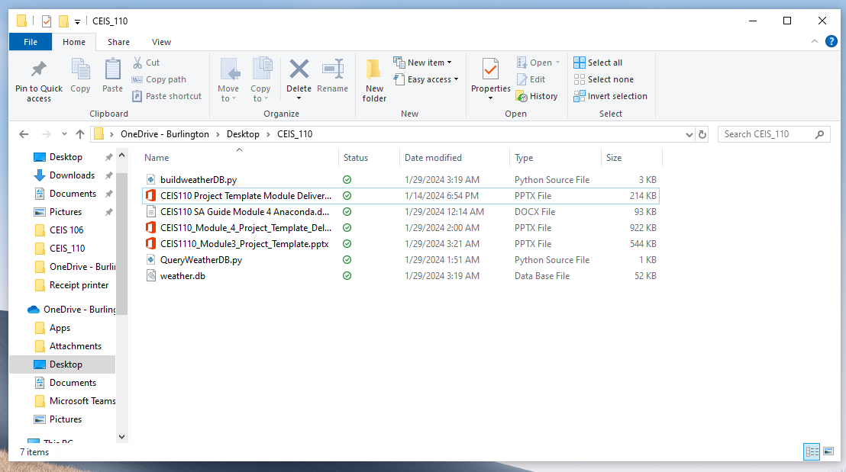
Weather.db File (Screenshot)
Screenshot of Windows Explorer showing database file Weather.db was created

Slide 11
Querying the Database
SQL or structured query language is a programming language that’s used when working with relational databases
SQL was used to query the database and view the results

Slide 12
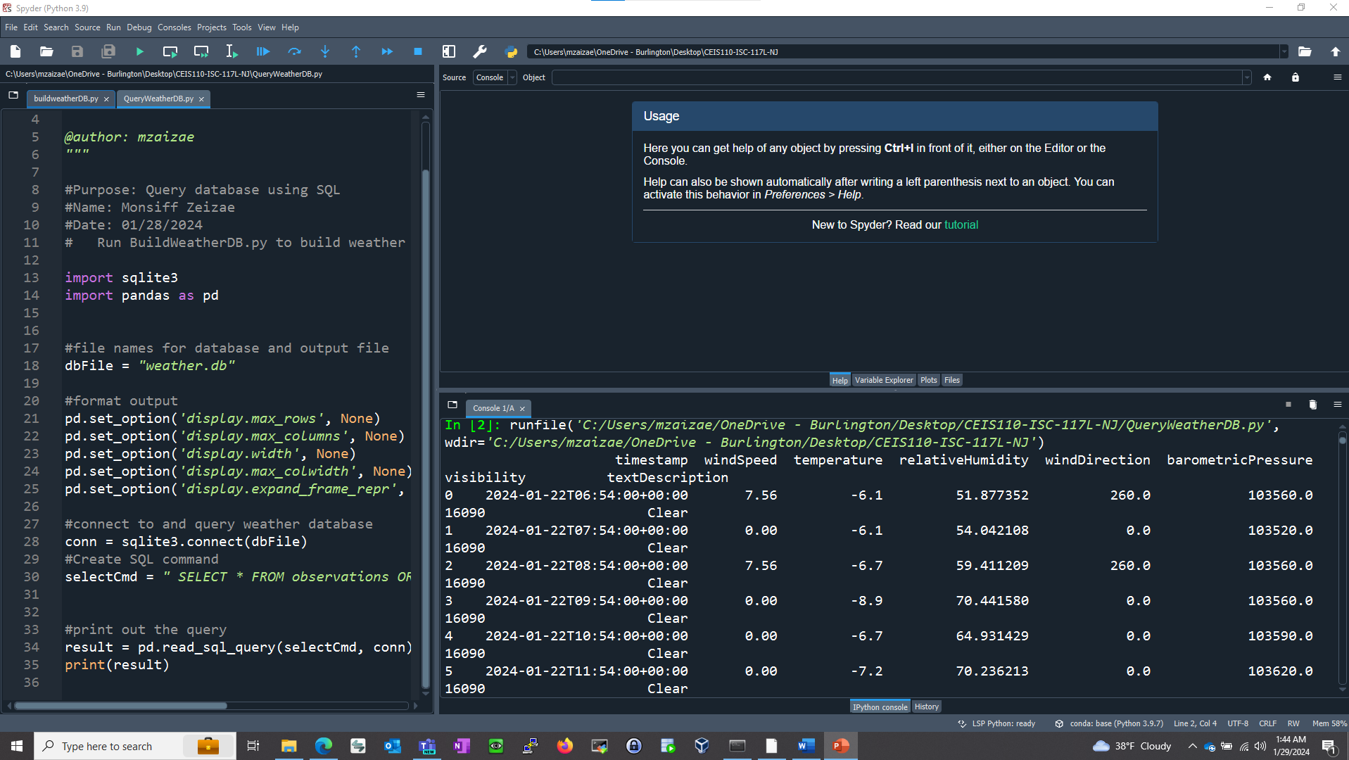
Query to retrieve all columns and all rows (Screenshot)

Slide 13
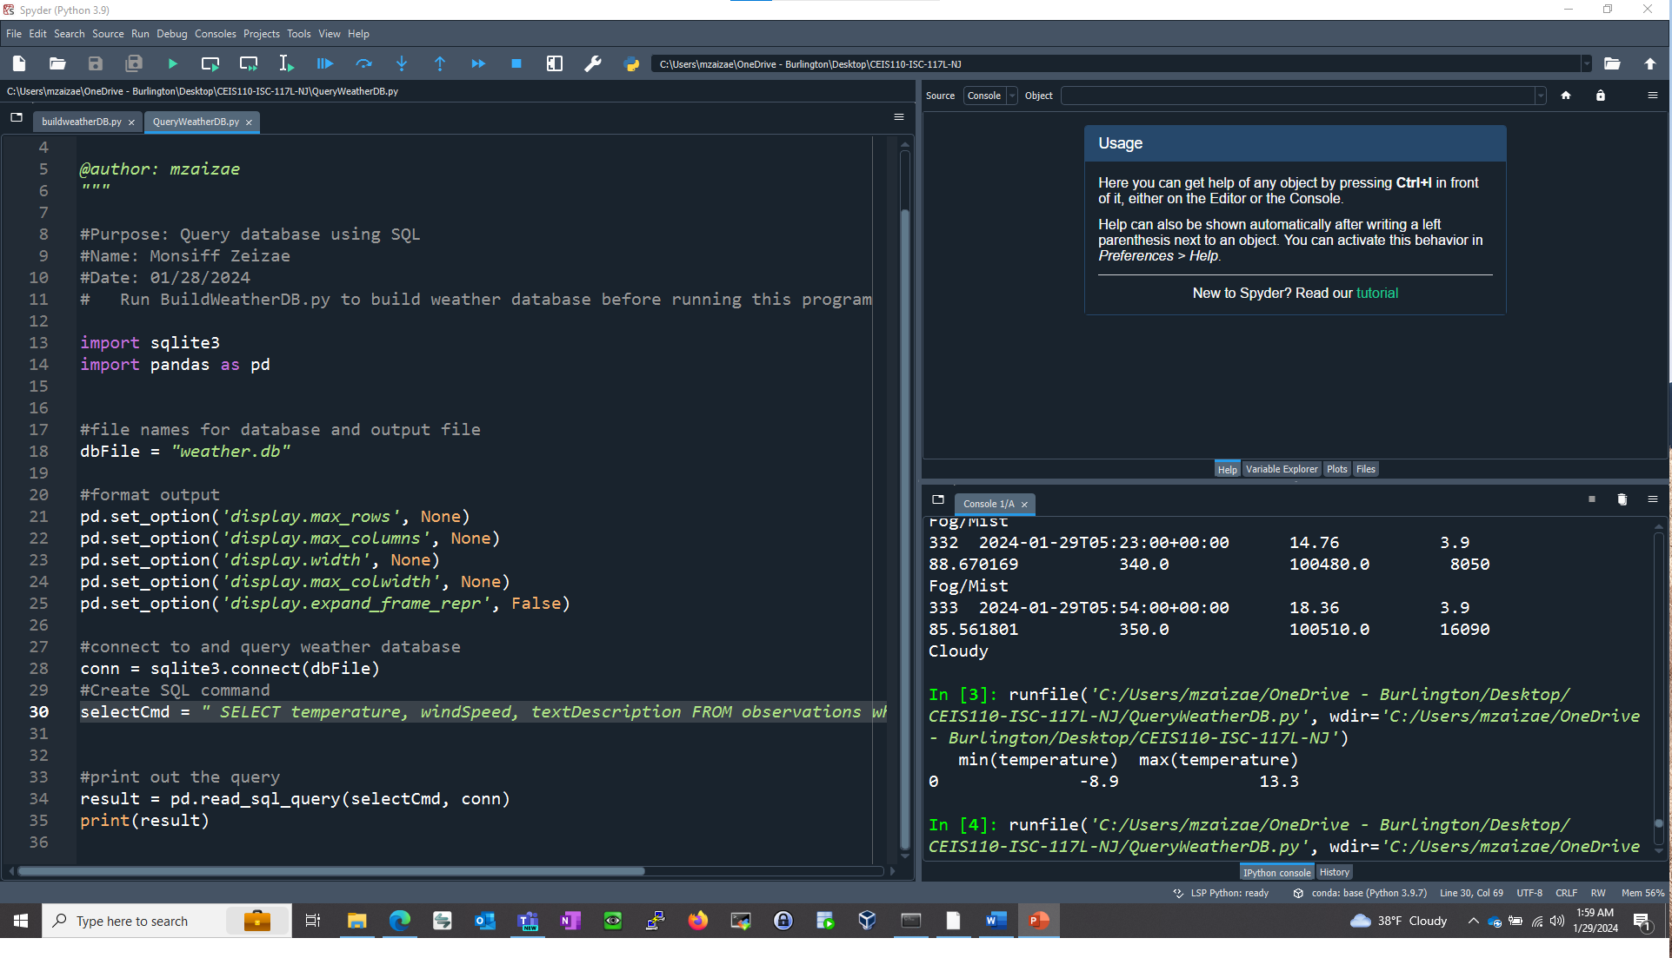
Query to retrieve lowest and highest temperatures (Screenshot)
The min and mac temperature were retrieved. These temperatures are reported in celsius

Slide 14
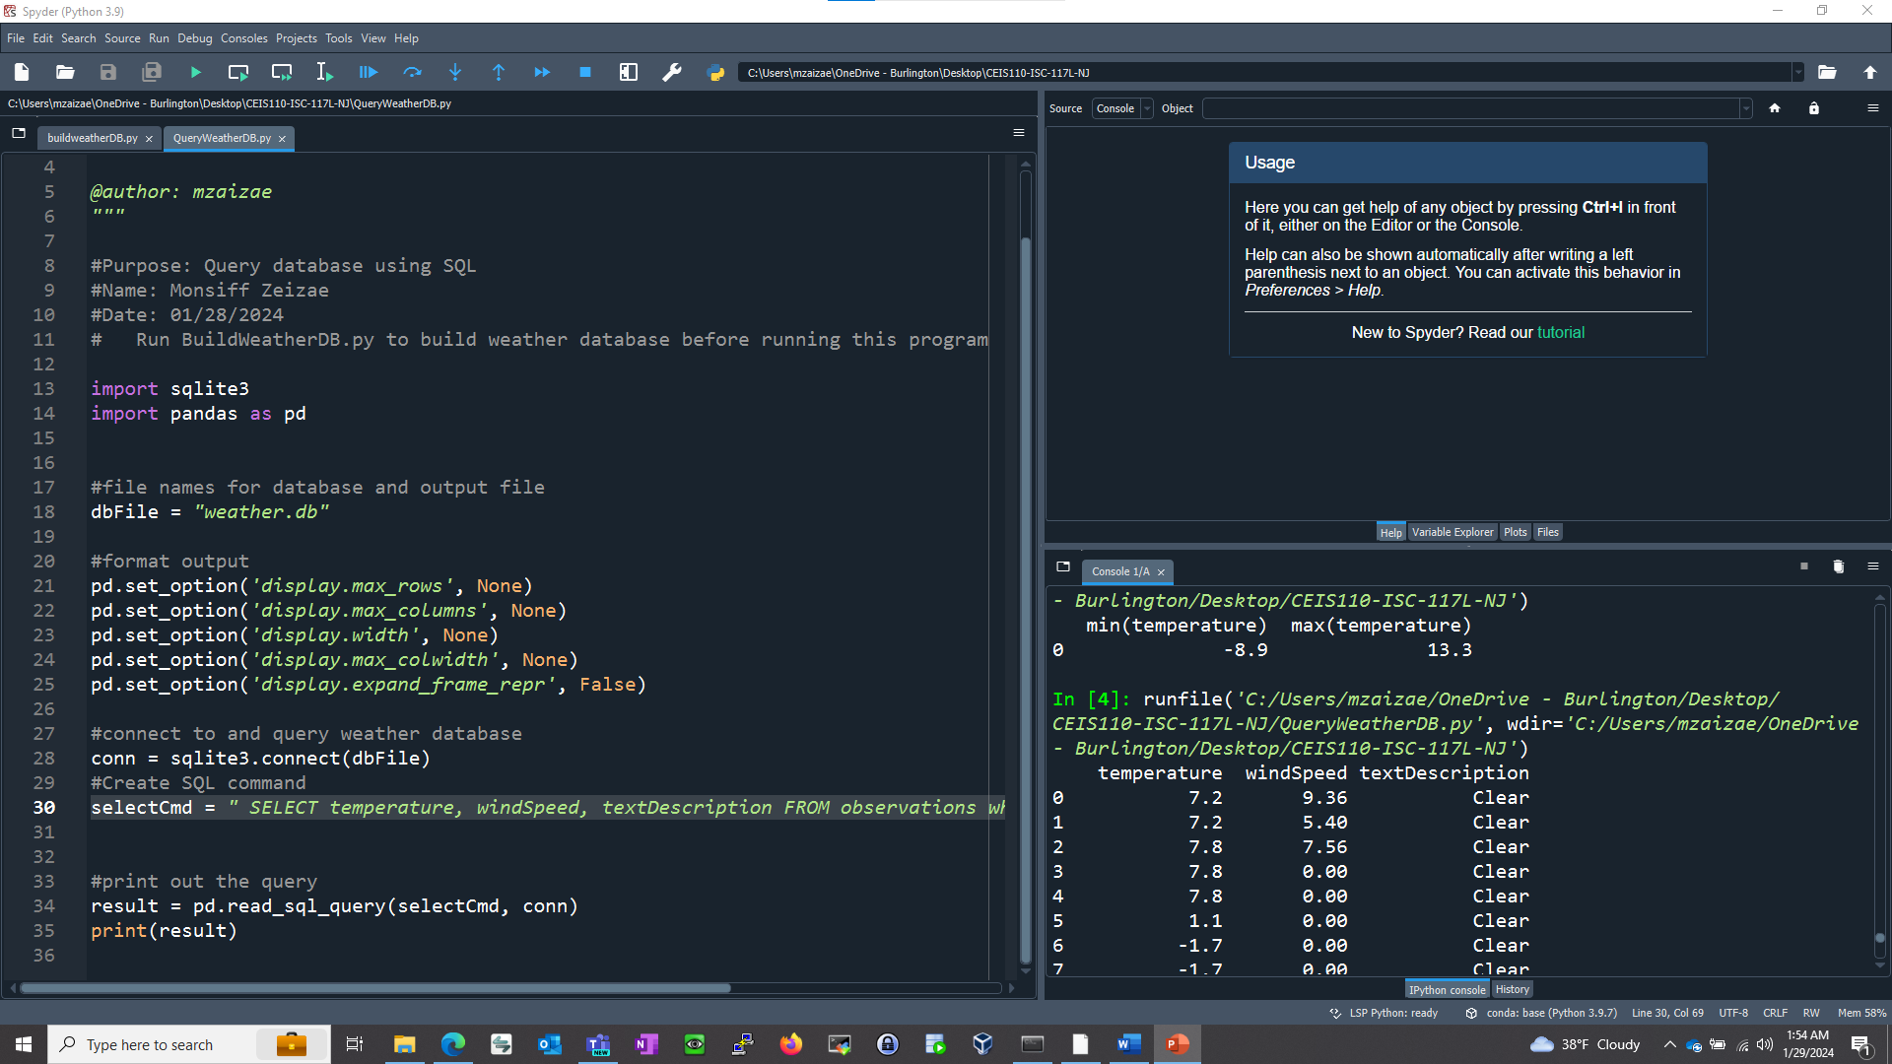
Query to retrieve all clear days (Screenshot)

Slide 15
Data Cleansing
Data output from machines can posses errors. To offset this, programs can automatically put it in the format needed to be read by the other programs when cleansing the data.
A python program is reading in the data output by the python program and saving it in a csv file so that it can be read by Excel
Often data must be cleansed of error or missing values altogether in a dataset.

Slide 16
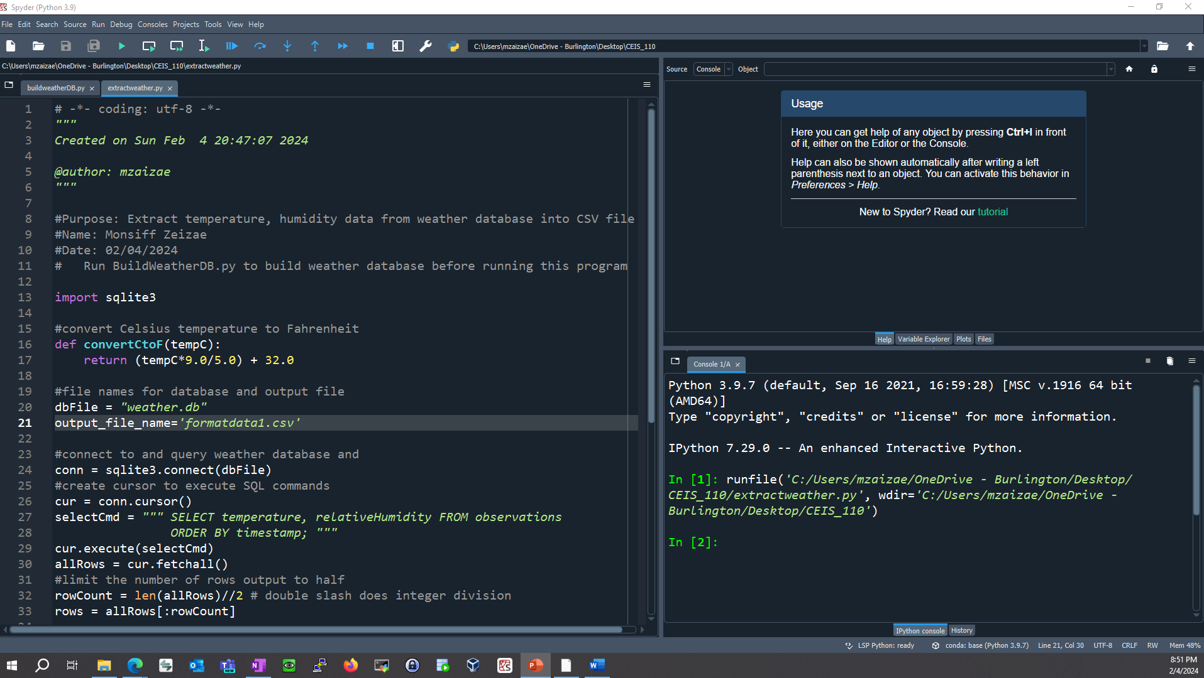
ExtractTempHumidity.py Python code screenshot
The code used will only retrieve the temperature and humidity values & report them to a csv file.

Slide 17
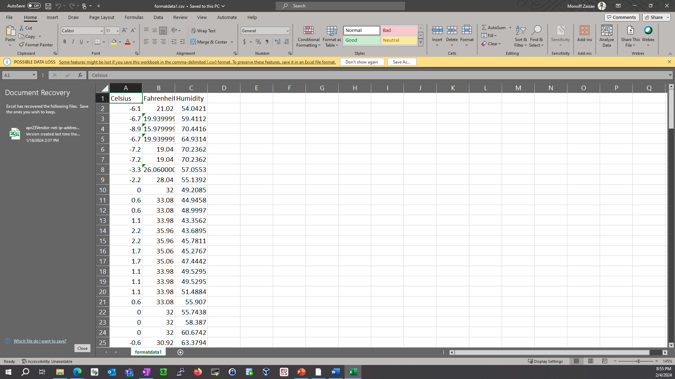
Retrieve and Convert Data to CSV Format (Screenshot)
Our python code created a csv file called formdata
This file contains data for Celsius, Fahrenheit and humidity

Slide 18
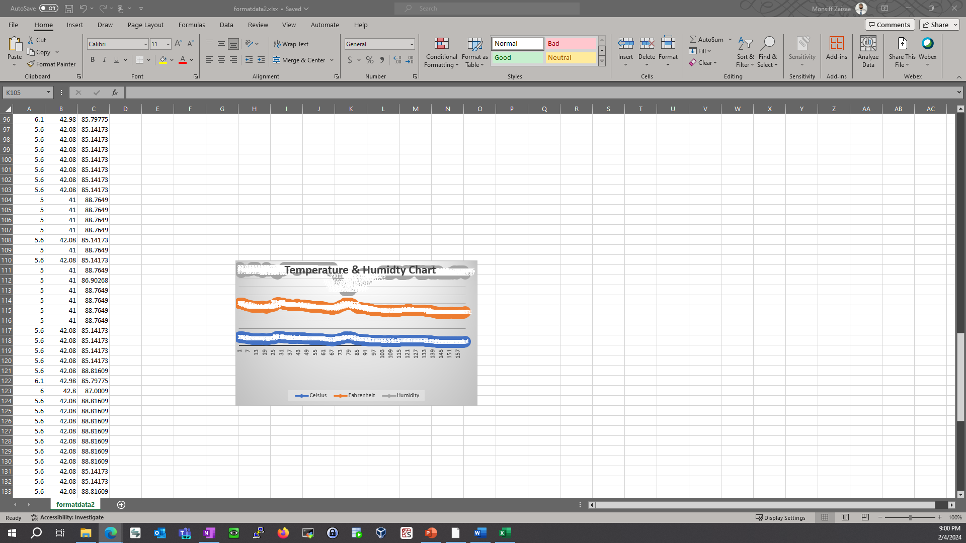
Temperature and Humidity Chart (Graph)
Excel chart based on temperature and humidity data from database

Slide 19
Data Analytics
Python contains data analytics modules that allow us to create charts and graphs that represent our data
Plots were generated analyzing both humidity and temperature
By downloading Anaconda, we are able to call upon these modules when needed as they are available within Anaconda

Slide 20
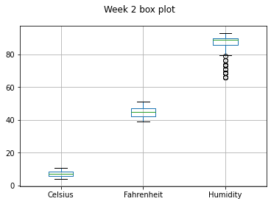
Plot 1
#Purpose: Create box plot for week 2 data
#Name: Monsiff Zeizae
#Date: 02/10/2024
import pandas as pd
import matplotlib.pyplot as plt
df2 = pd.read_csv("formatdata2.csv")
df2.boxplot(); plt.suptitle('Week 2 box plot')
#plt.show()
print(df2.info())
print(df2.describe())
print("The median is",df2.median())

Slide 21
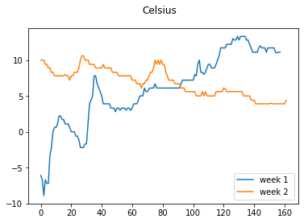
Plot #2
#Purpose: Create Celsius plot comparing period 1 and period 2 (week 1 and week 2)
#Name: Monsiff Zeizae
#Date: 02/10/2024
import pandas as pd
import matplotlib.pyplot as plt
df1 = pd.read_csv("formatdata1.csv") #baseline data is period 1 (older)
df2 = pd.read_csv("formatdata2.csv") #data for period 2 (more recent)
plt.figure(); df1.Celsius.plot(label = 'week 1 '); df2.Celsius.plot(label = 'week 2'); plt.legend(loc='best'); plt.suptitle('Celsius')
plt.show()

Slide 22
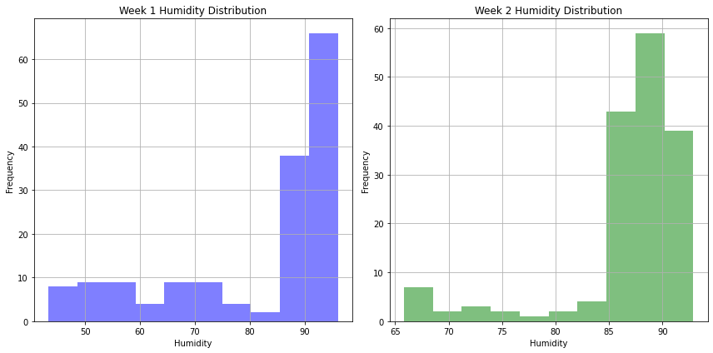
Analysis
Think of your own question and create a chart/graph to answer it
In the video we adjusted our code for humidity so I decided to build on that & compare humidity levels from the two different files/weeks

Slide 23
Challenge
On module 3 of the project I faced a challenge when running the pip install noaa_sdk in the console window. For some reason it would not execute and for that reason I was not able to successfully complete the project. After some instructions from the professor, I uninstalled anaconda altogether and re-installed it which resolved the issue.

Slide 24
Career Skills Gained
Ability to program using Python
Ability to retrieve data from relational databases
Ability to utilize a flowchart to better organize thoughts and program outlines
Ability to accurately analyze data, and utilize the graphing function of excel to represent our data

Slide 25
Conclusion
In conclusion, this project successfully demonstrated programming with data that was obtained from a cloud service, and also performing analysis on that data
After extensive work on this project, I feel fully equipped and able to further practice manipulating data using the python programming language

