Slide 1
CEIS 106 Final Project
Monsiff Zeizae

Slide 2
Overview
In this project we covered several important topics in Linux. Topics included how to navigate the Linux filesystem tree,
Linux shell scripts, user and group management, networking configurations in Linux.

Slide 3
Navigate the Linux Filesystem tree
Explain the differences between a relative path and an absolute/full path in Linux.
Answer: In Linux an absolute path is used to provide the entire locate of a file or a directory stemming from the root directory “/”. Whereas the relative path is used to specify the location of a file or directory relative to the current working directory.

Slide 4
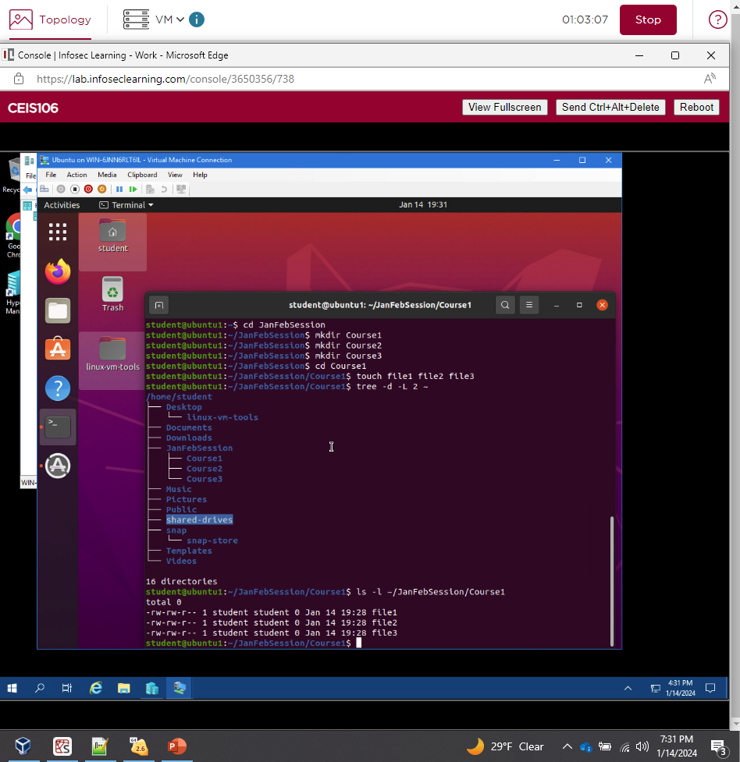
Create directories and files

Slide 5
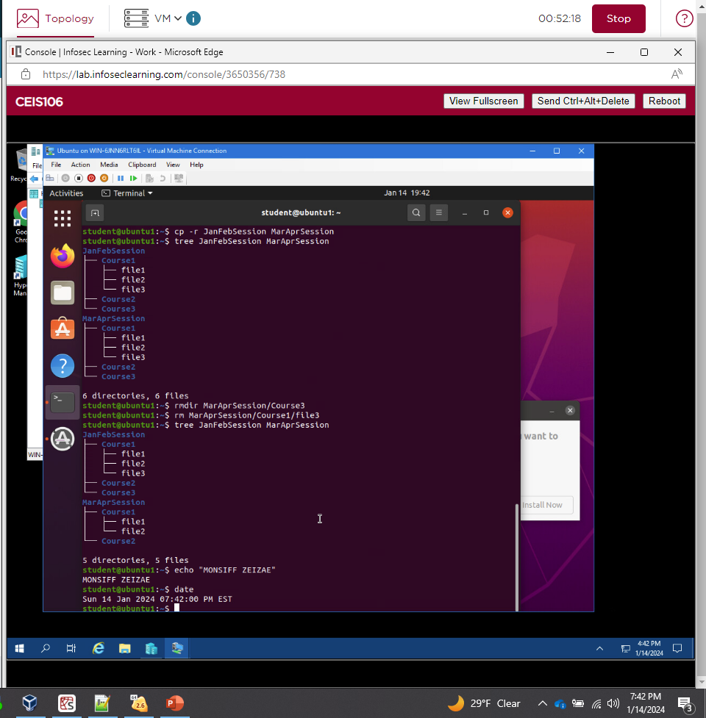
Copy and remove directories and files

Slide 6
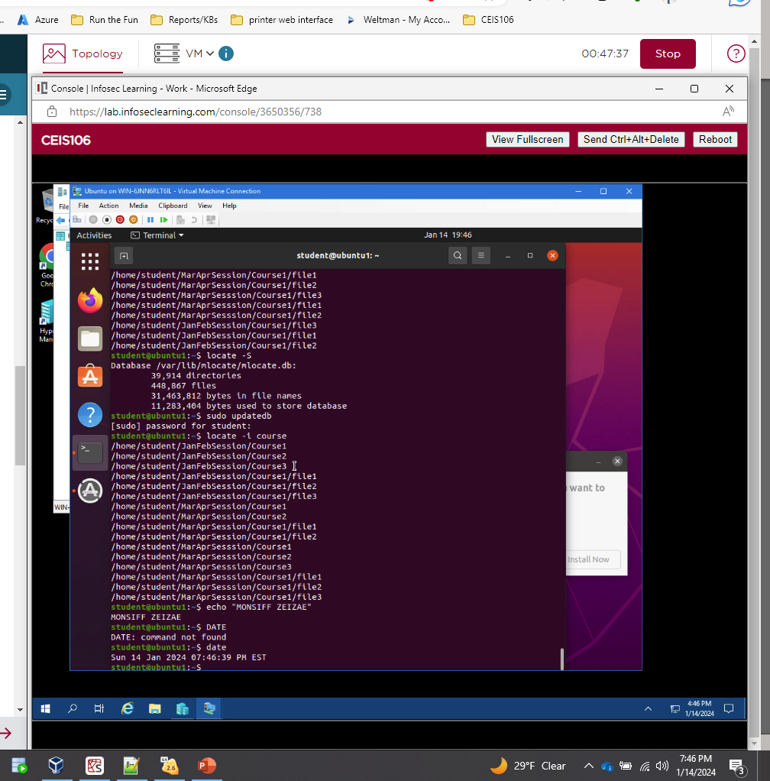
Locate directories and files

Slide 7
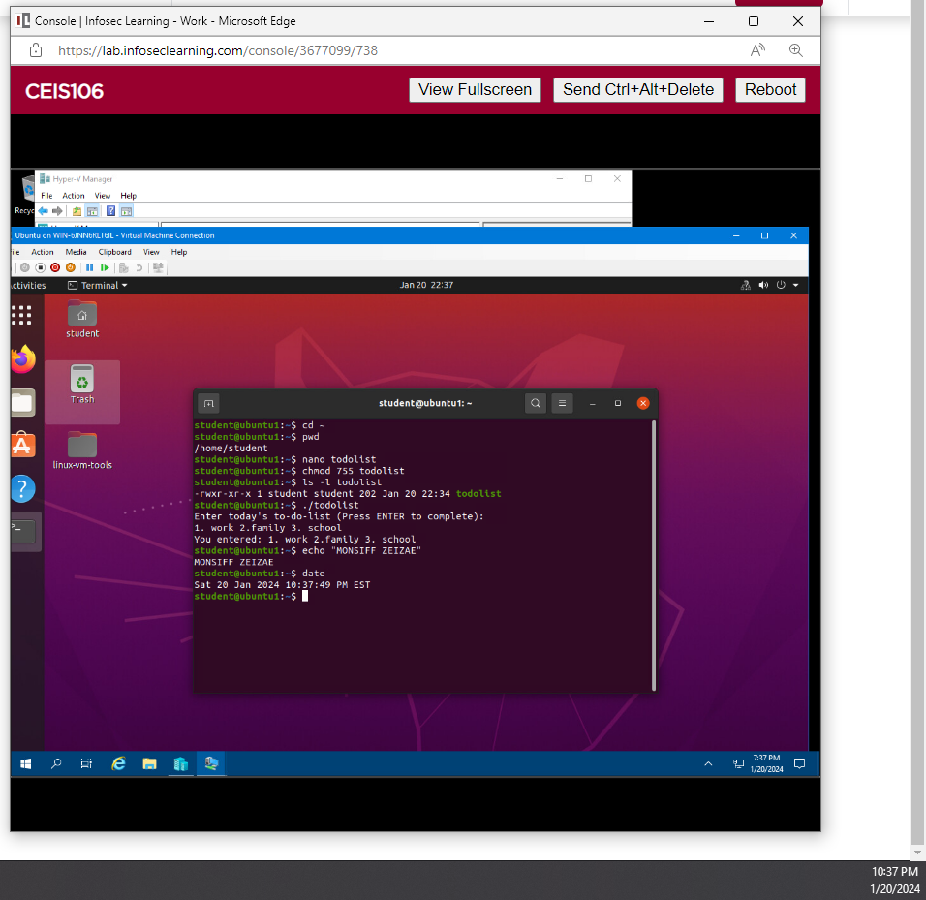
Change script file permissions

Slide 8
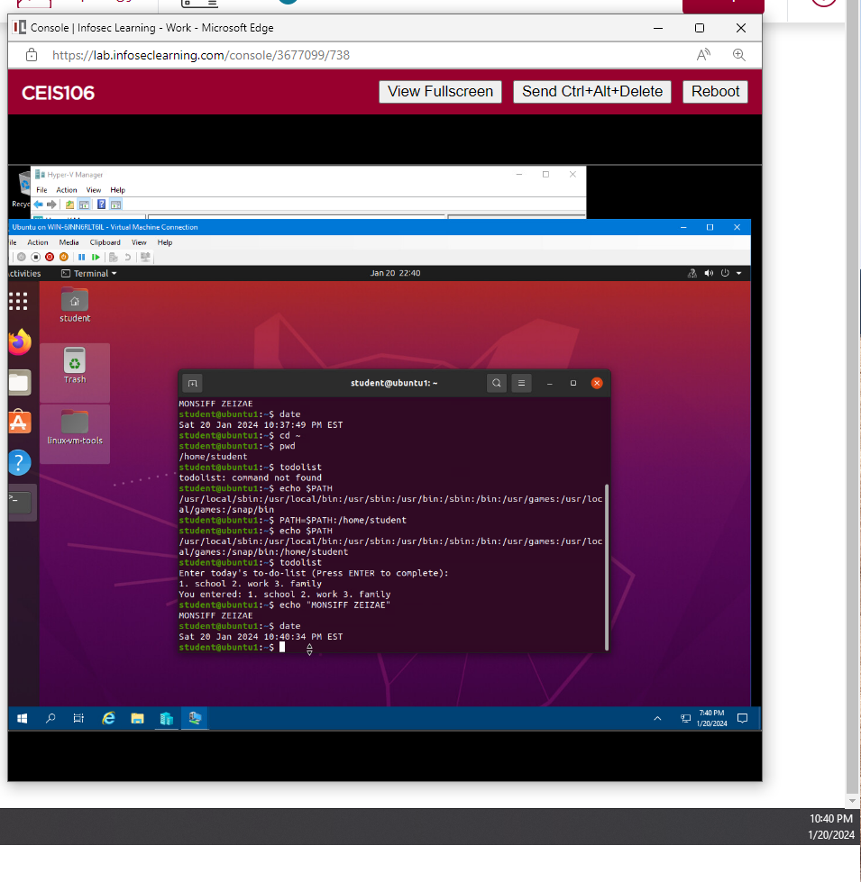
Set the PATH variable

Slide 9
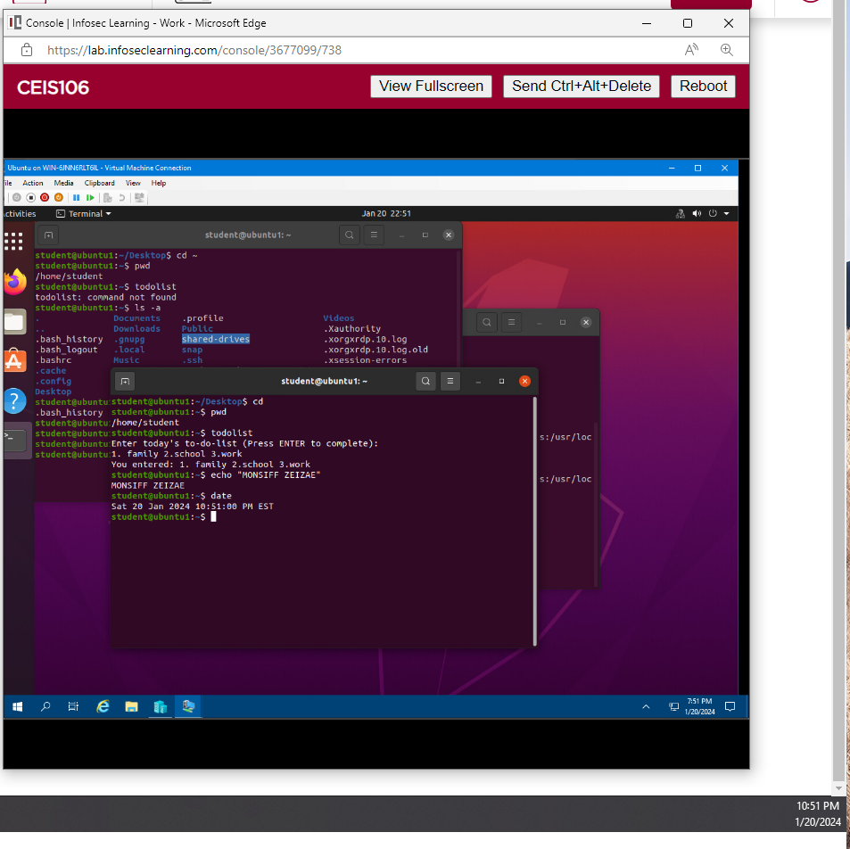
Make the PATH variable permanent

Slide 10
Add users and groups in CLI
. What does the –m option in the useradd command do?
Answer here: “-m” tells useradd command to create a home directory for the new user
2. What does the -3 option in the tail command do?
Answer here: it tells the tail command how many lines to show from the end of the file

Slide 11
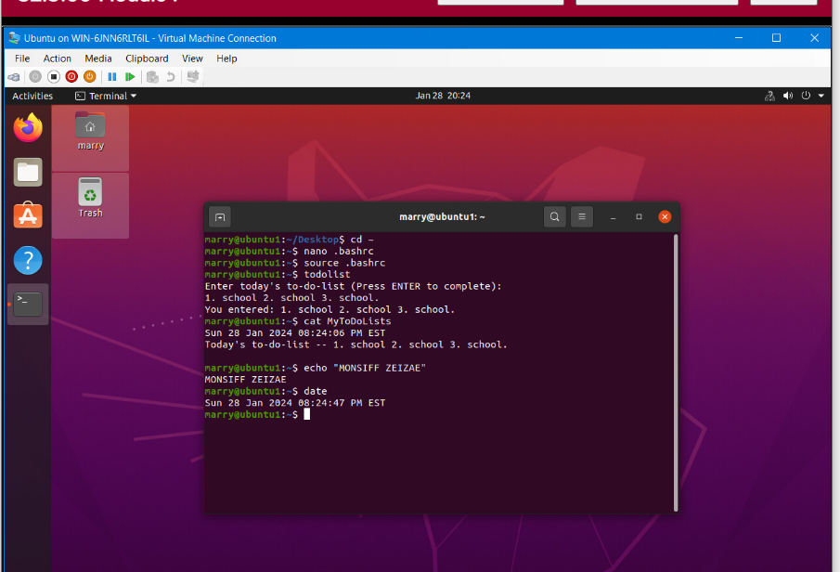
Test user and group settings

Slide 12
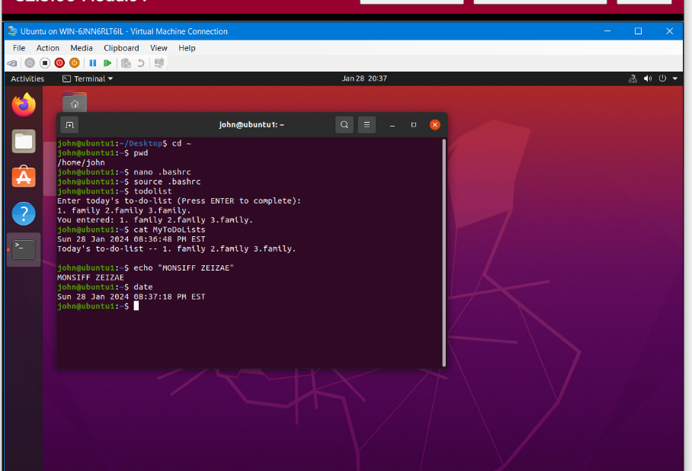
Add users in GUI

Slide 13
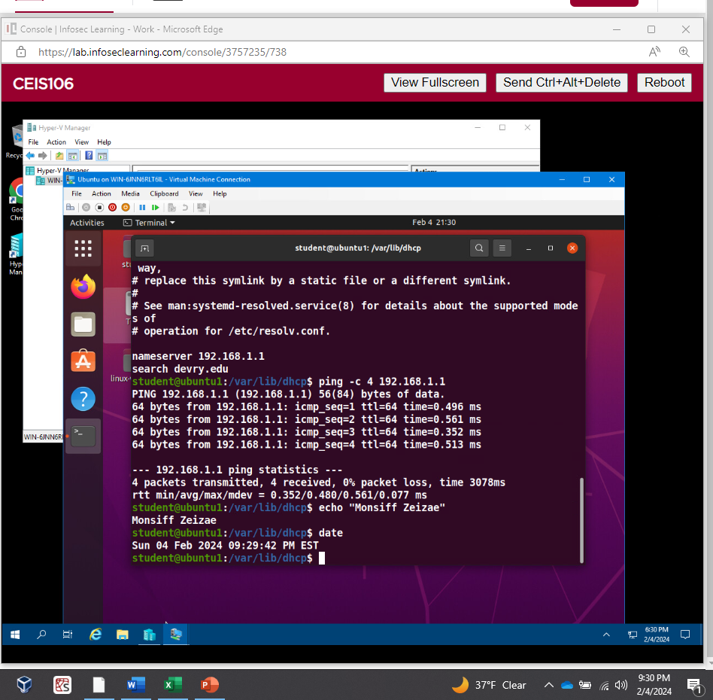
Network configurations

Slide 14
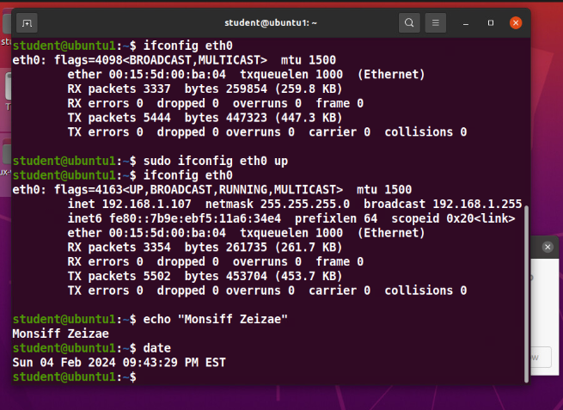
Use of network utilities

