Slide 1

01 / 08
For experienced professionals in Malaysia
What comes next?
10 years
Changing careers
Growing in your current role
Returning to work
of experience to build on
A direction, a skill gap,
and a next action
RePath AI / Team Gravity / Wu Tong and Liang Yiyan
Video 0:00 - 0:30
Notes:
SLIDE 1 OF 8
VIDEO 0:00 - 0:30
ENGLISH RECORDING SCRIPT
Ten years of work gives you experience worth keeping. But as AI changes tasks, where could that experience take you next?
RePath serves experienced professionals in Malaysia who are changing careers, growing in their role, or returning to work.
The problem is deciding which skills to carry forward and which new skills deserve limited learning time.
We turn that decision into a direction, a visible gap, and a next action. Here is Alex's journey.
VIDEO SHOTS
0:00-0:08 hook
0:08-0:16 audience
0:16-0:22 question
0:22-0:30 promise
SOURCES AND DISCLOSURE
Domain 1 official problem statement, sections 4, 6 and 8. Participant Handbook 6.3.5.2 and 6.3.5.6: https://drive.google.com/file/d/1fGBS-jevDj_FrF8wsbYNPzyU5TTrfk1V/view
Product modules: dist/model.mjs, dist/journey.mjs, dist/market-evidence.mjs, dist/rss.mjs, dist/work-profile.mjs and dist/career-data.mjs.
Fictional Alex Tan profile. Animated explanation plus actual browser capture of the running local RePath 0.2 prototype. Current matching uses rules, not an LLM. Planned signal-to-skill forecasting and skill-level SDG mapping are labelled.
https://www.dosm.gov.my/portal-main/release-content/big-data-analytics-job-market-insights-q22026
https://www.onetcenter.org/database.html
https://www.weforum.org/publications/the-future-of-jobs-report-2025/
https://rss.arxiv.org/rss/cs.AI
https://learn.microsoft.com/en-us/training/powerplatform/power-bi
https://sdgs.un.org/goals/goal4
https://sdgs.un.org/goals/goal8
https://sdgs.un.org/goals/goal9
https://sdgs.un.org/goals/goal10

Slide 2
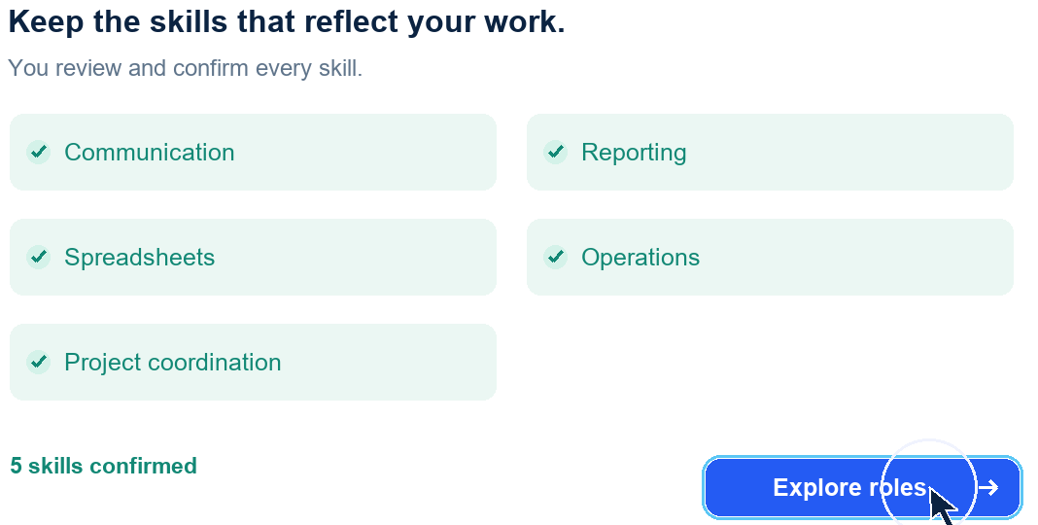
02 / 08
Experience into a confirmed profile
One project
What you did and delivered
Your situation
Prepare while employed
Confirmed skills
Skills you review and confirm
Alex Tan is a fictional user with 10 years in operations and marketing.
Video 0:30 - 1:10
Notes:
SLIDE 2 OF 8
VIDEO 0:30 - 1:10
ENGLISH RECORDING SCRIPT
Alex is a fictional operations and marketing lead with ten years of experience. He starts by adding one recent project.
He records what he did: coordinating teams and preparing weekly reports. The project gives the profile something more useful than a job title alone.
He adds his situation: currently employed, preparing alongside work, and interested in an adjacent role.
Then he checks the suggested skills himself. Communication, coordination, reporting, spreadsheets, and operations all reflect work he can explain.
VIDEO SHOTS
0:30-0:40 home
0:40-0:50 intake
0:50-0:59 context
0:59-1:10 skills
SOURCES AND DISCLOSURE
Domain 1 official problem statement, sections 4, 6 and 8. Participant Handbook 6.3.5.2 and 6.3.5.6: https://drive.google.com/file/d/1fGBS-jevDj_FrF8wsbYNPzyU5TTrfk1V/view
Product modules: dist/model.mjs, dist/journey.mjs, dist/market-evidence.mjs, dist/rss.mjs, dist/work-profile.mjs and dist/career-data.mjs.
Fictional Alex Tan profile. Animated explanation plus actual browser capture of the running local RePath 0.2 prototype. Current matching uses rules, not an LLM. Planned signal-to-skill forecasting and skill-level SDG mapping are labelled.
https://www.dosm.gov.my/portal-main/release-content/big-data-analytics-job-market-insights-q22026
https://www.onetcenter.org/database.html
https://www.weforum.org/publications/the-future-of-jobs-report-2025/
https://rss.arxiv.org/rss/cs.AI
https://learn.microsoft.com/en-us/training/powerplatform/power-bi
https://sdgs.un.org/goals/goal4
https://sdgs.un.org/goals/goal8
https://sdgs.un.org/goals/goal9
https://sdgs.un.org/goals/goal10

Slide 3
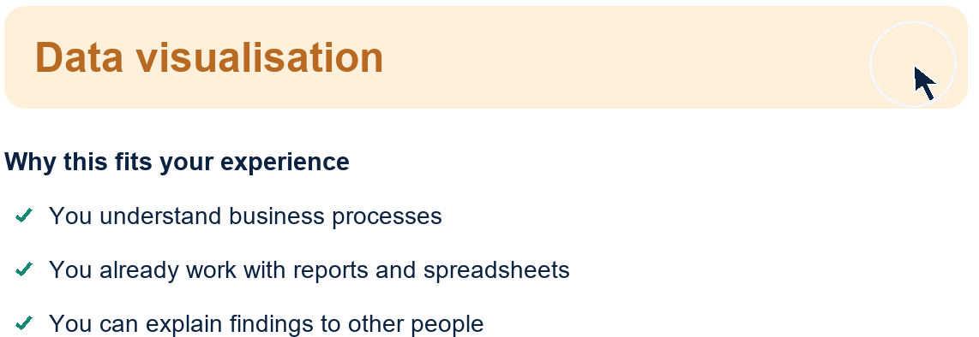
03 / 08
Career directions and visible gaps
4 / 5
Management Analyst
Required skills covered
in the prototype mapping
8 directions, with explanations
A fit score guides exploration. It is not a hiring probability.
Video 1:10 - 1:55
Notes:
SLIDE 3 OF 8
VIDEO 1:10 - 1:55
ENGLISH RECORDING SCRIPT
RePath ranks eight career directions using the confirmed profile. Alex can explore alternatives while seeing how much of his experience transfers.
Management Analyst is one option. In our prototype mapping, he covers four of five required skills: operations, reporting, spreadsheets, and communication.
The remaining gap is data visualisation. The explanation shows the strengths behind the recommendation and what he would need to practise next.
Current fit uses transparent rules for skills and experience, then includes time once confirmed. These scores guide exploration. They are not hiring probabilities.
VIDEO SHOTS
1:10-1:20 catalogue
1:20-1:32 match
1:32-1:42 gap
1:42-1:55 fit
SOURCES AND DISCLOSURE
Domain 1 official problem statement, sections 4, 6 and 8. Participant Handbook 6.3.5.2 and 6.3.5.6: https://drive.google.com/file/d/1fGBS-jevDj_FrF8wsbYNPzyU5TTrfk1V/view
Product modules: dist/model.mjs, dist/journey.mjs, dist/market-evidence.mjs, dist/rss.mjs, dist/work-profile.mjs and dist/career-data.mjs.
Fictional Alex Tan profile. Animated explanation plus actual browser capture of the running local RePath 0.2 prototype. Current matching uses rules, not an LLM. Planned signal-to-skill forecasting and skill-level SDG mapping are labelled.
https://www.dosm.gov.my/portal-main/release-content/big-data-analytics-job-market-insights-q22026
https://www.onetcenter.org/database.html
https://www.weforum.org/publications/the-future-of-jobs-report-2025/
https://rss.arxiv.org/rss/cs.AI
https://learn.microsoft.com/en-us/training/powerplatform/power-bi
https://sdgs.un.org/goals/goal4
https://sdgs.un.org/goals/goal8
https://sdgs.un.org/goals/goal9
https://sdgs.un.org/goals/goal10

Slide 4
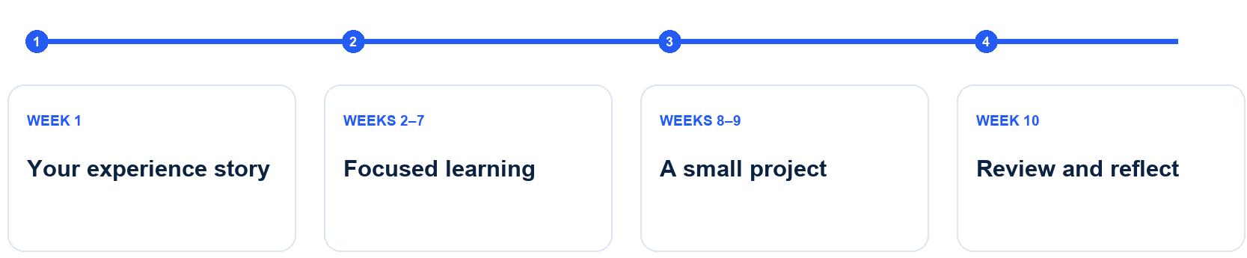
04 / 08
A plan that fits the week
4 hours
10 weeks
40 hours
each week
estimated pathway
including practice
A one-page visual report with three business insights and a recommendation
Fictional profile. Learning time includes practice and remains an estimate.
Video 1:55 - 2:35
Notes:
SLIDE 4 OF 8
VIDEO 1:55 - 2:35
ENGLISH RECORDING SCRIPT
At four hours a week, Alex's original profile produces an estimated ten-week pathway, about forty hours including practice.
An example task is a one-page visual report using public sample data, with three business insights and a recommendation.
Resources connect to the gap, including Microsoft Learn's Power BI learning paths. The plan also includes practice, rather than copying course durations.
Weekly steps cover an experience story, focused learning, a small project, and reflection. Skills practice connects to our goal of learning for employment.
VIDEO SHOTS
1:55-2:04 hours
2:04-2:12 task
2:12-2:24 resource
2:24-2:35 roadmap
SOURCES AND DISCLOSURE
Domain 1 official problem statement, sections 4, 6 and 8. Participant Handbook 6.3.5.2 and 6.3.5.6: https://drive.google.com/file/d/1fGBS-jevDj_FrF8wsbYNPzyU5TTrfk1V/view
Product modules: dist/model.mjs, dist/journey.mjs, dist/market-evidence.mjs, dist/rss.mjs, dist/work-profile.mjs and dist/career-data.mjs.
Fictional Alex Tan profile. Animated explanation plus actual browser capture of the running local RePath 0.2 prototype. Current matching uses rules, not an LLM. Planned signal-to-skill forecasting and skill-level SDG mapping are labelled.
https://www.dosm.gov.my/portal-main/release-content/big-data-analytics-job-market-insights-q22026
https://www.onetcenter.org/database.html
https://www.weforum.org/publications/the-future-of-jobs-report-2025/
https://rss.arxiv.org/rss/cs.AI
https://learn.microsoft.com/en-us/training/powerplatform/power-bi
https://sdgs.un.org/goals/goal4
https://sdgs.un.org/goals/goal8
https://sdgs.un.org/goals/goal9
https://sdgs.un.org/goals/goal10

Slide 5
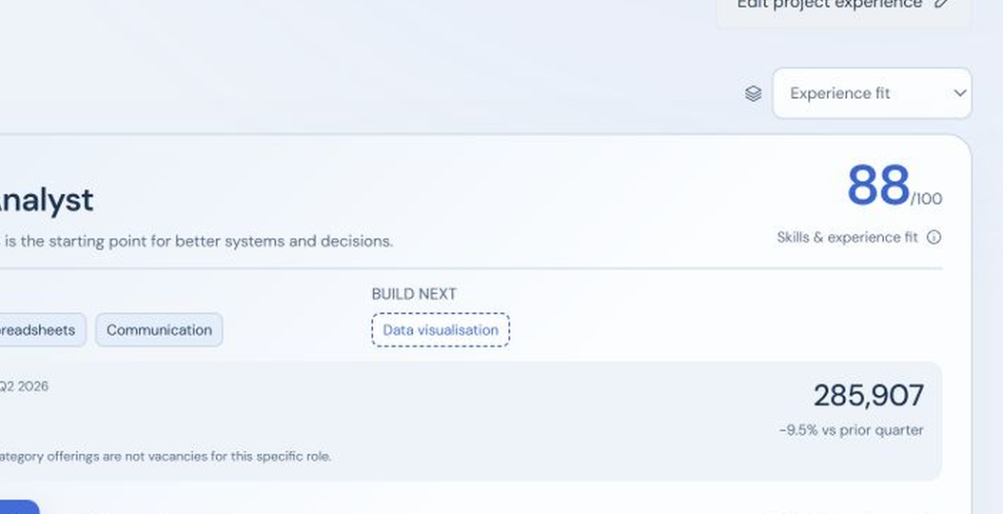
05 / 08
Working prototype demonstration
User confirms skills. The running app generates directions and a saved plan.
88
Initial fit reference
4 / 5 skills covered
4 hours / week
10-week saved plan
Video 2:35 - 3:30
Notes:
SLIDE 5 OF 8
VIDEO 2:35 - 3:30
ENGLISH RECORDING SCRIPT
This is the running prototype, using a fictional profile. Alex's project and current situation pass through the actual intake form.
Here he confirms communication in the skills list. The application generates career directions, including Management Analyst, with four of five skills covered and an initial fit reference of eighty-eight.
Opening the explanation shows the skill coverage and transferable experience behind that result. Data visualisation appears as the skill to build next.
After confirming four hours each week, he generates the ten-week plan. Marking the first task complete changes the saved progress. These are working interface actions, not simulated results.
VIDEO SHOTS
2:35-2:46 live1
2:46-3:02 live2
3:02-3:14 live3
3:14-3:30 live4
SOURCES AND DISCLOSURE
Domain 1 official problem statement, sections 4, 6 and 8. Participant Handbook 6.3.5.2 and 6.3.5.6: https://drive.google.com/file/d/1fGBS-jevDj_FrF8wsbYNPzyU5TTrfk1V/view
Product modules: dist/model.mjs, dist/journey.mjs, dist/market-evidence.mjs, dist/rss.mjs, dist/work-profile.mjs and dist/career-data.mjs.
Fictional Alex Tan profile. Animated explanation plus actual browser capture of the running local RePath 0.2 prototype. Current matching uses rules, not an LLM. Planned signal-to-skill forecasting and skill-level SDG mapping are labelled.
https://www.dosm.gov.my/portal-main/release-content/big-data-analytics-job-market-insights-q22026
https://www.onetcenter.org/database.html
https://www.weforum.org/publications/the-future-of-jobs-report-2025/
https://rss.arxiv.org/rss/cs.AI
https://learn.microsoft.com/en-us/training/powerplatform/power-bi
https://sdgs.un.org/goals/goal4
https://sdgs.un.org/goals/goal8
https://sdgs.un.org/goals/goal9
https://sdgs.un.org/goals/goal10
This section is captured from the actual running application, using the real intake, confirmation, scoring and plan state. Frames are edited for presentation pace. The reference score is 88 before time confirmation; the original five-skill profile becomes 91 after 4h/week is confirmed. Completing one weekly task changes saved progress from 0/10 to 1/10. This does not verify skill mastery.

Slide 6
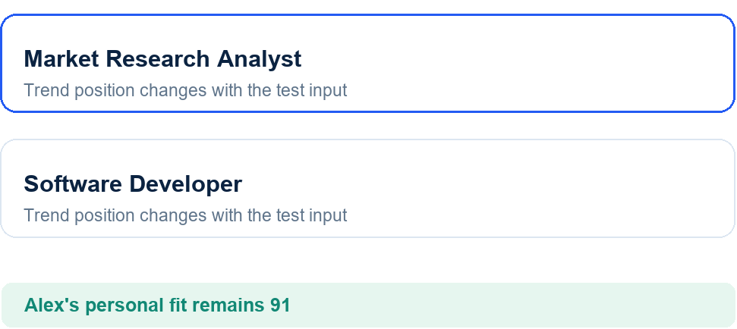
06 / 08
Evidence and the final AI layer
DOSM
Synthetic update changes market order
Dated Malaysian hiring observations
O*NET 31.0
Occupational tasks and curated mapping
WEF 2025
Long-term employment context
arXiv RSS
Refreshable research, separate from demand
Sensitivity: 91 moderate, 87 faster AI
Planned: review dated signals against tasks, then explain skill outlooks and scenarios
Video 3:30 - 4:45
Notes:
SLIDE 6 OF 8
VIDEO 3:30 - 4:45
ENGLISH RECORDING SCRIPT
Under the interface, rules make today's scores inspectable. Our proposed AI layer will extract candidate skills from experience and review research against occupational tasks. Users will still confirm their own skills.
DOSM gives dated Malaysian hiring observations. O*NET provides occupational tasks. WEF offers long-term expectations. arXiv supplies refreshable research signals. These sources have different update cycles, and a paper is not evidence of a new vacancy.
In this controlled engine test, a hypothetical demand update reorders the trend view while personal fit stays separate. The input is labelled as synthetic. It is not a new official release.
Our engine compares moderate and faster-AI assumptions. For Alex, the faster scenario reduces the reference score from ninety-one to eighty-seven under an explicit missing-skill penalty. The interface will explain these assumptions.
To complete the trend layer, we will record a signal's source and date, review the affected tasks, then label skills as emerging, stable, or declining. We will test how those changes affect recommendations.
VIDEO SHOTS
3:30-3:45 engine
3:45-4:05 sources
4:05-4:17 market
4:17-4:32 scenario
4:32-4:45 forecast
SOURCES AND DISCLOSURE
Domain 1 official problem statement, sections 4, 6 and 8. Participant Handbook 6.3.5.2 and 6.3.5.6: https://drive.google.com/file/d/1fGBS-jevDj_FrF8wsbYNPzyU5TTrfk1V/view
Product modules: dist/model.mjs, dist/journey.mjs, dist/market-evidence.mjs, dist/rss.mjs, dist/work-profile.mjs and dist/career-data.mjs.
Fictional Alex Tan profile. Animated explanation plus actual browser capture of the running local RePath 0.2 prototype. Current matching uses rules, not an LLM. Planned signal-to-skill forecasting and skill-level SDG mapping are labelled.
https://www.dosm.gov.my/portal-main/release-content/big-data-analytics-job-market-insights-q22026
https://www.onetcenter.org/database.html
https://www.weforum.org/publications/the-future-of-jobs-report-2025/
https://rss.arxiv.org/rss/cs.AI
https://learn.microsoft.com/en-us/training/powerplatform/power-bi
https://sdgs.un.org/goals/goal4
https://sdgs.un.org/goals/goal8
https://sdgs.un.org/goals/goal9
https://sdgs.un.org/goals/goal10
The hypothetical test changes the advertising/marketing input from 40,640 to 60,000. It is not an official new release. Personal fit remains 91 for Alex's original five-skill profile at 4h/week. The faster-AI rule subtracts four points for one missing core skill, producing 87. This is sensitivity logic, not a validated forecast. Automated signal-to-skill forecasting and a clearer multi-scenario view are planned. Source availability, interpretation and local mappings remain technical risks.

Slide 7
07 / 08
Final delivery and impact
Final build priorities
Proposed pilot
Skill outlooks from evidence
Scenario explanations
SDG links per role and skill
10 users, measured before and after
Role, gap and next action
Target: +20 percentage points
Baseline collection planned
Also review task completion
and work quality
Preliminary: core journey works. Final: complete all six required features.
Video 4:45 - 5:30
Notes:
SLIDE 7 OF 8
VIDEO 4:45 - 5:30
ENGLISH RECORDING SCRIPT
Alex leaves with a role to investigate, a skill gap, and a first action. Our preliminary demo proves that this journey works.
Our final build will add evidence-led skill outlooks, clearer scenario comparisons, and an SDG goal, target, and reason for every recommended role and skill.
We propose a ten-user pilot. Before and after RePath, we will check whether each user can identify a relevant role, a skill gap, and a next action.
Our proposed target is a twenty percentage-point improvement. Baseline collection remains planned. We will also review first-task completion and work quality.
VIDEO SHOTS
4:45-4:55 value
4:55-5:06 delivery
5:06-5:18 pilot
5:18-5:30 metrics
SOURCES AND DISCLOSURE
Domain 1 official problem statement, sections 4, 6 and 8. Participant Handbook 6.3.5.2 and 6.3.5.6: https://drive.google.com/file/d/1fGBS-jevDj_FrF8wsbYNPzyU5TTrfk1V/view
Product modules: dist/model.mjs, dist/journey.mjs, dist/market-evidence.mjs, dist/rss.mjs, dist/work-profile.mjs and dist/career-data.mjs.
Fictional Alex Tan profile. Animated explanation plus actual browser capture of the running local RePath 0.2 prototype. Current matching uses rules, not an LLM. Planned signal-to-skill forecasting and skill-level SDG mapping are labelled.
https://www.dosm.gov.my/portal-main/release-content/big-data-analytics-job-market-insights-q22026
https://www.onetcenter.org/database.html
https://www.weforum.org/publications/the-future-of-jobs-report-2025/
https://rss.arxiv.org/rss/cs.AI
https://learn.microsoft.com/en-us/training/powerplatform/power-bi
https://sdgs.un.org/goals/goal4
https://sdgs.un.org/goals/goal8
https://sdgs.un.org/goals/goal9
https://sdgs.un.org/goals/goal10
Final delivery plan covers the six Domain 1 must-have features. Current status: intake, explainable matching and time-based pathway work; trend-to-skill forecasting, full per-role/per-skill SDG rationales, and a clearer scenario interface remain planned.
Official Submission Template section 4 asks for a baseline, measurable KPI and Phase 2 target: https://docs.google.com/document/d/1RUb7bQvtaI5ds8SLHQtzAFmg8OGb9WsK/edit
The 10-user pilot and +20 percentage-point target are proposed planning choices, not official requirements or measured outcomes. Passing the core KPI requires a participant to name a relevant role, a specific skill gap and an actionable next step. T0 baseline has not been collected. A 20-point change equals two additional passing participants in a 10-person paired pilot. This small sample does not establish employment or wage impact. The formal impact baseline field remains to be completed from measurements or a cited, clearly labelled estimate.

Slide 8
08 / 08
SDG contribution in Alex's journey
4.4
Data visualisation practice
Builds relevant skills for employment
8.2
Business process improvement
Intended contribution to productivity
10.2
Free access and three languages
Supports our inclusion goal
Intended contributions. Detailed role and skill target links are part of the final build.
Video 5:30 - 6:00
Notes:
SLIDE 8 OF 8
VIDEO 5:30 - 6:00
ENGLISH RECORDING SCRIPT
Data visualisation practice connects to SDG four: relevant skills for employment.
Applying those skills to better business processes supports our aim under SDG eight. Free exploration and three languages support inclusion under SDG ten.
These are intended contributions. Detailed role and skill mappings remain part of our final build. RePath. Your experience still matters.
VIDEO SHOTS
5:30-5:37 sdgskill
5:37-5:48 sdgwork
5:48-6:00 sdgstatus
SOURCES AND DISCLOSURE
Domain 1 official problem statement, sections 4, 6 and 8. Participant Handbook 6.3.5.2 and 6.3.5.6: https://drive.google.com/file/d/1fGBS-jevDj_FrF8wsbYNPzyU5TTrfk1V/view
Product modules: dist/model.mjs, dist/journey.mjs, dist/market-evidence.mjs, dist/rss.mjs, dist/work-profile.mjs and dist/career-data.mjs.
Fictional Alex Tan profile. Animated explanation plus actual browser capture of the running local RePath 0.2 prototype. Current matching uses rules, not an LLM. Planned signal-to-skill forecasting and skill-level SDG mapping are labelled.
https://www.dosm.gov.my/portal-main/release-content/big-data-analytics-job-market-insights-q22026
https://www.onetcenter.org/database.html
https://www.weforum.org/publications/the-future-of-jobs-report-2025/
https://rss.arxiv.org/rss/cs.AI
https://learn.microsoft.com/en-us/training/powerplatform/power-bi
https://sdgs.un.org/goals/goal4
https://sdgs.un.org/goals/goal8
https://sdgs.un.org/goals/goal9
https://sdgs.un.org/goals/goal10
SDG 4.4 concerns relevant employment and entrepreneurship skills. SDG 8.2 concerns productivity through diversification, upgrading and innovation. SDG 10.2 concerns inclusion. These links describe intended contributions, not measured impact or UN endorsement. The current curated Management Analyst role tag uses SDG 9. The proposed next build assigns each role and skill a goal, target, rationale and evidence link, rather than simply attaching SDG icons.

