Slide 1

RePath AI
Prototype 0.2
Your Experience
Still Matters
Career transitions built on the work you have already done
Team Gravity
SDC Hackathon 2026
Wu Tong Liang Yiyan
Domain 1
Notes:
第 1 页｜建议 20 秒
大家好，我们的项目是 RePath AI，参加 SDC Hackathon 2026 的 Domain 1。我们希望帮助有多年工作经验的马来西亚职场人士，在工作任务和技能需求变化时，找到下一条可行的职业路径。我们的出发点很简单：下一程，不必从零开始。
资料与边界
Competition structure and Domain 1: user-supplied brief in this conversation. The handbook was not independently available in this workspace.
Product version: ../release.json. Original logo: ../dist/assets/repath-mark.png.
Team details supplied by user: Gravity, Wu tong, Liang yiyan. Cover capitalisation: Team Gravity, Wu Tong, Liang Yiyan.

Slide 2
The Problem
Work changes.
Experience becomes
harder to translate.
The transition gap
01 What can I carry forward?
02 Which adjacent roles fit?
03 What should I learn first?
AI and information processing are changing
employers’ expectations for work and skills.
User pain points are hypotheses
for interviews and pilot testing.
RePath AI
02 / 08
Notes:
第 2 页｜建议 45 秒
世界经济论坛的《Future of Jobs Report 2025》指出，AI 和信息处理等技术将影响企业对工作与技能的预期。这给职业转型带来一个具体问题：一个人过去做过很多项目，却不一定知道这些经验还能用于哪些工作。我们把待验证的用户困境分成三个问题：哪些能力可以带走，哪些相邻岗位值得考虑，以及应该先学什么。对需要尽快恢复收入的人来说，准备时间也是重要约束。这里没有把全球雇主预期当成马来西亚已经发生的裁员数据，也没有声称我们已经完成用户研究。我们会通过访谈和试用，验证这些问题的优先级。
资料与边界
WEF, The Future of Jobs Report 2025, published 7 January 2025: https://www.weforum.org/publications/the-future-of-jobs-report-2025/
The three user pain points are product hypotheses, not measured findings.

Slide 3
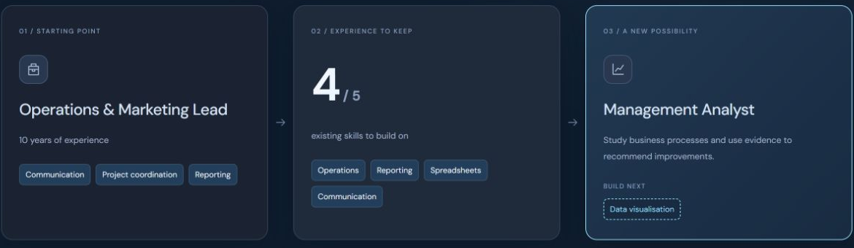
Who We Help
Experienced mid-career workers in Malaysia
10
Alex Tan
years in operations
and marketing
Fictional demo persona
Four of five prototype role skills already covered. Data visualisation is the next gap.
RePath AI
03 / 08
Notes:
第 3 页｜建议 30 秒
我们优先服务有多年经验、正在考虑转型的中年职场人士，也兼顾在职进阶和重返职场。这里的 Alex Tan 是虚构演示人物。他有十年运营和市场经验，做过报告、客户沟通和流程改进。对于原型定义的管理分析师技能集合，他已经覆盖五项中的四项，下一项缺口是数据可视化。这个案例想说明，我们可以把旧经验整理为下一份工作的基础。这个比例来自演示规则，并不代表录用概率或真实能力认证。
资料与边界
Fictional persona and skill sets: ../dist/model.mjs, presets.transition and roles.analyst.
Real screenshot captured from the unchanged RePath 0.2 local build, English UI. Four of five is prototype-defined skill coverage.

Slide 4
Our Solution
One journey from project experience to a next action
01
02
03
04
Experience
Skill profile
Role matching
Reskilling
Describe your projects
and current priorities
Confirm skills used
in your work
Compare adjacent roles
and visible skill gaps
Set weekly time and
follow a practical plan
8 career directions
Urgent income: apply while practising.
Study period: build a work sample first.
English, 中文 and Bahasa Melayu
RePath AI
04 / 08
Notes:
第 4 页｜建议 40 秒
RePath 把职业探索拆成四步。第一步填写实际做过的项目和当前处境，第二步由用户确认项目中真实用过的能力，第三步比较相邻职业和技能缺口，第四步根据每周可用时间生成行动计划。现在原型覆盖八个职业方向，支持英文、中文和马来文。它还会区分用户的当前安排：急需收入时，先整理项目材料并开始申请，补技能与求职并行；能留出学习期时，先练技能并形成目标岗位作品。用户处境改变的是行动策略。个人匹配仍然依据确认的技能和经验计算。
资料与边界
Implemented flow: ../dist/work-profile.mjs, discovery.mjs, work-context.mjs and journey.mjs.
Eight roles: ../dist/model.mjs. Language support: ../dist/i18n.js and related translation modules.

Slide 5
How Our AI Works
Current engine: transparent rules. Generative AI is planned.
DOSM
arXiv
WEF
O*NET
Malaysia hiring
AI research
Long-term outlook
Role tasks
Quarterly imports
RSS refresh + cache
Periodic reports
Versioned database
Personal fit
Market observation
Weights: skills 35 + experience 25
+ feasibility 15 after time is confirmed
Available weights are renormalised
Related DOSM categories affect trend order
Research and outlook provide context
Uncertainty: missing data stays visible. Scenario sensitivity is a stated assumption.
RePath AI
05 / 08
Notes:
第 5 页｜建议 55 秒
技术上，我们给四类数据分配不同职责。DOSM 提供马来西亚招聘观察，目前采用已导入的季度摘录；O*NET 提供职业任务参考，原型再做翻译和技能映射。WEF 提供长期雇主预期，arXiv 的 RSS 只提供研究信号，刷新遇到空结果或网络失败时保留明确状态。个人匹配先使用已确认的技能和经验，用户确认时间后才加入学习可行性。市场观察独立呈现，只有存在相关细分类别的方向才参与趋势排序。原型也有按核心技能缺口调整的情景敏感性规则，但它是假设，不是就业预测。当前没有接入生成式模型，后续计划让模型辅助提取项目能力，并保留用户确认与证据追溯。
资料与边界
Implementation: ../dist/model.mjs, market-evidence.mjs, rss.mjs, career-ui.mjs and career-data.mjs.
DOSM: https://www.dosm.gov.my/portal-main/release-content/big-data-analytics-job-market-insights-q22026 . Quarterly figures shown in the prototype derive from its locally recorded official excerpts. Independent page access timed out during deck preparation, so this deck makes no quantitative market claim.
O*NET: https://www.onetcenter.org/database.html . US occupational reference; RePath skill crosswalks are product interpretations, not official Malaysian validation.
WEF: https://www.weforum.org/publications/the-future-of-jobs-report-2025/ . Global employer expectations, not live local observations.
arXiv: https://rss.arxiv.org/rss/cs.AI . Research papers do not establish adoption or job losses. Current stored snapshot is empty, not a successful populated feed.
Scenario rule is implemented in matchRoles but a clear end-user scenario comparison interface remains planned. No LLM or GPU inference is implemented.

Slide 6
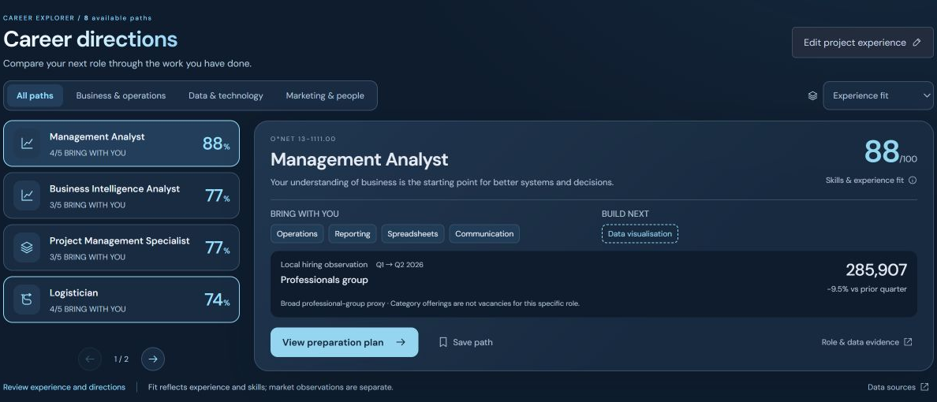
Prototype Demonstration
Alex’s next step: Management Analyst
01
Enter project evidence
02
Compare fit and gaps
03
Build a weekly plan
04
Confirm a new skill
Skill confirmation recalculates fit. Trend sorting uses separate market evidence.
RePath AI
06 / 08
Notes:
第 6 页｜建议 90 秒
【0–15 秒：经历输入】切换到运行中的英文 Demo。选择 See an example，说明这是虚构人物。进入 Try with my experience，点击 Use a sample，展示项目内容、行动与交付物。
【15–35 秒：方向与缺口】回到案例并打开 Career paths。展示八个方向，选 Management Analyst，指出可带走的 Operations、Reporting、Spreadsheets、Communication，以及待补的 Data visualisation。点击匹配依据，解释分数是规则参考。
【35–60 秒：行动计划】点击 View preparation plan，先解释任务与练习，再选择每周可投入时间并生成计划。开启免费的 Pro 演示，展示逐周任务、资源和作品要求。说明周期只是包含练习的规划估计。
【60–75 秒：重新计算】在 Skill review 中主动确认 Data visualisation，再回到 Career paths 展示缺口和匹配变化。说明这属于用户自评，完成任务不会自动证明掌握。
【75–90 秒：趋势与边界】将排序从 Experience fit 切换到 Local demand trend，解释市场排序与个人分数独立。真实市场更新后重排的逻辑已经有自动测试，但当前界面没有现场注入新季度数据的功能。不要把切换排序或假设样本称为新发布市场数据。最后打开数据来源页，展示来源、周期和 RSS 状态。
资料与边界
Live demo URL: https://repath-ai-0-2.lianghuihu.chatgpt.site . Hosted access may require ChatGPT sign-in. Local demo: node server.mjs, http://localhost:5173.
Screenshot: actual local RePath 0.2 build, English UI, fictional sample.
Data-change ordering and unchanged personal scores: ../tests/evidence.test.mjs, test “market ordering changes with observed related-category data; personal scores do not”. Mutated data in that test is hypothetical.
Timing includes live interaction. Do not claim a completed course, verified skill or job outcome.

Slide 7
SDG Alignment & Social Impact
4.4
Relevant skills
Focused practice and a role-relevant work sample
8.5
Decent work
Adjacent career options built on existing experience
10.2
Inclusion
Free exploration, three languages and flexible pacing
Role-level SDG 8 and 9 links are prototype interpretations.
Pilot measures: pathway completion, work-sample quality and user-reported clarity
Expected benefits. Employment and equity outcomes still require validation.
RePath AI
07 / 08
Notes:
第 7 页｜建议 50 秒
我们的预期价值可以对应三个 SDG 目标。SDG 4.4 关注就业所需的相关技能，RePath 将学习缩小到具体缺口，并要求形成可以讨论的作品。SDG 8.5 关注充分就业和体面工作，我们希望帮助用户识别能够复用经验的相邻方向。SDG 10.2 关注包容，我们通过免费探索、三种语言和可调整节奏，降低进入工具的门槛。产品中也为部分职业标注 SDG 8 或 9 的关联，这些是我们对职业贡献的解释，不是联合国认证。接下来试用会观察用户能否完成第一项行动、作品质量是否改善，以及用户对方向的清晰度是否提升。我们还没有验证就业率、收入或公平性的实际改善。
资料与边界
UN SDG target 4.4: https://sdgs.un.org/goals/goal4
UN SDG target 8.5: https://sdgs.un.org/goals/goal8
UN SDG target 10.2: https://sdgs.un.org/goals/goal10
Role-level SDG 8/9 annotations: ../dist/model.mjs. All product-to-SDG links are the team’s intended contribution, not UN endorsement.
Pilot measures and benefits are proposed. No user-study, employment or equity outcome data has been supplied.

Slide 8
Feasibility & Future Roadmap
Working now
Next development
Project intake and confirmed skill profiles
8 role comparisons and practical plans
Separate market views and source evidence
Local progress, export and 3 languages
Pilot interviews and work-sample review
Model-assisted intake with human confirmation
Reviewed market-update pipeline
Clearer scenario and SDG explanations
JavaScript modules + static frontend
Node.js local server + browser storage
Cross-market mapping needs local review.
Accounts, payments and outcomes need validation.
Your experience is the starting point.
Explore the RePath 0.2 prototype
RePath AI
08 / 08
Notes:
第 8 页｜建议 40 秒
我们已经实现可以运行的项目输入、八个方向比较、技能缺口、行动计划和三种语言。技术采用模块化 JavaScript 和静态前端，Node.js 提供本地服务器，记录保存在当前浏览器。接下来优先做用户访谈和作品评审，再接入需要用户确认的模型辅助分析，完善市场更新与情景展示。关键挑战是美国职业参考如何适配马来西亚，以及如何证明用户真的学会了技能。我们会保留来源、进行本地审核，并用作品支持验证。Free 和 Pro 目前只是概念方案，没有真实支付或订阅。我们的目标是，让用户带着已有经验开始下一程。谢谢。
资料与边界
Implemented scope: actual local code in ../dist/, ../server.mjs and ../release.json. No source changes made for this presentation.
All roadmap items are proposed without committed dates. No production authentication, payment, cross-device records, LLM API or employment-outcome validation is implemented.
The competition requirements and weights were supplied by the user. This deck is an eight-slide pitch structure, not an independent handbook compliance certification.

