Slide 1
Understanding solar panel adoption using the DeepSolar++ dataset
Alanoud Alhakbani, Luca Montanelli, and Mahmoud Ramadan

Slide 2
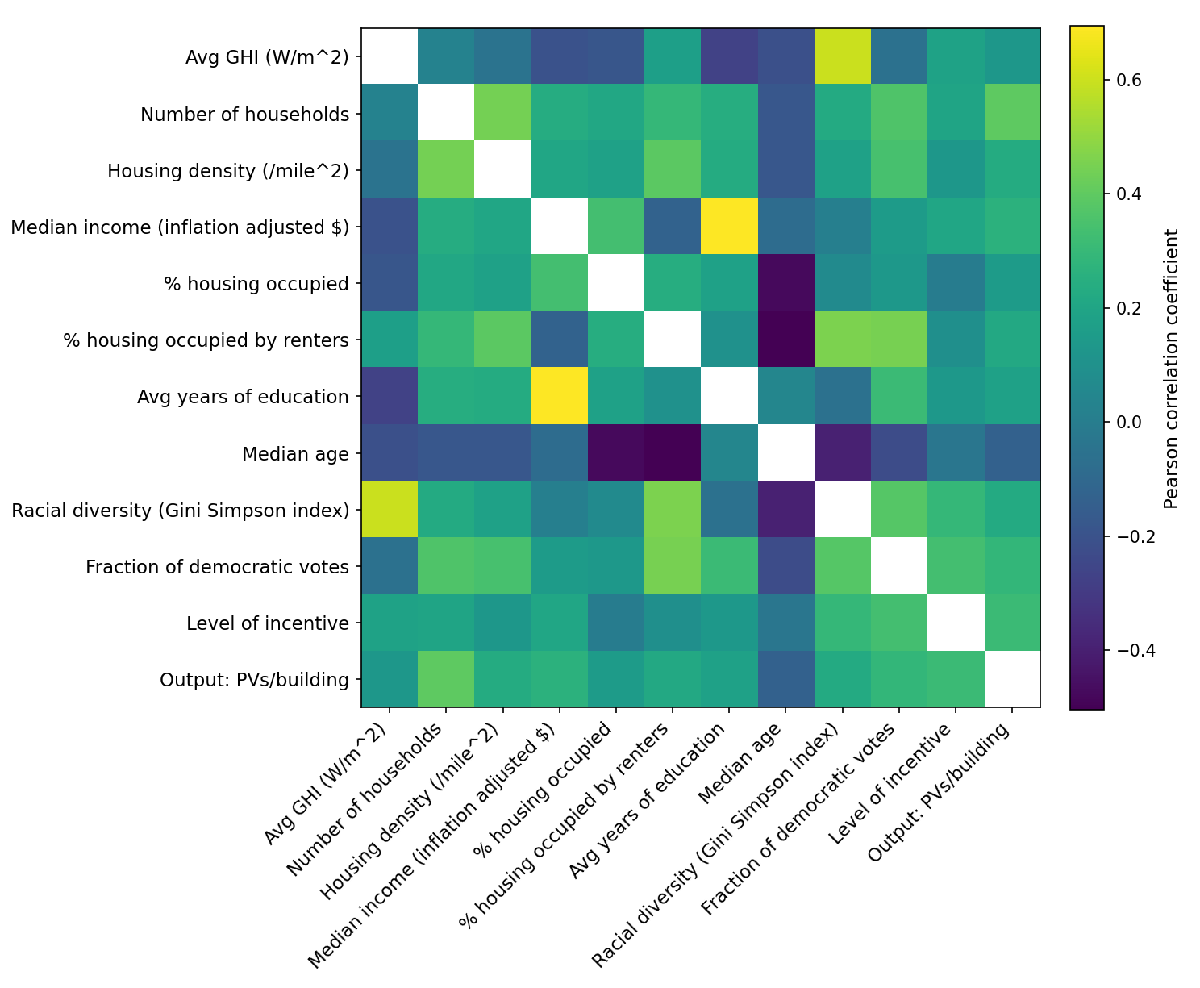
Data exploration
Correlation plot
Clustered time series
Clustered states

Slide 3
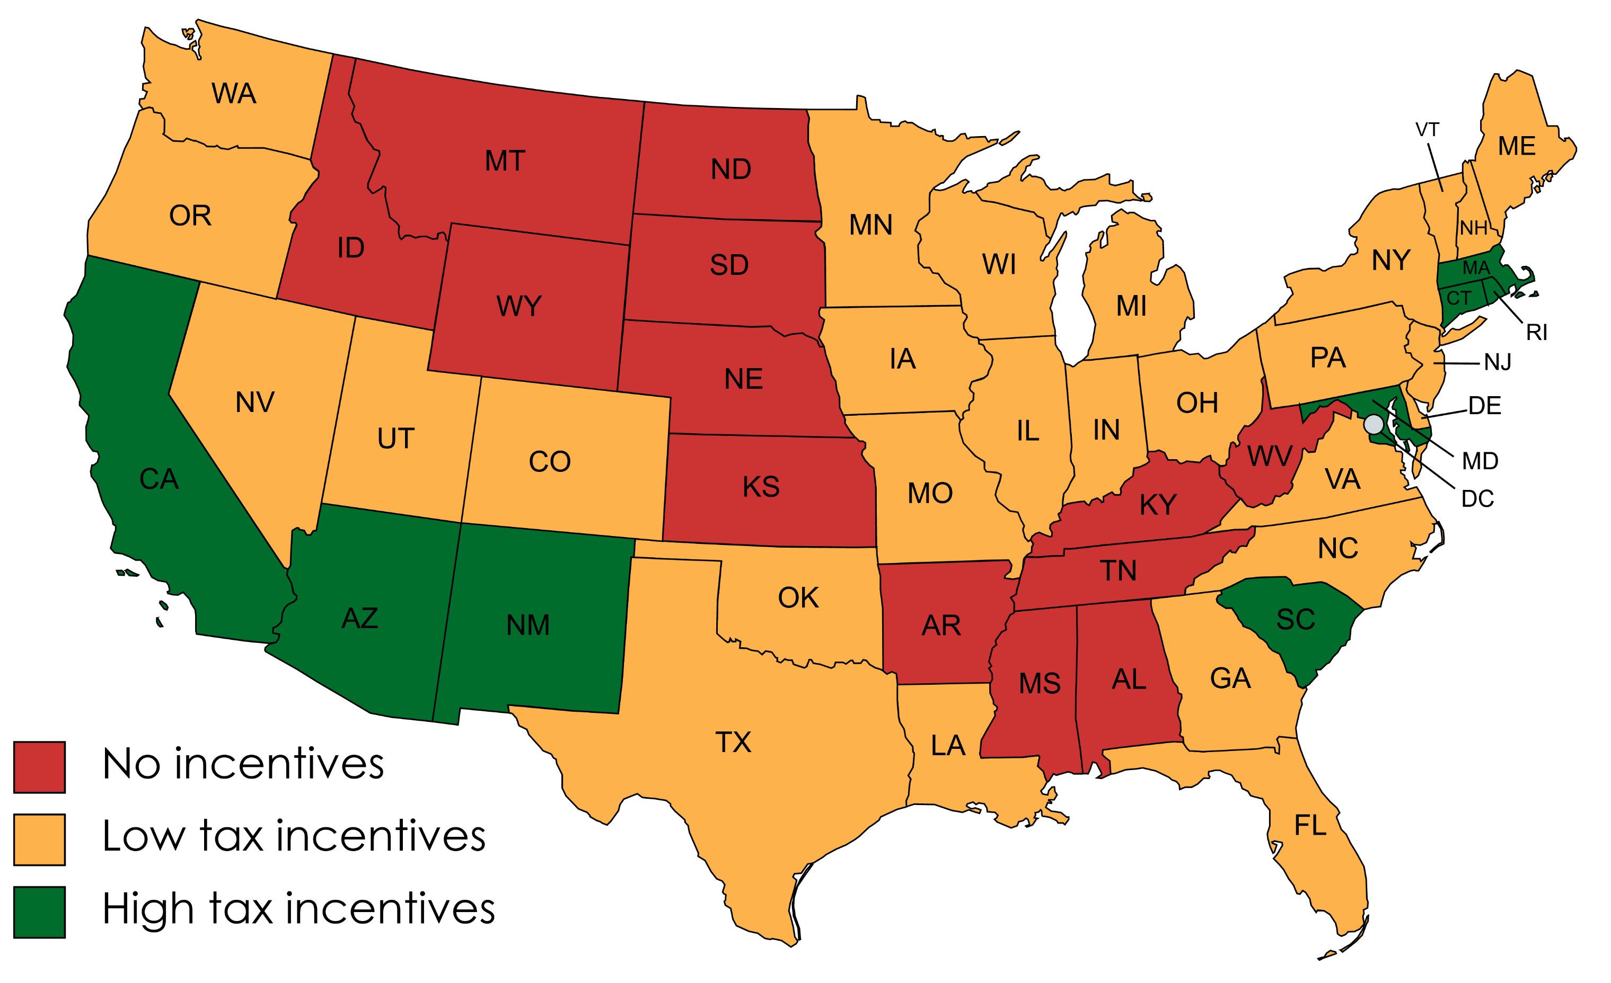
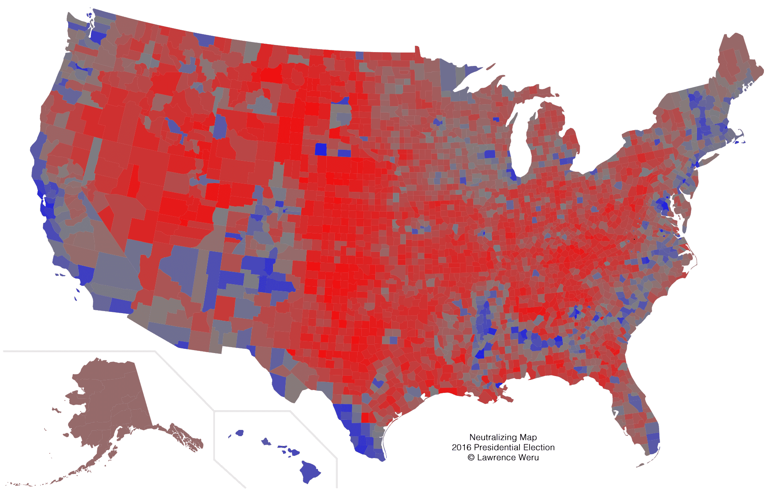
Additional features
Votes map
Incentives map
  With explanation of what those are

Slide 4
Preliminary model scoring
Table with different types of models
Explain that we focused on RF, XGBoost, and NN
 | Lasso | Ridge | RandomForest | GradientBoosting | XGBoost | NN
Without state features | 0.1770 | 0.1796 | 0.3075 | 0.2124 | 0.3566 | 0.2806
With state feature | 0.6550 | 0.6347 | 0.7232 | 0.6932 | 0.7079 | 0.5524
Only y>0 | 0.4963 | 0.4899 | 0.7106 | 0.7532 | 0.8100 | 0.7033

Slide 5
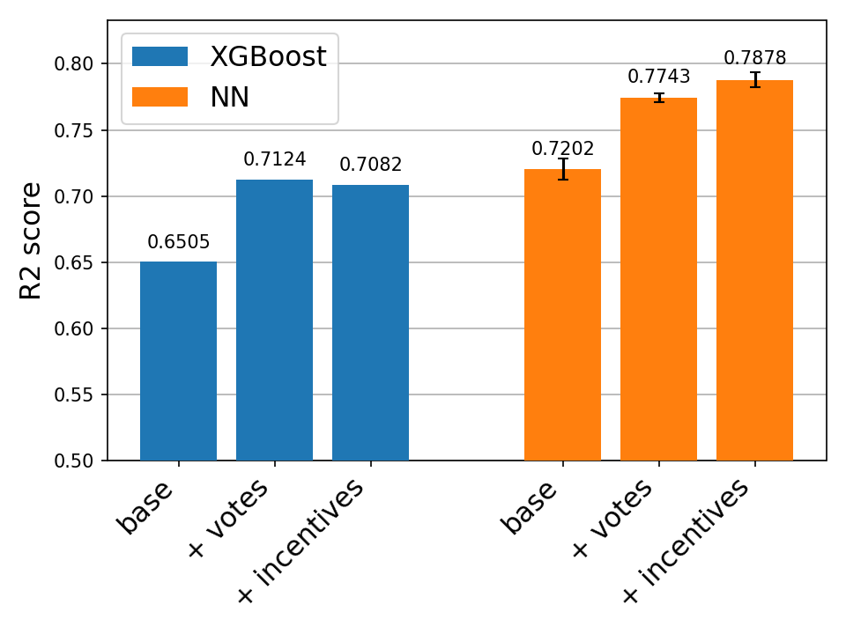
Best models
RF did nothing
XGBoost was good
NN was the best
Show bar plots of results for XGB and NN

Slide 6
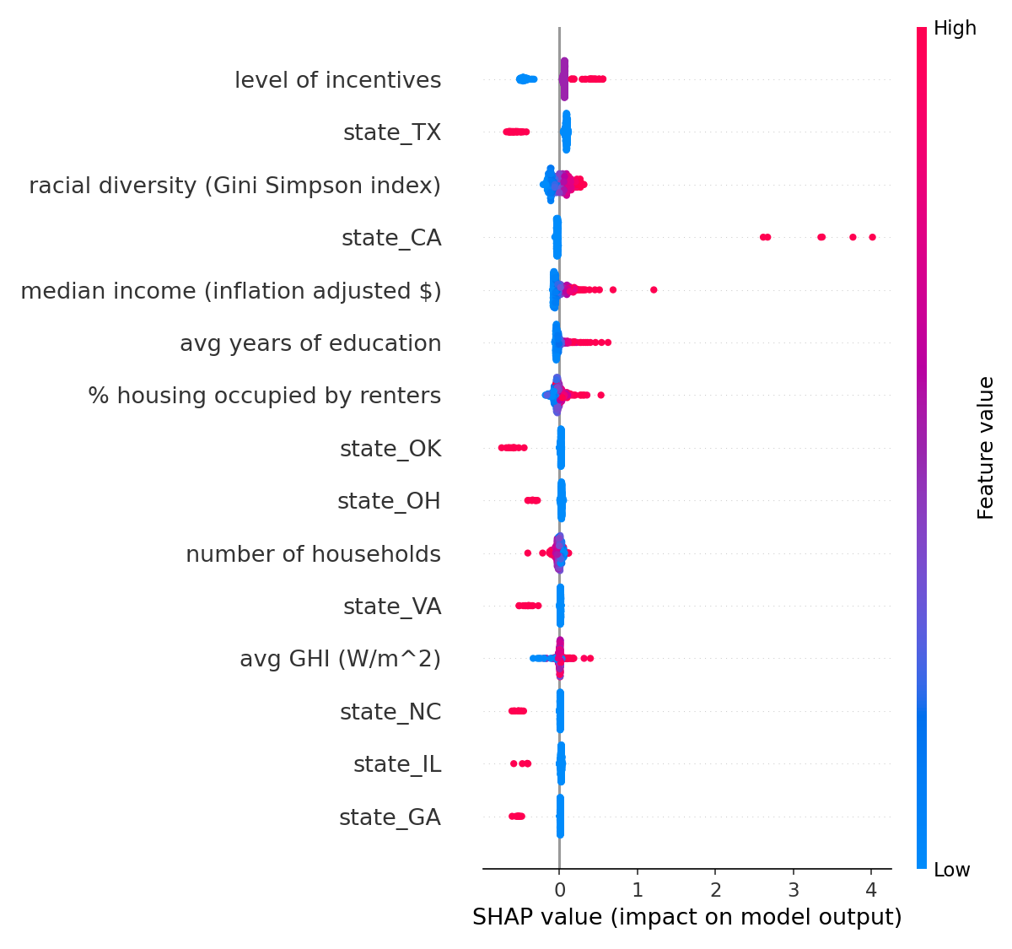
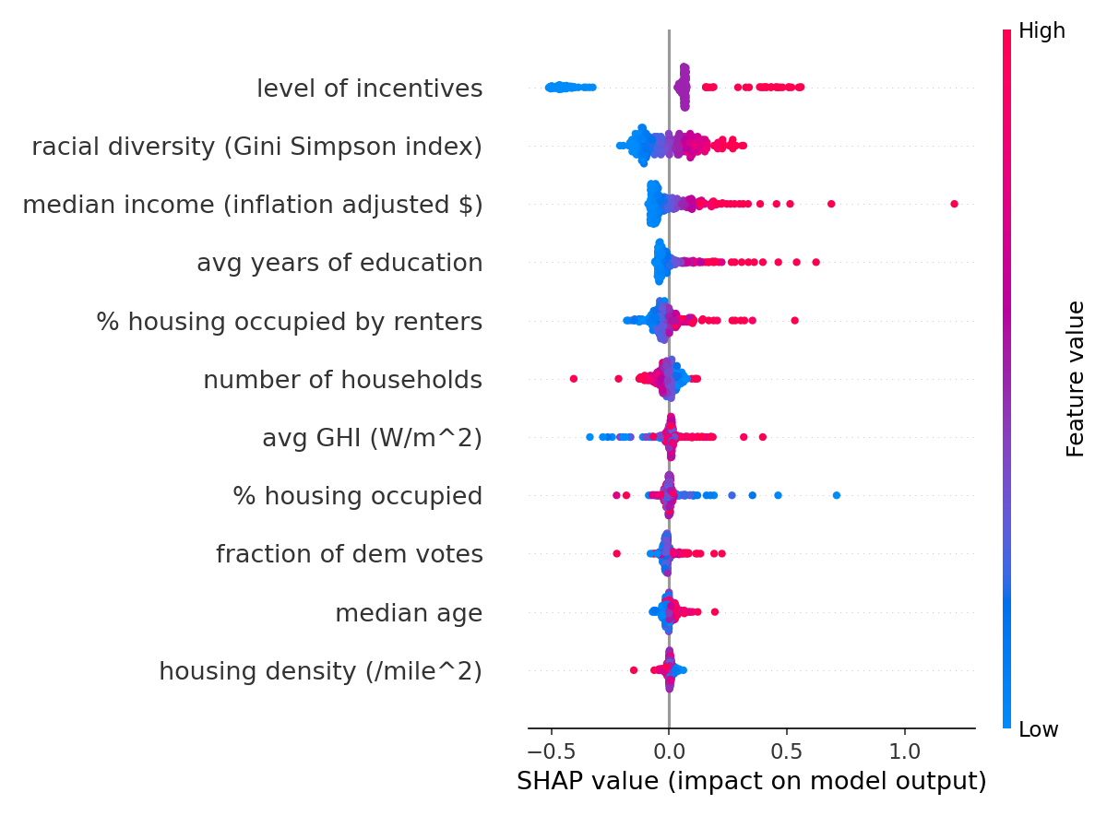
Interpretability
Show SHAP plot for all data

Slide 7
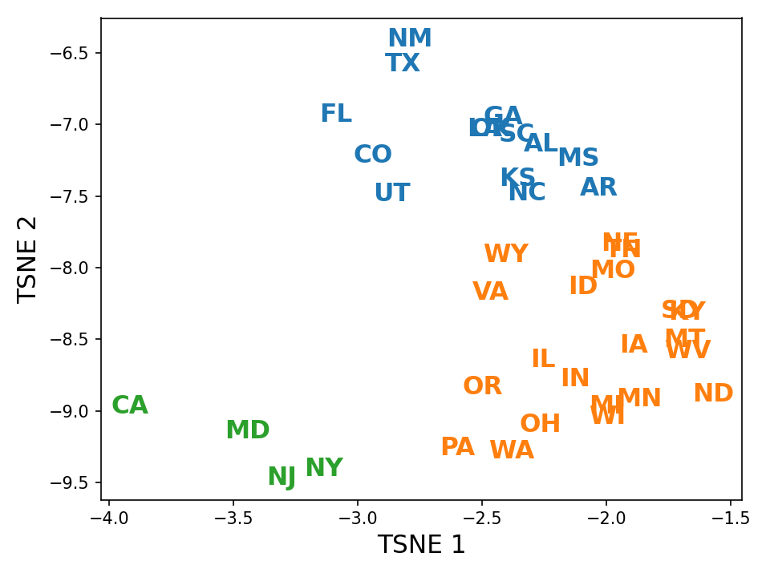
States clustering
Show that the model response varies by clusters of states
Poorer
Less dense
More diverse
Sunnier
Higher incentives
GHI contributes more
Richer
More racially diverse
More democratic
A lot denser
Income and density contribute more
Less diverse
Less sunny
Lower incentives
GHI contributes less

Slide 8
Time series anylsis

Slide 9
Conclusion

