Slide 1


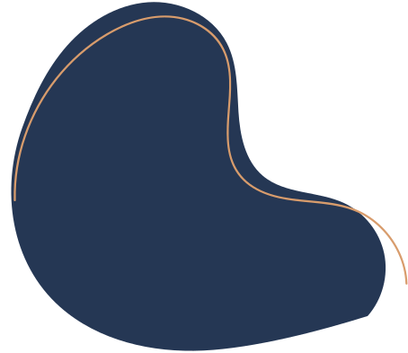

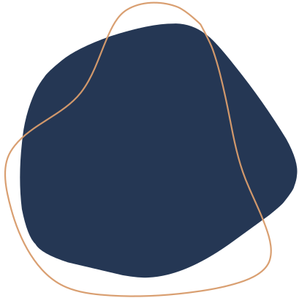
LAB 1
APPLICATION OF CLUSTERING METHODS TO SPORULATION YEAST MICROARRAY DATA
Alberto Montero
Teresa Vega
Notes:
zfADSFGsdgSDG

Slide 2
INDEX
Introduction
Algorithm and description
Result discussion
Conclusion and comparison
Jupyter Notebook

Slide 3

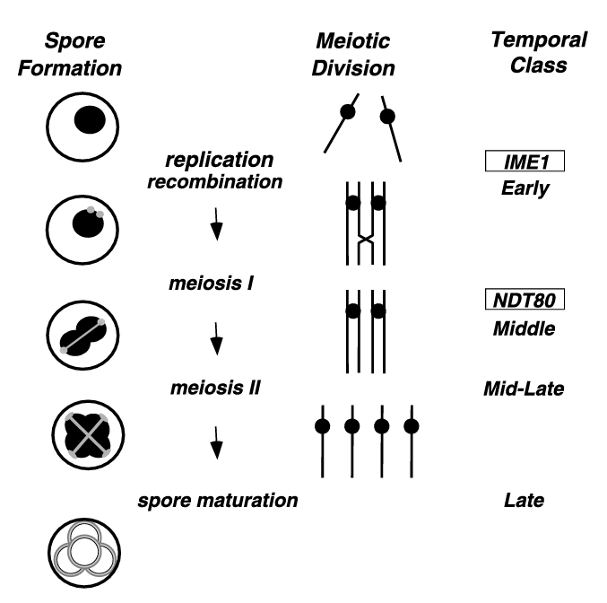

INTRODUCTION
Saccharomyces cerevisiae
Sexual Reproduction
Meiosis 1
Meiosis 2
Genes involved
Early
Middle
Mid-Late
Late
Multiple
ascospores

Slide 4


K-MEANS
01
02
03
PCA
ELBOW
Cluster Validation
PCA is used to reduce the dimensionality of a data set, maintaining as much variability as possible.
Technique that systematically tests a range of values for K and evaluates the fit of the clustering model based on the distortion
Silhouette score calculates the mean Silhouette Coefficient of all samples (mean ratio of intra-cluster and nearest-cluster distance)

Slide 5


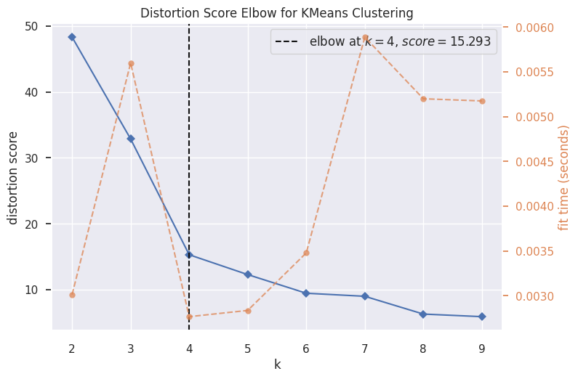
RESULT DISCUSSION
1
In elbow method k=4
2
Silhouette score k=2
3
Scatter plots

Slide 6
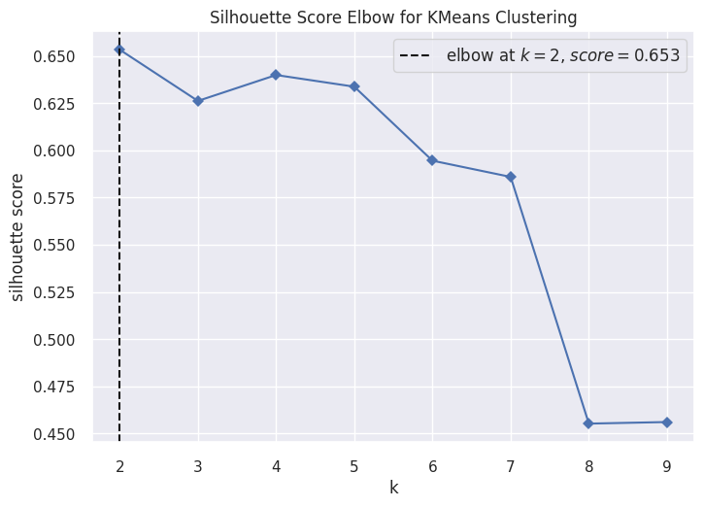
RESULT DISCUSSION
1
In elbow method k=4
2
Silhouette score k=2
3
Scatter plots

Slide 7
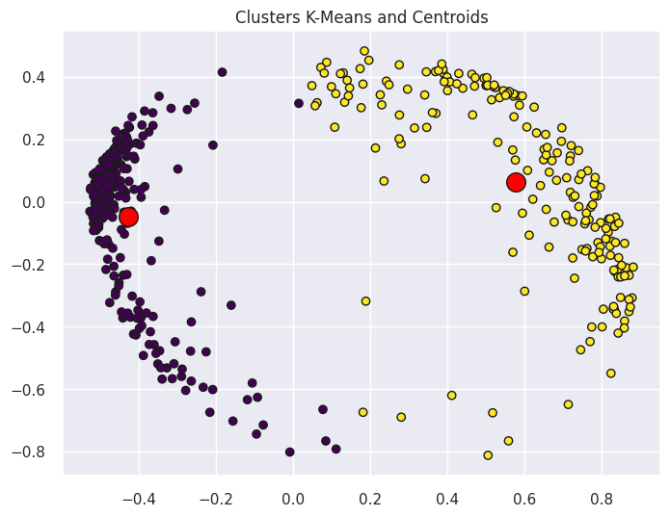
RESULT DISCUSSION
1
In elbow method k=4
2
Silhouette score k=2
3
Scatter plots

Slide 8
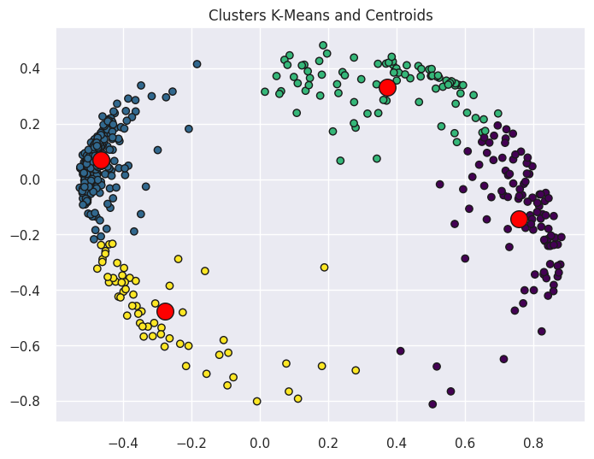
RESULT DISCUSSION
1
In elbow method k=4
2
Silhouette score k=2
3
Scatter plots

Slide 9
https://colab.research.google.com/drive/1Vw3ahfASMKj_WsatTFNA4R0UqJqK6Vpd?usp=sharing
JUPYTER
NOTEBOOK

Slide 10


THANKS FOR LISTENING TO US
teresavegamar@uma.es 13albertomontero@uma.es

