Slide 1

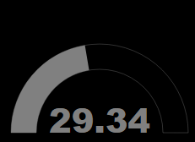
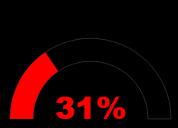
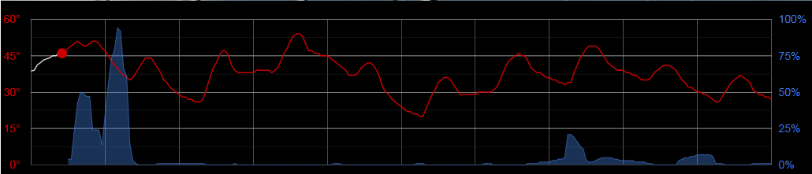
Daily Rainfall
.84
inches
Pressure
31
78° | 52°
O
Wind
12
Humidity
Feels like 84°
SSW
Fri, Nov 17th 11:02am
Wind
12

Slide 2

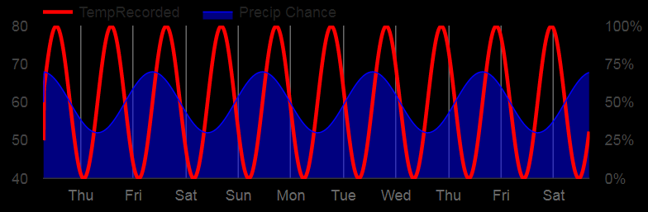
Daily Rainfall
.84
inches
Pressure
78° | 52°
31
O
Wind
12
mph
Feels Like 75
Humidity
Wed, Oct 18th 1:32pm
SSW

Slide 3

Winterset, IA
Daily Rainfall
.84
inches
Pressure
31 78° | 52°
O
Wind
12
mph
Humidity
SSW

Slide 4

Winterset, IA
Daily Rainfall
.84
inches
Pressure
31 78° | 52°
O
Wind
12
mph
Humidity
SSW

Slide 5

Winterset, IA
Daily Rainfall
.84
inches
Pressure
31 78° | 52°
O
Wind
12
mph
Humidity
SSW

Slide 6

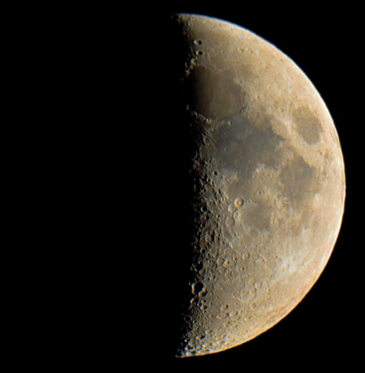
Winterset, IA
Daily Rainfall
.84
inches
Humidity
43%
31 78° | 52°
O
Wind
12
mph
Astronomic
6:23am
First
Quarter
SSW
8:35pm

Slide 7
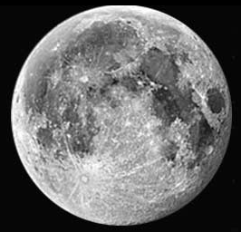
Winterset, IA
Daily Rainfall
.84
inches
Astronomic
31 78° | 52°
O
6:23am
First
Quarter
8:35pm
Wind
12
mph
Humidity
43%
30.5
inches
SSW

Slide 8
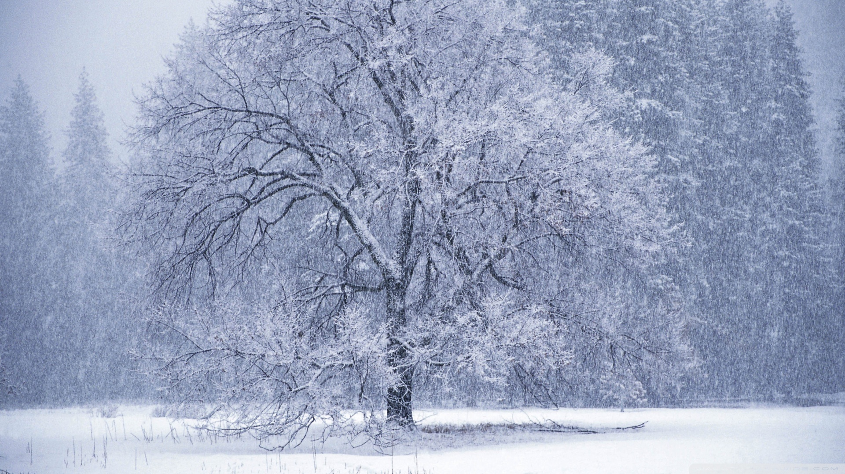
Winterset, IA
Daily Rainfall
.84
inches
Pressure
31 78° | 52°
O
Wind
12
mph
Humidity
SSW

Slide 9

Winterset, IA
Daily Rainfall
.84
inches
Pressure
31 78° | 52°
O
Wind
12
mph
Humidity
SSW

Slide 10
72° 78° | 52°

