Slide 1
Orientation discrimination paradigms

Slide 2
Vogels and Orban (1985) Line orientation discrimination (+ training study)
Identification task (Exp 1)
Increment stimulus was tilted clockwise by an amount (Delta_s) with respect to the standard orientation (s_0). Decrement stimulus was tilted anticlockwise by the same amount.
For a given orientation difference Delta_s between standard and stimulus orientation, the increment and decrement stimuli were presented sequentially in random order. Thus only one line was presented during each trial.
The increment and decrement stimuli were each associated with one of two responses.
Intertrial interval was 5 sec. Each stimulus presentation was preceded by a warning tone.
Auditory feedback (correct or incorrect) was given after each trial.

Slide 3
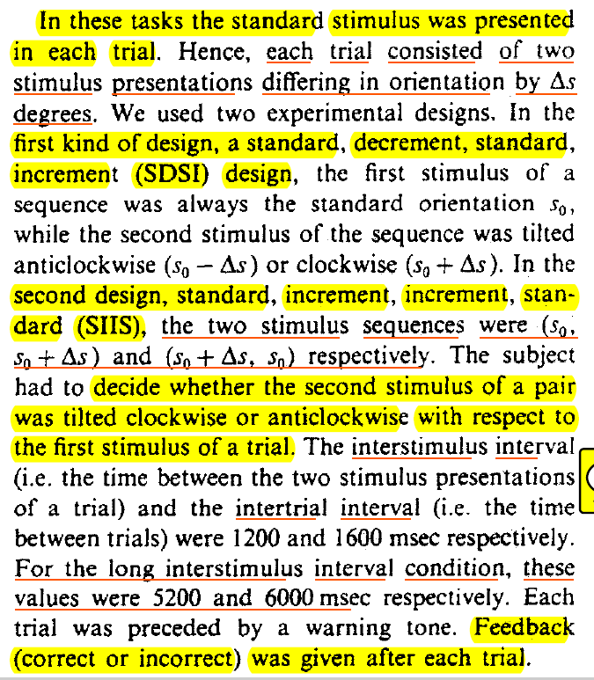
Vogels and Orban (1985) Line orientation discrimination (+ training study)
Temporal 2AFC tasks (Exp 2)
Two experimental designs:
SDSI
SIIS

Slide 4
Vogels and Orban (1985) Line orientation discrimination (+ training study)
General procedure
Four standard orientations: vertical, horizontal, left/right oblique
Informal staircase procedure by subject to determine Delta_s for 75% accuracy
Delta_s was decreased when a subject reached 90% correct

Slide 5
Vogels et al. (1984) Method of constant (or single) stimuli
Abstract:
“Orientation discrimination for single long lines presented in a frameless environment was measured with a method of constant stimuli in 18 normal subjects and in both eyes of 9 amblyopes. Orientation discrimination was tested at four meridians (horizontal, vertical, left, and right oblique). Although the normal subjects showed considerable individual variability in their just noticeable differences in orientation, each subject showed a consistent oblique effect. In amblyopic subjects...”

Slide 6
Vogels et al. (1984) Method of constant (or single) stimuli
Apparatus:
In a black painted box, a red fluorescent bar of 15 deg visual angle length and 0.23 deg width was illuminated with ultraviolet (UV) light (contrast 0.10 (c = log AI/I))
600-msec exposure-time
Within this time, the subject had to make a decision about the bar's orientation and signal it by depressing one of two response keys.
Interstimulus interval was 5 sec.

Slide 7
Vogels et al. (1984) Method of constant (or single) stimuli
Procedure:
All the differential orientation thresholds were determined using a method of constant stimuli procedure in a sequential discrimination paradigm.
Threshold measured in two steps: a training and a test step.
In the training step, two bars with orientations symmetrical with respect to the meridian tested, were presented in random sequence in each block of 20 trials. The orientation difference was decreased in successive blocks by 0.5 deg or 1 deg steps and the smallest difference for which the subject got 90% correct responses was determined (the 90% correct estimate).
The latter orientation difference was split up in four equal intervals. The five corresponding bar orientations were presented in random sequence in four blocks of 80 trials. After probit analysis, the SD was taken as the JND in orientation.
For the normal subjects only the right eye was tested
The meridians tested were horizontal, vertical, left (45 deg) and right (135 deg) oblique.

Slide 8
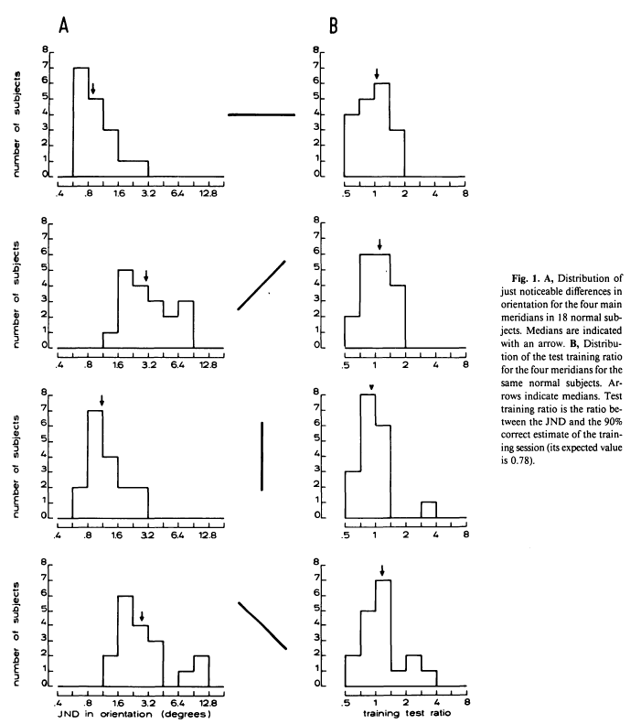
Notice the large individual differences: JNDs differ of over a five-fold range for principal orientations and a eight-fold range for oblique meridians.
This scatter is largely due to genuine individual differences and not to method unreliability
Vogels et al., 1984

Slide 9
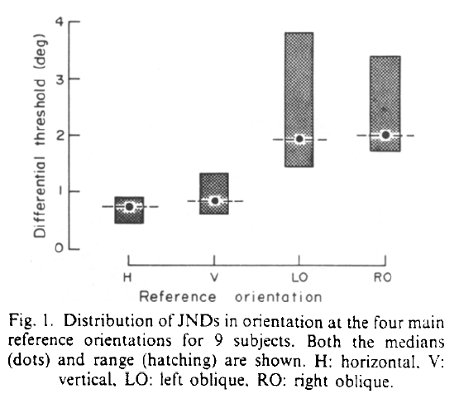
Orban et al (1984, Vis Res) Method of constant stimuli
During the training the subject had to discriminate between 2 orientations, symmetrical with respect to the reference orientation.
The difference between both orientations was gradually decreased until the performance of the subject fell below 90% correct responses.
The subject had to press one key for orientations tilted clockwise from the reference orientation and the other for orientations tilted anticlockwise.
The smallest orientation difference for which the subject reached 90% fixed the interval used in the JND determination.
Five orientations dividing the interval into 4 equal parts were used for determination of the JND.
Each orientation was presented 64 times in random order without feedback and each differential threshold is based on 320 responses

Slide 10
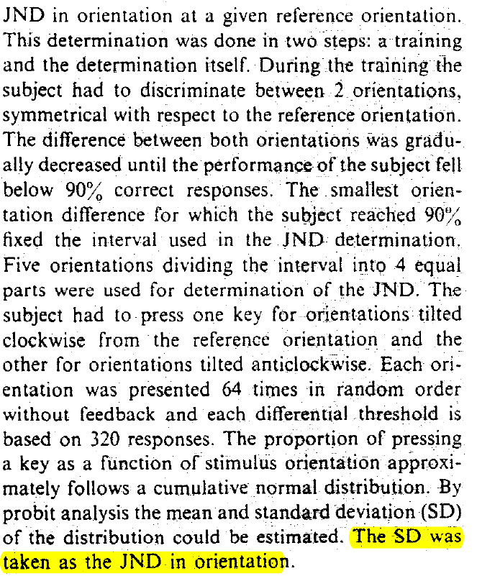
Orban et al (1984, p. 122)

Slide 11
Wilks et al. (2014) Orientation discrimination training study
Stimuli:
Gabor patches, sinusoidal gratings convolved with a Gaussian envelope (standard deviation: 0.62° of visual angle, carrier wavelength: 0.41°) at maximal contrast against a uniform grey background
Procedure:
Experiments comprised a test day (day 1), in which (after a short demo exercise) orientation discrimination sensitivity and the tilt illusion magnitude were measured.
This was followed by three orientation discrimination training days in which each participant was trained on a specific orientation of either 45deg or 135 deg (days 2–4)

Slide 12
Wilks et al. (2014) Orientation discrimination training study
Exp1
A test session for experiment 1 consisted of 20 blocks, each containing 44 trials, and took participants 35–60 minutes
Orientation discrimination sensitivity ... measured using the method of constant stimuli
After fixation dot was presented for 500 ms, a reference grating with a constant orientation of either 135° or 45° was presented for 200 ms.
After ISI=500 ms a test grating rotated by up to +/−30° from the reference appeared for 200 ms.
Participant judged whether the test stimulus was rotated clockwise or anticlockwise in comparison to the constant reference.
11 possible orientation differences between reference and test gratings: −30°, −15°, −7.5°, −3.75°, −1.5°, 0°, 1.5°, 3.75°, 7.5°, 15°, or 30°

Slide 13
Wilks et al. (2014) Orientation discrimination training study
A possible apparent motion artefact?
“The 500 ms interval between the two stimulus presentations (during which only a blank screen with a fixation point was shown) should have been too long for producing an apparent motion percept. While there may be a small possibility that participants perceived a motion signal induced by the second stimulus relative to their memory of the first (reference) stimulus...” (p.5)

Slide 14
Wilks et al. (2014) Orientation discrimination training study
Training session:
A training session consisted of 20 blocks, each containing 40 trials, and took participants 25–50 minutes.
Participants randomly assigned to training around references of 45° or 135°. All training sessions were performed for same reference.
The task was exactly as during the test sessions, except that participants were never presented with an illusion stimulus (i.e. with a surround) and the test stimulus never had the same orientation (0 degree rotation) as the reference.

Slide 15
Wilks et al. (2014) Orientation discrimination training study
Exp 2 – gratings shown simultaneously
The reference and test stimulus were presented side by side to allow direct comparison and feedback was only given during the training sessions.
A test session consisted of 25 blocks, each containing 44 trials, and took participants 40–60 minutes to complete.
Only one stimulus interval. After 500 ms blank period (fixation dot), a reference grating with a constant feature value of either 135° or 45° was presented for 200 ms on either the left or right of a central fixation point at an eccentricity of 4.15°.
A test grating appeared simultaneously and would be rotated up to +/−30° relative to the reference. The side where the test was presented varied randomly
Participants would make a two-alternative forced choice judging which of the two gratings appeared more vertical

Slide 16
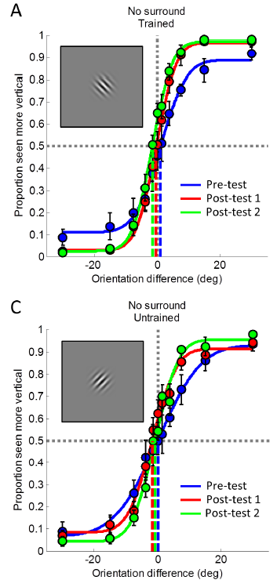
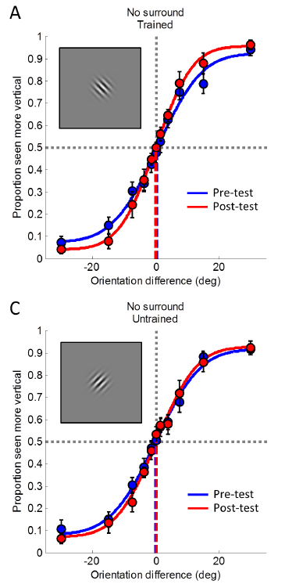
Exp 1
Exp 2

Slide 17
Shiu & Pashler (1992): Matching or identification task
One of the few studies that uses a matching task:
“In the matching task, two lines were presented successively for 45 msec each, separated by a 300-msec blank interval. Observers reported after each trial whether the lines were the same or different in orientation.” (p. 583)
Used only two lines “inclined at either 9.8° or 7° counterclockwise from the vertical axis” (p.583)
Observers maintained fixation at the center of the display
Each line was presented at either the top-left or the bottom-right corner -- location was constant during training and was swapped later to test for transfer

Slide 18
REFs
Orban, G. A., Vandenbussche, E., & Vogels, R. (1984). Human orientation discrimination tested with long stimuli. Vision Research, 24(2), 121–128. https://doi.org/10.1016/0042-6989(84)90097-X
Vogels, R., Orban, G. A., & Vandenbussche, E. (1984). Meridional variations in orientation discrimination in normal and amblyopic vision. Investigative Ophthalmology & Visual Science, 25(6), 720–728.
Vogels, Rufin, & Orban, G. A. (1985). The effect of practice on the oblique effect in line orientation judgments. Vision Research, 25(11), 1679–1687. https://doi.org/10.1016/0042-6989(85)90140-3
Wilks, C. E. H., Rees, G., & Schwarzkopf, D. S. (2014). Dissociable Processes for Orientation Discrimination Learning and Contextual Illusion Magnitude. PLOS ONE, 9(7), e103121. https://doi.org/10.1371/journal.pone.0103121

