Slide 1
Customer Experience Center KPIs
Jun 2022
Project Overview

Slide 2






Cloud Contact Center Solution. ( Context)
Fundamentals of the program
Strategy
AS IS
TO BE
Transform the current Contact Center services into a rich featured and integrated environment by enabling a new single cloud Omnichannel Solution.
Mix of CC technologies, few capabilities
No connected tools, No consistent CX
Complex local reporting and analytics
UK, PH, ES, US and FR have implemented Genesys Cloud
One single Omnichannel platform WW
Customer Journey, Consistent CX
Improved KPIs and performance
Centralized reporting and better analytics
Drivers
Service Improvement
Innovation
Digital Transformation
Obsolescence
Optimization
Omnichannel Experience
Integration with Dynamics CRM
Customer identification
Genesys leads the contact center market
Predictive routing, AI
Better analytics
Digital Transformation through an Omnichannel platform
New Digital channels
Mitigate / remove obsolescence
Software as a service is always updated
Standardization of the CC technology
More features available
Business Benefits
Omnichannel Experiences
Increase agent effectiveness
Easy growth
CRM integration
Customer identification
Integrating with existing softwares
Full visibility of customer interactions
99.997% of Service Availability
Business continuity
OPEX reduction
Standardized Contact Center technology
Reduction of partners
Consolidate billing processes
Home office
PowerBI reports
Better monitoring and advanced analytics
Standard support process
Exciting roadmap

Slide 3
KIPs for CEx Contact Center -Project Description
Objective:
Enable a Data Hub and Trusted Data Set to Calculate the Required KPIs by the Customer Experience Center, based on GENESYS Data for USA.
Scope:
Enable Data Pipelines (Data Ingestion)
Build the Data Model and Trusted Data Sets,
Configure Semantic Layer
Publish in Data Portal for Self Service usage.
Configure Dashboard Templates for the Main KPIs to be shared used and tailored according to final user requirements by themselves.

Slide 4






Data Architecture approach- As Is
Producers
Ingestion
Data Lake
Data Hubs
Semantic Layer
Self-Service
Consumers
Raw Data Store
Internal
Data Analyst…
------------
External
Customers, Suppliers,
etc…
Genesys Cloud
Contact Center
Customer 360 Data
Models
Contact Cert KPIS
Commercial
Customer Experience KPI’s
Customer Interactions Insights
SaaS
Higher TCO
Customer Experience
High Speed Results
Standard Architecture for all Cemex countries that consume Genesys

Slide 5

Data Architecture approach- To Be ( With Python)
Producers
Ingestion
Data Lake
Data Hubs
Semantic Layer
Self-Service
Consumers
Raw Data Store
Process
Internal
Data Analyst…
------------
External
Customers, Suppliers,
etc…
Genesys Cloud
Contact Center
Customer 360 Data
Models
Contact Cert KPIS
Commercial
Customr eExperience KPI’s
Customer Interactions Insights
SaaS
Higher TCO
Python as Computing Process
Customer Experience
High Speed Results
Standard Architecture for all Cemex countries that consume Genesys

Slide 6
Opportunity Areas
One opportunity in this project is that sometimes the load of the information is very slow in the Powr BI environment.
Opportunity Area Solution
The introduction of Python in the processing area is one way that we want to improved in the extraction of the information.
Scope of the solution
The scope for now, is with a data set make some exercises to review the times of the loading data.
Main designers
Hugo Fernando Martinez.

Slide 8
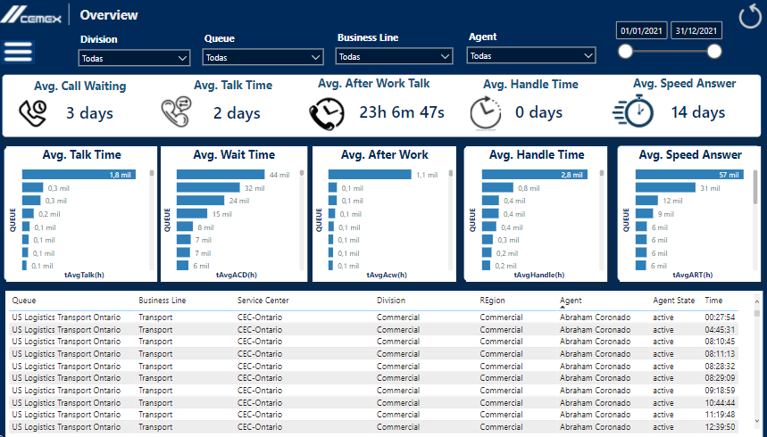
Report Screens

Slide 9
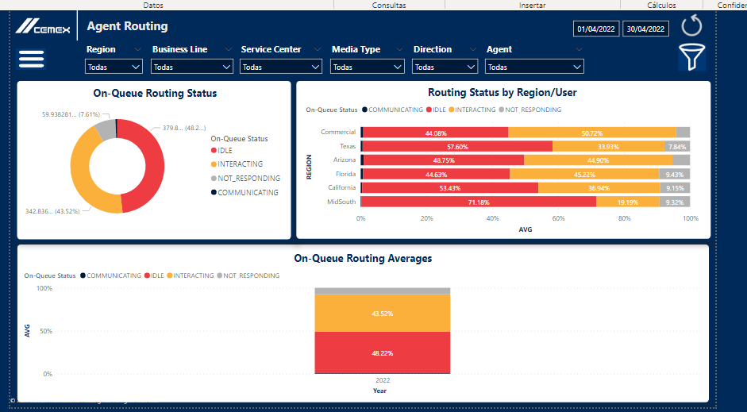
Report Screens

Slide 10
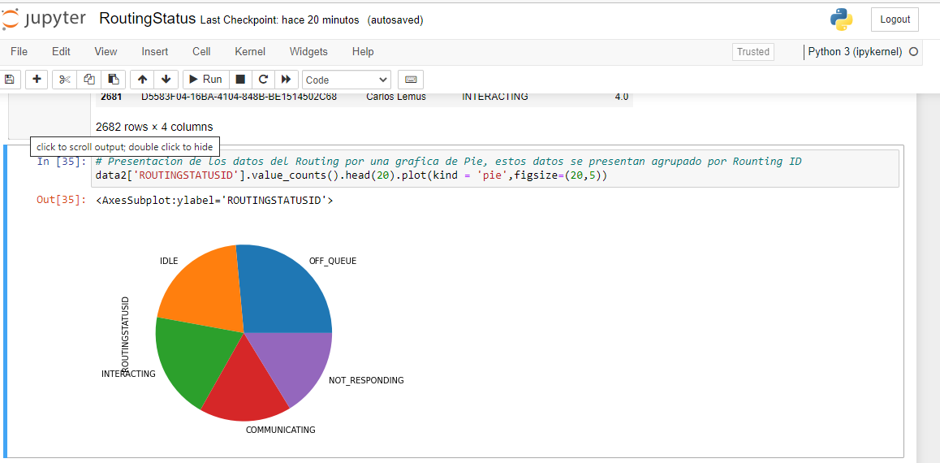
Python grahp like Rounting PBI

Slide 11
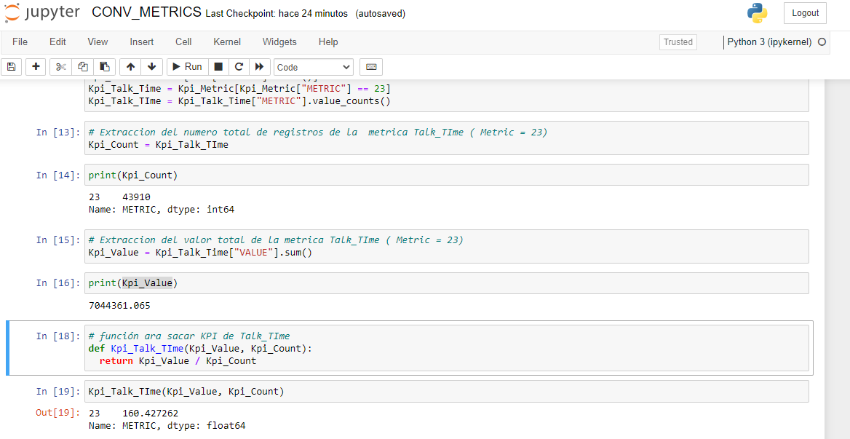
Python KPI – Talk TIme

