Slide 1
Data Scientist Certification
Rodrigo Conrado Cortés Montes de Oca

Slide 2
Project: Recipe Site Traffic
Objectives:
Identify the characteristics of the recipes that will lead a High Traffic.
Predict which recipe will lead to High Traffic in our website.
Predict correctly 80% of the time.

Slide 3
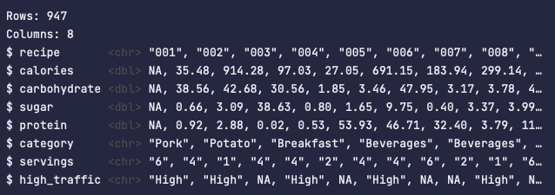
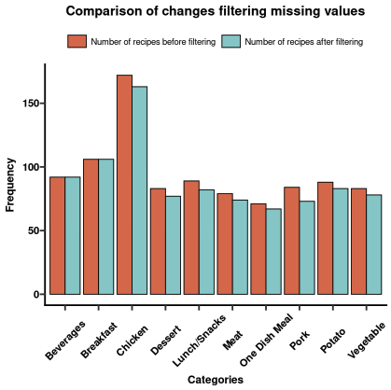
Database provided
947 Recipes
8 Variables
5.5 % of data were excluded for containing mising values

Slide 4
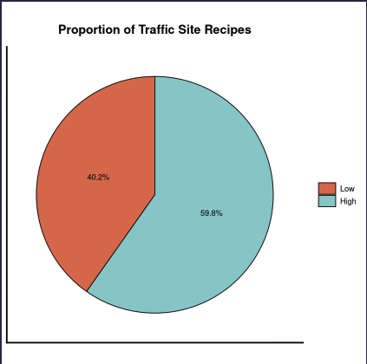
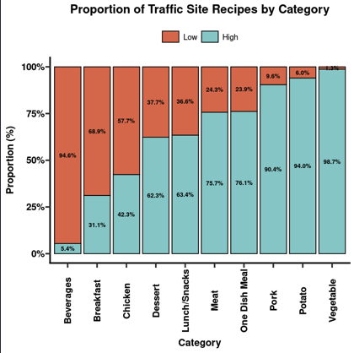
Traffic Site and Category

Slide 5
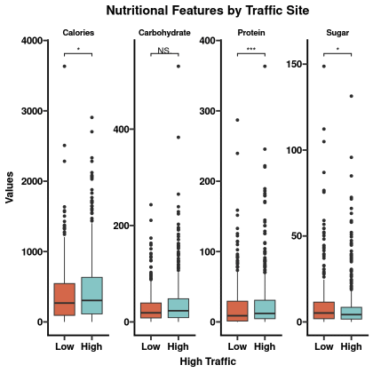
Nutritional Features
The Calories, Protein and Sugar were higher in those recipes with high traffic in the site.
The Carbohydrates were not different between groups.
The Protein were the most significative variable.

Slide 6
Model Development
Create a model that predicts correctly 80% of the time which recipe will have high-traffic in the website.
Logistic Regression
Random Forest
Gradient Boosting

Slide 7
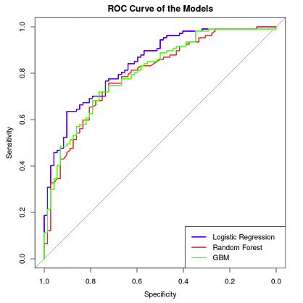
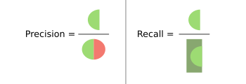

Model Evaluation
Precision: How many retrived high-traffic recipes are correct?
Recall: How many high traffic recipes are correctly retrived?
Logistic Regresion:
Precision: 81.1%
Recall: 76.6%
Random Forest:
Precision: 82%
Recall: 68.2%
Gradient Boosting:
Precision: 81.1%
Recall: 68.2%

Slide 8
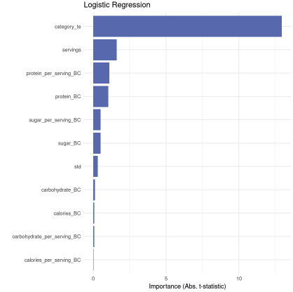
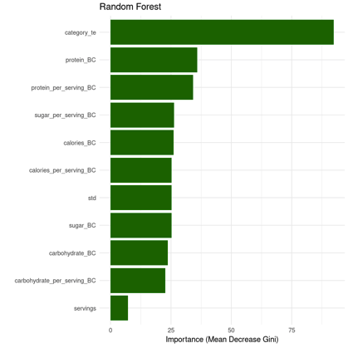
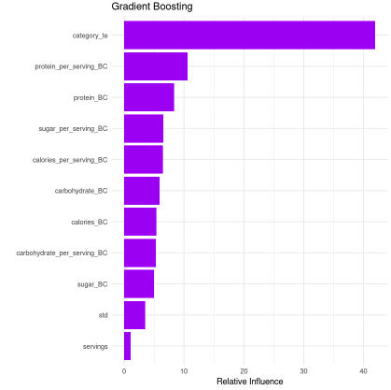
Important Features

Slide 9
Buisness Metric and Recomendations
Keep a high Proteins per Serving to obtain high-traffic recipes
Precision is the most important aspect to control of the model. (> 80%)
Vegetables is a secure high-traffic recipe (99% of the cases)

Slide 10
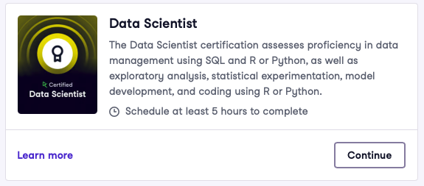
Thanks

