Slide 1
WELCOME TO THE FINAL DEFENSE
Greetings from our adviser, Ma’am Jalipha Ampog and the Whole TVL-ICT students
Date held: May 23, 2023

Slide 2
CLASS SCHEDULING MANAGEMENT SYSTEM CSMS
<p> Presented by: Hosni Benito, Monthafer Barani, Abdulrahim Abdulbasher, Rania H. Azis </p>

Slide 3
ABOUT THE PROJECT
01
<p> The key purpose of this project is to provide and assess students at Mindanao State University – Marawi Senior High School with a system beneficial for managing their time and schedule. </p>

Slide 4
PROJECT CONTEXT
<p> PROBLEMS: </p>
Lack of proper scheduling management in the institution
Schedule conflict
Lack of productivity due to improper scheduling
<p> IMPORTANCE AND BENEFITS: </p>
For Students
For Teachers
For the School Institution

Slide 5
SYSTEM’S OBJECTIVES:
Enhance the current class schedule management process
Facilitate effective communication
Design and implement a user-friendly and efficient desktop application
Improve data accuracy

Slide 6
SCOPE AND LIMITATION
<p> Setting: </p>
- MSU – Marawi Senior High School
<p> Respondents / Participants: </p>
- Selected MSU-MSHS Faculties and Students
<p> System Limitations: </p>
The system will have three users namely; the administrators(admin), the teachers, and the students
Only the administrators have access to add, edit or delete the schedules and events.
The teacher can view schedules & events, view students’ info and message users.
The students can also view schedules & events and message users but can only view teachers’ info.
This project will not cover any factors not in relation with the problem and goal of the project.

Slide 7
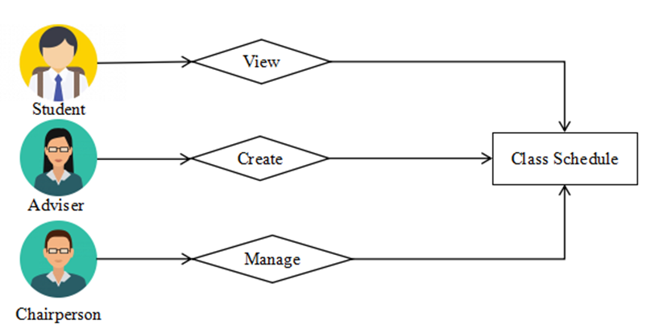
EXISTING WORKFLOW
The figure on the right presents the existing workflow of the class scheduling management in MSU – MSHS.

Slide 8
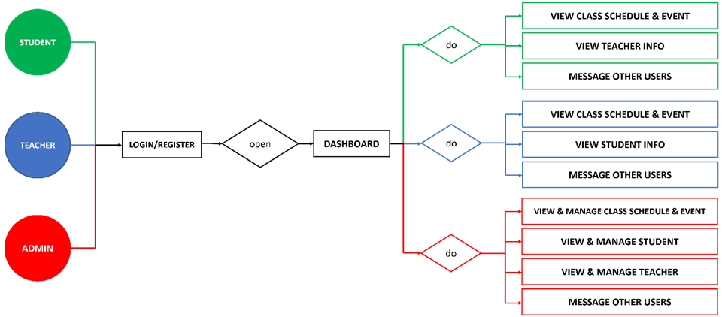
WORKFLOW RESOLUTION

Slide 9
PROJECT TIMELINE
 | Month 1 November | Month 2 December | Month 3 January | Month 4 February | Month 5 March | Month 6 April | Month 7 May
Requirement Planning
Requirement Analysis
Prototyping
Coding
Designing
Testing
Implementation

Slide 10
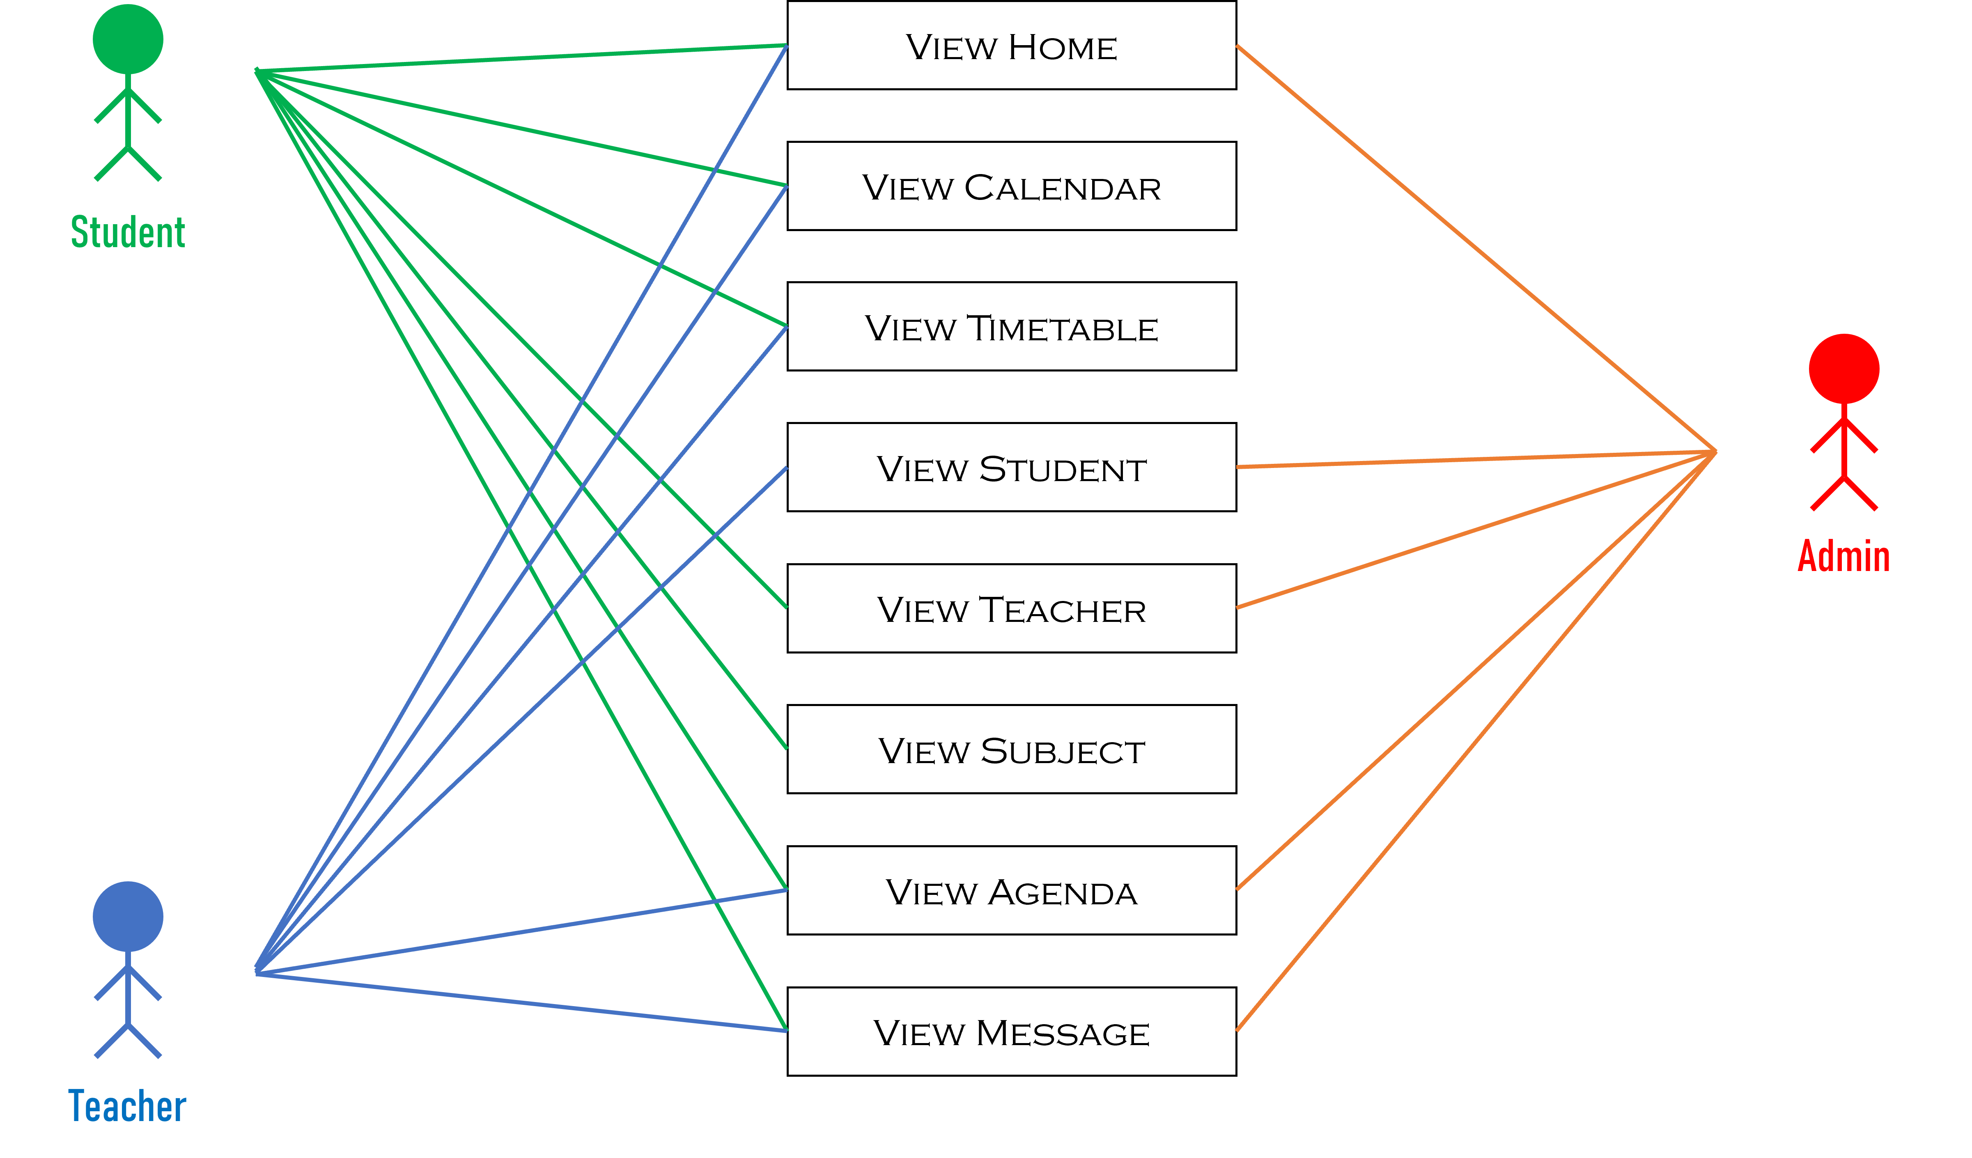
CASE DIAGRAM

Slide 11
CONCLUSION
RECOMMENDATION
The result is a Class Scheduling Management System that is purpose-built to support the specific roles and activities of stakeholders and end-users.
Embrace automation
Regularly update and maintain data
Optimize resource allocation
Seek user feedback and continuous improvement
Provide training and support
Make a Web-Based Application

Slide 12
REFERENCES:
◦ http://www.ibe.unesco.org/en/glossary-curriculum-terminology/s/school-timetable
◦ https://goschooler.com/benefits-of-school-timetable-management-systems
◦ https://ezyschooling.com/parenting/expert/importance-of-a-timetable-in-student-life
◦ https://www.wrike.com/blog/dont-let-schedule-conflicts-ruin-your-plans/?fbclid=IwAR32BrxeC9te2eHisHHzZT4a5jmBjZVSVF7L75uqG9gtn10Yg7chBb7bJUQ
◦https://scholarworks.umt.edu/cgi/viewcontent.cgi?article=9366&context=etd
◦ https://ww1.odu.edu/content/dam/odu/col-dept/cdse/docs/2-classroom-schedules.pdf

Slide 13
THANK YOU!
NOW PROCEEDING TO THE SYSTEM DEMONSRATION →

Slide 14
CLASS SCHEDULING MANAGEMENT SYSTEM CSMS
Do you have any questions?
<p> Presented by: Hosni Benito, Monthafer Barani, Abdulrahim Abdulbasher, Rania H. Azis </p>

