Slide 1
Refactor (Idea)
Additional slide of Refactor
zhuym

Slide 2
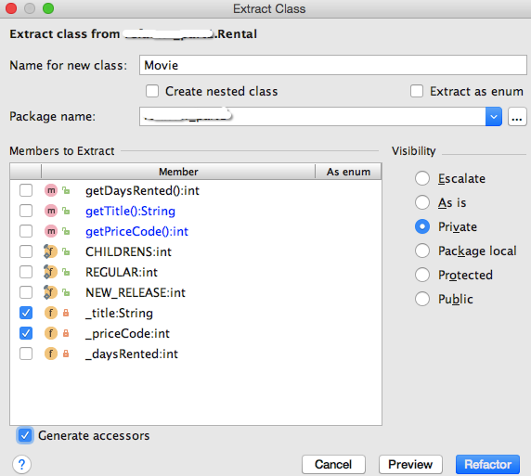
Extract Class
Right click class
-> refactor
-> Extract
-> Delegate

Slide 3
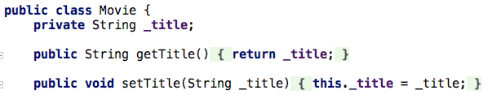
Rename of method
Right click method
-> refactor
-> rename

Slide 4
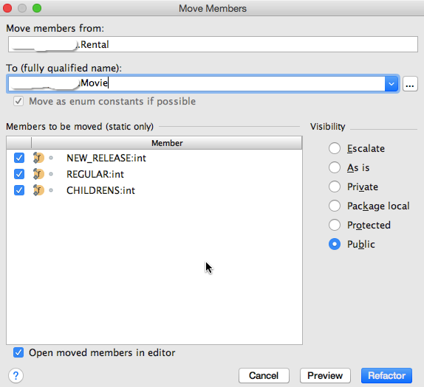
Move field
Right click field
-> refactor
-> Move

Slide 5
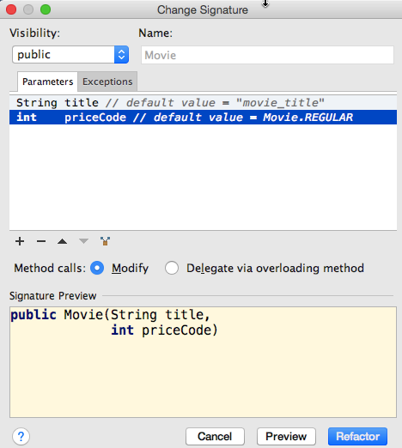
Change Method Signature
Right click constructor of Movie
-> refactor
-> Change Signature

Slide 6
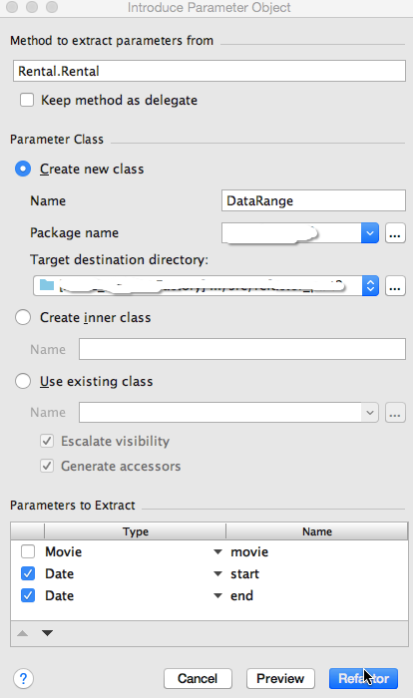
Introduce Parameter Object
DateRange
Right click constructor of Rental
-> refactor
->Extract
-> Parameter object

Slide 7
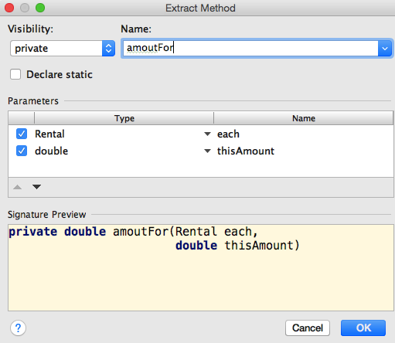
Extract Method
amountFor
Right click selected code
-> refactor
-> Extract
-> Method

Slide 8
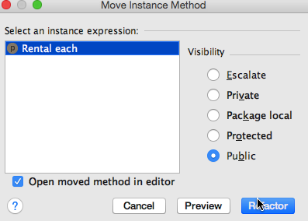
Move Method
Right click method name
-> refactor
-> Move

Slide 9
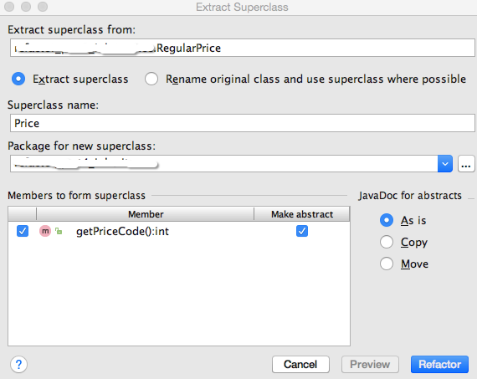
Extract Superclass
Right click one of three classes
-> refactor
-> Extract
-> Superclass

Slide 10
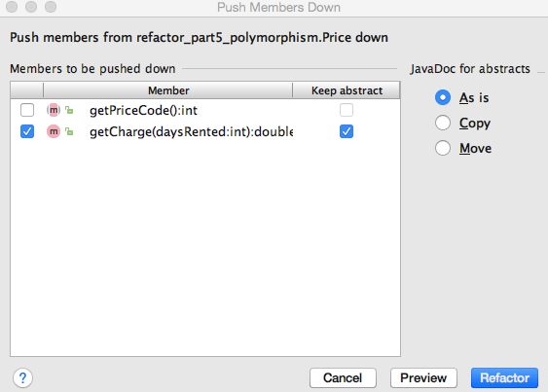
Push down methods
Right click Price
-> refactor
->Push Members Down

Slide 11
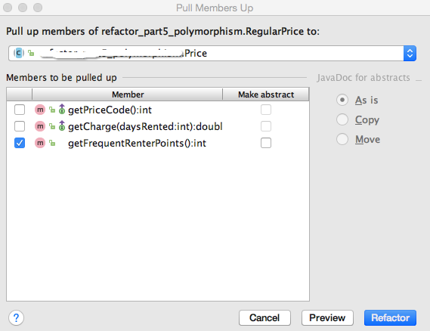
Pull up methods
Right click sub class of Price
-> refactor
->Pull Members Up

Slide 12
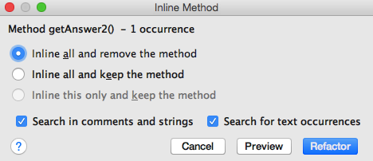
Inline method
Right click getAnswer1()
-> refactor
-> Inline…

