Slide 1
The Raft Consensus Algorithm
Diego Ongaro John Ousterhout
Stanford University
http://raftconsensus.github.io

Slide 2
What is Consensus?
Agreement on shared state (single system image)
Recovers from server failures autonomously
Minority of servers fail: no problem
Majority fail: lose availability, retain consistency
Key to building consistent storage systems
Servers

Slide 3
Inside a Consistent System
TODO: eliminate single point of failure
An ad hoc algorithm
“This case is rare and typically occurs as a result of a network partition with replication lag.”
– OR –
A consensus algorithm (built-in or library)
Paxos, Raft, …
A consensus service
ZooKeeper, etcd, consul, …

Slide 4

Replicated State Machines
Clients
z←6
Consensus Module
State Machine
Consensus Module
State Machine
Consensus Module
State Machine
x | 1
y | 2
z | 6
x | 1
y | 2
z | 6
x | 1
y | 2
z | 6
Servers
Log
Log
Log
x←3
y←2
x←1
z←6
x←3
y←2
x←1
z←6
x←3
y←2
x←1
z←6
Replicated log ⇒ replicated state machine
All servers execute same commands in same order
Consensus module ensures proper log replication
System makes progress as long as any majority of servers are up
Failure model: fail-stop (not Byzantine), delayed/lost messages

Slide 5
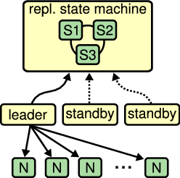
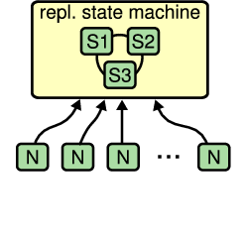
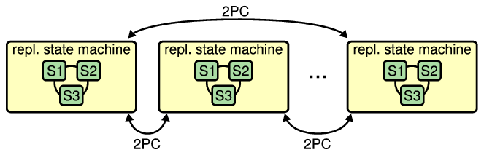
How Is Consensus Used?
Top-level system configuration
Replicate entire database state

Slide 6
Paxos Protocol
Leslie Lamport, 1989
Nearly synonymous with consensus
“The dirty little secret of the NSDI community is that at most five people really, truly understand every part of Paxos ;-).” – NSDI reviewer
“There are significant gaps between the description of the Paxos algorithm and the needs of a real-world system…the final system will be based on an unproven protocol.” – Chubby authors

Slide 7
Raft’s Design for Understandability
We wanted the best algorithm for building real systems
Must be correct, complete, and perform well
Must also be understandable
“What would be easier to understand or explain?”
Fundamentally different decomposition than Paxos
Less complexity in state space
Less mechanism

Slide 8
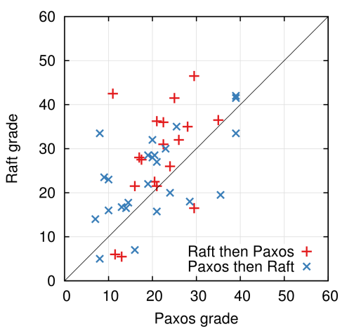
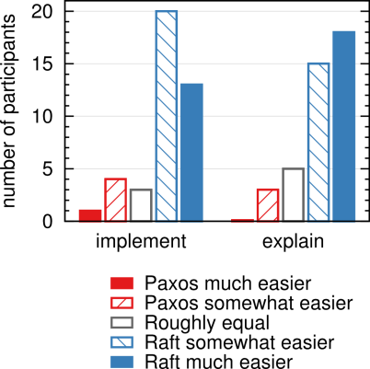
Raft User Study
Quiz Grades
Survey Results

Slide 9
Raft Overview
Leader election
Select one of the servers to act as cluster leader
Detect crashes, choose new leader
Log replication (normal operation)
Leader takes commands from clients, appends them to its log
Leader replicates its log to other servers (overwriting inconsistencies)
Safety
Only a server with an up-to-date log can become leader

Slide 10
RaftScope Visualization

Slide 11
Core Raft Review
Leader election
Heartbeats and timeouts to detect crashes
Randomized timeouts to avoid split votes
Majority voting to guarantee at most one leader per term
Log replication (normal operation)
Leader takes commands from clients, appends them to its log
Leader replicates its log to other servers (overwriting inconsistencies)
Built-in consistency check simplifies how logs may differ
Safety
Only elect leaders with all committed entries in their logs
New leader defers committing entries from prior terms

Slide 12
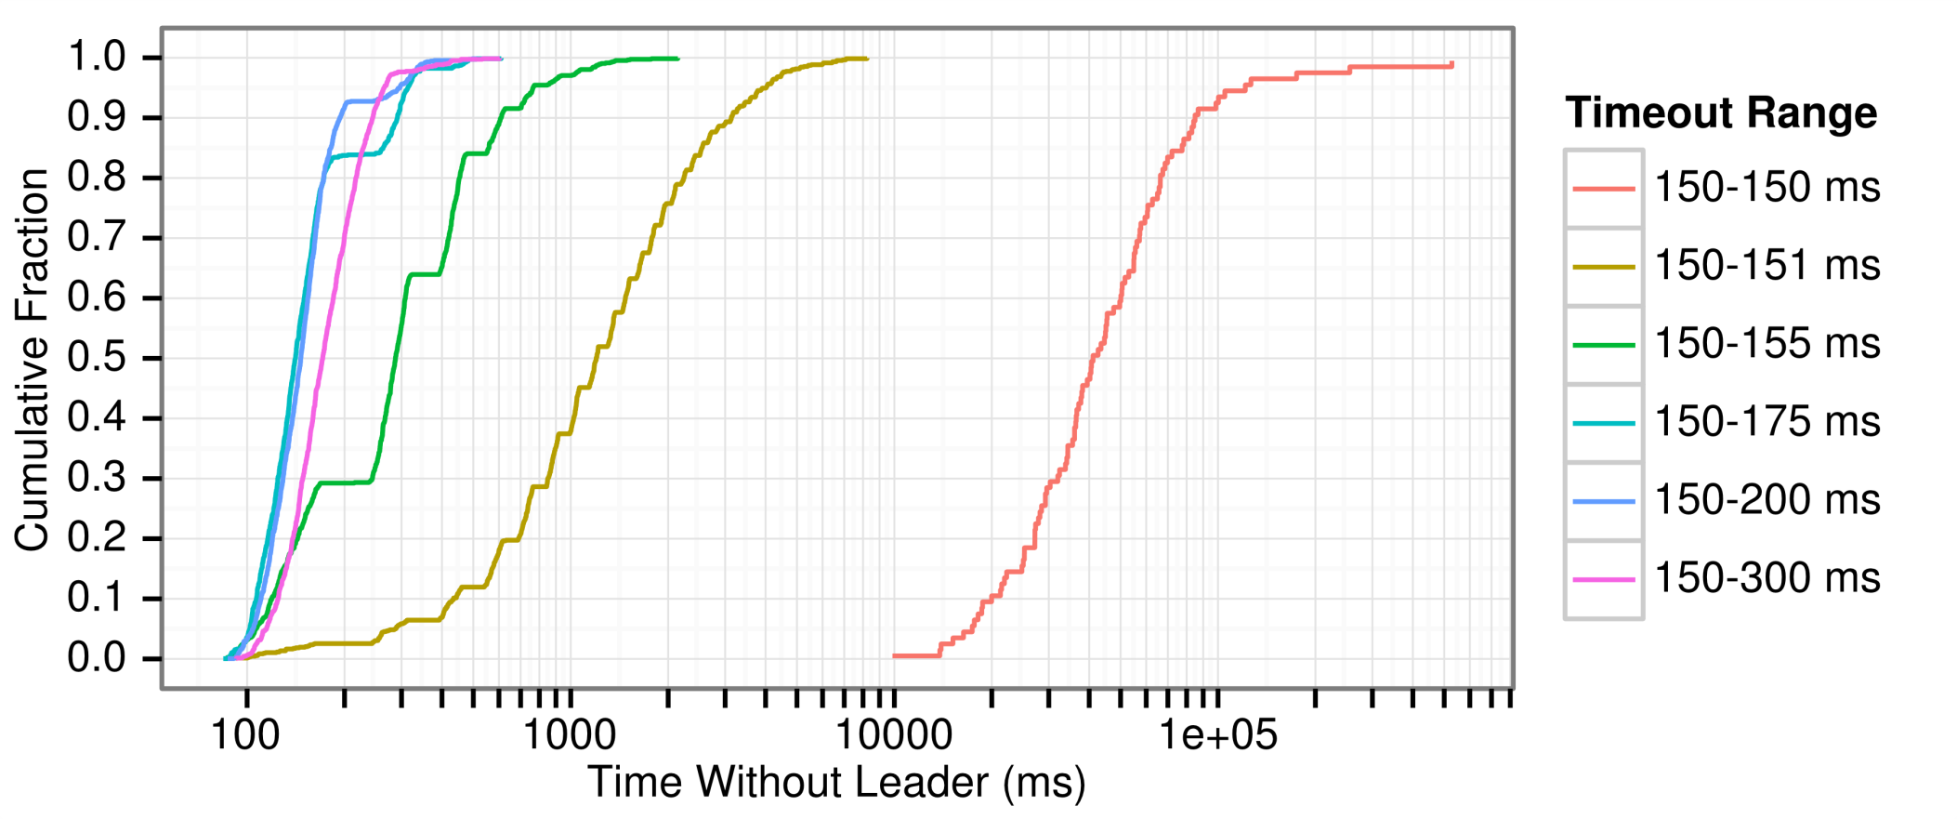
Randomized Timeouts
How much randomization is needed to avoid split votes?
Conservatively, use random range ~10x network latency

Slide 13
Raft Implementations (Stale)
go-raft | Go | Ben Johnson (Sky) and Xiang Li (CoreOS)
kanaka/raft.js | JS | Joel Martin
hashicorp/raft | Go | Armon Dadgar (HashiCorp)
rafter | Erlang | Andrew Stone (Basho)
ckite | Scala | Pablo Medina
kontiki | Haskell | Nicolas Trangez
LogCabin | C++ | Diego Ongaro (Stanford)
akka-raft | Scala | Konrad Malawski
floss | Ruby | Alexander Flatten
CRaft | C | Willem-Hendrik Thiart
barge | Java | Dave Rusek
harryw/raft | Ruby | Harry Wilkinson
py-raft | Python | Toby Burress
…

Slide 14
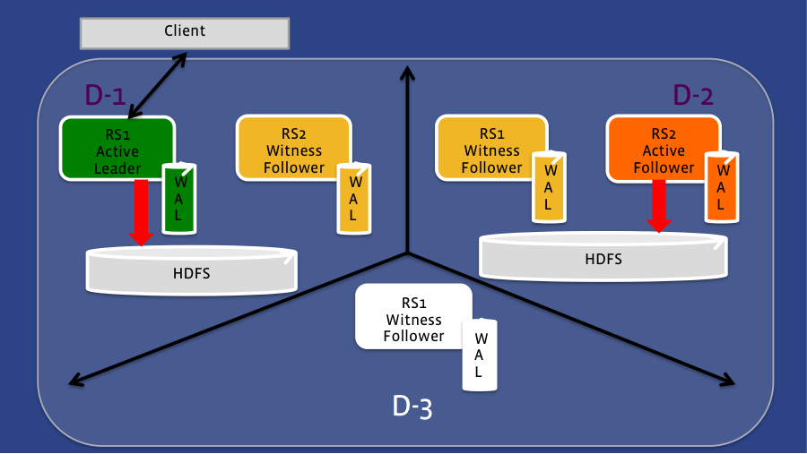
Facebook HydraBase Example
https://code.facebook.com/posts/321111638043166/hydrabase-the-evolution-of-hbase-facebook/

Slide 15
Conclusions
Consensus widely regarded as difficult
Raft designed for understandability
Easier to teach in classrooms
Better foundation for building practical systems
Paper/thesis covers much more
Cluster membership changes (simpler in thesis)
Log compaction (expanded tech report/thesis)
Client interaction (expanded tech report/thesis)
Evaluation (thesis)

Slide 16
Questions
raftconsensus.github.io

