Slide 1

AICTE-ALIGNED VIRTUAL INTERNSHIP PRESENTATION
AI-Based Application
Development
IILM UNIVERSITY
Greater Noida, U.P.
School of Computer Science
& Engineering
Internship Report Presentation — Multilingual Translation Tool
and CampusConnect FAQ Chatbot
Internship Organization: Code Alpha | Role: Artificial Intelligence Intern
Duration: 20 July 2026 – 20 August 2026 (4 Weeks)
MONTY YADAV
Student ID: CA/DF1/240153
Roll No: 25SCS1003004707
B.Tech CSE | Section 2CSE15 | Sem 3
Batch 2025-29

Slide 2
Candidate & Program Overview
🎓
Candidate Details
💼
Internship Profile
STUDENT NAME
ORGANIZATION
Monty Yadav
Code Alpha
ROLL NUMBER
ROLE
25SCS1003004707
Artificial Intelligence (AI) Intern
DEGREE
PROGRAM TYPE
B.Tech, Computer Science & Engineering
Virtual Internship Program
SECTION / SEMESTER
DURATION
2CSE15 / 3rd
20 Jul 2026 – 20 Aug 2026 (4 Weeks)
ACADEMIC BATCH
STUDENT ID
2025-29
CA/DF1/240153
UNIVERSITY
PROJECTS DELIVERED
IILM University, Greater Noida, U.P.
2 (Translation Tool + FAQ Chatbot)
AI-Based Application Development | Monty Yadav
2

Slide 3
Organization Profile: Code Alpha
Code Alpha is a technology-focused organization offering virtual internship programs in Artificial Intelligence, Web Development, Android Development, Data Science, and Cybersecurity — built around practical, project-based learning.
🧩
🌐
🧑‍🏫
📁
Practical Learning Model
Multi-Domain Programs
Mentor-Guided Execution
Portfolio-Oriented Outcomes
Provides hands-on, project-based experiences rather than purely theoretical modules.
Runs internships spanning AI, Web Dev, Android, Data Science and Cybersecurity.
Interns build real applications under the guidance of experienced mentors.
Focused on helping students build a strong, showcase-ready technical portfolio.
AI-Based Application Development | Monty Yadav
3

Slide 4
Problem Statement & Project Scope
⚠️ The Challenge
🎯 The Solution Scope
Language barriers make quick, reliable translation difficult without relying on heavy, paid software.
Institutions receive a large volume of repetitive student queries on admissions, courses and facilities, consuming significant staff time.
Two standalone AI-based web applications for demonstration and academic purposes.
Translation Tool covers text-based translation across multiple commonly used languages.
FAQ Chatbot answers a predefined set of campus questions using similarity matching, not full conversational AI.
Both apps run locally or deploy on Streamlit Cloud, extendable with more languages / larger FAQ data / advanced NLP models.
AI-Based Application Development | Monty Yadav
4

Slide 5
Core Project Objectives
🌐
💬
🗂️
🖥️
🔗
Multilingual Translation
Campus FAQ Chatbot
Supporting Features
Interactive UI
Version Control
Design a tool capable of translating text between multiple languages in real time.
Build a chatbot that understands and answers student queries using FAQ & similarity matching.
Implement chat history, clear-chat option, and graceful handling of unknown questions.
Design simple, user-friendly interfaces for both applications using Streamlit.
Organize, document, and host both completed projects on GitHub for public access.
AI-Based Application Development | Monty Yadav
5

Slide 6
Technologies & Tools Used
🐍
🚀
🌍
🔍
🐙
Python
Streamlit
deep-translator
difflib
GitHub
Core programming language used for all application logic.
Framework used to build and deploy interactive web-based UIs.
Python library used to perform multilingual text translation.
Standard library module used for similar-question matching in the chatbot.
Used for version control, project organization, and source hosting.
AI-Based Application Development | Monty Yadav
6

Slide 7
System Architecture
Both applications follow a modular UI → logic → data-layer design
Multilingual Translation Tool
Streamlit UI
(Text Input)
➜
deep-translator
Module
➜
Translation
Engine
➜
Translated
Output
CampusConnect FAQ Chatbot
User Query
(Chat Input)
➜
difflib Similarity
Matching
➜
FAQ
Database
➜
Chatbot
Response
Chat history for the FAQ chatbot is maintained in Streamlit session state, allowing users to review previous interactions and clear the conversation on demand.
AI-Based Application Development | Monty Yadav
7

Slide 8
Project 1: Multilingual Translation Tool
Key Features
Built With
Instant text translation across 10 languages (English, Hindi, French, Spanish, German, Italian, Japanese, Chinese, Arabic, Bengali).
Simple source → target language selection with dropdown menus.
One-click Translate and Clear actions for a smooth workflow.
Copyable output box so translated text can be reused instantly.
Graceful handling of empty input, identical languages, and connection errors.
Python
Streamlit
deep-translator (Google Translator engine)
How It Works
User input flows from the Streamlit interface into the deep-translator module, which communicates with a translation engine and returns the translated text to the UI.
AI-Based Application Development | Monty Yadav
8

Slide 9
Project 2: CampusConnect FAQ Chatbot
Key Features
Built With
6 FAQ categories: Admissions, Academics, Fees, Campus, Student Services, Placements.
Similar-question matching using difflib, plus keyword-based fallback matching.
Interactive chat interface with persistent chat history and a Clear Chat option.
One-click FAQ buttons alongside free-form question typing.
Friendly “unknown question” handling that redirects users to supported topics.
Python
Streamlit
difflib (standard library)
How It Works
User queries are compared against stored FAQ questions using difflib similarity matching; the closest match's answer is returned, or a default message is shown if no good match is found.
AI-Based Application Development | Monty Yadav
9

Slide 10
Development Methodology
1
2
3
4
Requirement Analysis
Environment Setup
Translation Tool Build
FAQ Chatbot Build
Identified core features needed for translation and FAQ-answering applications.
Installed and configured Python, Streamlit, deep-translator and difflib.
Built the interface and integrated the translation logic.
Prepared the FAQ dataset and implemented similar-question matching.
5
6
7
Supporting Features
Testing
Deployment & Docs
Added chat history, clear-chat option and unknown-question handling.
Verified translations across languages and validated chatbot responses.
Organized code into repositories and uploaded to GitHub.
AI-Based Application Development | Monty Yadav
10

Slide 11
Expected Outcomes & Key Skills Demonstrated
✅
🧠
🎨
Two fully functional apps
Stronger AI/NLP understanding
UI design skills
Multilingual Translation Tool + CampusConnect FAQ Chatbot, both deployed via Streamlit.
Practical grasp of NLP concepts, text-matching algorithms, and tool deployment.
Hands-on experience designing simple, interactive interfaces with Streamlit.
📁
🛠️
📚
Portfolio-ready projects
Software best practices
Project organization
Two well-documented, GitHub-hosted projects for a technical portfolio.
Improved problem-solving, independent execution and version control with Git.
Sharpened skills in structuring, documenting and presenting technical work.
AI-Based Application Development | Monty Yadav
11

Slide 12
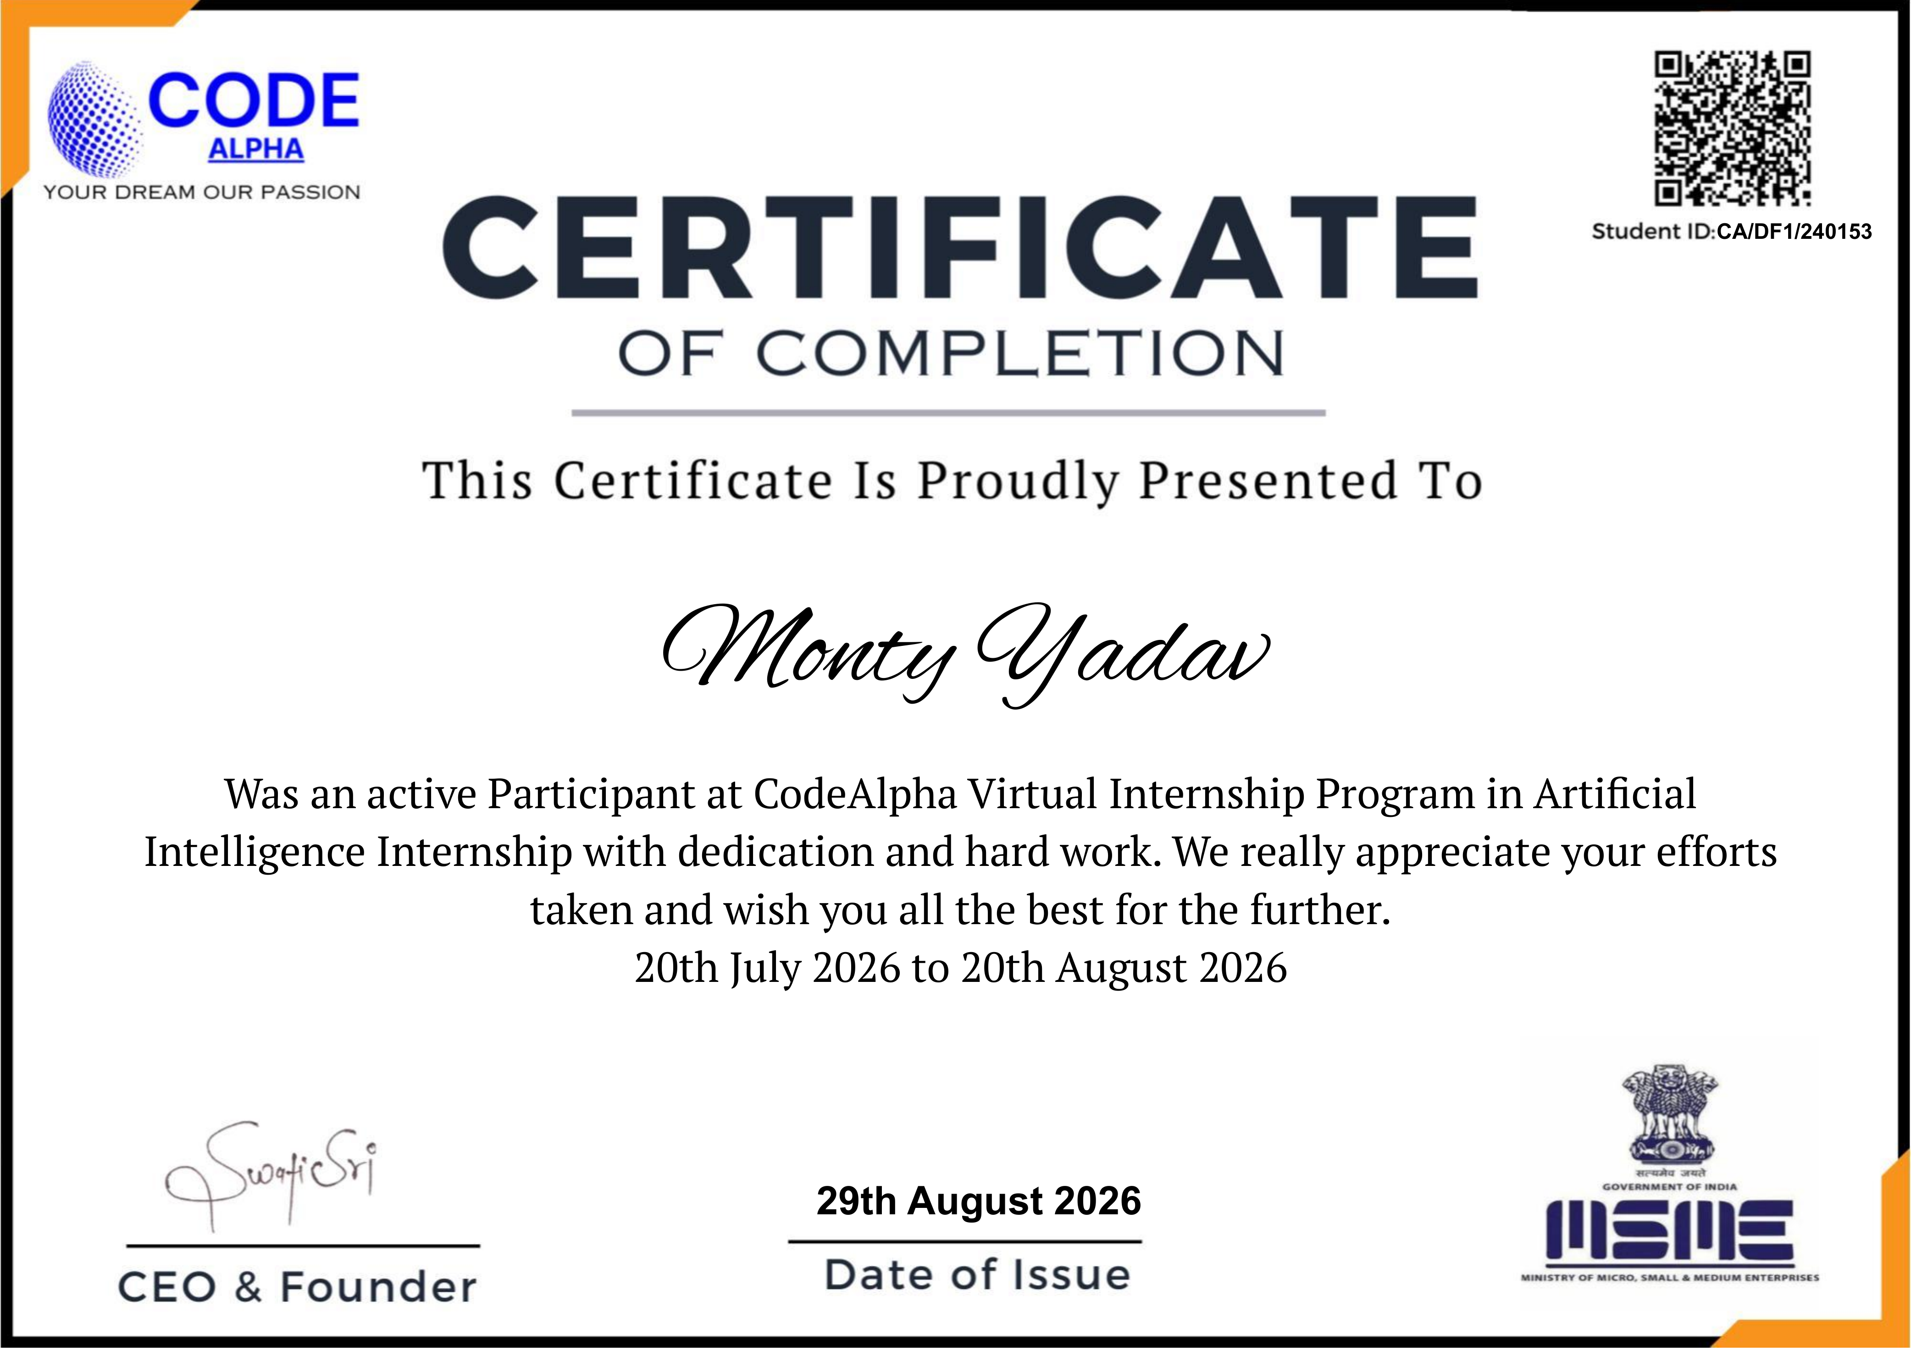
Certification & Official Verification
INTERNSHIP TITLE
Artificial Intelligence Virtual Internship
ISSUING ORGANIZATION
Code Alpha
DURATION
20 July 2026 – 20 August 2026
STUDENT ID
CA/DF1/240153
DATE OF ISSUE
29 August 2026
AI-Based Application Development | Monty Yadav
12

Slide 13
Thank You
Monty Yadav
School of Computer Science & Engineering
Roll No: 25SCS1003004707 | IILM University, Greater Noida, U.P.

