Slide 1
Adaptive Smart ACO Based Robust Communication for Vehicle Platooning using Spider-Web Topology
By: [Student Name(s)] | Roll No: [Roll No(s)] Dept. of Electronics and Telecommunication Engineering [College Name] Under Guidance of: [Guide Name]

Slide 2
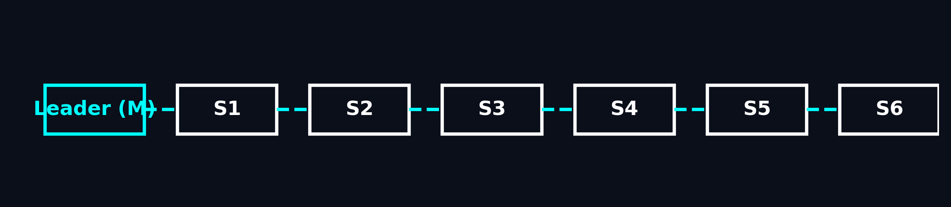
Introduction to Vehicle Platooning
Platooning connects multiple vehicles in a coordinated convoy.
Driven by a leader, followed tightly by slaves.
Benefits:
• Reduced fuel consumption
• Better traffic flow
• Automated driving coordination

Slide 3
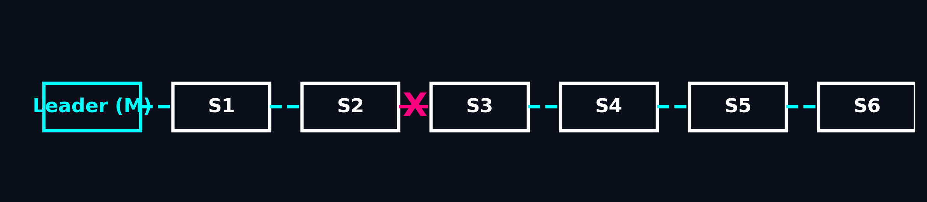
Problem Statement
Communication failure leads to catastrophic consequences:
• Unsafe spacing
• Delayed braking
• Coordination loss
• High collision risk

Slide 4
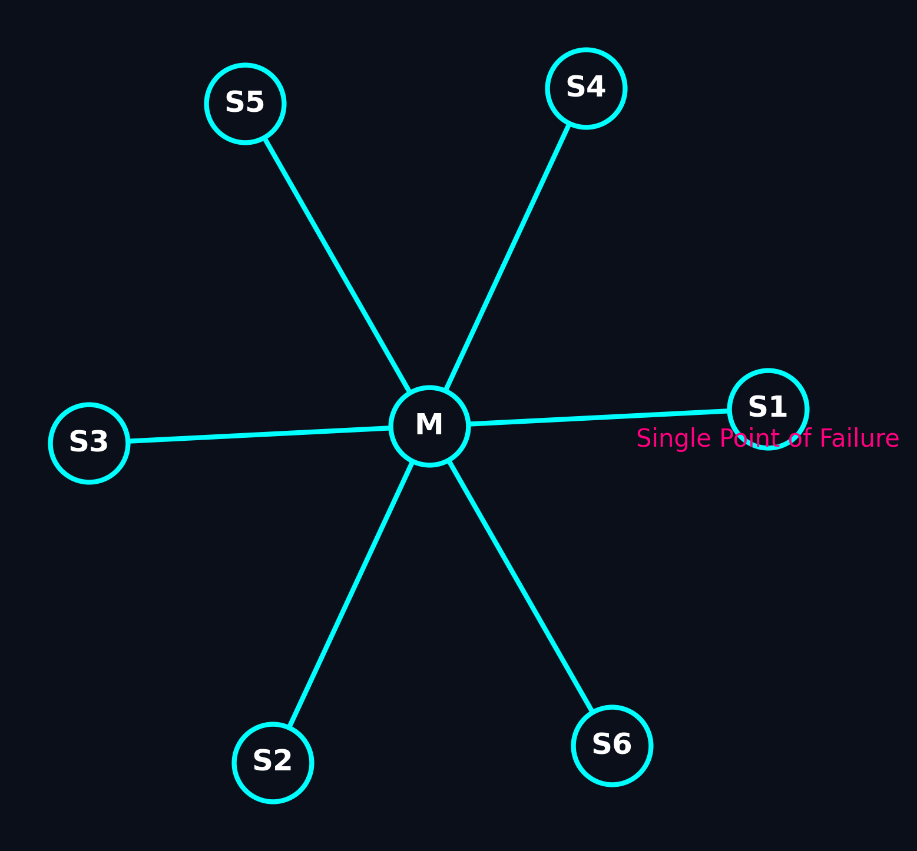
Existing Communication Model (Star Topology)
Master node directly controls all slaves.
Problem: Single Point of Failure.
If one link breaks, communication is permanently lost.
Lack of path redundancy.

Slide 5
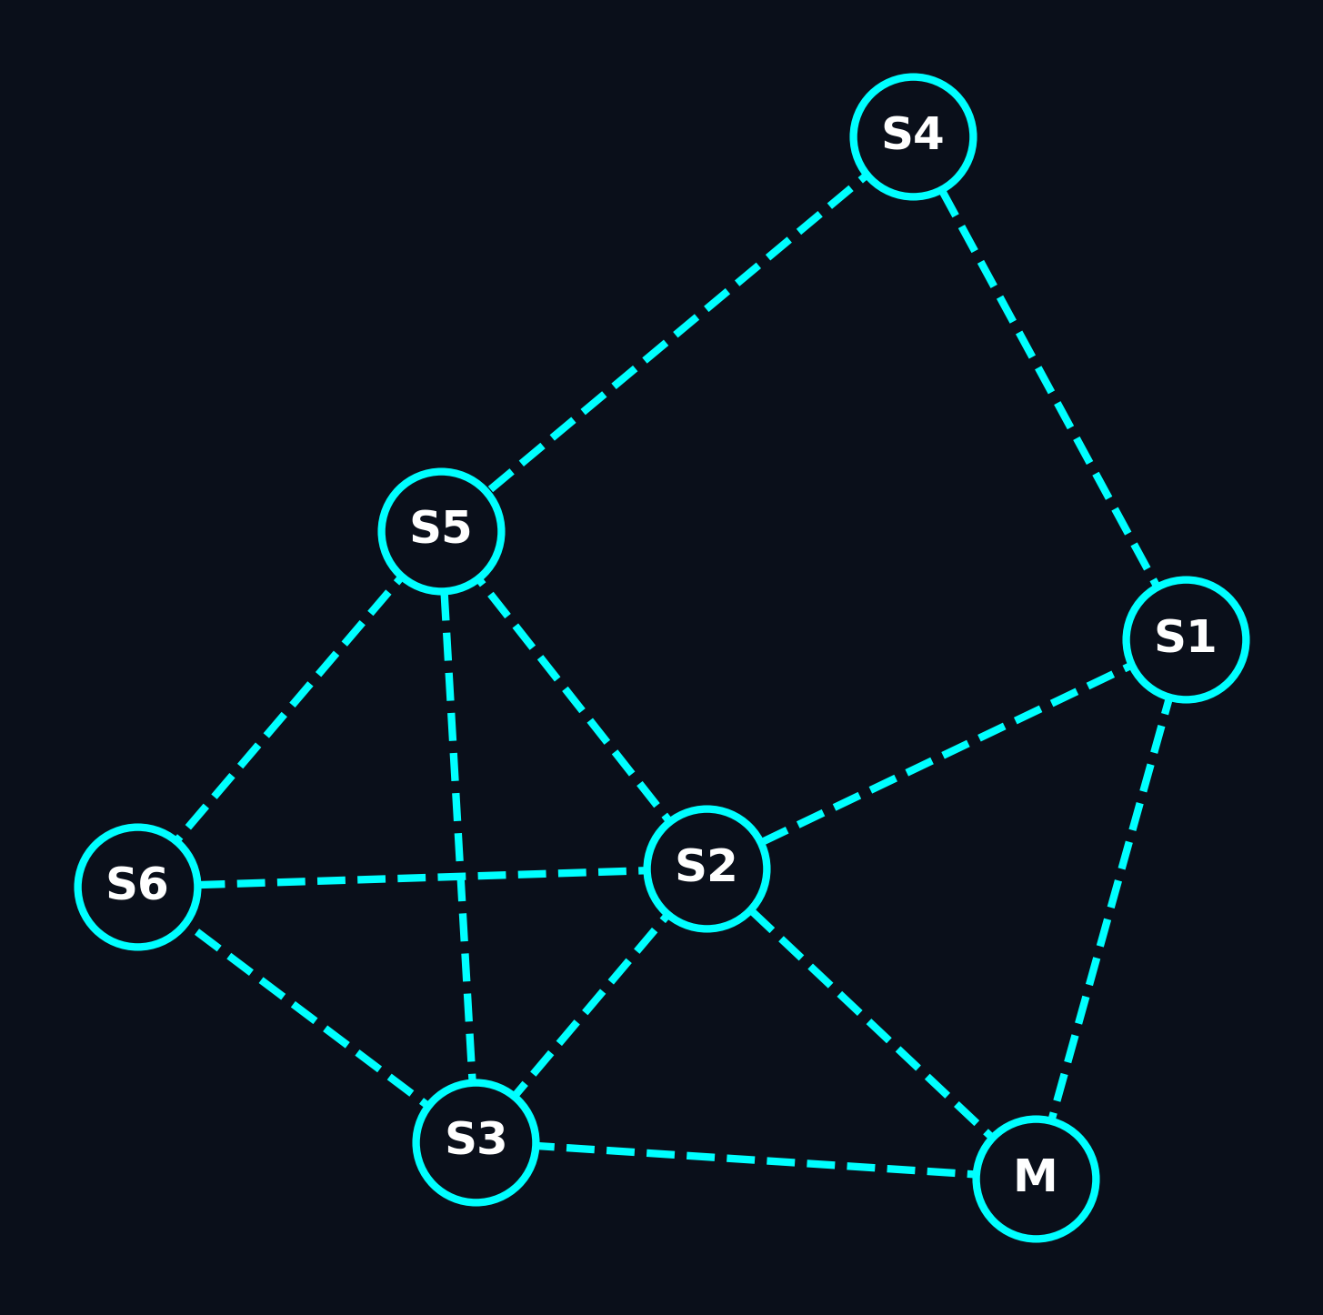
Proposed Spider-Web Topology
Mesh-like communication links.
Redundant multi-hop architecture.
If a direct link fails, packets route through neighbors.
Ensures structural robustness.

Slide 6
Why Classical ACO is Insufficient
Fixed Alpha, Beta, and Rho parameters.
Cannot adapt dynamically to network congestion.
Slow response during cascading link failures.
Unnecessary latency and premature convergence.
Suboptimal paths in high-stress scenarios.

Slide 7
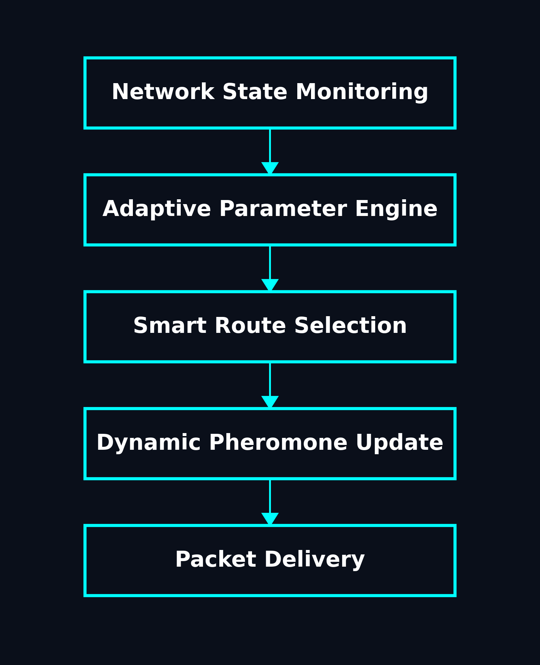
Proposed Upgrade: Adaptive Smart ACO
Introduces real-time dynamic parameter adjustment.

Slide 8
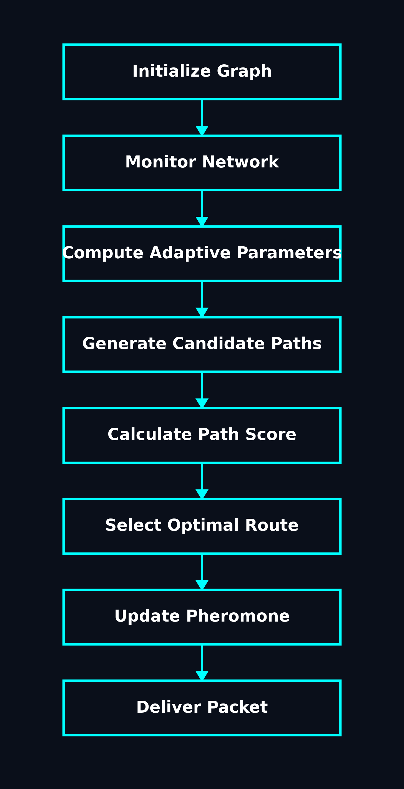
AS-ACO Working Principle
System continuously monitors:
• Congestion
• Reliability
• Link failures
Dynamically adjusts parameters instantly.

Slide 9
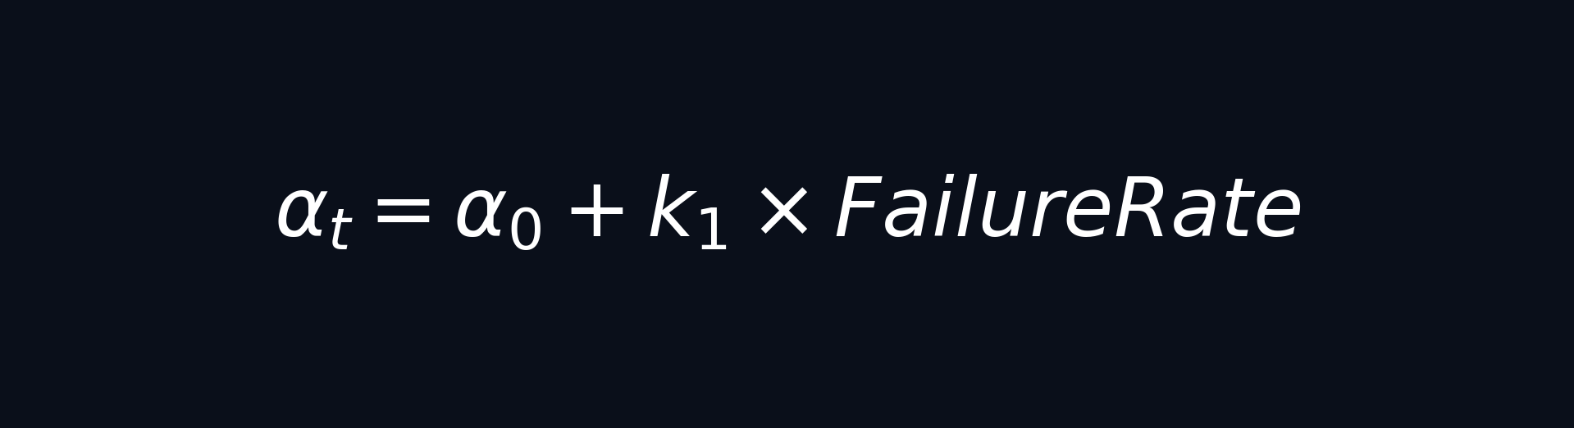

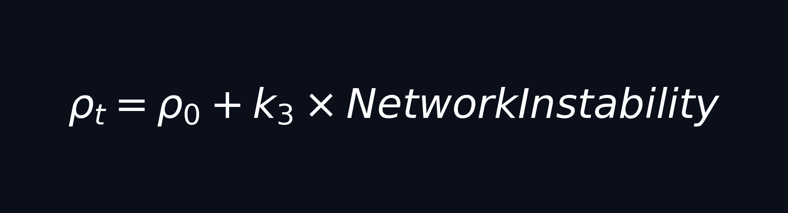
Adaptive Parameter Logic
Alpha = Pheromone trust
Beta = Heuristic influence
Rho = Pheromone evaporation

Slide 10

Network Monitoring Layer
Continuously calculates real-time network health.
Computes Instability Metric dynamically.
Triggers adaptive routing adjustments.

Slide 11
Route Selection Algorithm

Slide 12
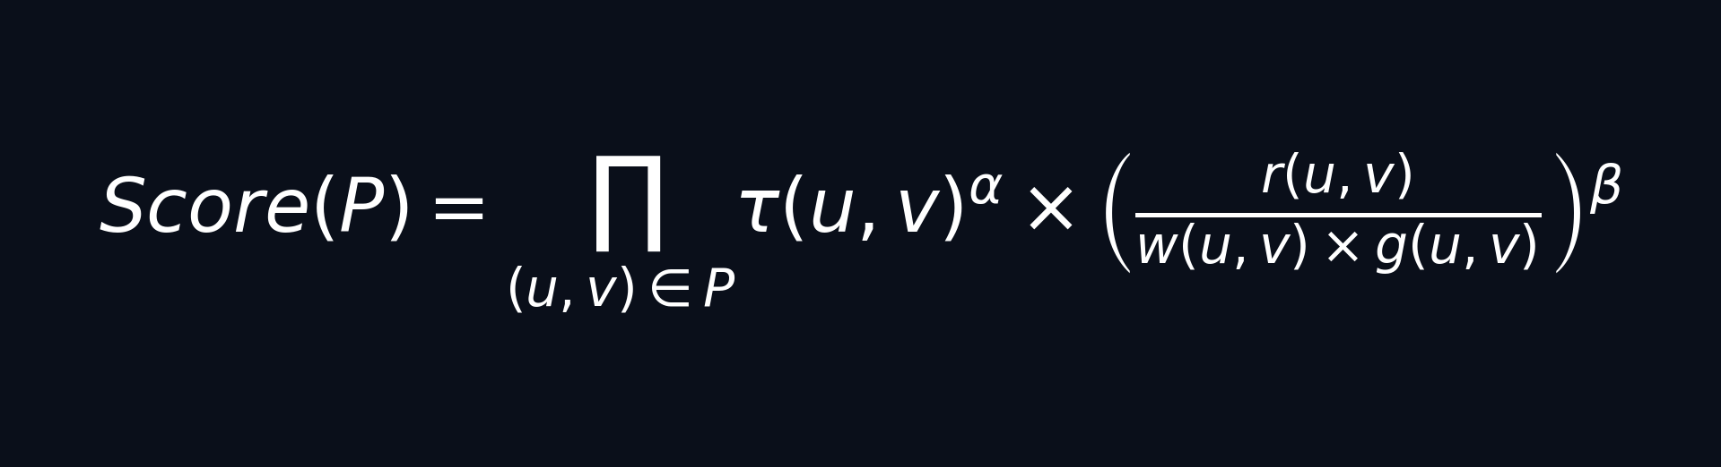
Mathematical Path Scoring Model
Evaluates candidate paths based on:
• Pheromone density (τ)
• Link reliability (r)
• Latency weight (w)
• Congestion factor (g)

Slide 13

Dynamic Pheromone Update
Evaporates old pheromones using dynamic Rho.
Deposits fresh pheromones inversely proportional to path length (L_P).

Slide 14



Evaluation Metrics
PDR: High reliability indicator.
Latency: Fast decision making.
Redundancy: Optimization check.

Slide 15
Simulation Environment Stack
Python 3.10+
NetworkX (Topology & Graphs)
Matplotlib (Real-time Analytics)
Tkinter (Interactive Dashboard)
Modular Architecture:
• network.py
• aco.py
• simulation.py
• ui.py

Slide 16
Performance Comparison (Table)
Metric | Baseline | Classical ACO | AS-ACO
Packet Delivery Ratio | 65% | 88% | 98%
Average Latency | 45.2 ms | 32.1 ms | 21.5 ms
Average Redundancy | 3.8 hops | 2.5 hops | 2.1 hops

Slide 17
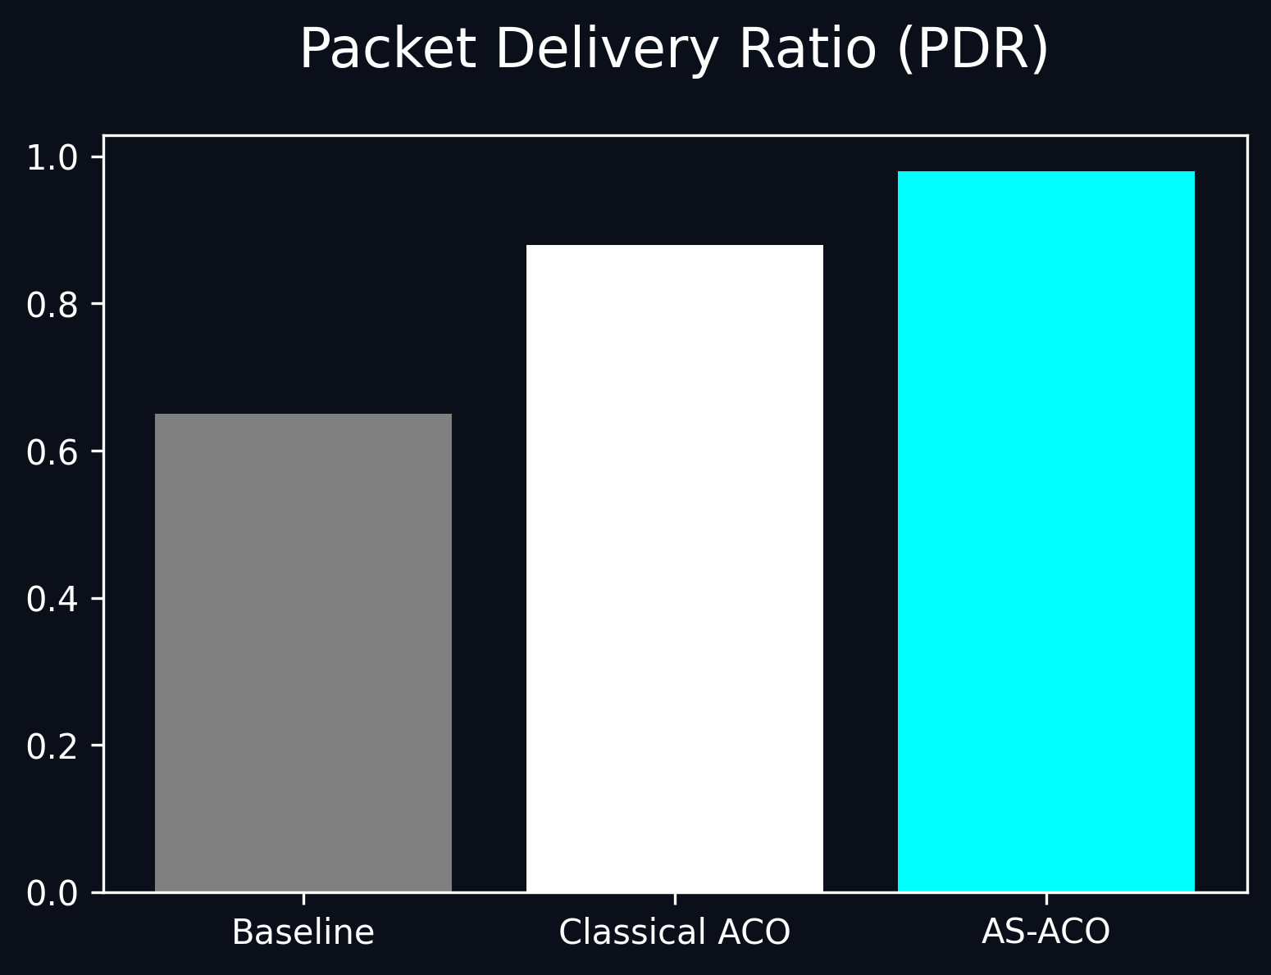
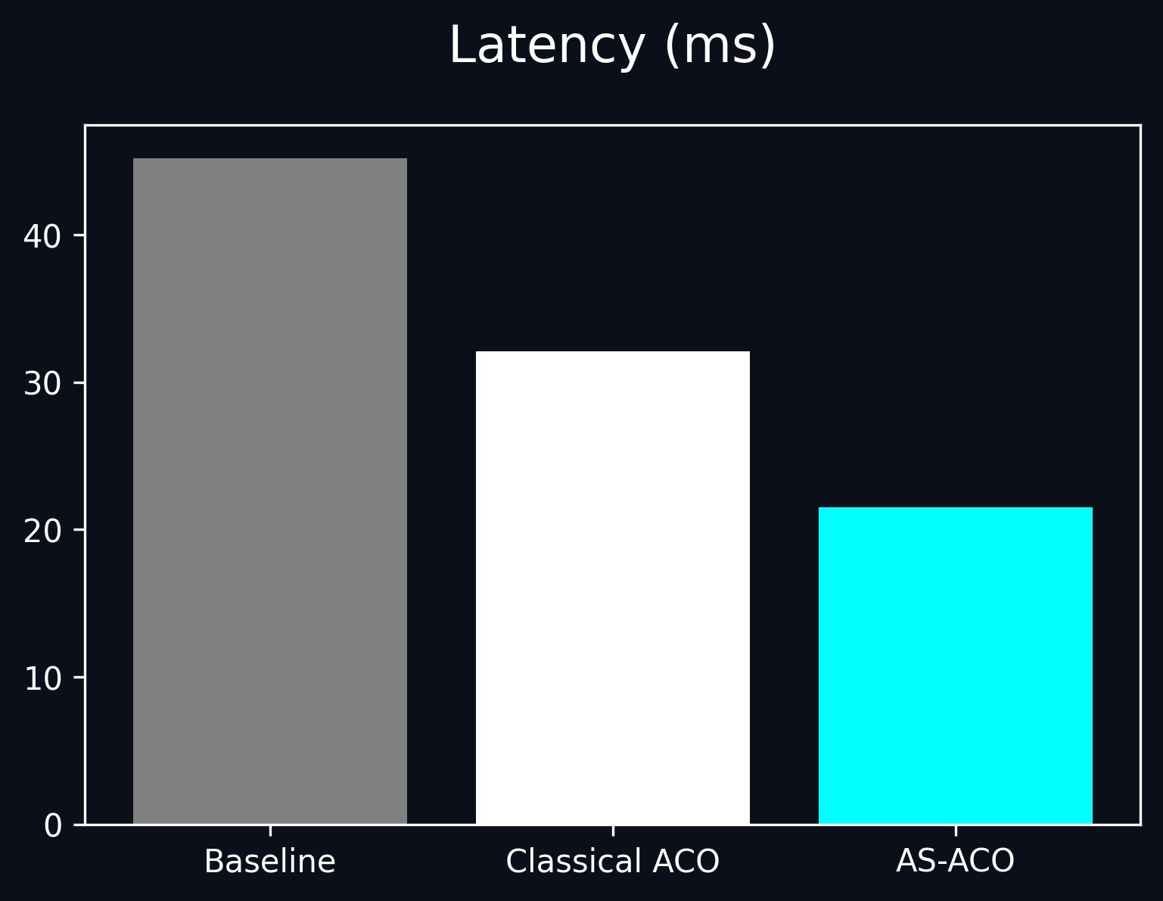
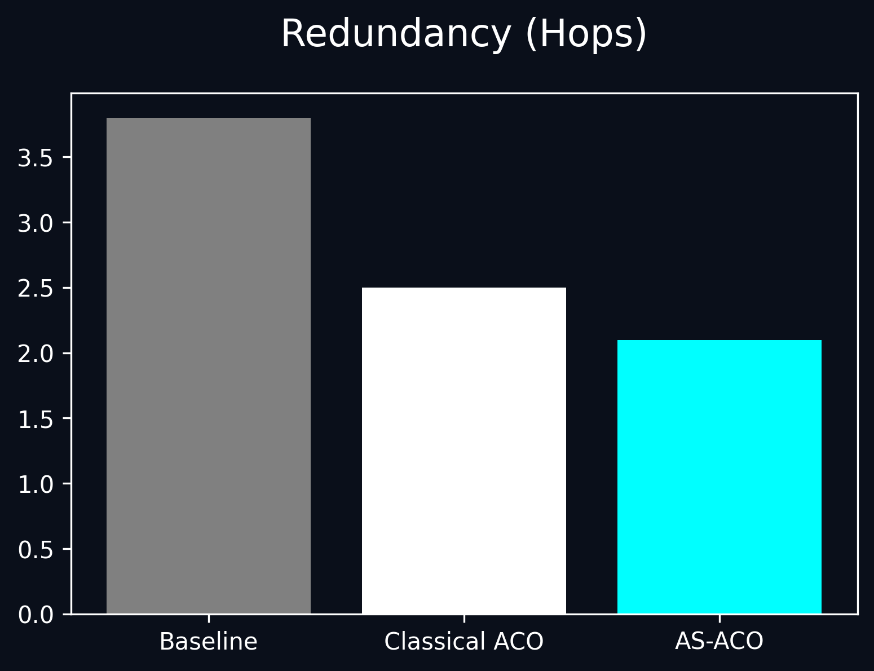
Performance Benchmarks

Slide 18
Advantages of Proposed System
✔ Superior Fault Tolerance & Reliability
✔ Real-time Dynamic Routing Intelligence
✔ Zero Single-Point-of-Failure
✔ Instant Response to Congestion
✔ Lower Latency & High PDR

Slide 19
Future Scope
• CARLA / SUMO Simulator Integration
• Implementation of Reinforcement Learning (RL)
• 5G V2X Communication Modeling
• Real-world Autonomous Vehicle Integration

Slide 20
Conclusion
Adaptive Smart ACO successfully solves the critical limitations of Classical ACO.
By dynamically adjusting its routing behavior based on real-time network conditions, the system ensures maximum reliability.
This paves the way for highly intelligent and robust communication in next-generation autonomous vehicle platooning.

Slide 21
Thank You Any Questions?

