Slide 1

MySqlDBConnection Framework
Created By: Monu Rathor

Slide 2

Contents
Pre Requirement
Introduction
Steps to add framework
Working with framework
Queries.

Slide 3
Pre requirements:-
MySql installed into your system.
Make sure MySql have to start. If MySql is stopped then always return error.
Add MySqlDBConnection framework into your project.
Add libmysql.16.0.0.dylib into your project.
Database available into MySql. Which you want to connect.

Slide 4
Introduction:-
MySqlDBConnection is a framework for Mac-64 bit application.
It is provide facility to connect with mysql database.
It is easy to use.
We have to provide database scheme, host name, user name, database name, and port number. Then this framework connect to you with the mysql database. If it return success then you have to successfully connect. Other wise return error.
For exapmle-
Scheme:@”mysql”
host:@”localhost”
username:@”root”
database:@”msecure”
port:3306
Result is return in dictionary form.

Slide 5
Steps to add framework:-
Download MySqlDBConnection.Framework from SVN. There are following link of SVN:
https://subversion.assembla.com/svn/commonspace/KnowledgeShare/MySqlDbConnection
Unzipe MySqlDBFramework
Create a New project in Xcode.

Slide 6
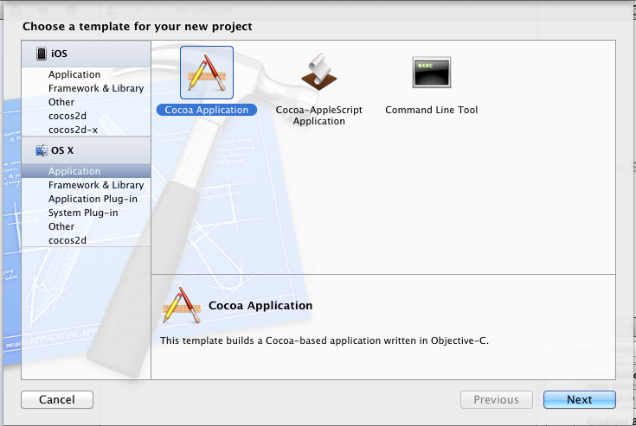
Select new project → OSX → Application → Cocoa
Application and click next button.

Slide 7
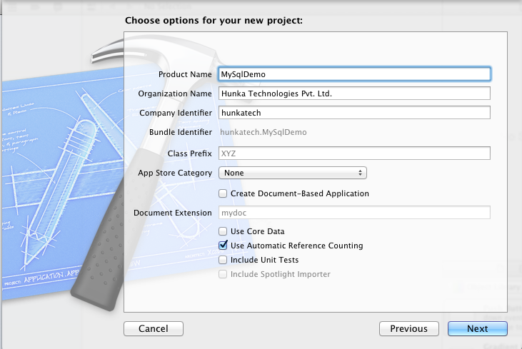
Give your project name. For example- MySqlDemo.
Check “Use Automatic Reference Counting.
Click Next button.

Slide 8
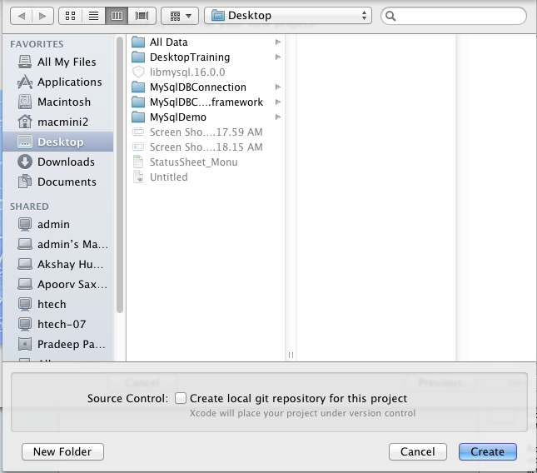
Give your project location where you want to store.
Click Create button.

Slide 9
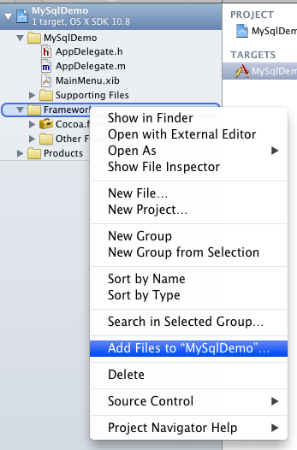
Right click on project Framework folder and click Add Files to “MySqlDemo”.
Choose location where MySqlDBConnection framework is store. And add framework.
Again right click on project framework folder and add “libmysql.16.0.0.dylib”.

Slide 10
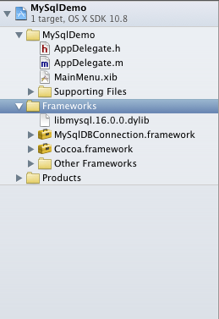

Slide 11
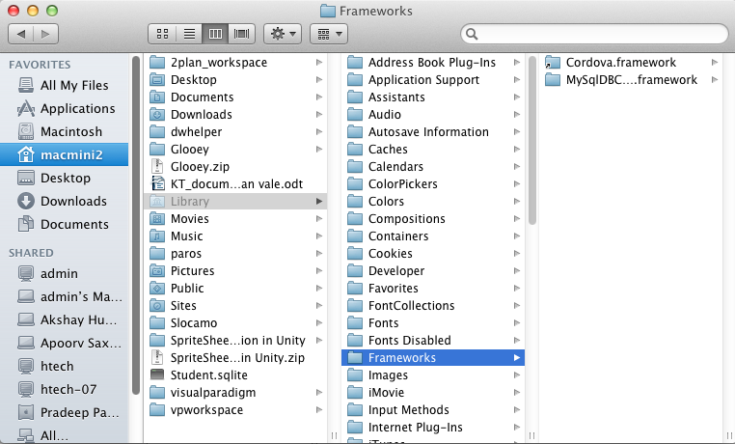
Copy MySqlDBConnection framework into following location on system drive-
/Library/Frameworks/

Slide 12
MySqlDBConnection Framework successfully added.

Slide 13
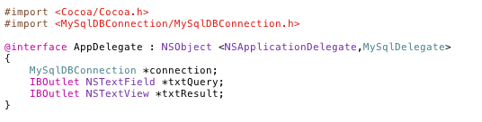
Working with Framework
Import framework.
Create object of MySqlDBConnection.

Slide 14
Working with Framework
You have two option to working with framework-
Using protocol method.
Without using protocol method.

Slide 15
Using protocol method
There are two protocol method define.
/*
* When connection is successfully established then mySqlConnectionSuccess:Error: method is called.
*/
- (void)mySqlConnectionSuccess:(BOOL)successs Error:(NSError *)error
/*
* It is return result for all query.
* It is called when you call executeQuery:, fetchAllRecordFromTable:, fetchRecordFromTable:Where:,
* insertRowIntoTable:Statement:, updateRowIntoTable:Statement:Where:, deleteRowFromTable:Where: method.
*/
- (void)mySqlResult:(NSDictionary *)dictionary Error:(NSError *)error

Slide 16
Using protocol method
There are following method using with protocol-
/*
* This method is used for established a connection.
* Given port number 3306 for mysql. It i default port number for myql.
*/
- (void)connectToMySqlWithScheme:(NSString*)scheme Host:(NSString*)host UserName:(NSString*)user Password:(NSString*)password DatabseName:(NSString*)database PortNumber:(int)portNo;
/*
* This method is used for execute sql query.
* The result return in mySqlResult:Error: delegate method.
*/
- (void)executeQuery:(NSString*)sql;
/*
* Fetch record from teble.
*/
- (void)fetchAllRecordFromTable:(NSString*)table;
- (void)fetchRecordFromTable:(NSString*)table Where:(NSString*)condition;

Slide 17
Using protocol method
/ * Method for using insert row into table.
* Statement is used for column name and its value.
*/
(void)insertRowIntoTable:(NSString*)table Statement:(MySqlStatement*)statement;
/* Method for using update row into table.
* Statement is used for column name and its value.
*/
- (void)updateRowIntoTable:(NSString*)table Statement:(MySqlStatement*)statement Where:(NSString*)condition;
/*
* This method is used for delete row.
*/
- (void)deleteRowFromTable:(NSString*)table Where:(NSString*)condition;
- (void)deleteAllRecordFromTable:(NSString*)table;

Slide 18
Without using protocol method
There are following method using with protocol-
- (void)connectToMySqlWithScheme:(NSString*)scheme
Host:(NSString*)host
UserName:(NSString*)user
Password:(NSString*)password
DatabseName:(NSString*)database
PortNumber:(int)portNo
successResult:(void (^)(id <DBConnection> connection, id connectionUR))successResult
failureResult:(void (^)(NSError *error))failureResult;
- (void)executeQuery:(NSString *)sql
successResult:(void (^)(id dict))successResult
failureResult:(void (^)(NSError *error))failureResult;

Slide 19
Without using protocol method
- (void)fetchAllRecordFromTable:(NSString *)table
success:(void (^)(id dict))success
failure:(void (^)(NSError *error))failure;
- (void)fetchRecordFromTable:(NSString*)table Where:(NSString*)condition
success:(void (^)(id dict))success
failure:(void (^)(NSError *error))failure;
- (void)insertRowIntoTable:(NSString*)table Statement:(MySqlStatement*)statement
success:(void (^)(id dict))success
failure:(void (^)(NSError *error))failure;
- (void)updateRowIntoTable:(NSString*)table Statement:(MySqlStatement*)statement Where:(NSString*)condition
success:(void (^)(id dict))success
failure:(void (^)(NSError *error))failure;

Slide 20
Without using protocol method
- (void)deleteRowFromTable:(NSString*)table Where:(NSString*)condition
success:(void (^)(id dict))success
failure:(void (^)(NSError *error))failure;
- (void)deleteAllRecordFromTable:(NSString*)table
success:(void (^)(id dict))success
failure:(void (^)(NSError *error))failure;

Slide 21
Queries

