Slide 1

COVID-19
Mitigation Measures and its Effect
Abdelmalek Hajjam/ Monu Chacko
05/15/2020

Slide 2
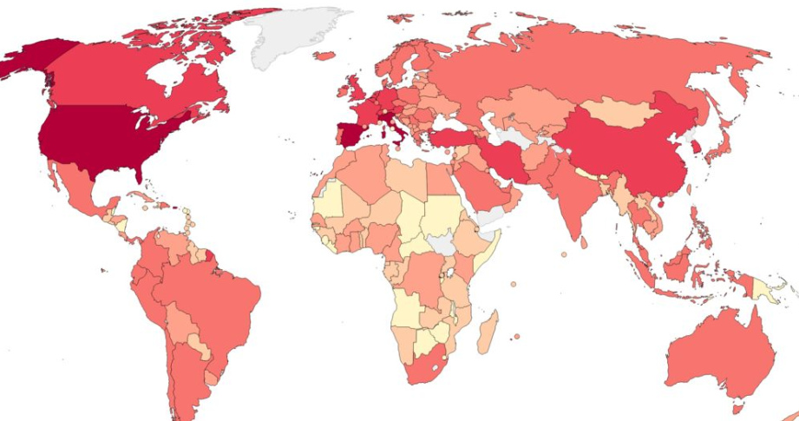
Abstract
The only remedy to reduce the spread of the virus is the mitigation measures put in place by countries.
We will find the correlation between measures like lockdown, masks etc and number of cases.
The correlation between government type like democratic, central to the number of cases.

Slide 3
Introduction
In the absence of vaccine and medicines for COVID-19, the only remedy is state intervention.
Countries across the world chose different strategies like herd immunity, recommendation for social distancing measures, strict enforcing social distancing etc.
Countries have different form of government like democratic, centralized, decentralized etc.
The data for this project was taken from https://data.world/. This is an emerging dataset.
This project had its challenges because we are in the middle of this crisis and this situation is still emerging. There are not many datasets or historical data for this kind of virus. Since we are still in the middle of this pandemic we only can hope our conclusions are correct. For example what would be the conclusion if there are multiple waves. How would society view loss of economy vs health etc. This story is still being told. However we need this study to find solution to the problem we are still facing.

Slide 4
Literature Review
History of Pandemics: This literature takes you to the history of infectious diseases. The response and effect on remedy can be found here.
The New England Journal of Medicine (nejm.org/coronavirus) has lot of facts about this disease.
This heat map (healthmap.org/covid-19/) shows how this virus spread over time. This information is important because it could provide information about how the spread could have stopped.

Slide 5
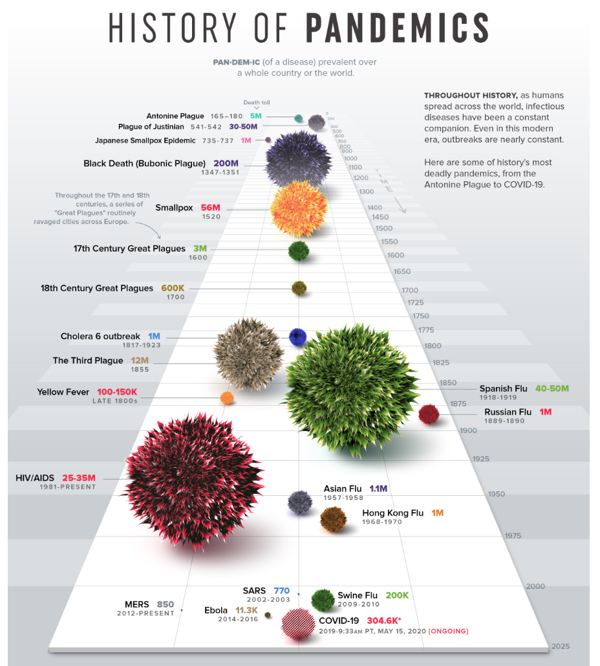
Source: https://www.visualcapitalist.com/history-of-pandemics-deadliest/

Slide 6
Methodology
Data Imputation:
Missing data was handled whenever necessary. There was missing or incorrect data reported. This was evident by plotting time series data. There was sudden unexplained drop in numbers which didn’t seem correct.
Missing data:
This is an emerging dataset and there were many features that had to be brought in manually. There was lack of dataset for response etc.

Slide 7
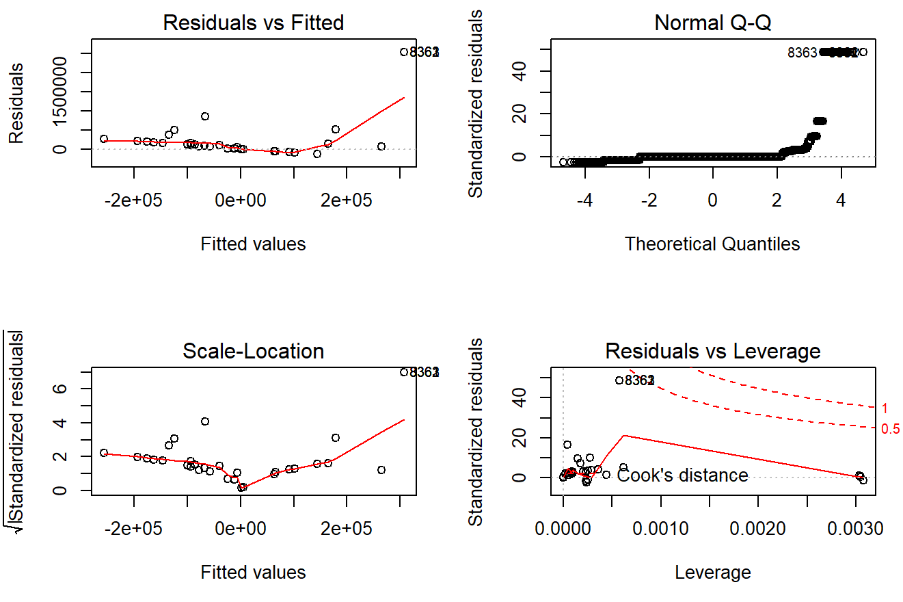
Transformations
The dataset needed transformation to make sense.
Features like Cases, Population, GovtType, Lockdown and Mask etc were transformed to groups to meaningful analysis.

Slide 8
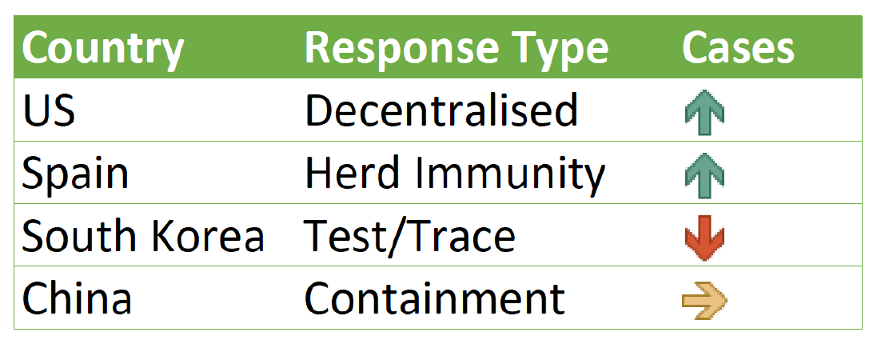
Conclusion
In the absence of vaccines, medicines etc government response with clarity and proper communication was the most effective.
Centralized government tend to be more effective than decentralized.
State that enforced with containment measures early on faired better.
Not taking action and letting the pandemic playout is costly.
Fear of the virus brings compliance in the absence of remedies like vaccines and medicines.

