Slide 1
CYPHER 2026
Agent Harness for Enterprise: Engineering the Runtime for Reliable AI Agents
The runtime that turns a language model into a reliable, governed, production agent.
PRESENTED BY
Manoranjan Rajguru
Cypher 2026 · 01

Slide 2
01
THE CONCEPT
What an Agent Harness Is — and Why It Exists
The engine that wraps a model with the loop, tools, memory and guardrails to act reliably.
Cypher 2026 · 02

Slide 3
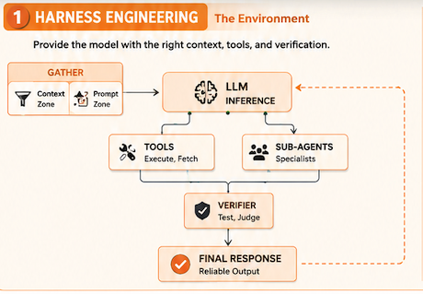
From Prompt Engineering to Harness Engineering
Prompt engineering
Shape a single model call — instructions, examples, output format.
Context engineering
Manage the information state that flows across steps and turns.
Harness engineering
Integrate prompts + context with execution, tools, state, lifecycle, observability, verification and governance.
Loop Engineering
Call model → observe → run tools → feed back → repeat. The rule most builders miss: Do not loop on confidence. Loop on evidence.
Graph Engineering
Nodes, edges, branches, joins. It answers a different question not what the agent does, but what's allowed to run next. Worth it for real branches and approvals. Overkill for "give one agent three tools and go."
Cypher 2026 · 03

Slide 4
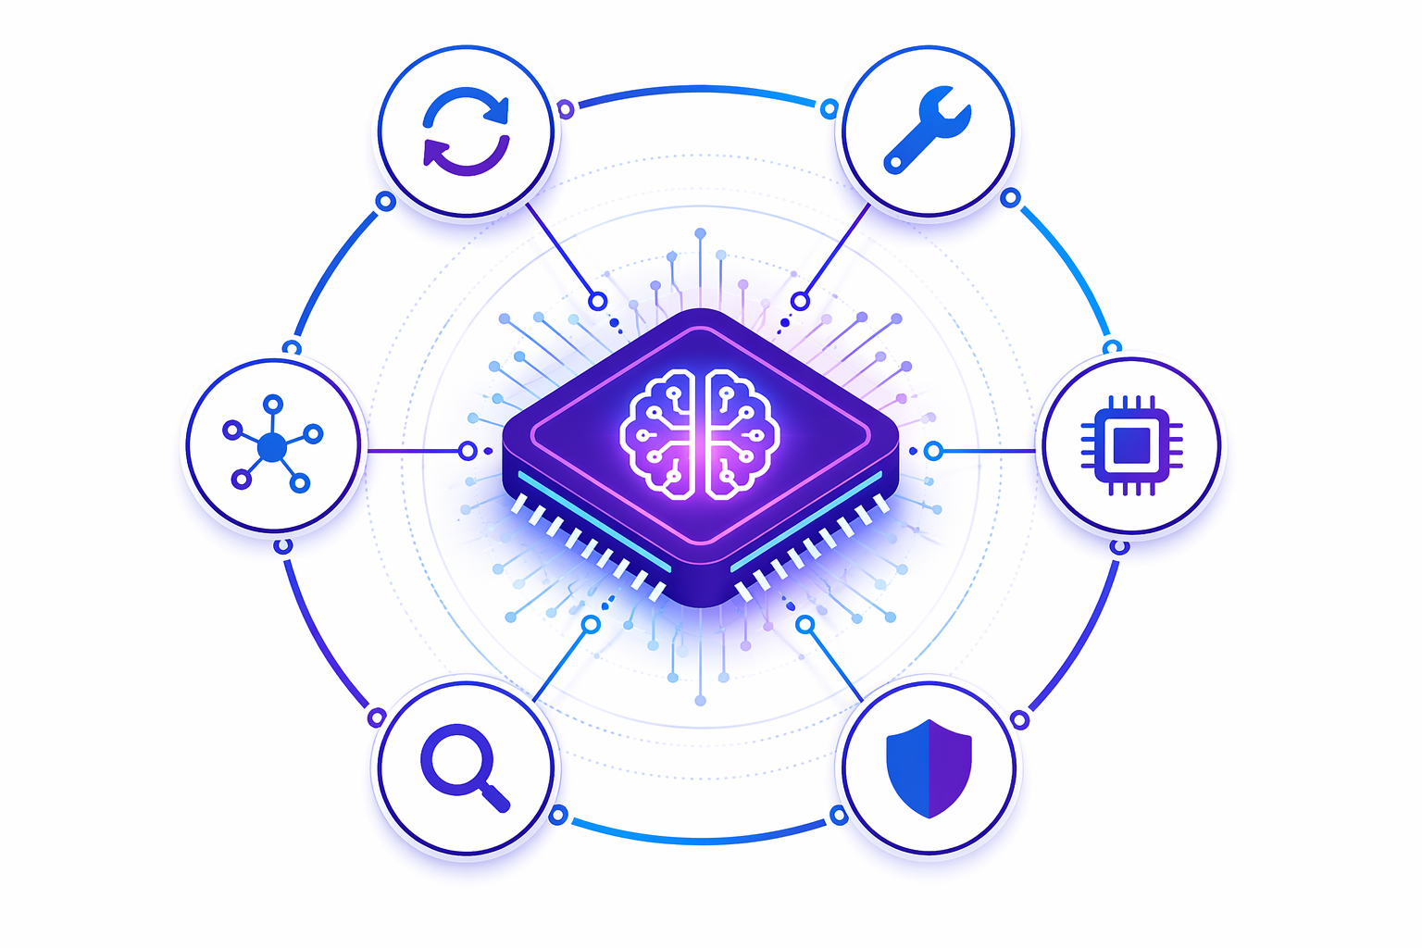

The Concept · What Is an Agent Harness?
The model reasons. The harness runs the show.
An agent harness is the execution engine that wraps a model with the loop, tools, memory and guardrails it needs to act reliably.
Turns a single prompt into a durable, multi-step task
Adds orchestration, state and control flow
Enforces safety: sandboxing, verification, HITL
Makes agents observable, testable, enterprise-ready
Cypher 2026 · 04

Slide 5
“
The model was never the product. The harness — the operating layer around it — is what ships reliability.
Reliability, not raw capability, is what enterprises actually deploy.
Cypher 2026 · 05

Slide 6
02
ANATOMY
The Anatomy of an Agent Harness
Eight components that turn a raw model into a dependable, governed agent.
Cypher 2026 · 06

Slide 7
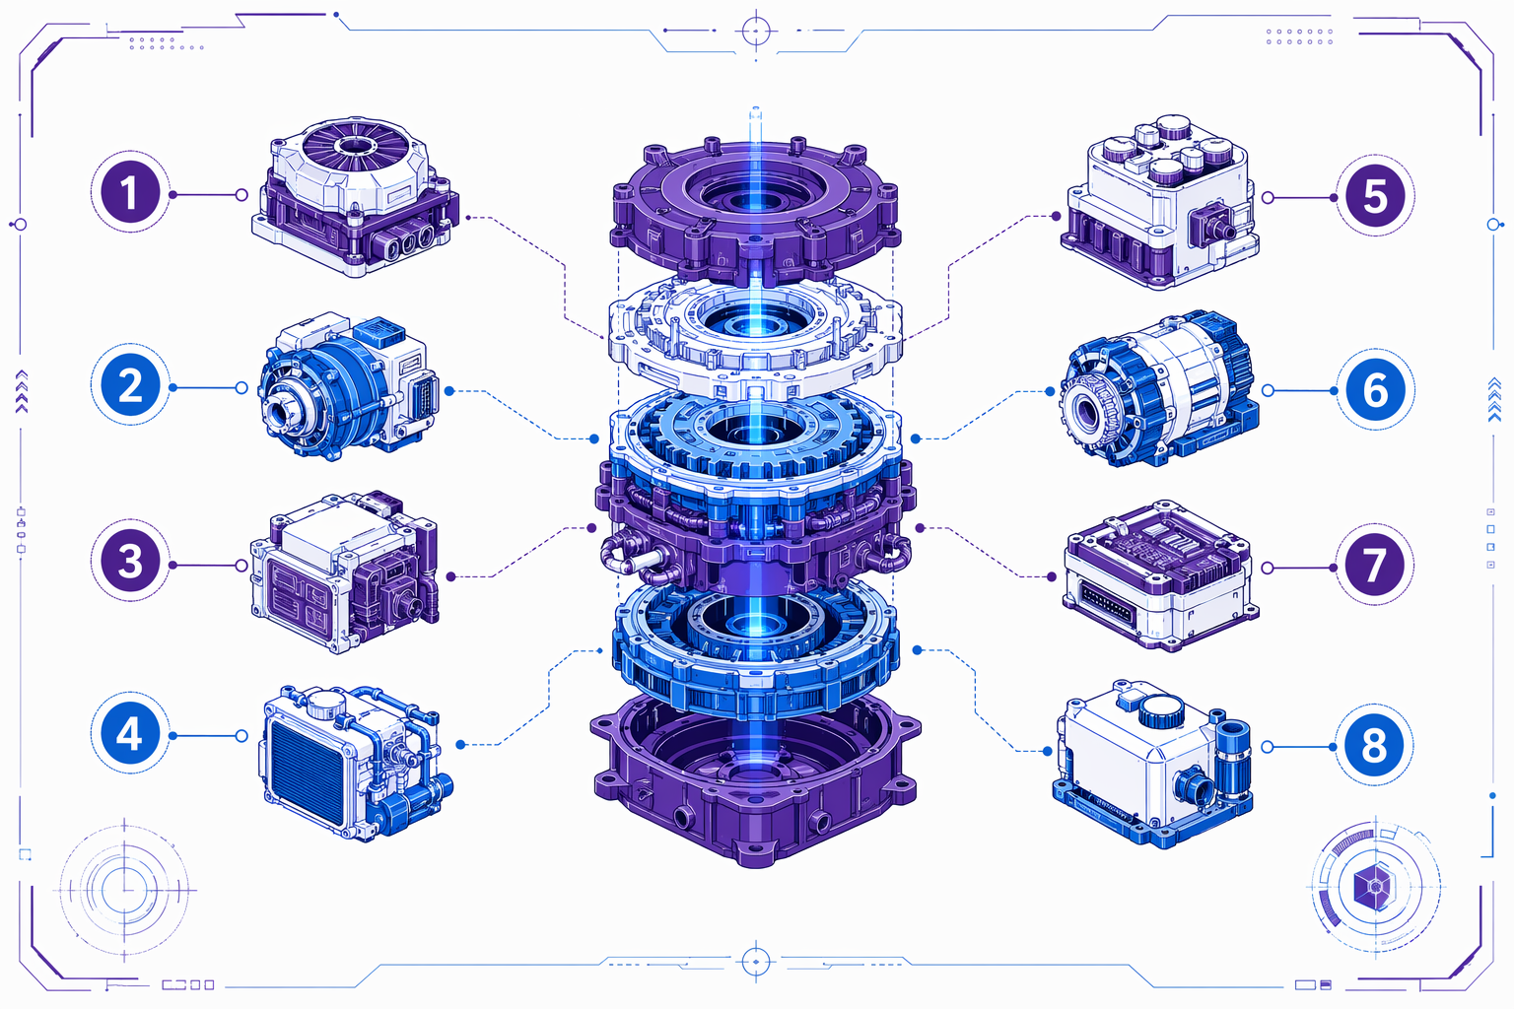
Anatomy · The Eight Building Blocks
Eight components turn a model into a dependable agent.
Each block below is a distinct responsibility — together they form the harness around the model core.
Loop · Orchestrator/Planner
Tools · Memory & Context
Sandbox · Dynamic Sub-Agents
Verifier · Observability & Evals
Cypher 2026 · 07

Slide 8
THE ANATOMY OF AN AGENT HARNESS
THE HARNESS REFERENCE ARCHITECTURE
Seven layers wrap a stateless model into a governed, long-running agent
CONTROL PLANE
STRUCTURAL CORE
Execution
Observability
E
O
traces · cost · latency · failures
Sandboxes · microVMs · OS/browser perms
Model Internal
Capability
Verification
T
Tooling
evals · benchmarks · attribution
MCP / A2A · discovery · invocation
Context / Memory
C
Governance
LLM
G
short-term · session · persistent
identity · RBAC · audit · policy
L
Life Cycle
MODEL-INTERNAL CAPABILITY
inner loop
O
Orchestration
multi-agent control flow
Cypher 2026 · 08

Slide 9
01
THE CONTROL LOOP
The Loop Is the Beating Heart of Agency
Every harness runs an event loop with interception points the model never sees.
Cypher 2026 · 09

Slide 10



The Beating Heart · The Agent Loop
01
02
03
04
Perceive
Plan
Act
Observe & Reflect
Gather context, retrieve knowledge, read current state.
Decompose the goal into ordered, tool-bound steps.
Call tools and APIs to execute each step safely.
Check results, apply guardrails, retry or escalate.
Loop until the goal is met or a stop condition fires — retries, tool calls and human intervention all live here.
Cypher 2026 · 10

Slide 11
THE AGENT LOOP AS AN EVENT PIPELINE
THE AGENT LOOP AS AN EVENT PIPELINE
Eight lifecycle hooks — each an interception point with a validated contract
1
task_start
permits: system prompt
2
step_start
3
permits: history edits
4
before_model
permits: context assembly
5
after_model
permits: response · tool calls
6
inner step
repeats until
before_tool
7
stop condition
permits: input · approval gate
8
after_tool
permits: tool result
step_end
permits: read-only
task_end
permits: read-only
Cypher 2026 · 11

Slide 12
Why the Loop Is Hard · Deterministic Control
The model proposes; the harness disposes. Control belongs to code, not the policy.
Stop conditions
Detect done, budget exhaustion, or the need to escalate — deterministically.
8
Budgets & runaway
Cap steps, tokens, wall-clock and tool calls; kill loops that don't converge.
lifecycle hooks per step
Drift & repair
Errors become control-flow signals that trigger targeted repair, not restart.
5
Human interrupt
A person can pause, inspect and override at any hook boundary.
processor outcomes
Cypher 2026 · 12

Slide 13
02
ORCHESTRATION
The Orchestrator & Planner
Decompose intent into an executable, checkable plan — then adapt when steps fail.
Cypher 2026 · 13

Slide 14
PLANNER · DECOMPOSITION, ROUTING, RE-PLANNING
THE ORCHESTRATOR / PLANNER
Decompose intent into an executable, checkable plan — then adapt when reality disagrees
Goal decomposition
Routing & control flow
Re-planning
1
Stop conditions
2
3
4
break intent into ordered,
choose next action · branch ·
repair the plan when a step fails
checkable sub-tasks
detect done · budget exhausted ·
delegate
or new info arrives
must escalate
FOUR PLANNING STRATEGIES
Search-based
Linear
Orchestration
Structure-grounded
explore trajectory space under
sequential decomposition into
workflow DAG / multi-phase
planning anchored to a dependency
execution feedback (CodeTree)
subtasks
coordination (MapCoder)
graph (CodePlan)
tree + backtrack
S1 → S2 → S3 → S4
fan-out phases
DAG of code deps
PLANNING AS CONTRACT FORMATION
step: apply_patch
A plan is not prose — it is an executable specification. Each step declares pre-conditions and post-conditions
pre: tests_exist()
the harness checks at runtime. Failure signals (compiler errors, failed tests, exceptions) become control-flow
post: all_tests_pass()
inputs that trigger targeted repair or re-planning — not a full restart. The contract makes progress verifiable.
on_fail: replan(step)
Contracts convert a stochastic planner into a system with checkable intermediate state — the basis for reliability.
Cypher 2026 · 14

Slide 15
03
CAPABILITY SURFACE
Tools, Skills & Protocols
How the harness grounds reasoning in real actions — and connects to a wider ecosystem.
Cypher 2026 · 15

Slide 16
SKILLS · PERSISTENT EXECUTABLE MEMORY
SKILLS · PERSISTENT EXECUTABLE MEMORY
A skill is not a tool. Tools are supplied; skills are learned, stored and reused — competence that compounds.
TOOL
SKILL
A fixed capability the harness exposes.
A reusable behavior the agent authored, verified and persisted.
Stateless. Same on every run.
Composed from tools + control flow. Grows over time.
e.g. http_get() · run_sql()
e.g. resolve_flaky_test() · migrate_schema()
THE SKILL LIBRARY LIFECYCLE
1
Encounter
Retrieve
Synthesize
Verify
2
Persist
3
4
5
novel task with no
compose a candidate
execute against tests /
store to the library
matching skill
recall & adapt on the
skill from tools + code
environment feedback
with an index key
next similar task
CURRICULUM · the library IS long-term memory
Voyager
automatic curriculum + continually expanding skill library
LYRA
converts human corrections into reusable executable skills + RAG memory
ViReSkill
vision-grounded replanning with skill-memory caching for stability
BOSS
synthesizes new skill chains via language-guided practice
Without a skill library every session re-derives behavior from scratch. With one, the agent gets better as it works.
Cypher 2026 · 16

Slide 17
MCP · THE MODEL CONTEXT PROTOCOL
MCP · MODEL CONTEXT PROTOCOL
Transport: stdio (local) · Streamable HTTP (remote). Discovery is dynamic — a client lists a server's capabilities at connect time, so tools can be added without changing agent code.
MCP SERVERS · independently deployed
AGENT HOST
Filesystem Server
the harness
resources: files, dirs
MCP Client A
GitHub Server
tools: PRs, issues, search
MCP Client B
Database Server
tools: query · resources: schema
MCP Client C
Vector Store Server
tools: semantic_search
THREE SERVER PRIMITIVES
Tools
Prompts
Resources
model-invoked functions with typed schemas
reusable templated interactions
readable context the client can load
Harness responsibility: authenticate servers · allow-list tools · scope least-privilege · bound the blast radius of every MCP call.
Cypher 2026 · 17

Slide 18
A2A · THE AGENT-TO-AGENT PROTOCOL
TASK LIFECYCLE
CLIENT AGENT
REMOTE AGENT
submitted
delegates a task it
opaque · different
cannot do alone
vendor / framework
working
discovers peer
publishes Agent Card
input-required
sends Task
streams results
completed
THE AGENT CARD · capability advertisement
A2A + MCP · they compose, not compete
A public JSON descriptor a remote agent serves so others
A2A — horizontal: agent ⇄ agent delegation & negotiation
can discover and invoke it — no shared code required.
across trust and vendor boundaries.
{ "name": "invoice-reconciler",
MCP — vertical: agent → tools & resources it calls directly.
"skills": ["match", "flag-exceptions"],
A single agent is an A2A server to its callers and an MCP
"endpoint": "https://…/a2a",
client to its tools — simultaneously.
"auth": "oauth2", "streaming": true }
Modalities negotiated per task: text · forms · files · streams.
peer ⇄ [A2A] ⇄ AGENT → [MCP] → tools
A2A turns isolated agents into a collaborating workforce — task delegation with identity, negotiation and streaming built in.
Cypher 2026 · 18

Slide 19
04
STATE
Context Engineering & Memory
Keep the agent coherent across steps and sessions — without blowing the budget.
Cypher 2026 · 19

Slide 20

MEMORY · A LAYERED STATE HIERARCHY
Context management is the tax of implicit shared state — six memory types, each with provenance and staleness
Working memory
volatile · per-step
1
the live context window — current task state inside the loop
Semantic memory
AutoCodeRover · RepoCoder
2
repository / knowledge retrieval — RAG, BM25, embeddings
Experiential memory
trace store
3
past task trajectories & outcomes, replayed for reuse
Long-term memory
persistent
4
durable facts, threads, evolving skill libraries across sessions
Multi-agent memory
blackboard · locks
5
shared interaction history — requires synchronization
Compaction / offload
fit the budget
6
summarize · selectively retain · offload to external stores
Compaction is a first-class harness policy: what to keep, what to summarize, what to offload — decided by the harness, logged for audit.
Cypher 2026 · 20

Slide 21
05
EXECUTION
Sandboxing & Session Isolation
Contain the blast radius: isolate execution, gate permissions, reclaim per session.
Cypher 2026 · 21

Slide 22
SANDBOXING & SESSION ISOLATION
SANDBOXING & SESSION ISOLATION
Permissioned execution contains the blast radius — every side effect is isolated and reversible until verified
UNTRUSTED · agent-generated code & tool calls
TRUSTED · production systems
EPHEMERAL SANDBOX
Databases
per-session · destroyed on exit
writes staged, applied post-verify
agent process
P
Prod APIs
generates & runs code
scoped tokens, per-action approval
reads session state only
gate
no ambient credentials
Secrets / KMS
permission
never mounted in the sandbox
boundary
CPU / mem cap
wall-clock TTL
egress deny-list
read-only FS
File systems
diffs reviewed before commit
Isolation boundaries: container · microVM · OS-level perms · desktop VM —
a cost/security choice the harness makes per workload.
Permissioned state transition: a bad action is contained, not catastrophic. Irreversible effects are blocked until a
deterministic verifier passes — so failure is safe by construction, and every session is isolated from every other.
Session isolation: no cross-session state or credential leakage · resources reclaimed on exit · one compromised run cannot touch another.
Cypher 2026 · 22

Slide 23
06
SCALING OUT
Dynamic Sub-Agent Delegation
Spawn specialists at runtime, isolate their context, verify, then fan results back in.
Cypher 2026 · 23

Slide 24
SUB-AGENT FAN-OUT / FAN-IN
DYNAMIC SUB-AGENT DELEGATION
Spawn specialists at runtime, run them in isolated context, verify, then fan results back in
ORCHESTRATOR
decomposes · delegates · synthesizes
Retriever
Tester
Summarizer
Coder
Critic
gather sources
write patch
run & verify
adversarial review
fan-in synthesis
own context window
own context window
own context window
own context window
own context window
FAN-IN · verified results merged into a single answer
INTERACTION MODES
WHY DELEGATE
Collaborative
agents jointly build one artifact
Critique & repair
One giant prompt is brittle: context collides,
reviewer flags · repairer fixes
attention dilutes, failures cascade. Sub-agents give
Adversarial
each specialist a clean, bounded context and an
red-team tries to break the output
Debate
isolated failure domain — parallelism scales complex work without a monolithic prompt.
competing solutions, resolved by execution
Cypher 2026 · 24

Slide 25
MULTI-AGENT SHARED STATE & TOPOLOGY
MULTI-AGENT SHARED STATE & TOPOLOGY
The hard part isn't spawning agents — it's the shared state they read and write. Formality drives correctness.
Shared blackboard
Parallel branches + merge
Hierarchical memory
A
A
blackboard
A
A
central mutable store · all read/write
independent work · merge at sync points
local & global scopes per agent tier
state is just files — no sync; prone to stale views & conflicts
SHARED-STATE REPRESENTATION · least → most formal
CONVERGENCE CRITERIA
git as shared state; history = audit trail; merge = collision signal
Correctness
Implicit / file-only
all tests pass
Security
the live running system is the state; observed via outcomes
no vuln signatures
Performance
Repository-based
profiling targets met
explicit structure with defined read/write (ACID-like) semantics
Score
Execution-based
reward threshold reached
Consensus
agent majority agrees
Implicit
Blackboard / transactional
no further changes proposed
Key law: topology complexity is inversely correlated with shared-state formality — the more agents, the more you must formalize state.
Cypher 2026 · 25

Slide 26
07
RELIABILITY
Verification & Guardrails
Deterministic sensors turn stochastic actions into pass/fail — the reliability layer.
Cypher 2026 · 26

Slide 27












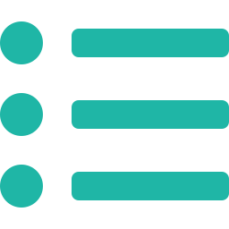





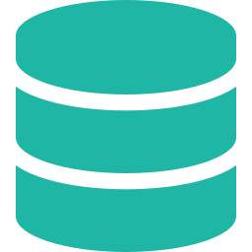





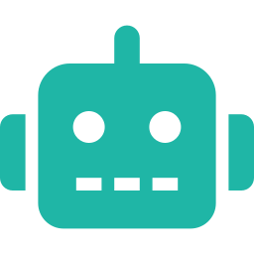







Component 6 · Verification & Guardrails
WHAT IS VERIFICATION?
VERIFICATION COMPONENT ARCHITECTURE
VERIFICATION LOOP
Verification is the harness layer that independently checks whether the agent’s output, actions, and outcomes satisfy the required success criteria using deterministic evidence—not the model’s self-claims.
Closed-loop improvement with evidence.
Generate
(Agent Output)
1. DETERMINISTIC SENSORS
(Observe & Measure)
2. VERIFIERS & JUDGES
(Interpret & Evaluate)
3. POLICY & GUARDRAILS
(Authorize & Protect)
4. HUMAN-IN-THE-LOOP
(Approve High Risk)
1. DETERMINISTIC SENSORS
(Observe & Measure)
2. VERIFIERS & JUDGES
(Interpret & Evaluate)
3. POLICY & GUARDRAILS
(Authorize & Protect)
4. HUMAN-IN-THE-LOOP
(Approve High Risk)
Collect raw, objective signals from the environment.
Evaluate evidence against rules, criteria, or semantic rubrics.
Ensure actions are allowed, safe, and compliant.
Route high-risk actions for human approval.
WHY IT MATTERS
Unit Tests / Integration Tests
Authorization & Permissions
High Risk Detected
Rule-based Verifier
Deterministic rules and thresholds
▼
LLMs are probabilistic; verification is deterministic.
Static Analysis / Linters
Data Privacy / PII Checks
Review by Human
Retry
(Re-attempt Action)
Verify
(Collect & Evaluate Evidence)
Provides objective evidence of correctness.
Build & Compilation
Compliance / Regulations
▼
Schema / Contract Validation
Constraint Verifier
Schema, format, required fields
Risk Scoring & Thresholds
Approve / Reject / Override
Repair
(Fix based on Feedback)
Enables safe, policy-compliant, auditable execution.
Runtime Metrics (Latency, Error)
▼
Action Constraints (Scopes, Limits)
Decision Recorded
Powers reliable retry/repair loops with concrete feedback.
Retrieval / Grounding Signals
LLM-as-a-Judge
Semantic evaluation using rubrics (faithfulness, completeness, safety)
Agent Runtime (Tools, Memory)
DESIGN PRINCIPLES
EXAMPLES OF VERIFICATION IN ACTION
Output: Raw evidence
(machine-readable)
Output: Pass / Fail + Scores
+ Explanations
Output: Allowed / Blocked
+ Risk Score
Output: Approved / Rejected
+ Audit Record
Deterministic First Prefer tests, rules and schemas over LLM opinions.
Coding Agent
Unit tests, lint, build, security scan, coverage, benchmarks
PASS
Evidence Over Assertions Record logs, metrics, and artifacts instead of trusting model claims.
FAIL
VERIFICATION RESULT
Deterministic decision with full audit trail
RAG / Knowledge Agent
Documents retrieved, citations exist, grounding score, hallucination check, PII leakage
PASS
Layered Verification Combine sensors, judges, policy checks, and human approval.
FAIL
Bounded Retries Allow repair loops with limits to avoid infinite cycles.
Financial Agent
Balance check, destination valid, fraud score, policy check, human approval
PASS
Fully Auditable Persist every decision for replay, compliance, and observability.
FAIL
Cypher 2026 · 27

Slide 28
08
OBSERVABILITY
Traces Are the Primary Object
You cannot run in production what you cannot measure — the whole run, span by span.
Cypher 2026 · 28

Slide 29
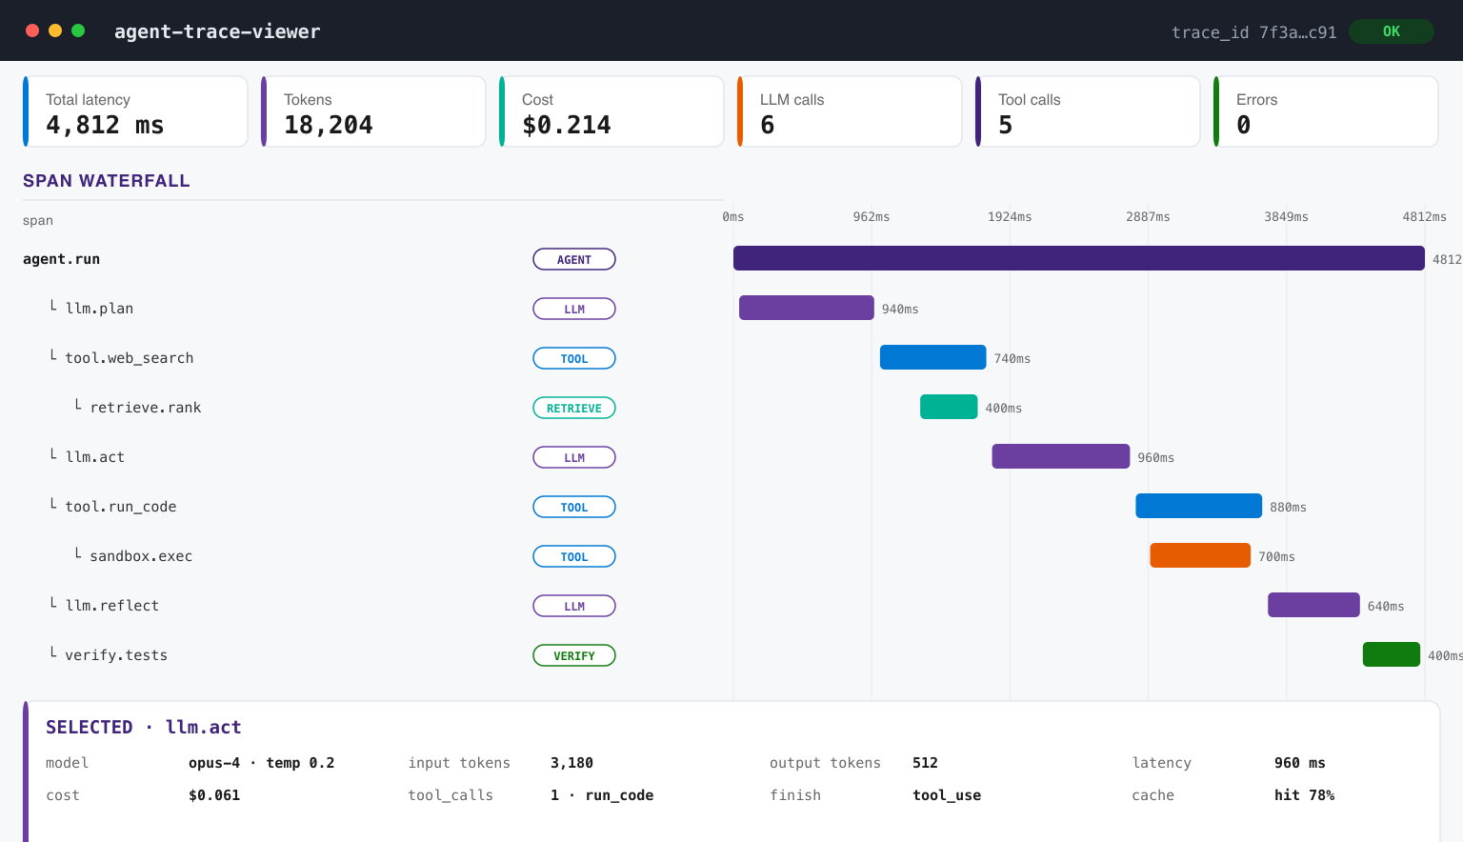
DISTRIBUTED TRACING OF AN AGENT RUN
Cypher 2026 · 29

Slide 30
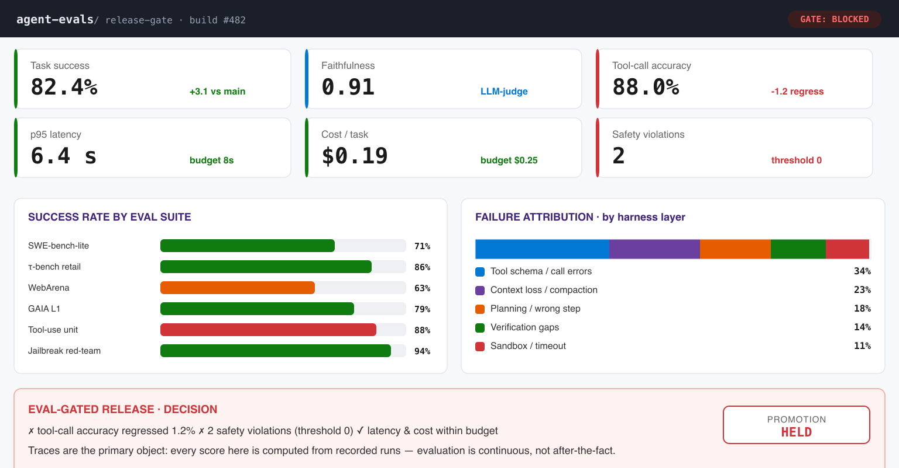
EVALUATION FROM TRACES · THE RELEASE GATE
Cypher 2026 · 30

Slide 31
09
CONTROL PLANE
Governance & Self-Improvement
Identity, audit and policy — and a harness that optimizes itself under hard constraints.
Cypher 2026 · 31

Slide 32
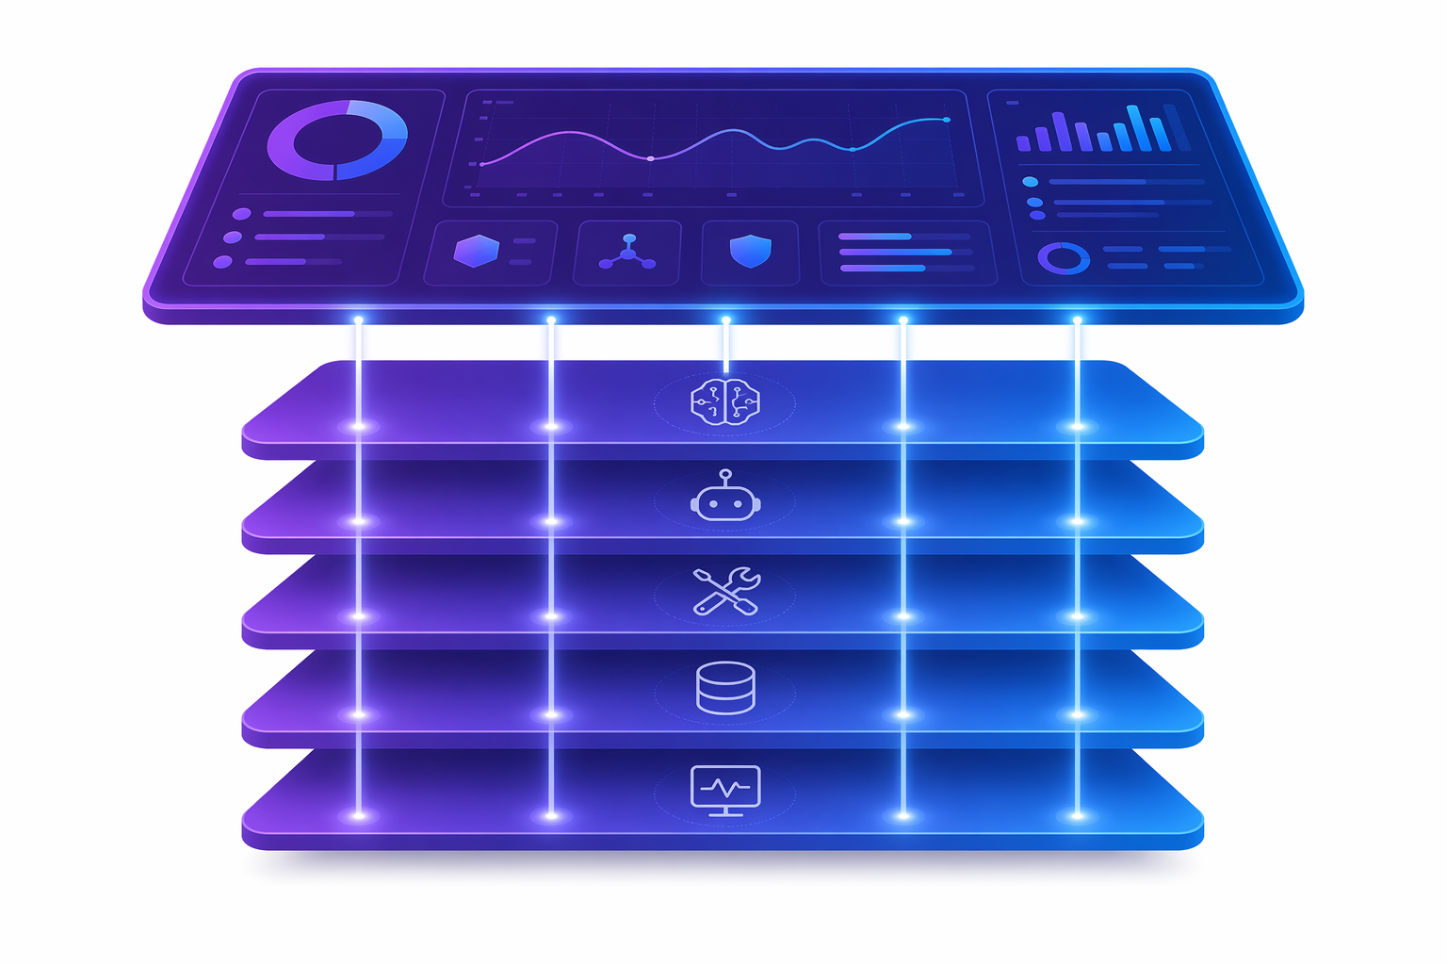
Governance · The Enforcement Layer
Model-level, system-level and organizational controls the model never sees.
Identity & RBAC
Every agent, tool and sub-agent acts under a scoped identity.
Permission models
Least-privilege by default; approvals as explicit lifecycle hooks.
Audit & provenance
Every action, tool call and state change is recorded and attributable.
Declarative constitutions
Policy-as-code the harness enforces at each interception point.
Cypher 2026 · 32

Slide 33
THE SELF-EVOLVING HARNESS · AEGIS
THE SELF-EVOLVING HARNESS
Telemetry becomes an optimization signal — a meta-agent proposes harness edits that typed gates accept or reject
1
Digester
gate: actionability < α → no-op
stage
compress ~10M trace tokens → per-task summaries: outcome, failure class, implicated component
2
Planner
defends: under-exploration
stage
build the adaptation landscape; force structural options, not just prompt tweaks
3
Evolver
emit typed builder edits + change manifest; smoke-test new processor code
gate: 0 type-safe → no-op
stage
4
Critic + Deterministic Gate
cannot be bypassed
stage
check manifest vs trace evidence & non-local effects; then build → smoke → seesaw
Cypher 2026 · 33

Slide 34
10
SYNTHESIS
Putting the Harness Together
The tensions, the open problems, and what to instrument before you ship.
Cypher 2026 · 34

Slide 35
11
ON AZURE AI FOUNDRY
Building the Harness on Microsoft Azure AI Foundry
The managed engine that provides every harness component as a governed capability.
Cypher 2026 · 35

Slide 36

Microsoft Foundry
Agent Service
Build
Deploy
Operate
Optimize
Enterprise-grade developer platform for building, deploying, operating, and optimizing agentic applications.
Cypher 2026 · 36

Slide 37

Hosted Agent
User
Microsoft Teams
Foundry Service Gateway
Control Plane
Agent version lifecycle
Snapshot creation
ADC Sandbox mgmt
Data Plane (Agents v2)
Protocol Layers: Invoke Responses (and MCP, A2A)
Session management
Request routing → sandboxes
Observability & Evals
Distributed Tracing
Agent Logs & Metrics
Evaluation metrics, benchmarking
Identity & Tools
Agent Identity, OBO for Tools
Curated Skills & Tools
Tools Catalog
Compute Substrate – MicroVM
Session isolation
Stateful session storage
Sub-second cold start
Scale-to-zero
Egress control
Cypher 2026 · 37
Notes:
Secure and fast ephemeral microVMs per user session
Session state persistence across ephemeral microVM runs (across idle time shutdowns) that is very friendly to code-agents that require full file-systems (differentiation from competitors today that don't give durable file systems)
Uses Entra Agent Identity vs managed-identity to enable separation from traditional processes and directory memberships for digital-employee scenarios.
Full auditability and control on egress policies (including forward-looking business logic-y policies that are for enforcement and for reactive alerts/outliers)
Auto-conversion to multiple API protocols in Responses path - easy path to publish to Teams/M365 w/ Activity protocol

Slide 38
Orchestration Framework
The Agent Build Landscape
Model APIs
OpenAI Responses
Anthropic Messages
Agent-loop + tool calling bult in. Great for single-agent scenarios.
Agent Frameworks
Microsoft Agent Framework (MAF)
LangGraph
CrewAI
Autogen
Multi-agent orchestration, state machines, checkpointing, HITL, error recovery
Coding Agents SDK
GitHub Copilot SDK
Claude Agent SDK
Cursor
Windsurf
Full autonomous loop: plan → act → observe → iterate. Embed in your project.
Claws / Personal
Agent Platforms
OpenClaw
NanoClaw
Full-stack end-user products: skills marketplace, multi-channel, native apps.
Cypher 2026 · 38
Notes:
SPEAKER NOTES — Slide 6: The Agent Build Landscape
Owner: Vivek Bhadauria / Atul Aggarwal | Time: 22:00 – 26:00
Four ways developers build agents today. Agent Service doesn't pick a winner — the platform treats them all the same.

Slide 39
Tools & Knowledge
Foundry Toolbox
Curate
Browse tool catalog
Bundle into a toolbox
Configure auth + steering
Reuse across agents
Search
Tool Search tool
Dynamically finds best tool
Context-aware selection
Solves context-window explosion
Govern
Private tool catalog
Org-level permissions
DLP / RAI / rate limits
Full observability + audit
API Key –– OAuth –– User Impersonation (OBO)
Cypher 2026 · 39
Notes:
SPEAKER NOTES — Slide 11: Foundry Toolbox
Three pillars: Curate (browse, bundle, configure, reuse), Search (dynamic tool discovery, context-aware), Govern (private catalog, org permissions, DLP/RAI, audit).
Auth: API Key, OAuth, User Impersonation (OBO), Agent Identity.
Value prop: "One place to manage all your tools across all your agents."

Slide 40
“
Let’s Build.
Foundry gives you the managed engine — bring your harness and ship enterprise-grade agents.
Cypher 2026 · 40

Slide 41
Thank You
Cypher 2026 · 41

