Slide 1
Cypher 2026
Agent Harness for Enterprise:
Engineering the Runtime for Reliable AI Agents
Manoranjan Rajguru
Microsoft

Slide 2
The Day — From One LLM Call to a Full Agent
M1
Your First Agent — the agent loop, streaming
M2
Tools & Function Calling — give the agent hands
M3
Context Engineering — sessions, memory, compaction
M4
The Agent Harness ★ — create_harness_agent — batteries included
M5
Multi-Agent Orchestration — sequential, concurrent, handoff…
M6
Evaluating & Optimizing — measure quality, gate CI
M7
Operationalizing — tracing, middleware, guardrails
M8
Capstone & Hosting — combine it all; A2A, Functions
Labs are hands-on Jupyter notebooks · live at monuminu.github.io/Cypher-workshop26
Cypher 2026 · 02

Slide 3
Foundations
What is an agent, and why now?
Cypher 2026 · 03

Slide 4
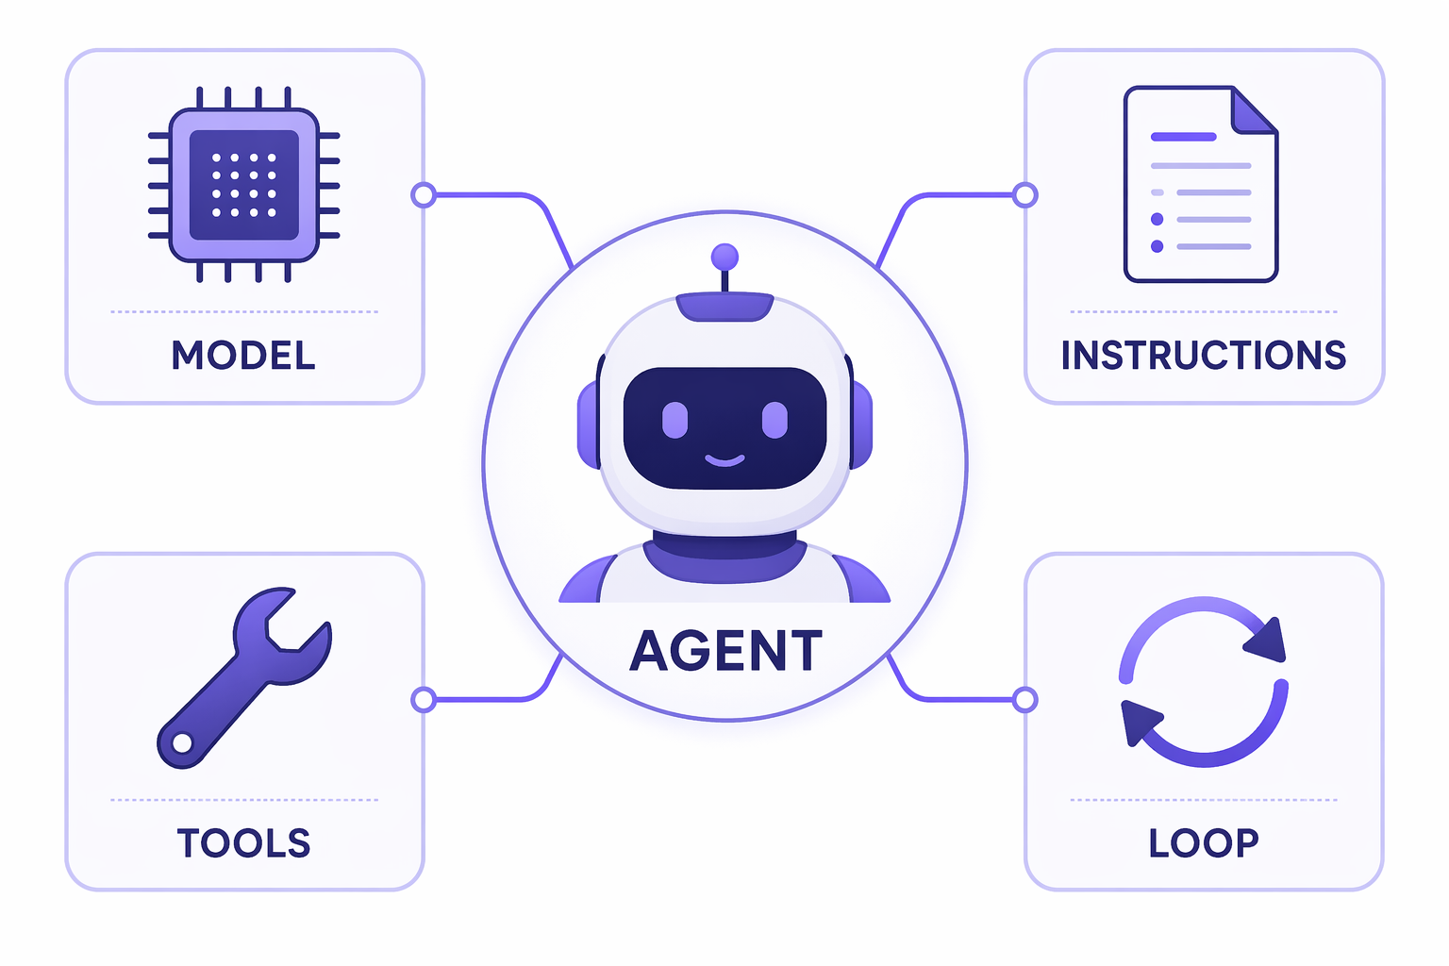
From an LLM Call to an Agent
• An LLM alone is text-in, text-out — no memory, no actions.
• An agent wraps the model in a loop that adds three powers:
  – Tools — it can act, not just talk
  – Memory — it remembers across turns
  – Control flow — it plans and repeats until done
• Agent = model + instructions + tools + a loop.
The anatomy of an agent
Cypher 2026 · 04

Slide 5
The Agent Loop (ReAct)
• Every agent.run() executes a reason → act → observe loop:
  – 1 · Send conversation + available tools to the model
  – 2 · If the model calls a tool, run it and feed the result back
  – 3 · Repeat until the model returns a final answer
REASON
ACT (tool)
OBSERVE
ANSWER
→
→
→
With no tools the loop is a single hop; add tools (M2) and it iterates.
Cypher 2026 · 05

Slide 6
Why the Microsoft Agent Framework
Swap with one env var:
• Open-source SDK — the successor to Semantic Kernel + AutoGen.
• Two core capabilities: Agents and Workflows.
• Code-first and fully programmable.
• Provider-agnostic — one interface, many backends.
• Python and C#.
Azure AI Foundry
OpenAI
Azure OpenAI
Anthropic
Ollama
AWS Bedrock
Google Gemini
MODEL_PROVIDER=… → notebook code never changes
Cypher 2026 · 06

Slide 7
Context Engineering
Deciding what the model sees
Cypher 2026 · 07

Slide 8
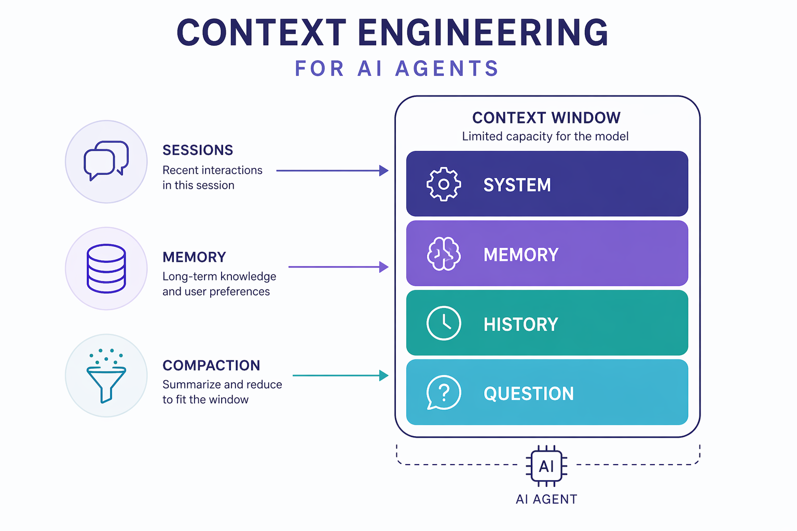
Context Engineering
• The model only sees what fits in its context window.
• Engineering that window is where real quality comes from.
  – Sessions — carry history across turns
  – Context providers — inject facts before each run
  – Memory — persist what matters
  – Compaction — summarize so you never overflow
What goes into the window each turn
Cypher 2026 · 08

Slide 9
The Agent Harness ★
Everything, assembled
Cypher 2026 · 09

Slide 10
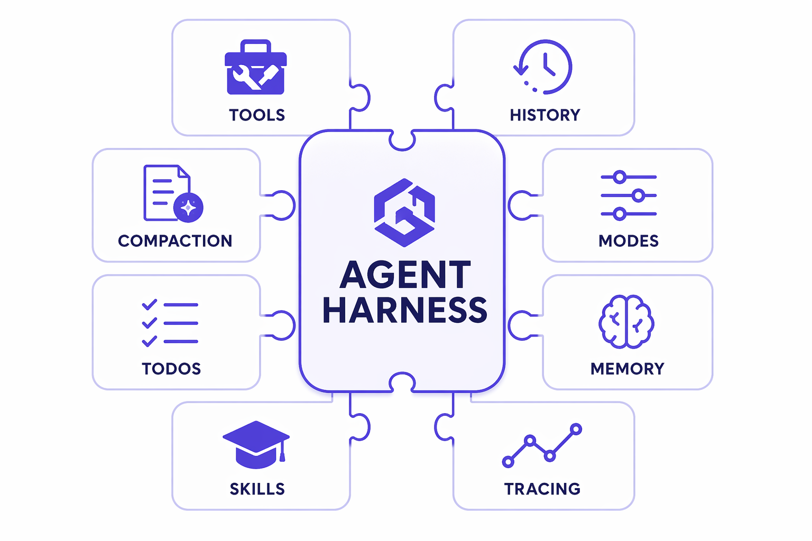
What is Agent Harness ?
• Re-assembling the same machinery every time? The harness packages it.
• One factory call wires up:
  – Tool loop · history + persistence · compaction
  – Todos (planning) · plan/execute modes
  – Durable memory · skills · OpenTelemetry
• Every battery can be disabled or replaced.
The 8 batteries of the harness
Cypher 2026 · 10

Slide 11
Tools & Function Calling
• A tool is a typed Python function + a docstring + the @tool decorator.
• The model decides when to call it; the framework runs it and loops.
• Approval gates put a human in the loop for risky actions:
  – approval_mode="always_require" pauses for confirmation
  – approval_mode="never_require" runs automatically (demos)
@tool
model calls it
run + feed back
approve?
Tools are the agent's hands — small, well-described, single-purpose.
Cypher 2026 · 11

Slide 12
Multi-Agent Orchestration
When one agent isn't enough
Cypher 2026 · 12

Slide 13
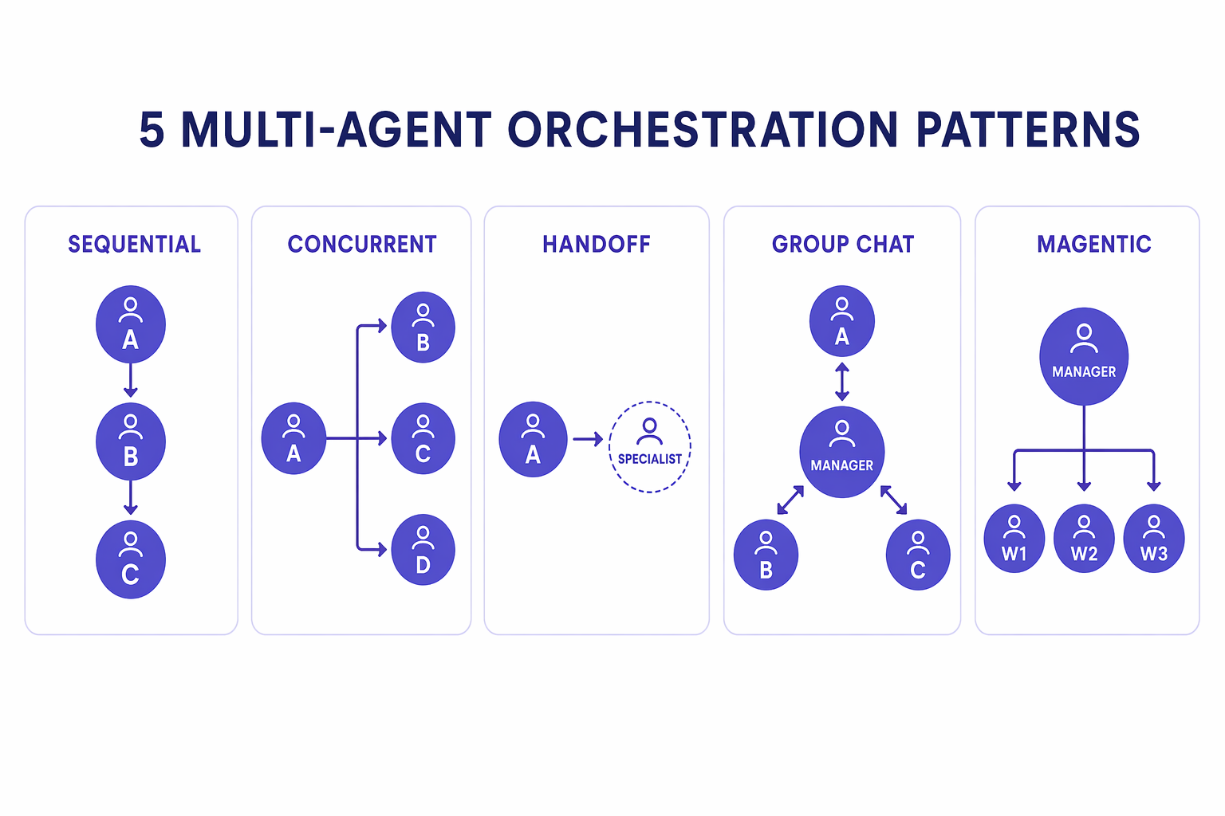
Five Orchestration Patterns
Specialized agents collaborating
• Sequential · Concurrent · Handoff · Group Chat · Magentic — start with the simplest that fits.
Cypher 2026 · 13

Slide 14
Optimize & Operate
From demo to production
Cypher 2026 · 14

Slide 15
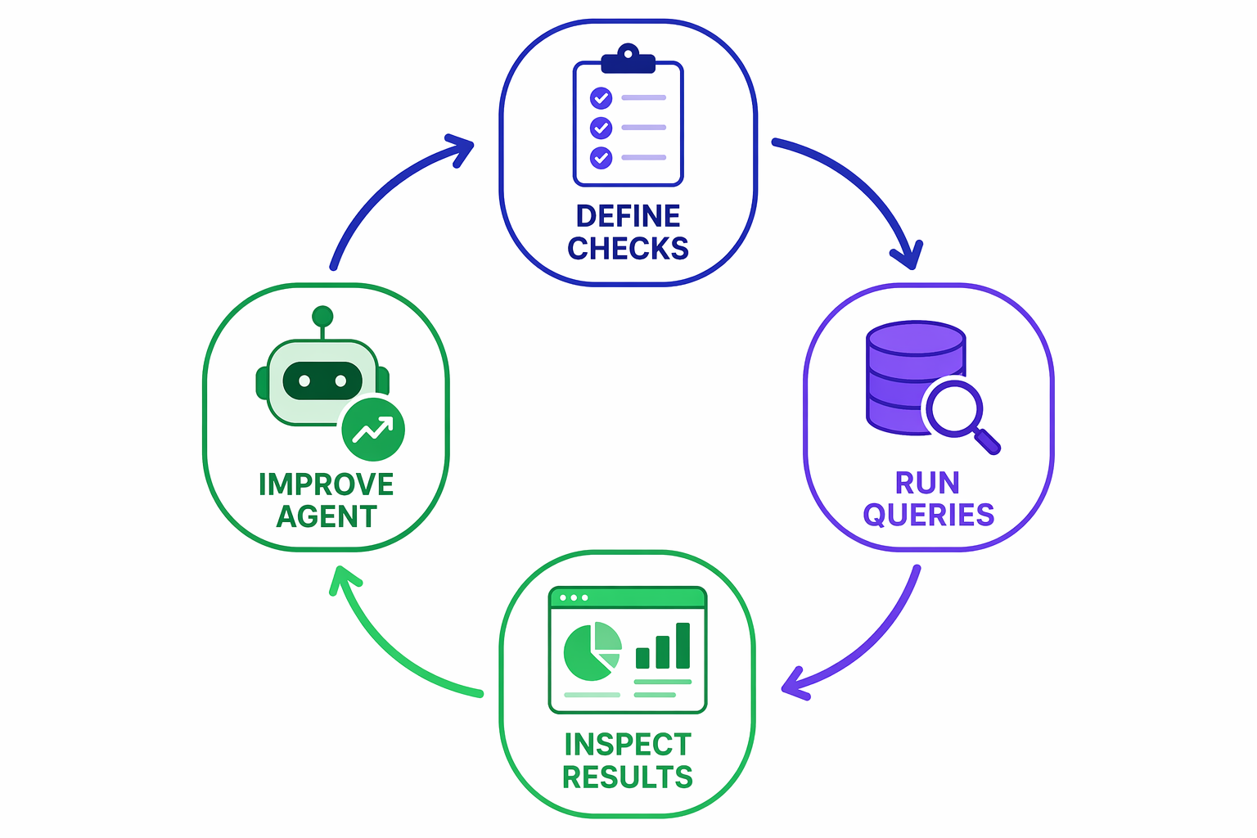
Evaluating & Optimizing Agents
• A demo that works once isn't a product.
• Measure quality so you can improve it on purpose:
  – Define checks (keyword, custom, model-graded)
  – Run them over a query set
  – Inspect failures → improve → re-run
• raise_for_status() makes a regression break CI.
The evaluation loop
Cypher 2026 · 15

Slide 16
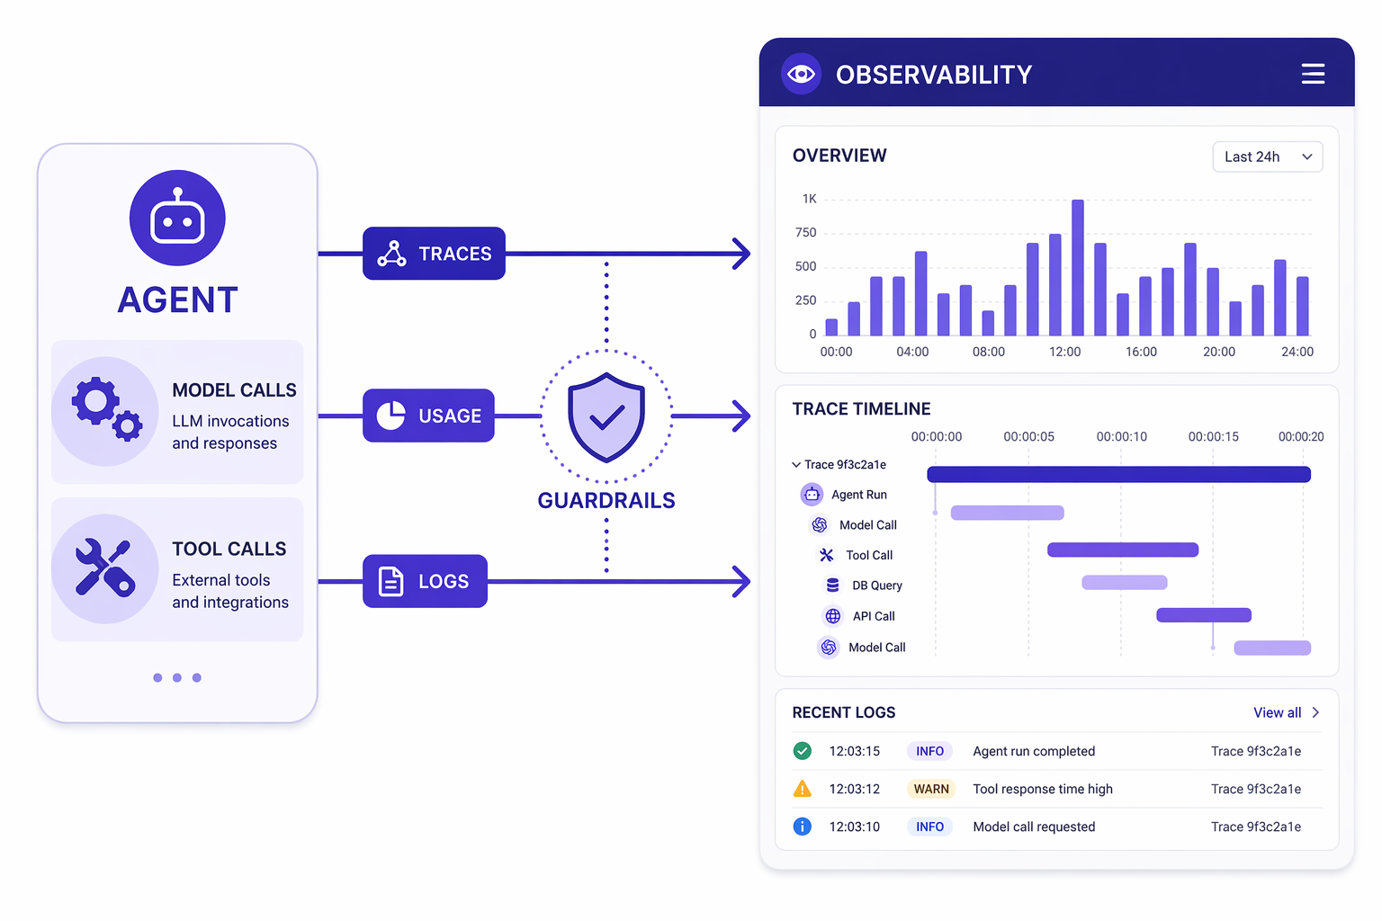
Operationalizing — See Inside the Agent
• Agents are non-deterministic and call external tools.
• Middleware = a control point around every model call:
  – Usage tracking (tokens / cost)
  – Guardrails (redaction, injection checks)
• OpenTelemetry gives end-to-end traces to any backend.
Tracing, usage & guardrails
Cypher 2026 · 16

Slide 17
Hands-On — Build It Yourself
• 8 self-contained lab notebooks — M1 through M8.
• Provider-agnostic: pick a backend, the code stays the same.
• Runnable without an instructor — revisit anytime.
Live workshop site: monuminu.github.io/Cypher-workshop26
github.com/microsoft/agent-framework · learn.microsoft.com/agent-framework
Cypher 2026 · 17

Slide 18
Thank You
Cypher 2026

