Slide 1

Course Management System
An application that can be added to a web server
to create a flexible web-based environment for
creating and managing online courses
Provides tools for creating online activities and assignments
Allows integration of almost any content
Oriented towards creating communities of learners
Contains detailed logging and grading to help assessment
Integrates very easily and securely into existing environments
Open Source software under the GPL license
Compares very well to products like WebCT, Blackboard, eCollege

Slide 2
Background
Administrator of Online Learning at Curtin University of Technology
Experienced developer of internet software (since 1986)
Dissatisfaction with existing products at the time
Had the ability to fix problems and customize software but was
restricted in doing so by Closed Source licenses.
Developed passionate belief in the possibility of something better
Masters and PhD studies
Performed detailed case studies of online classes and students
Detailed reviews of education literature
→ Moodle 1.0, 2001

Slide 3
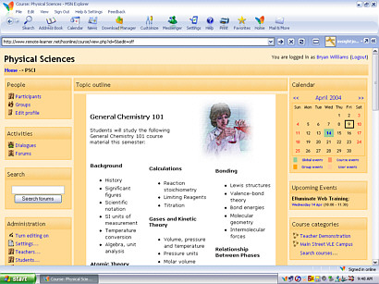
Creating Courses
Course design is based on the simple
metaphor of a series of activities
There are nearly 20 available types of
activities, such as forum discussions,
assignments, glossaries, chats etc
and each has many different options.
Creating courses is quite simple, and
lends itself to constant re-evaluation
and re-shaping during a course
Filters provide auto-linking and auto-formatting of text, solid mathematics
notation, and integration of multimedia (sound, video) throughout courses.
Email notifications of events and posts keep interaction bubbling
Content from around the web, including packaging standards like SCORM,
can easily be introduced at any time.
Moodle courses can be packaged and moved around.

Slide 4

Usage
Moodle is downloaded over 300 times each day
1600 registered sites in 88 countries
Universities, Colleges, High Schools, Primary Schools
Many thousands of unregistered sites too
Interface is translated into over 40 languages
Over 2000 recent participants in the support forums

Slide 5
Development
Over 75 contributing developers in total
Many are teachers who are “scratching an itch”
Many are paid by their institutions to produce customizations
Some are contracted via moodle.com by clients who need certain features
Not everything ends up in the main release – Moodle’s modular structure provides choice
All modifications are also Open Source

Slide 6

Support
Local support – Moodle creates employment
for IT staff all around the world
Community support via
forums at Moodle.org and
elsewhere on the web
Commercial support via world-wide
Moodle Partners at Moodle.com

Slide 7

Some Future Directions
Better documentation
Further simplification of the user interface
Further clarification on the programmer interfaces
Further options for most modules
Increased performance and scalability in key areas
Even better integration with existing systems
Templates and accessibility
Increased pedagogical support
More standards support
Course sharing

Slide 8


Sharing Courses
Moodle courses already can be compressed into a single file and shared between installations
We are working towards automating this process via the Moodle Course Exchange, creating a marketplace for teachers.
Moodle Exchange
Course
Course
Pay?
Pay?
Teacher using courses
Teacher producing courses

