Slide 1
Simple Linear Regression: TRAINING SET
Inputs
Training dataset
House price data
Outputs/ actuals
x
2104
1600
2400
1416
3000
1985
1534
y
399900
329900
369000
232000
539900
299900
314900
Size(sq ft) | Price (USD)
2104 | 399900
1600 | 329900
2400 | 369000
1416 | 232000
3000 | 539900
1985 | 299900
1534 | 314900
….. | …..
Features
Labels/Truths
Requirement: predict house prices
Src: Prof Andrew Ng Coursera Course: Introduction to Machine Learning
Notes:
Data driven model so let’s look at our data
supervised learning model
Regression -> output consists of continuous data

Slide 2
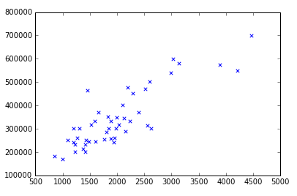
PLOT OF TRAINING SET
House Price
(USD)
House Size (feet²)
Src: Prof Andrew Ng Coursera Course: Introduction to Machine Learning

Slide 3
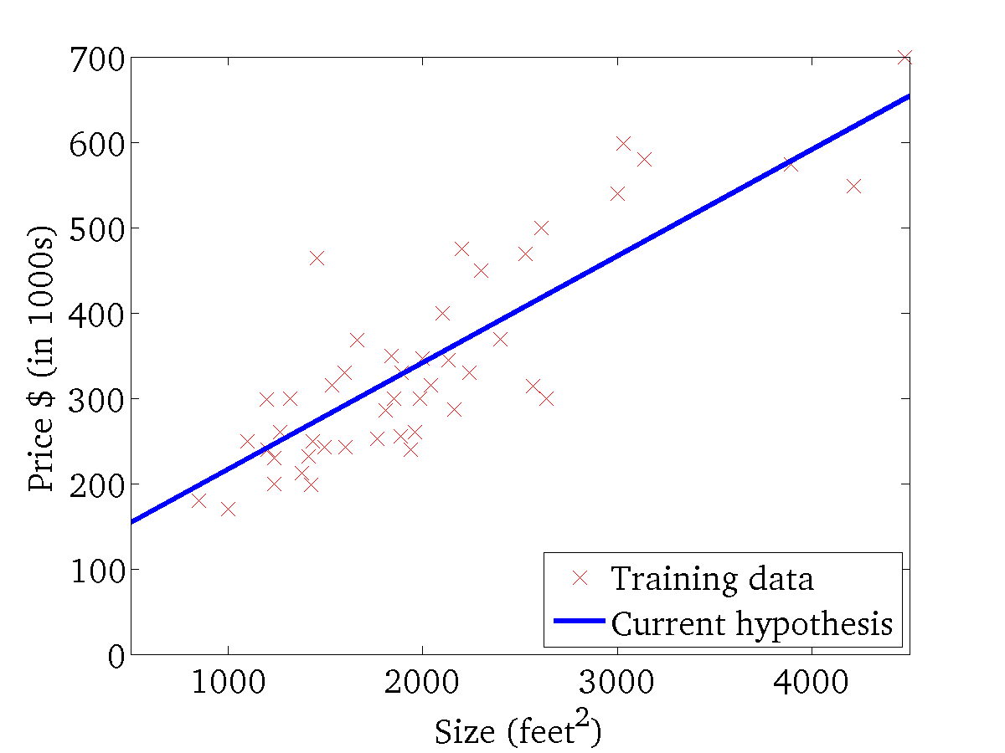
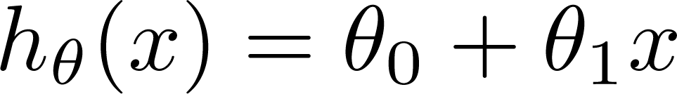
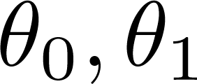
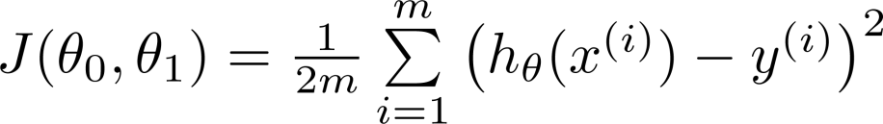
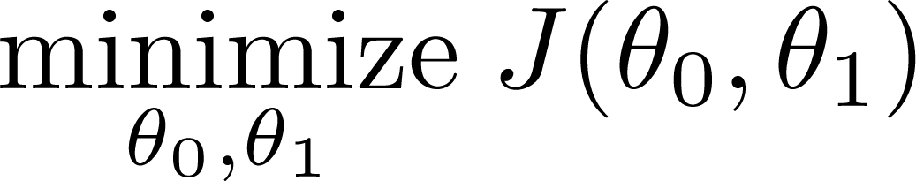
MODEL
Hypothesis:
Parameters/Co-efficients:
Cost Function:
Goal:
Src: Prof Andrew Ng Coursera Course: Introduction to Machine Learning
Notes:
What we want at the end of this process is a function that can take x and predict house price for me.
Looking at the data I think a straight line would be a good fit.
So I choose my prediction function to be the equation for a straight line - aka the hypothesis
Now I have a way to predict my data … if I can find my parameters theta0, theta1
Bring in the concept of a cost function, also known as the loss function
Choose this function - basically difference between prediction and actual
Optimise this cost function to find the best values of theta0/1
Summarise:
Choose a prediction function -> a line
Determine the cost function that sums the errors between the prediction and actual
Optimise the cost function to find the parameters
Plug those into the hypothesis and use this to make predictions.

Slide 4
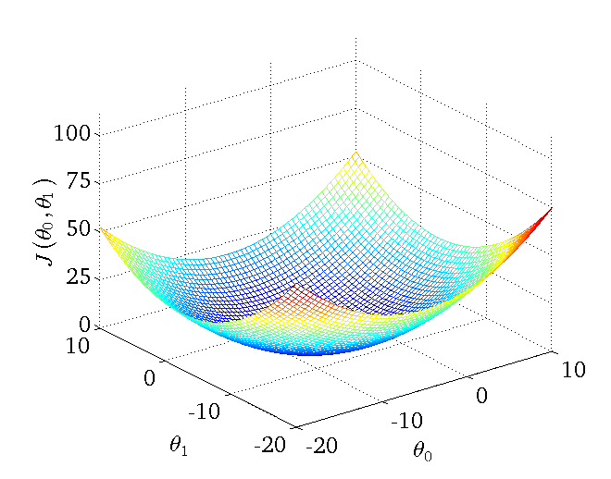
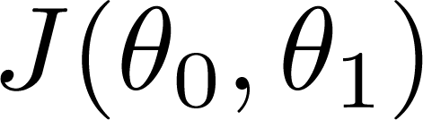

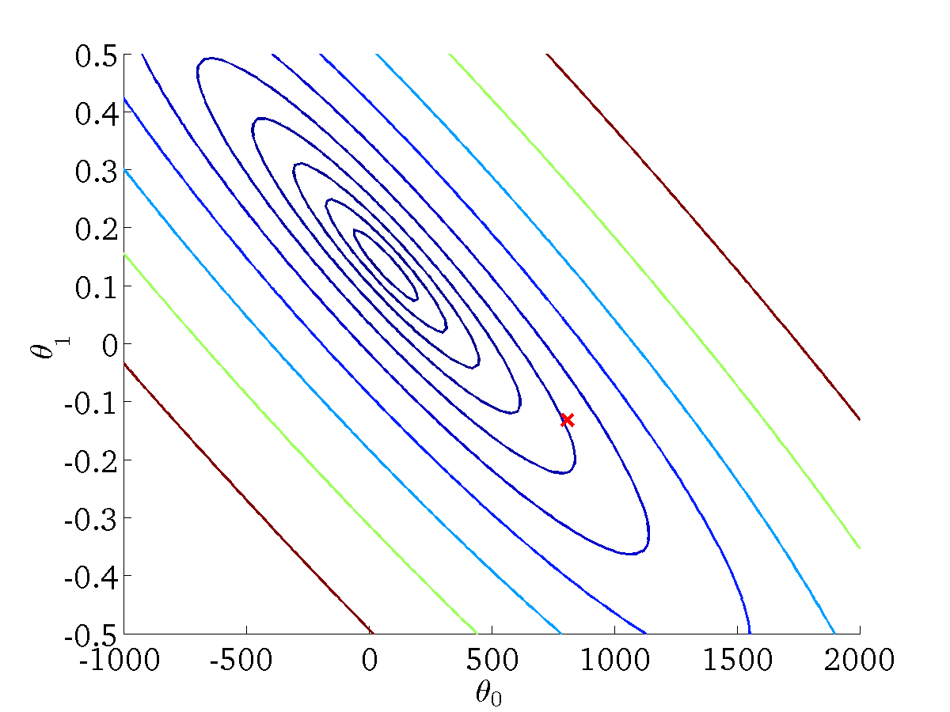
Optimisation: Gradient Descent
Contour plot
function of the parameters )
Src: Prof Andrew Ng Coursera Course: Introduction to Machine Learning

Slide 5


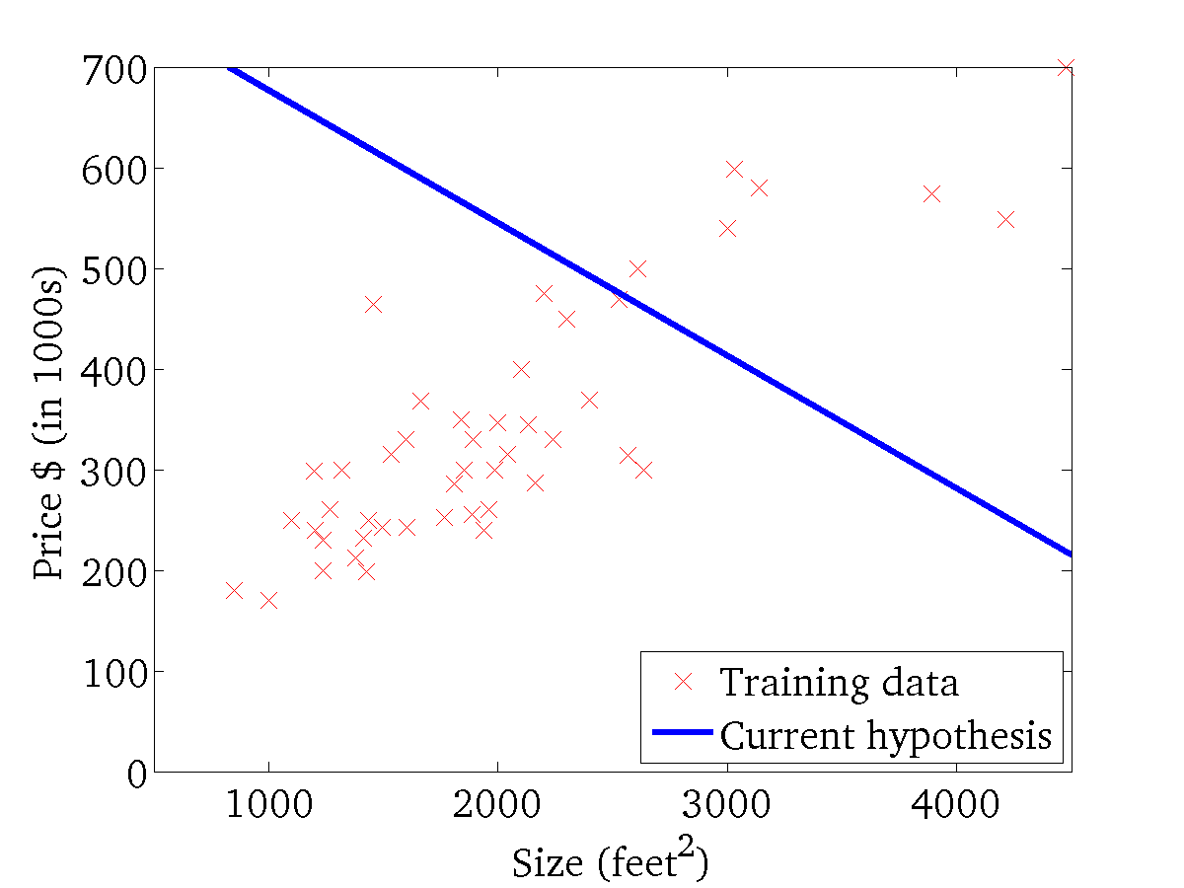
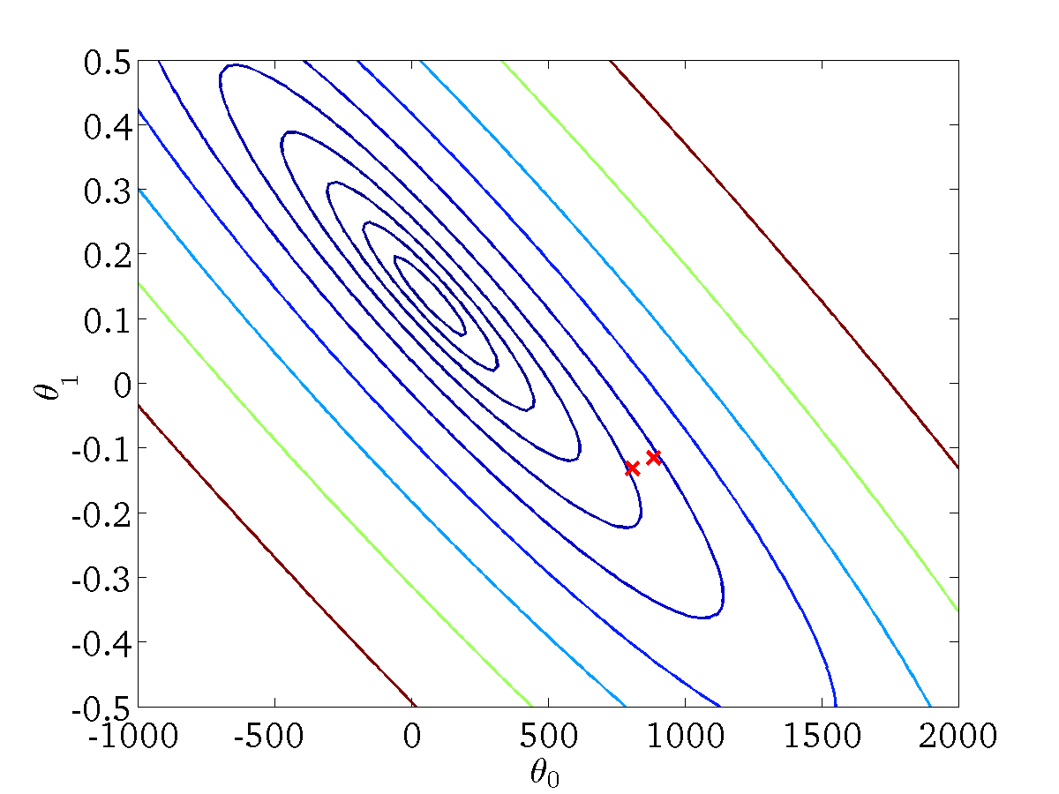
Gradient Descent: Step through Iterations
(for fixed , this is a function of x)
(function of the parameters )
Src: Prof Andrew Ng Coursera Course: Introduction to Machine Learning

Slide 6
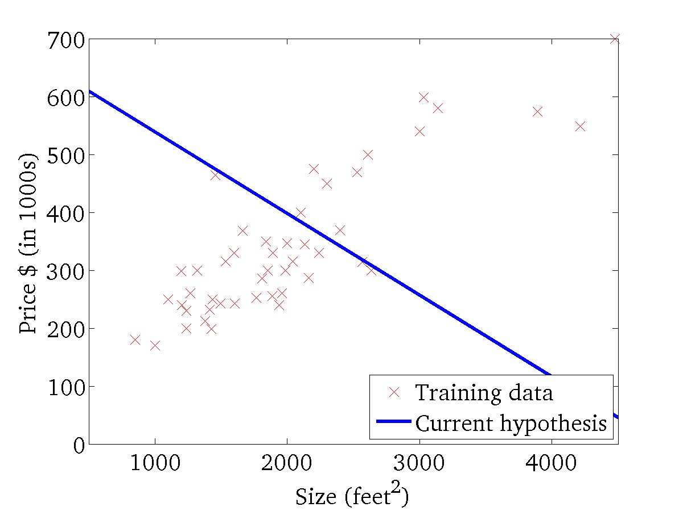
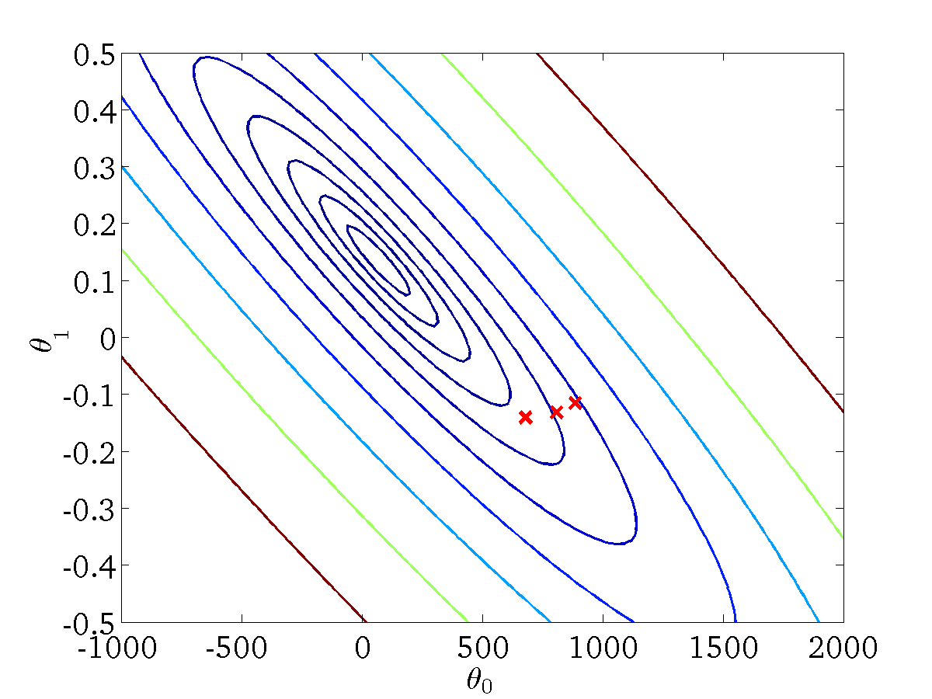
(for fixed , this is a function of x)
(function of the parameters )
Src: Prof Andrew Ng Coursera Course: Introduction to Machine Learning

Slide 7
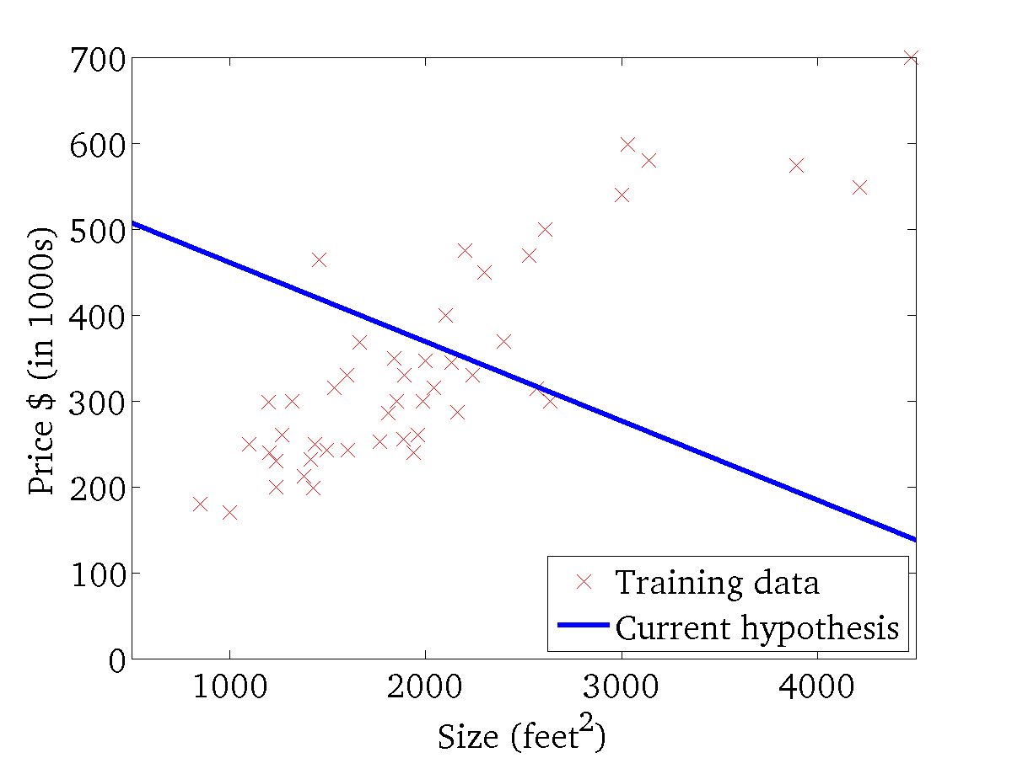

(for fixed , this is a function of x)
(function of the parameters )
Src: Prof Andrew Ng Coursera Course: Introduction to Machine Learning

Slide 8
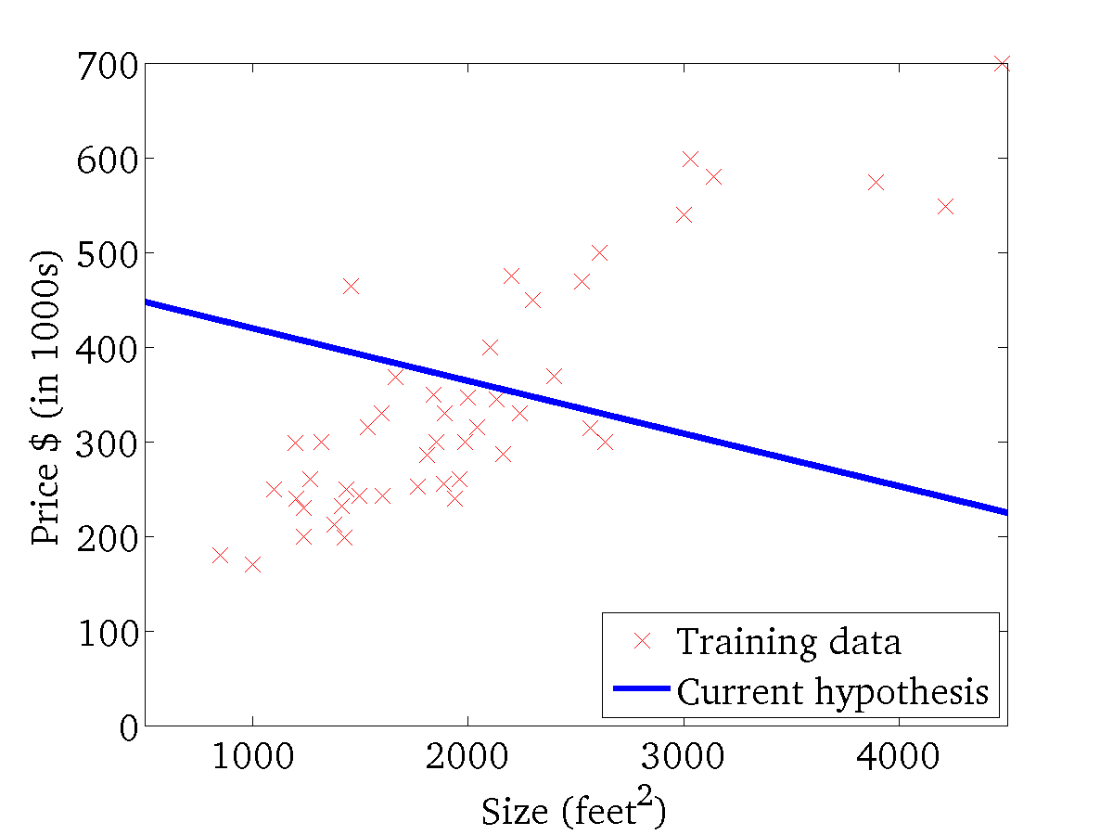
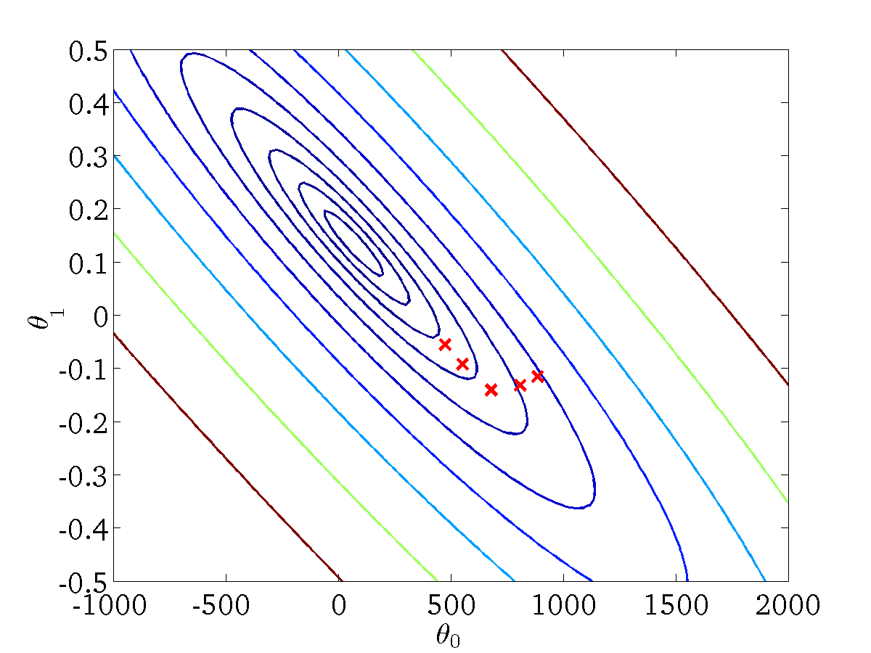
(for fixed , this is a function of x)
(function of the parameters )
Src: Prof Andrew Ng Coursera Course: Introduction to Machine Learning

Slide 9
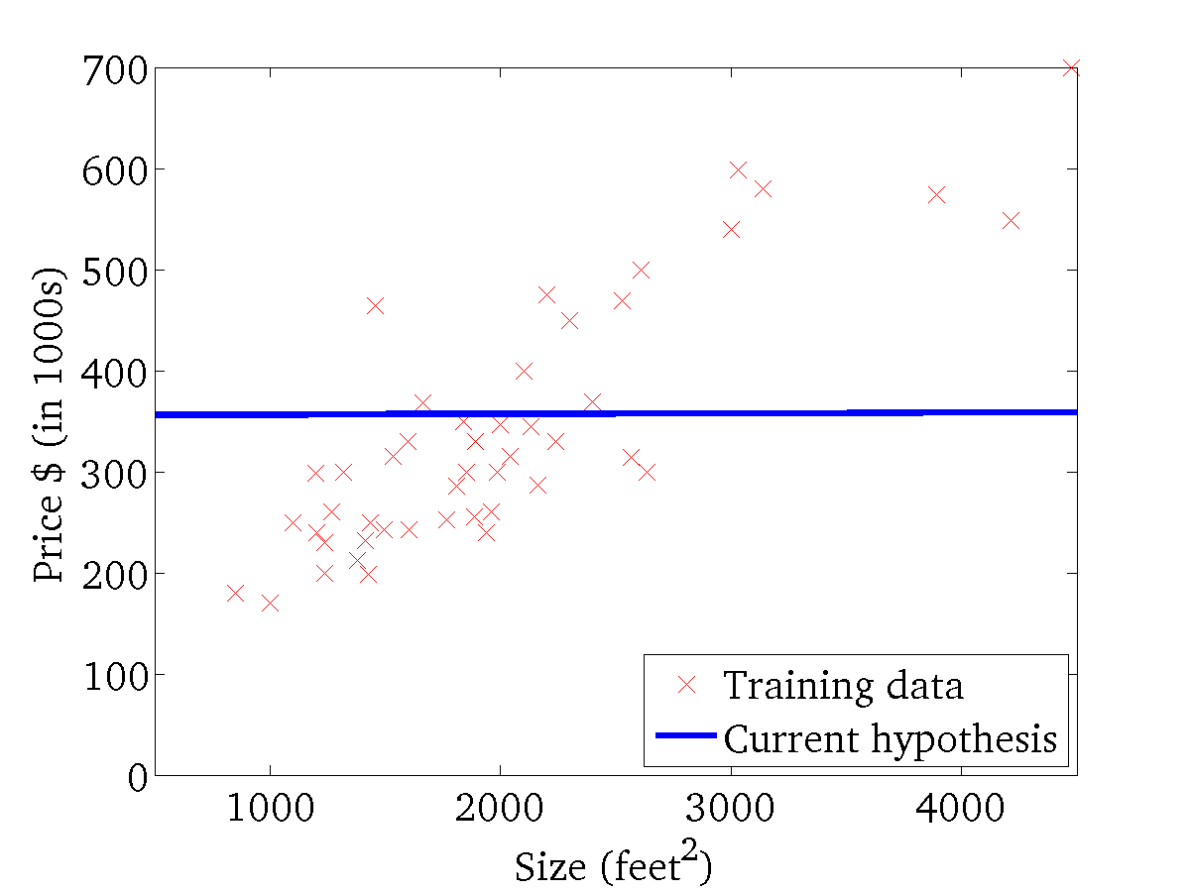

(for fixed , this is a function of x)
(function of the parameters )
Src: Prof Andrew Ng Coursera Course: Introduction to Machine Learning

Slide 10
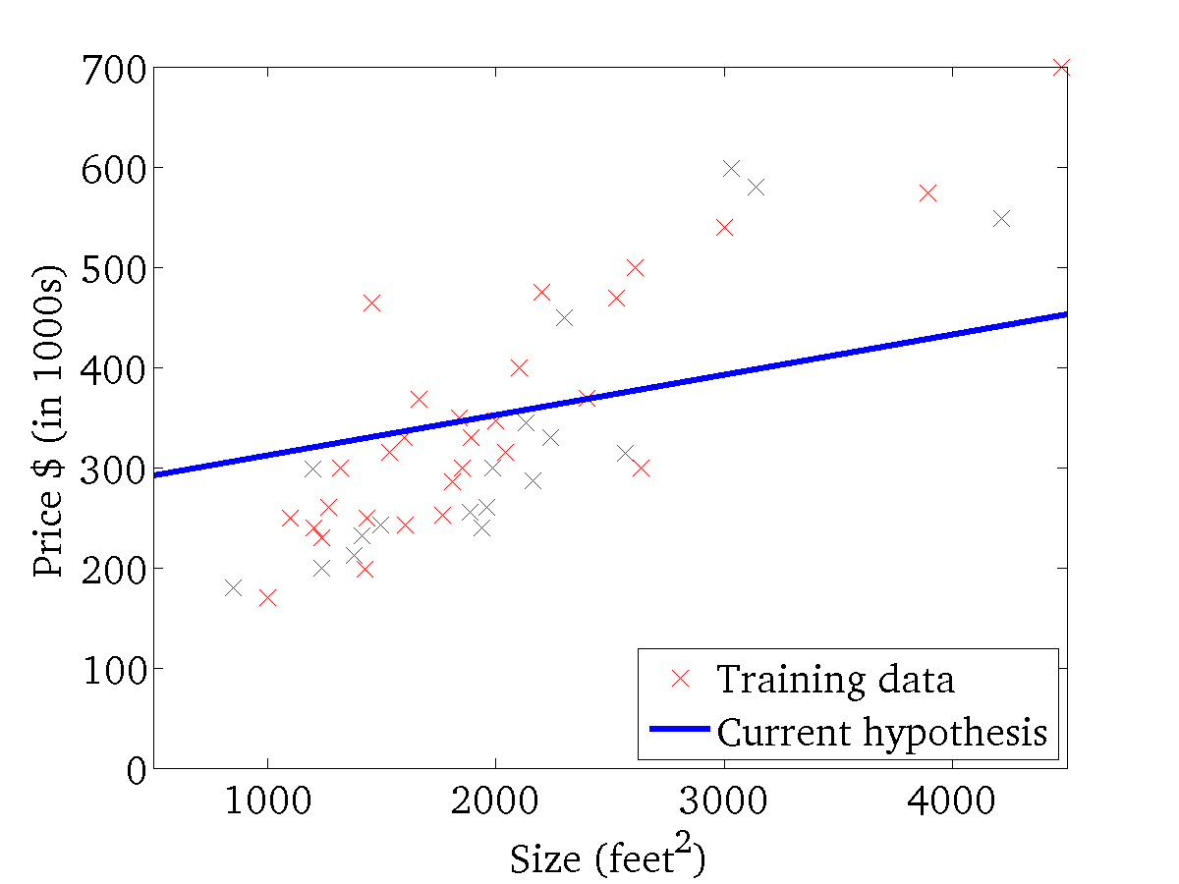

(for fixed , this is a function of x)
(function of the parameters )
Src: Prof Andrew Ng Coursera Course: Introduction to Machine Learning

Slide 11
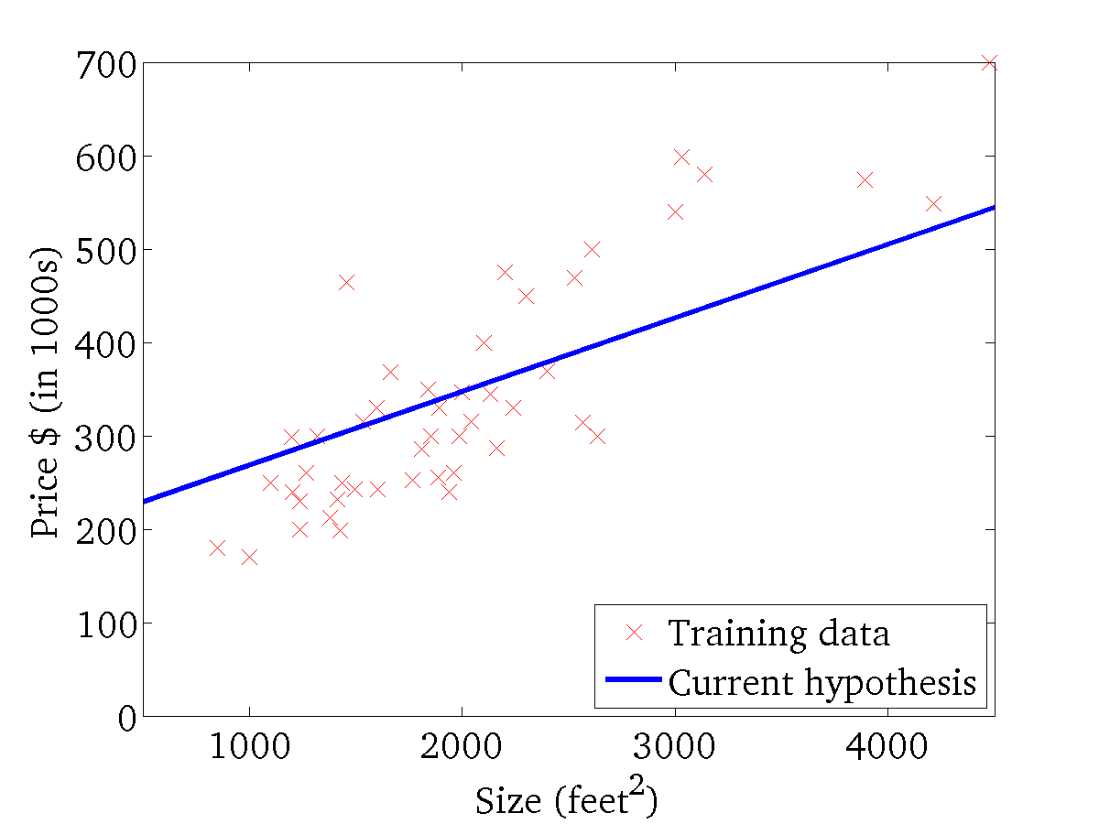
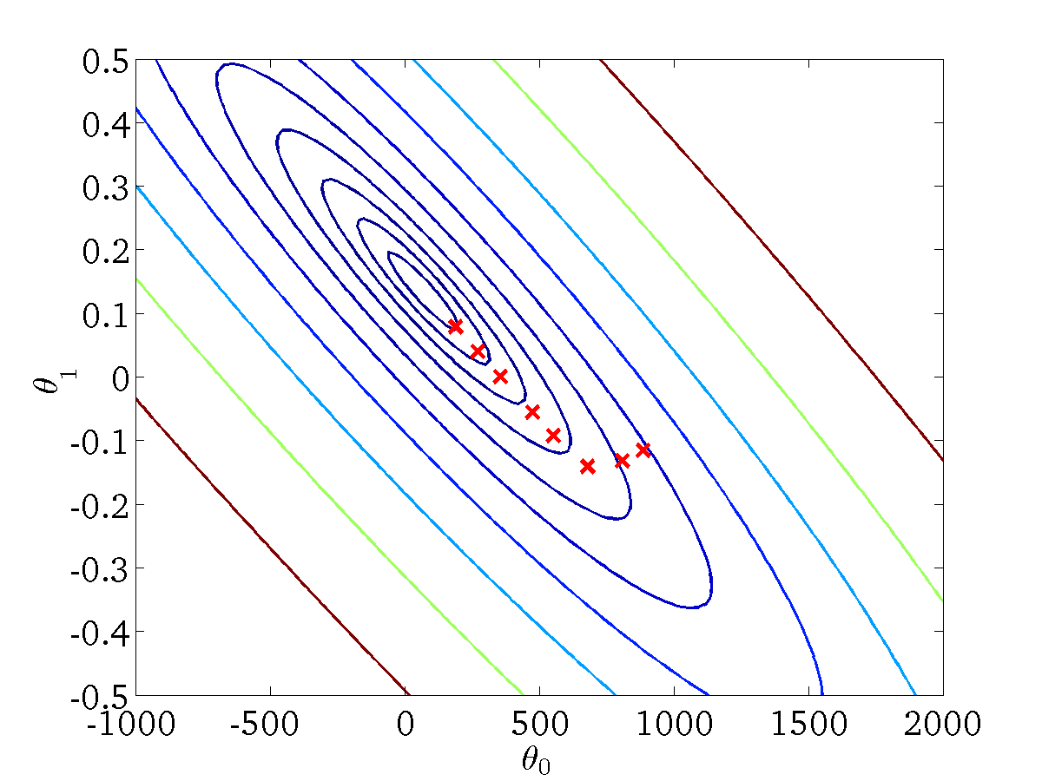
(for fixed , this is a function of x)
(function of the parameters )
Src: Prof Andrew Ng Coursera Course: Introduction to Machine Learning

Slide 12

(for fixed , this is a function of x)
(function of the parameters )
Src: Prof Andrew Ng Coursera Course: Introduction to Machine Learning
Notes:
PM: Illustrate that now we have optimal parameters we can make predictions.

Slide 13
Extension of concepts
Multi-variate input X - more than one feature
Vector of Weights (nx1) to match features
Size | No Of Rooms | No of floors | Price
2104 | 3 | 1 | 399900
1600 | 3 | 2 | 329900
2400 | 3 | 3 | 369000
1416 | 2 | 2 | 232000
3000 | 4 | 1 | 539900
1985 | 4 | 2 | 299900
1534 | 3 | 2 | 314900
X matrix (mxn)
m training records
n features
h(X) = 𝚹₀ + 𝚹₁x₁ + 𝚹₂x₂ + 𝚹₃x₃
Notes:
Mention faster convergence if you normalise and scale
Remove redundant features, etc

Slide 14
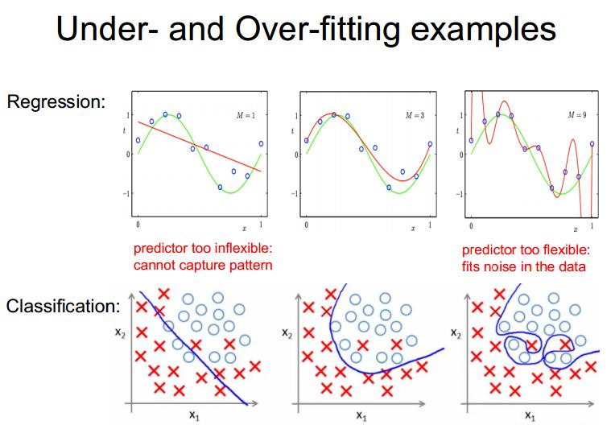
Extension of concepts
Notes:
Evaluation of model - based on

Slide 15
To Summarise – the ML Pipeline
Input – training set with labels/values
Split some training data into test and validation sets
Training a model (training set)
Tweaking model’s hyperparameters (validation set)
Evaluation of the model (test set)
Using the model to make new predictions

