Slide 1
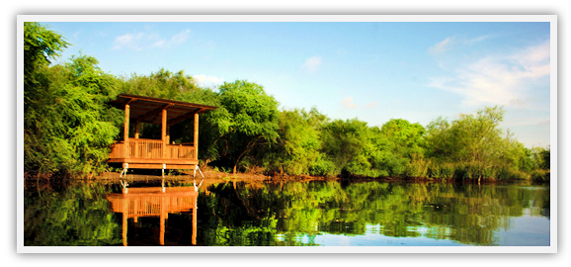
Resaca Riparian Characterization Using Python
Alvaro Garcia

Slide 2
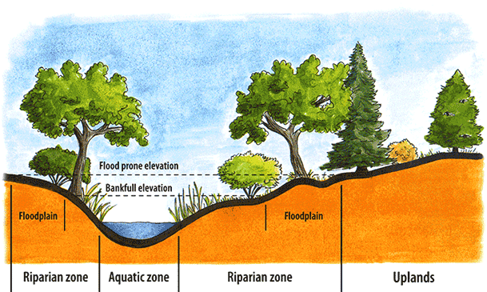
Riparian Zones
Help improve water quality through nutrient removal
Serve as habitat for various fauna and flora
Stabilize soil and reduce sediment runoff

Slide 3
Goals/Aims
Delineate riparian zones using USDA method
Based on elevation, land cover, soil, wetlands, 50 year flood heights, streams, lakes, and watersheds
Use resaca subwatershed shapefiles for more precision
Create test buffers at various recommended lengths (Hawes and Smith 2005)
Erosion Control: 30 to 98 ft.
Water Quality: 16 to 164 ft. with 49 ft. being optimal
Aquatic Wildlife: 33 to 164 ft.
Terrestrial Wildlife: Test for continuity of riparian zone?
Test those buffers on the delineated resaca riparian zones

Slide 4
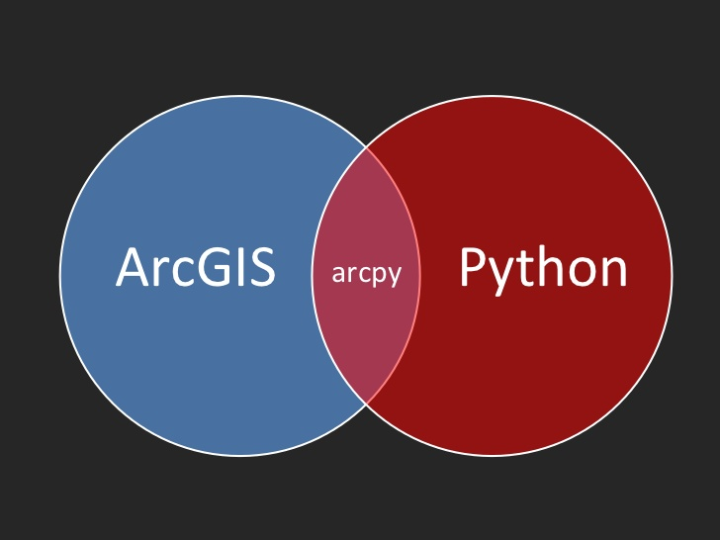
Methods
Arcpy and Arcpy API
Create buffers using Python rather than manually on GIS
Characterize resaca riparian zones and rank subwatersheds based on functions

Slide 5
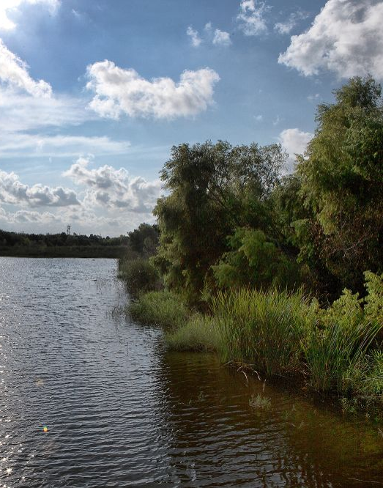
Significance
The absence of riparian zones or engineered hard edges may impact resaca water quality and sedimentation rates
Riparian zones serve as a biodiversity hub for many species
Urban development can threaten ecosystem services provided by both riparian zones and resacas

Slide 6
Thank you for your time!

