Slide 1
Python Cameron County Population Modeling
Alvaro Garcia

Slide 2
Introduction
Urbanized populations are expected to increase
Urbanization can have impacts on:
Water Quality/Quantity in Watersheds
Habitat Displacement/Fragmentation
Flora/Fauna
Urbanization and population modeling can help foresee impacts and help plan ahead.

Slide 3
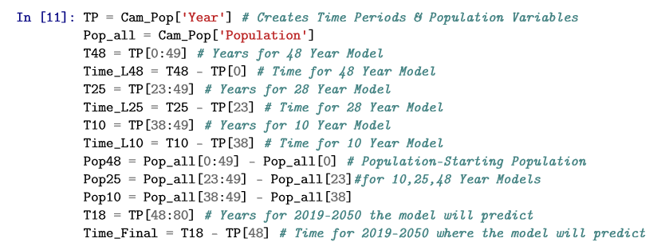
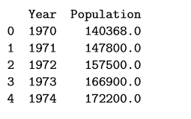
Methods – Data Preparation
Acquired Population Data – 1970-2018
Used Pandas to create data frame and set exponential equation variables

Slide 4
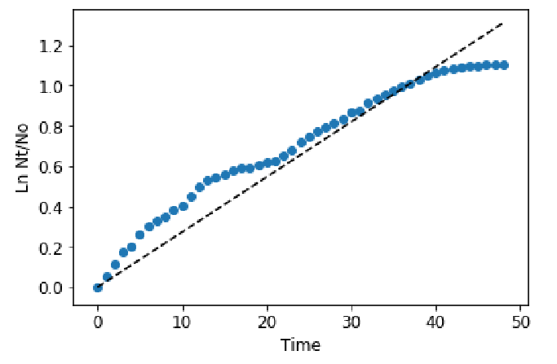
Methods – OLS Regression on the Exponential Growth Equation
Using Statsmodels package, OLS regression was performed on the natural log of population over starting population versus time.
This was also done for linear models
Difference between population and starting population vs time
Using Statsmodels predict function, population projections were made
This was done for:
1970-2018
1993-2018
2008-2018

Slide 5
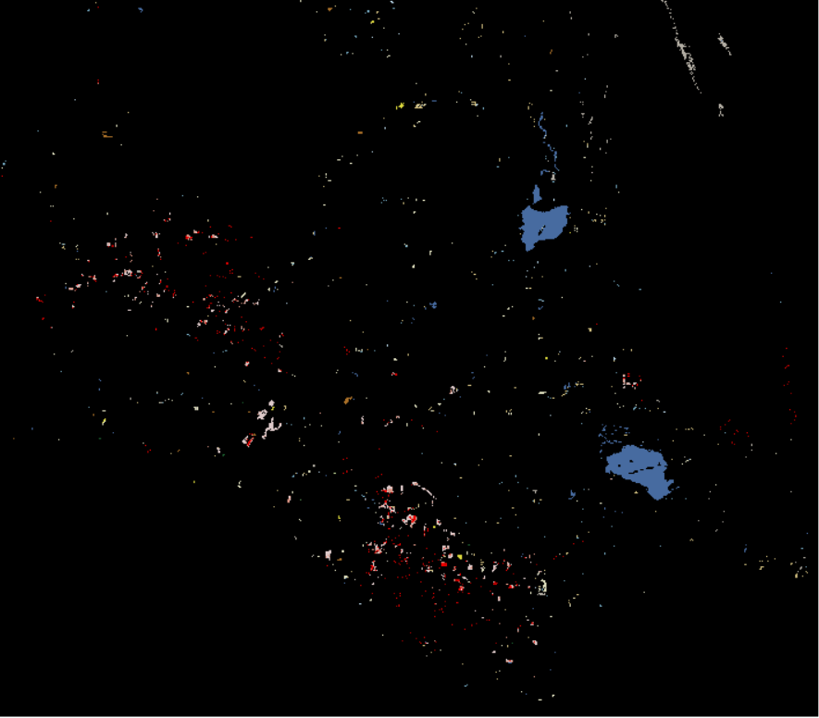
Methods – GIS Landcover Analysis
NLCD provides land cover change rasters
2001-2006, 2006-2011
Counted pixel values that had changed to urbanization classifications
Calculated linear rates

Slide 6
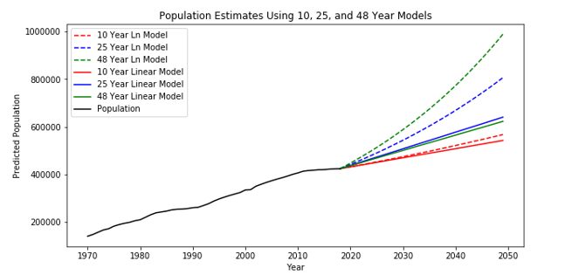
Results – Population Model

Slide 7

Results – Land Cover Classification

Slide 8
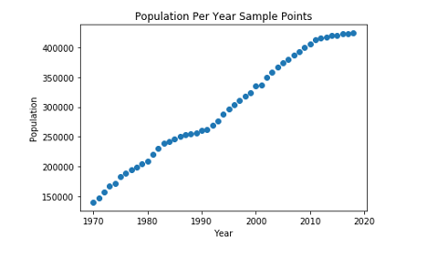
Conclusions
Change to urbanization classifications is fairly constant
Longer time period = more exponential behavior
Linear segments in the population data dictated models
As time increases, the model’s accuracy will probably fall off

Slide 9
Thank you for your time!

