Slide 1

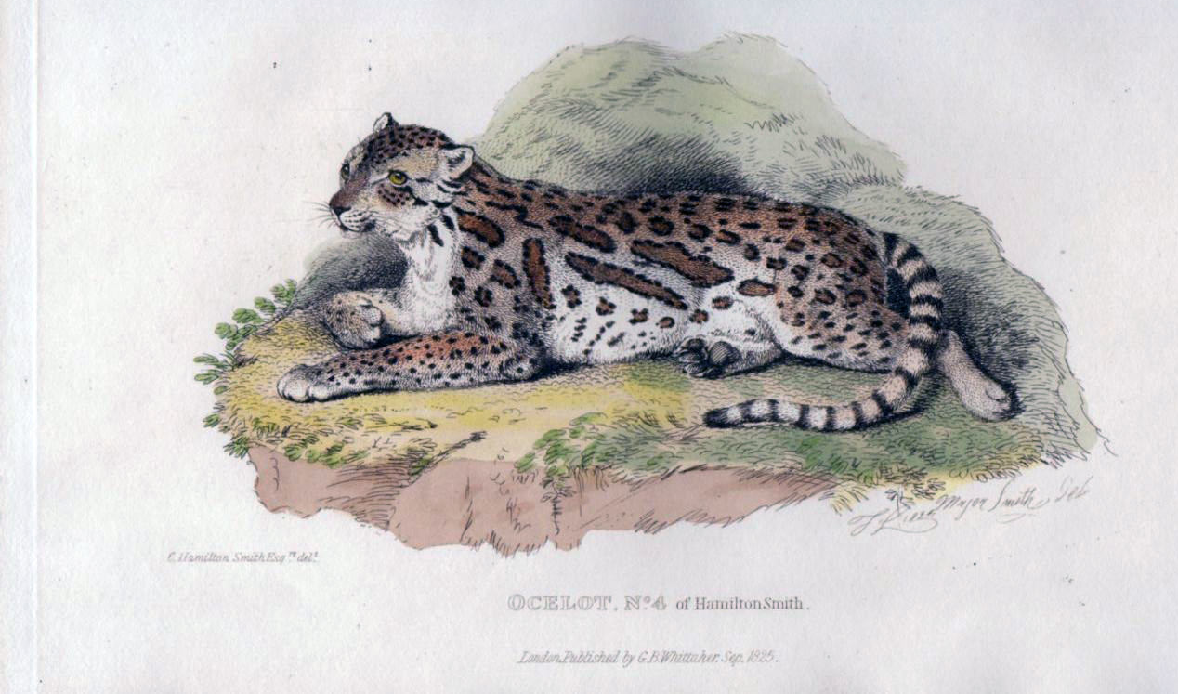
Using Vegetative Cover to Estimate Occupancy of Bobcats in South Texas
T. Miles Hopkins

Slide 2
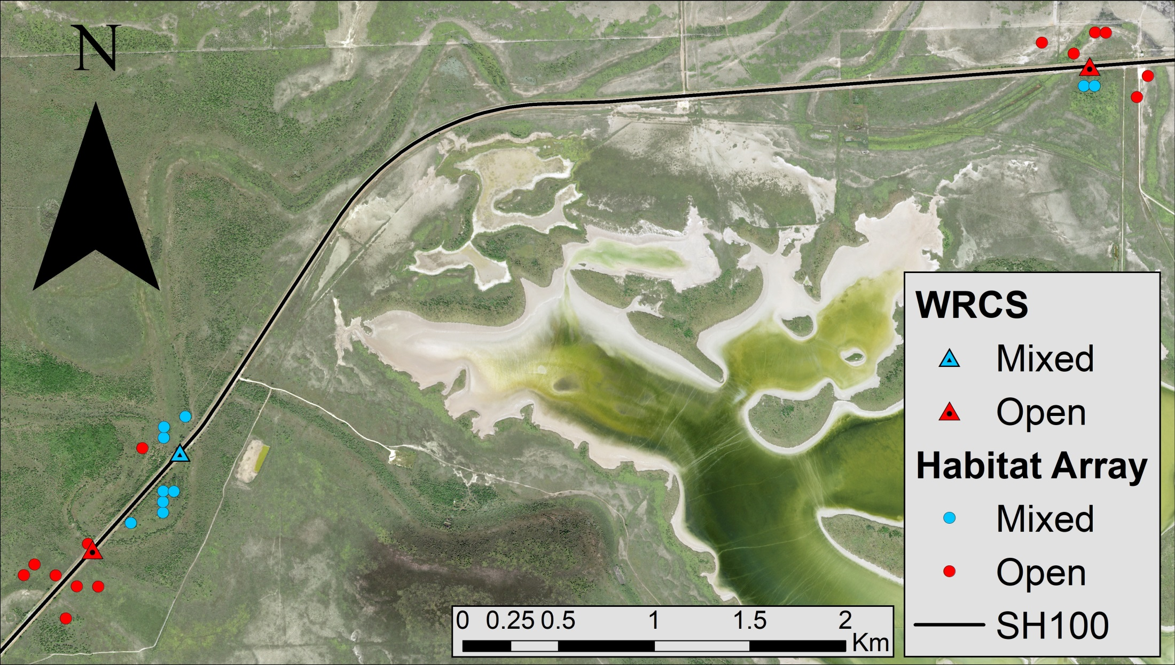
Vegetation Cover and Camera Array
Camera array to monitor wildlife crossing structures (WCS) on SH100
Using control sites to create an occupancy model surrounding SH100
Chose bobcats as a surrogate for ocelots
WCS

Slide 3
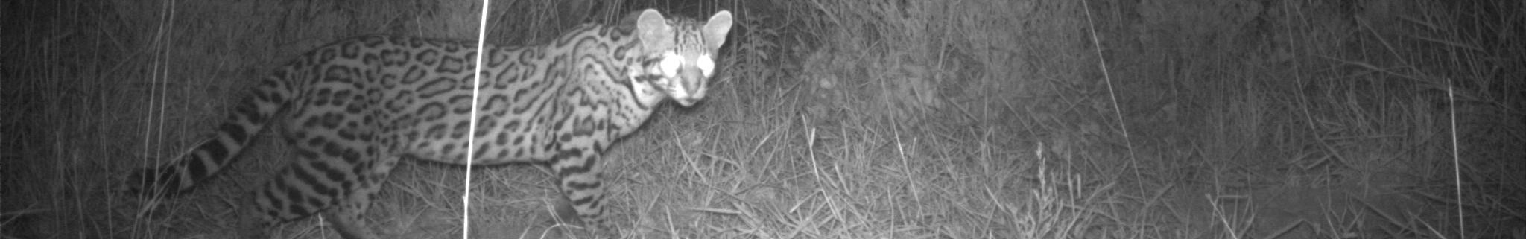
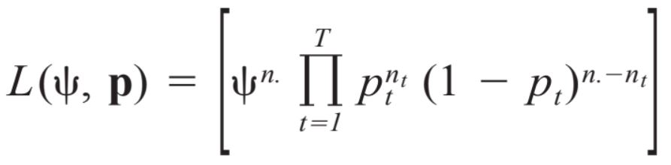
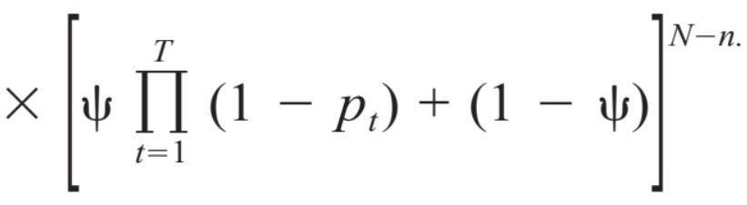
Occupancy Model
Occupancy: probability a patch is occupied by a species
Used MacKenzie et al. (2002) approach
Detection probability <1
Completed Steps
Presence/absence database based on canopy cover
Use bootstrap averages to determine ψ
ψ is influence of canopy cover
Create occupancy model

Slide 4
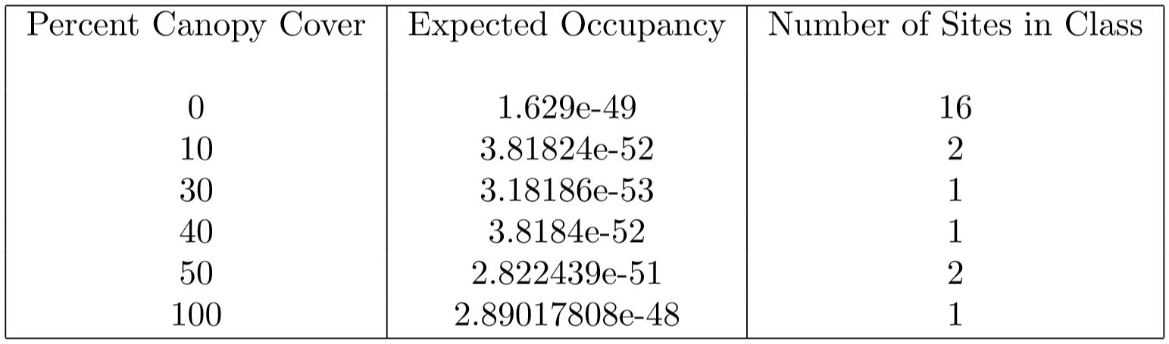
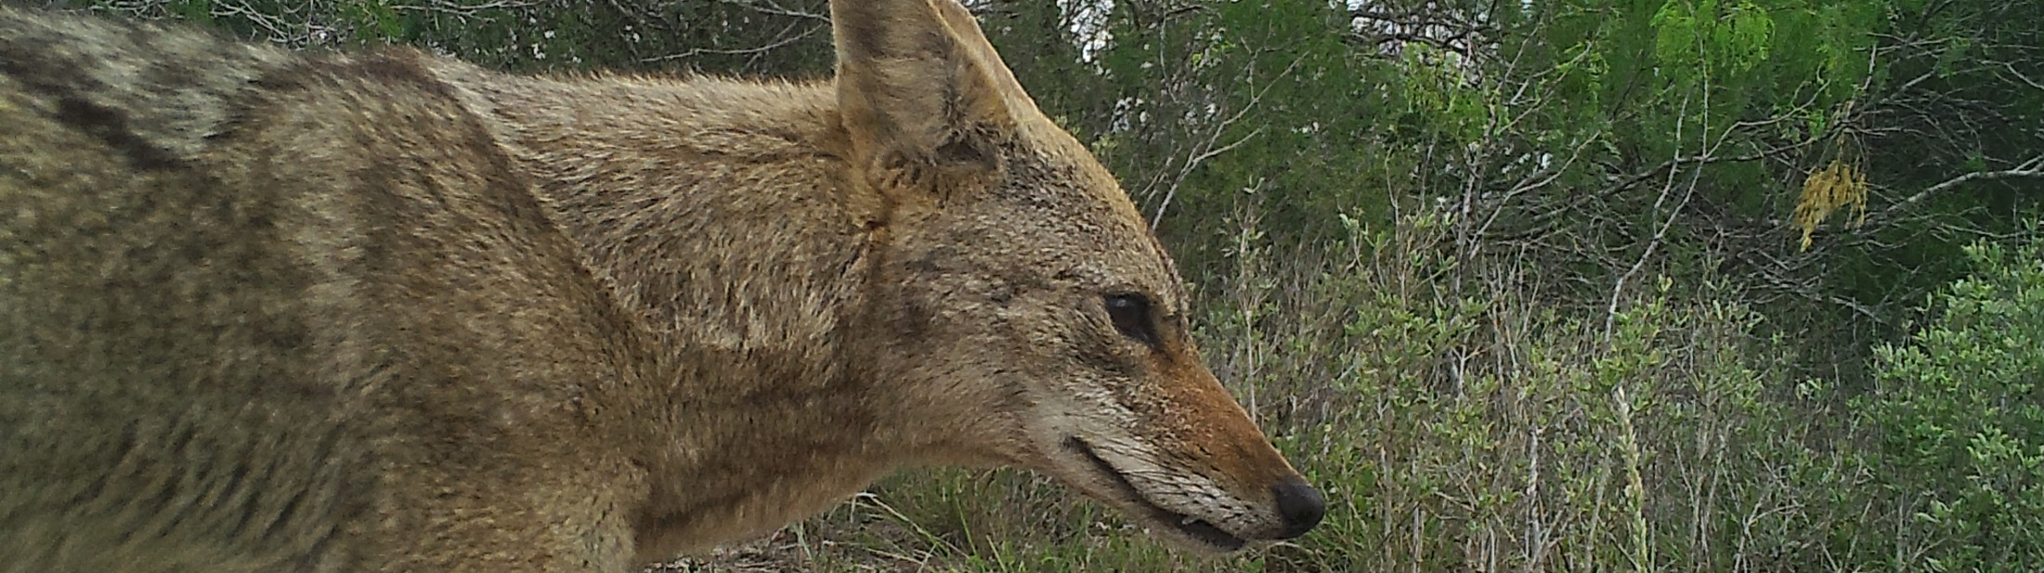
Results

Slide 5
Results
All results are effectively zero
Abnormal for this type of analysis
Expected due to data used
Future analysis should be more successful

Slide 6
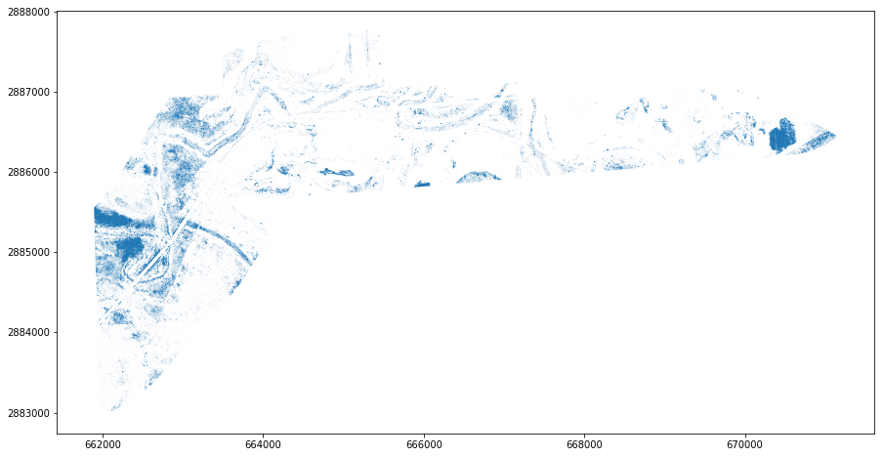
Future Work
Blue dots indicate canopy cover from trees or shrubs.

Slide 7
Future Work
Use data from the new control array within the model
Use canopy cover map (pictured) to create an occupancy map using model results
Blue dots indicate canopy cover from trees or shrubs.

Slide 8
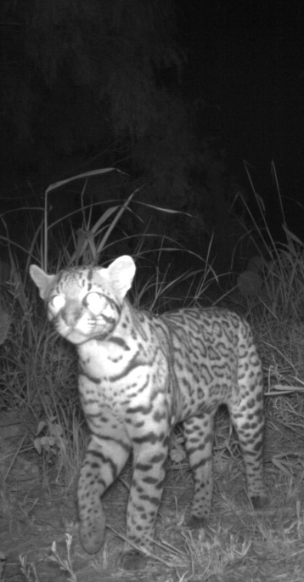
Questions?

Slide 9
Questions?

