Slide 1
Using Python in Stable Isotope Analysis
German Torres

Slide 2
What is SIA?
SIA in ecology is used as one of the primary means for examining the structure and dynamics of food webs.
It most commonly measures the ratios of Nitrogen-15 and Carbon-13 in respect to Nitrogen-14 and Carbon-12 isotopes
It has some limitations due to some pretreatments that must be done to get accurate readings, however they can be corrected with mathematical normalizations

Slide 3
Objectives of the program
Create a user-friendly way to correct the values of Carbon isotopes
Visually convey the results in an understandable manner
Be able to be used with any Excel file and to be used multiple times in the future

Slide 4
Methods

Slide 5
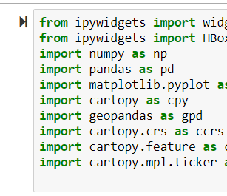
Selecting adequate packages
Ipywidgets was the package selected for building the interactive GUI of the program
Pandas was utilized to handle the data
Cartopy was used to handle the construction of the map

Slide 6
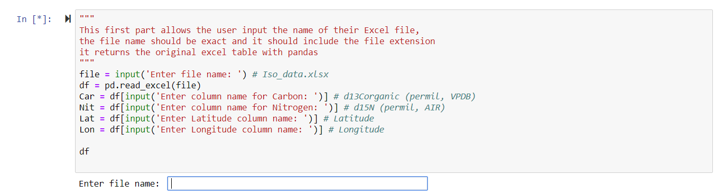
Building the interactivity

Slide 7

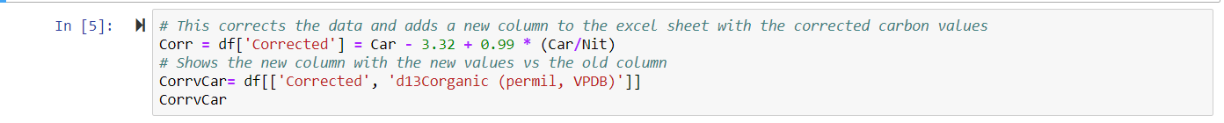
Correction

Slide 8
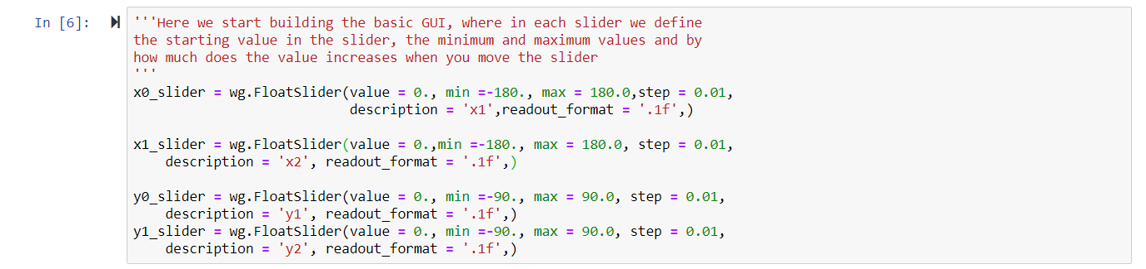
Generating sliders

Slide 9
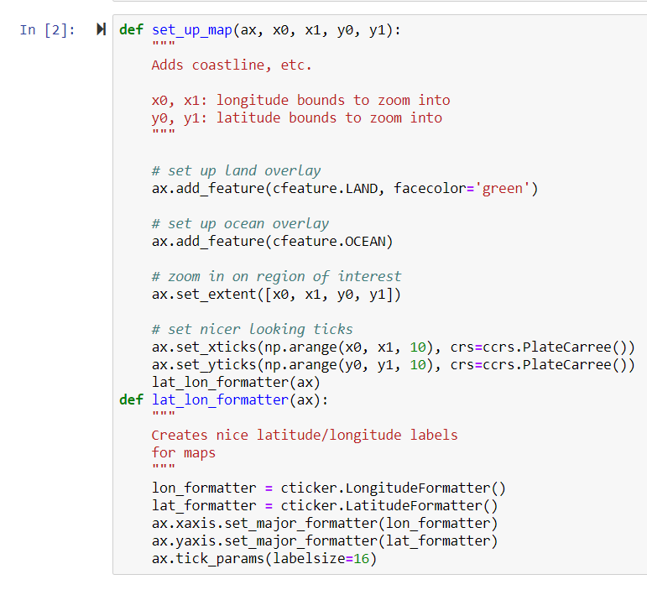
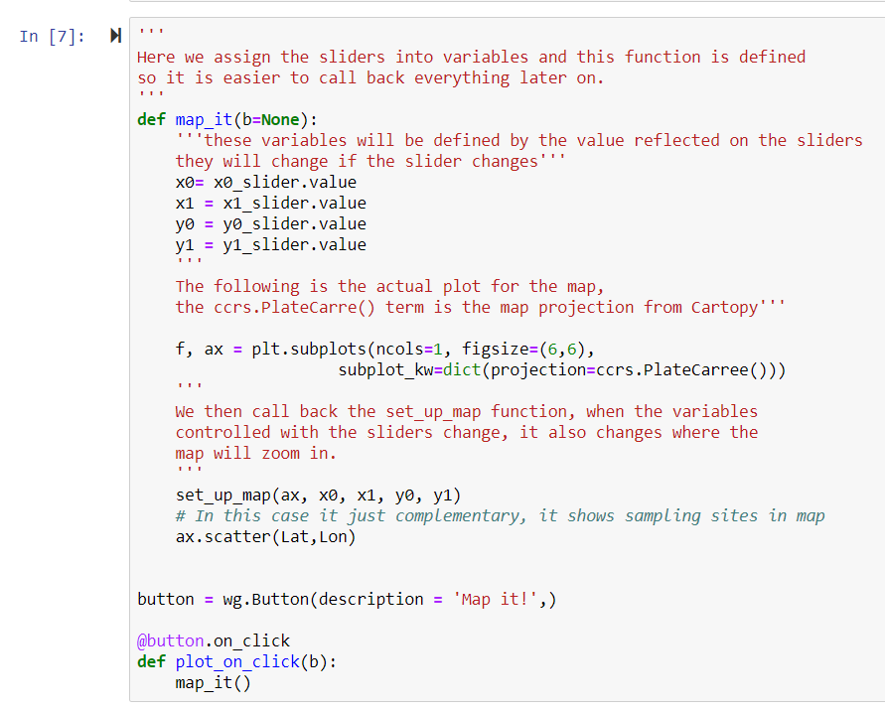
It’s all about functions!

Slide 10
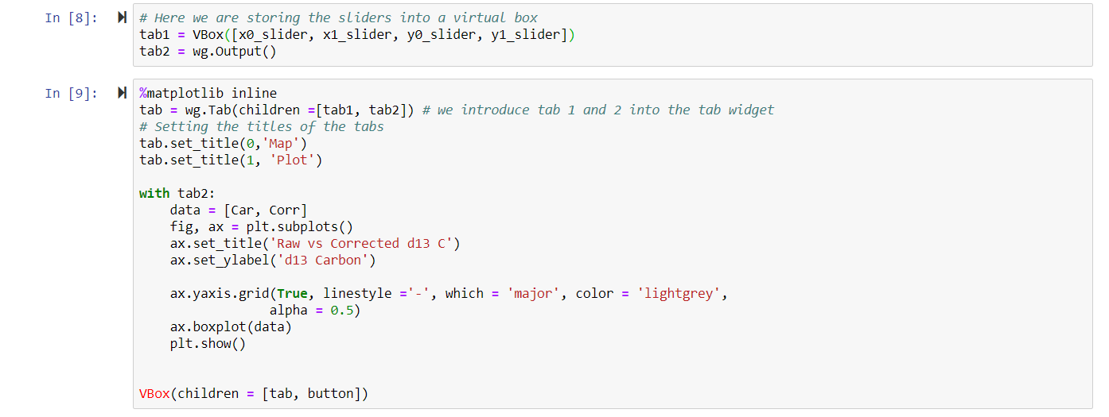
Thus, the box is tricked

Slide 11
Let’s talk about the map

Slide 12
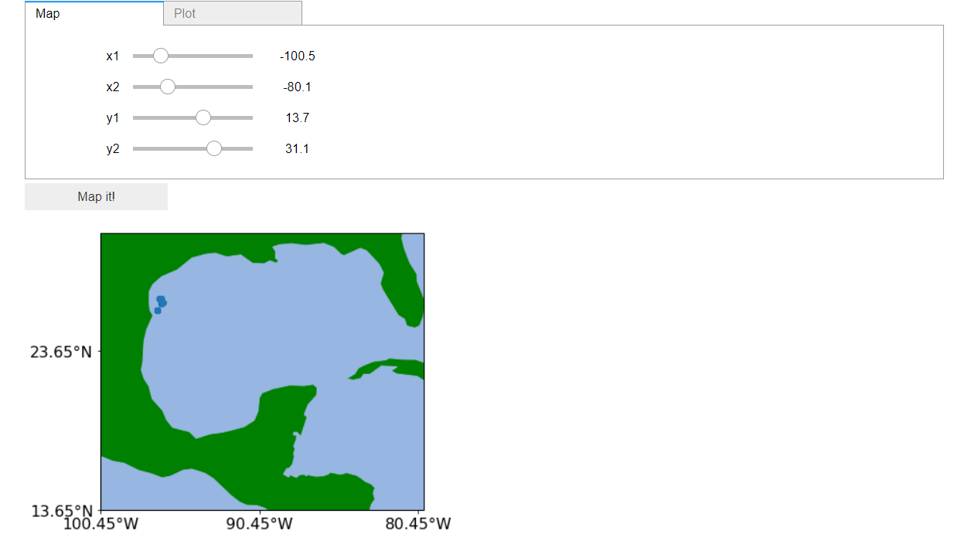
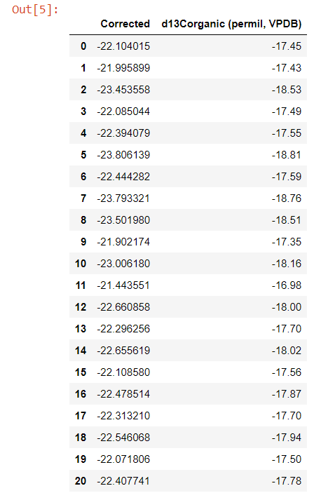
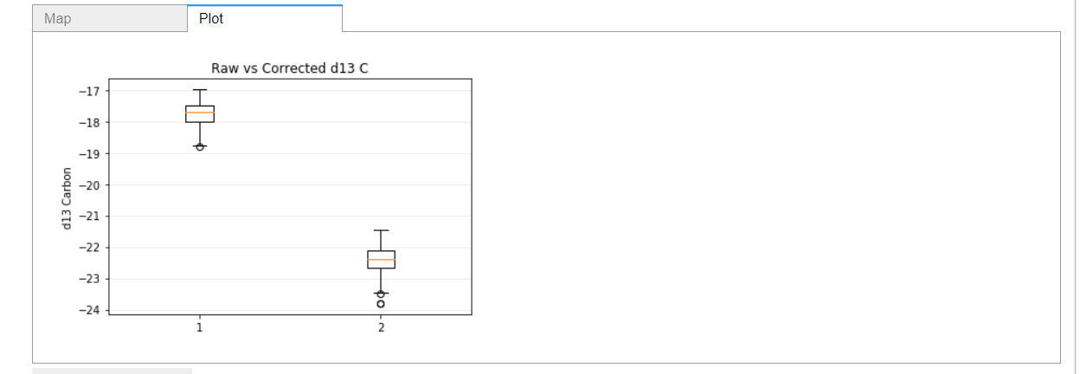
Results

Slide 13
Discussion
Program completes its objective
Data can be used for further statistical analysis
It has its limitations

Slide 14
Bibliography
Kürten, B. et al. Carbon and nitrogen stable isotope ratios of pelagic zooplankton elucidate ecohydrographic features in the oligotrophic Red Sea. Prog. Oceanogr. 140, 69–90 (2016).
Post, D. M. et al. Getting to the fat of the matter: models, methods and assumptions for dealing with lipids in stable isotope analyses. Oecologia 152, 179–189 (2007).
Layman, C. A. et al. Applying stable isotopes to examine food-web structure: an overview of analytical tools. Biol. Rev. 87, 545–562 (2012).

