Slide 1
Dietary habits and disease activity in rheumatoid arthritis patients

Slide 2
RESEARCH QUESTIONS
RETRIEVE DIETARY PATTERNS
Are there prevalent dietary patterns (DPs) followed by patients?
TECHNIQUES
Principal component analysis
Factor analysis
RELATE PATTERNS WITH DISEASE ACTIVITY
Are there significant relationships between different dietary patterns and disease form?
TECHNIQUES
Clustering
(Logistic Regression)
Analysis supported by
Edefonti V, Parpinel M, Ferraroni M, Boracchi P, Schioppo T, Scotti I, Ubiali T, Currenti W, De Lucia O, Cutolo M, Caporali R, Ingegnoli F. A Posteriori Dietary Patterns and Rheumatoid Arthritis Disease Activity: A Beneficial Role of Vegetable and Animal Unsaturated Fatty Acids. Nutrients. 2020 Dec 17;12(12):3856. doi: 10.3390/nu12123856. PMID: 33348651; PMCID: PMC7766886.

Slide 3
1.
DATASET
PRE-PROCESSING
365 observations, 499 variables.
Each row is a patient suffering of rheumatoid arthritis.

Slide 4
RELEVANT ATTRIBUTES
Patients’ info
Nutrients (34 variables)
Single foods (110 variables)
Food groups (35 variables)
Others: Diseases, drugs, etc.

Slide 5
IRRELEVANT ATTRIBUTES
Attributes for a study on the relation between air pollution and rheumatoid arthritis
Answers to the food frequency questionnaire: already translated into scores
365 observations, 304 variables left

Slide 6
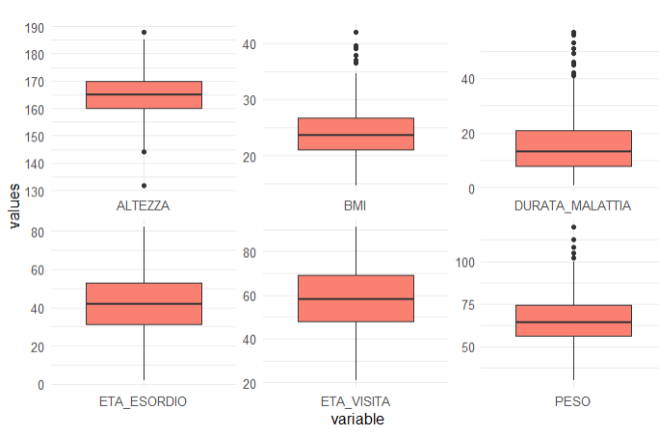
EXPLORATORY ANALYSIS
Descriptive analysis of the most relevant variables

Slide 7
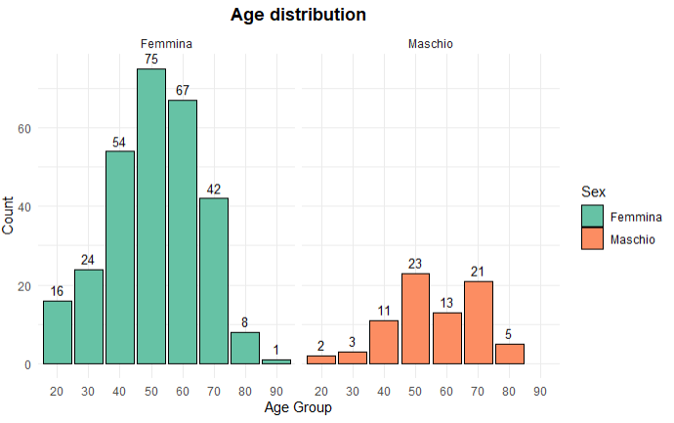
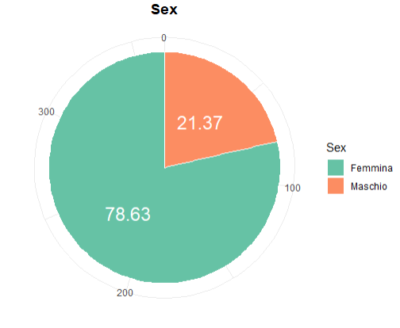
BIOLOGICAL SEX and AGE
Highly unbalanced dataset
Nearly 80% of patients are female patients. Disease mainly affecting female individuals
In both groups most of the patients are in their 50s

Slide 8
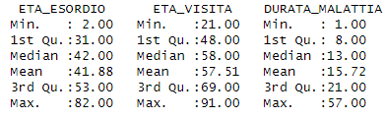
Beginning
Present
Duration
Since the average duration is 15 years, the highest incidence is around the 30s

Slide 9
DISEASE ACTIVITY INDICATORS
RHEUMATOID FACTOR
{0,1}
1: severe activity
0: low-moderate activity
DAS28
(0.0,9.9)
DAS28 < 2,6: Remission
DAS28 >= 2,6 & <= 3,2: Low activity
DAS28 > 3,2 & <= 5,1: Moderate activity
DAS28 > 5,1: Severe activity
Composite index
SDAI
(0.0,100.0)
SDAI <3.3: Remission
SDAI >= 3.3 & <= 11: Low activity
SDAI > 11 & <= 26: Moderate activity
SDAI > 26: Severe activity
Composite index (Simplified Disease Activity Index): measuring pain in 28 joints

Slide 10
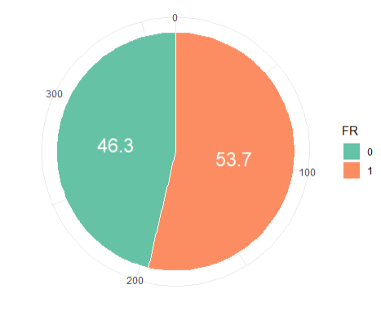
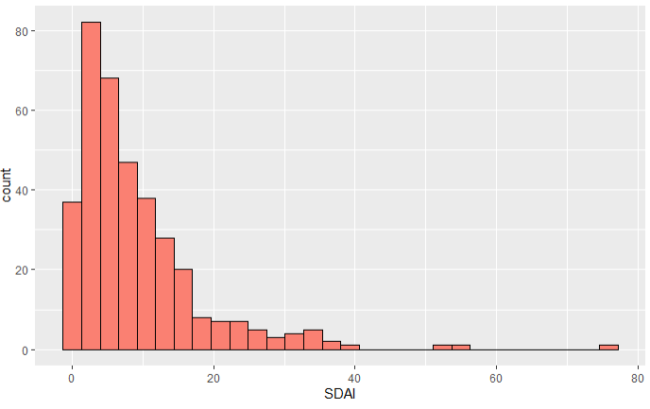
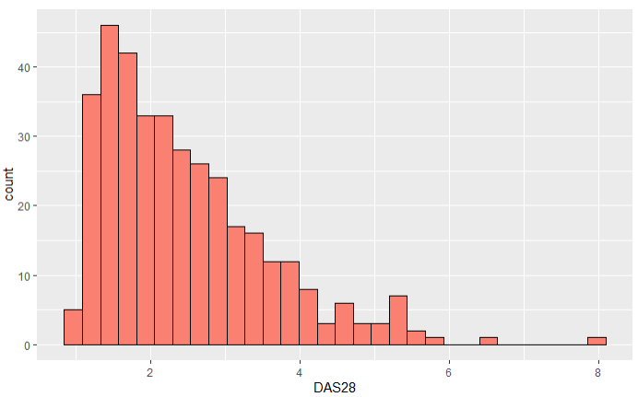

Slide 11
108
155
81
21
SDAI
REMISSION
LOW ACTIVITY
MODERATE ACTIVITY
SEVERE ACTIVITY

Slide 12
227
60
64
14
DAS28
REMISSION
LOW ACTIVITY
MODERATE ACTIVITY
SEVERE ACTIVITY

Slide 13
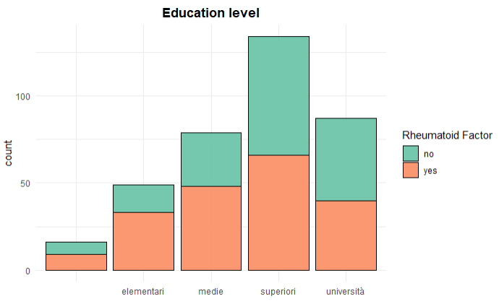
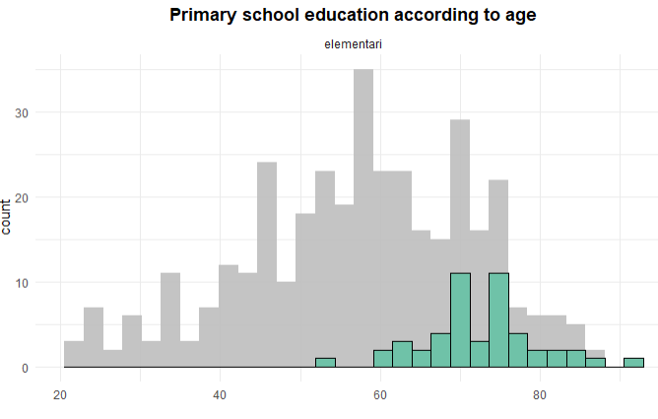
EDUCATION
16 missing values
No expected relationship between disease activity and education level
Higher incidence of 1 in primary school due to the age of patients: older people more likely to have the disease and more likely to have finished primary school only. No correlation

Slide 14
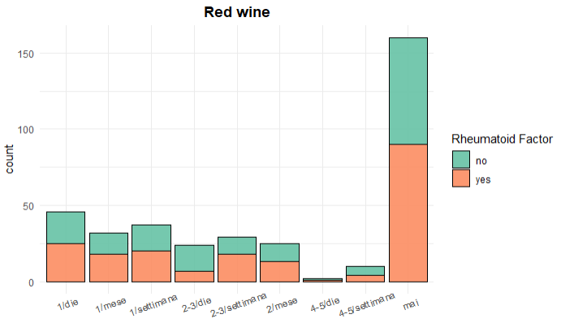
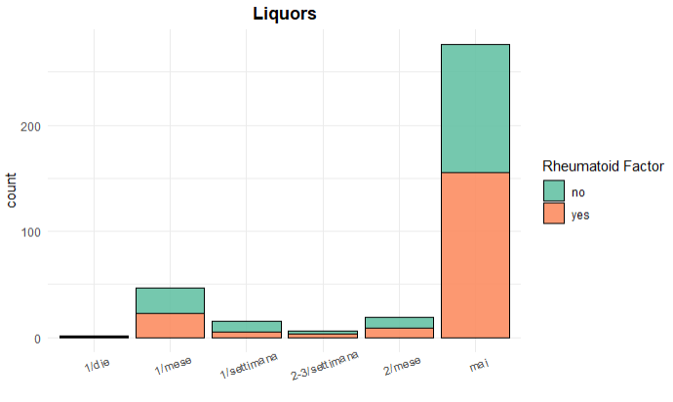
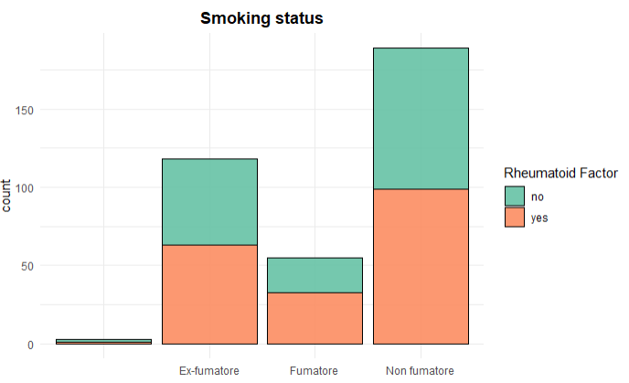
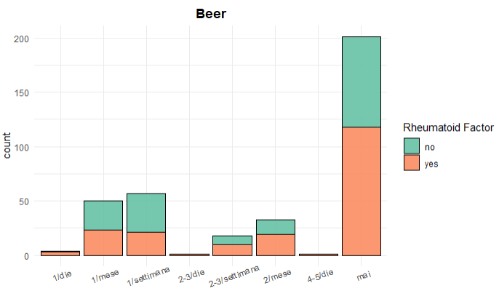
ALCOHOL and SMOKE
No relevant relationship

Slide 15
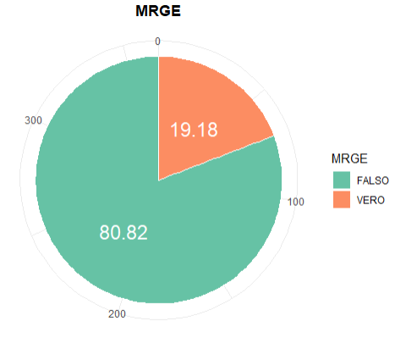
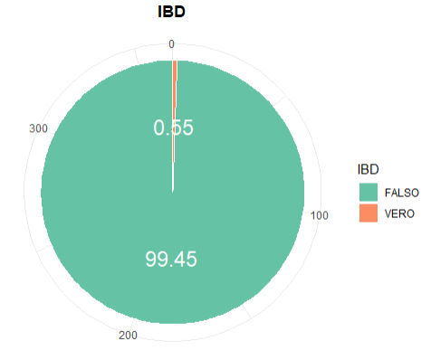
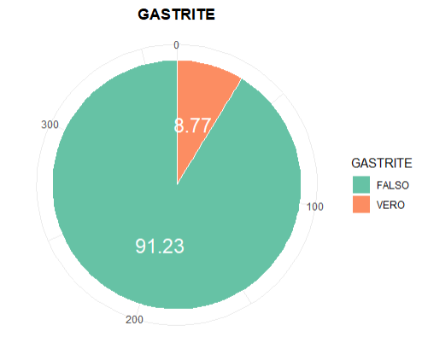
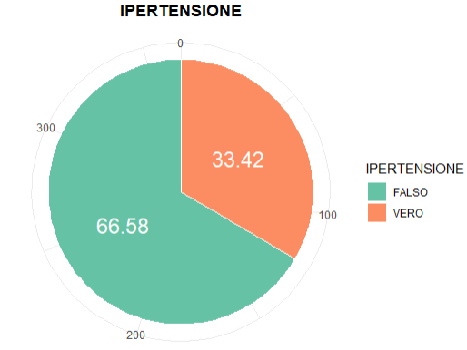
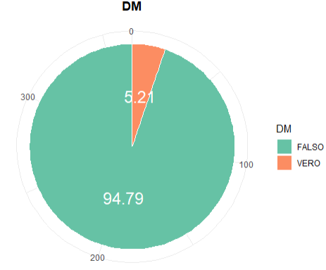
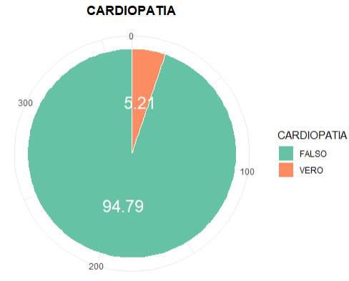
COMORBIDITIES
Gastroesophageal Reflux
Inflammatory bowel
Gastritis
Hypertension
Diabetes
Cardiovascular

Slide 16
2. DPs RETRIEVAL
PCA and FACTOR ANALYSIS

Slide 17
Principal Component Analysis
Goal: Reduce dataset and find suitable number of components explaining the majority of the variance in the dataset
PCA was performed on the original dataset as well as subsets, split based on the DAS28 score to find possible differences between lightly/heavily affected patients
Only subset with high DAS28 (>3.2) Included in presentation

Slide 18
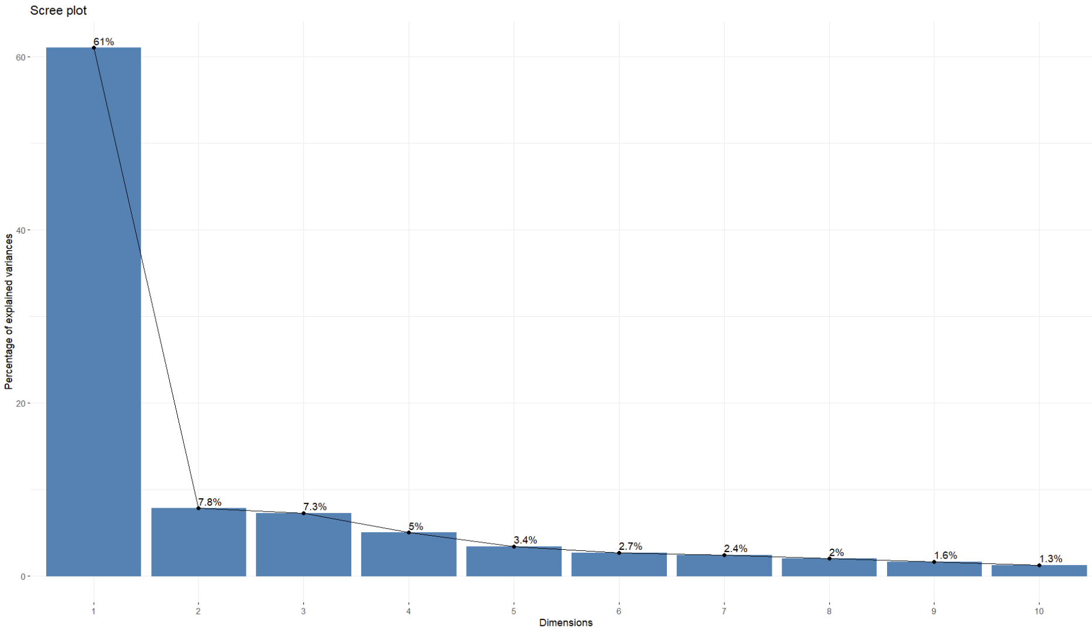
Principal Component Analysis
 | Cumulative Proportion
PC1 | 0,610
PC2 | 0,688
PC3 | 0,761
PC4 | 0,811
PC5 | 0,845
PC6 | 0,872

Slide 19
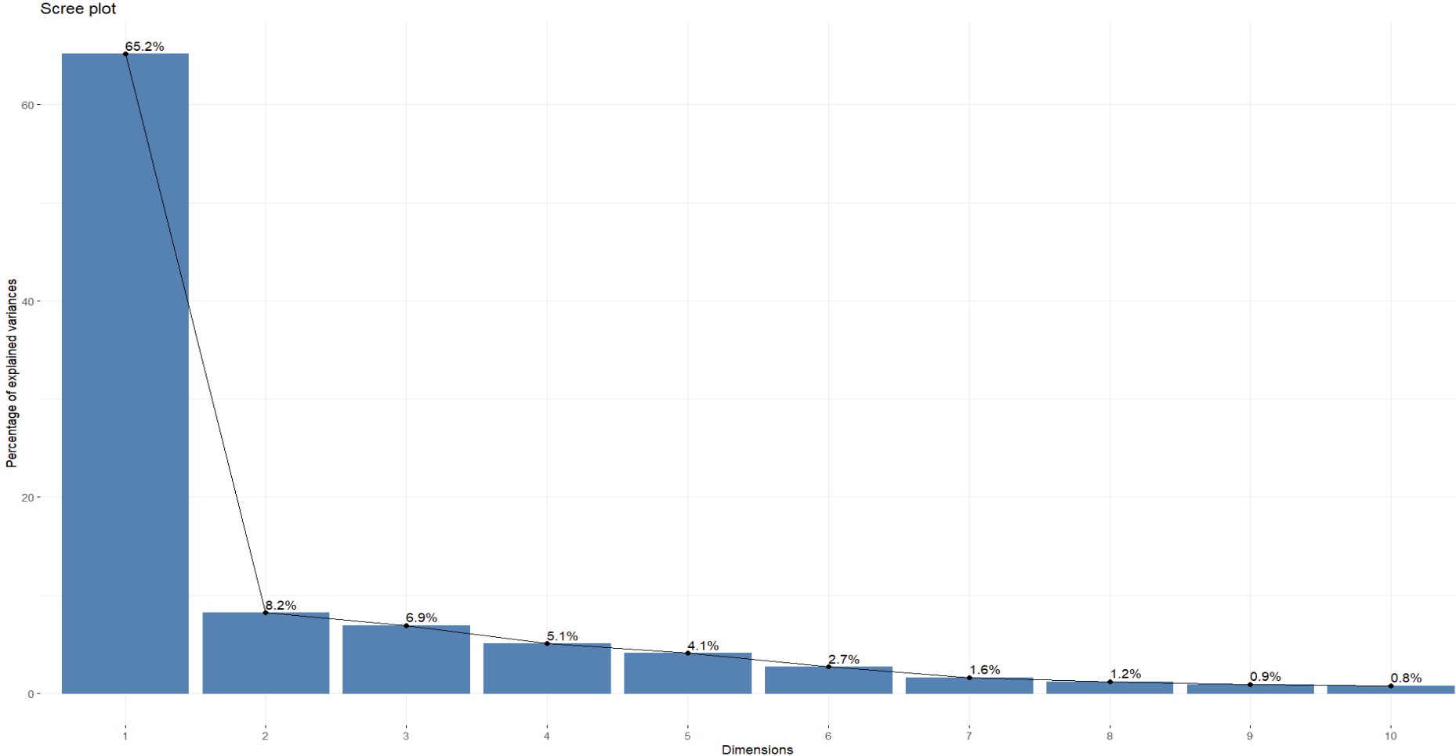
Principal Component Analysis – high DAS28 score
 | Cumulative Proportion
PC1 | 0,6515
PC2 | 0,7337
PC3 | 0,8031
PC4 | 0,8539
PC5 | 0,8947
PC6 | 0,9218

Slide 20
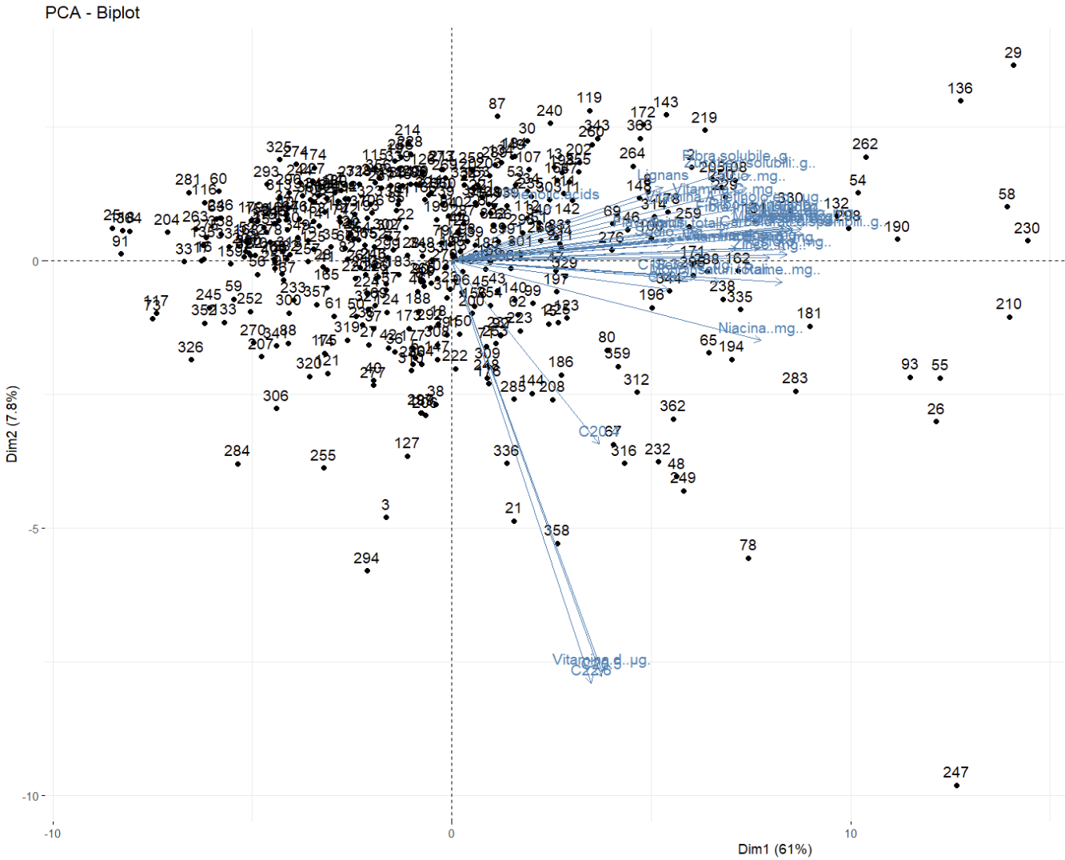
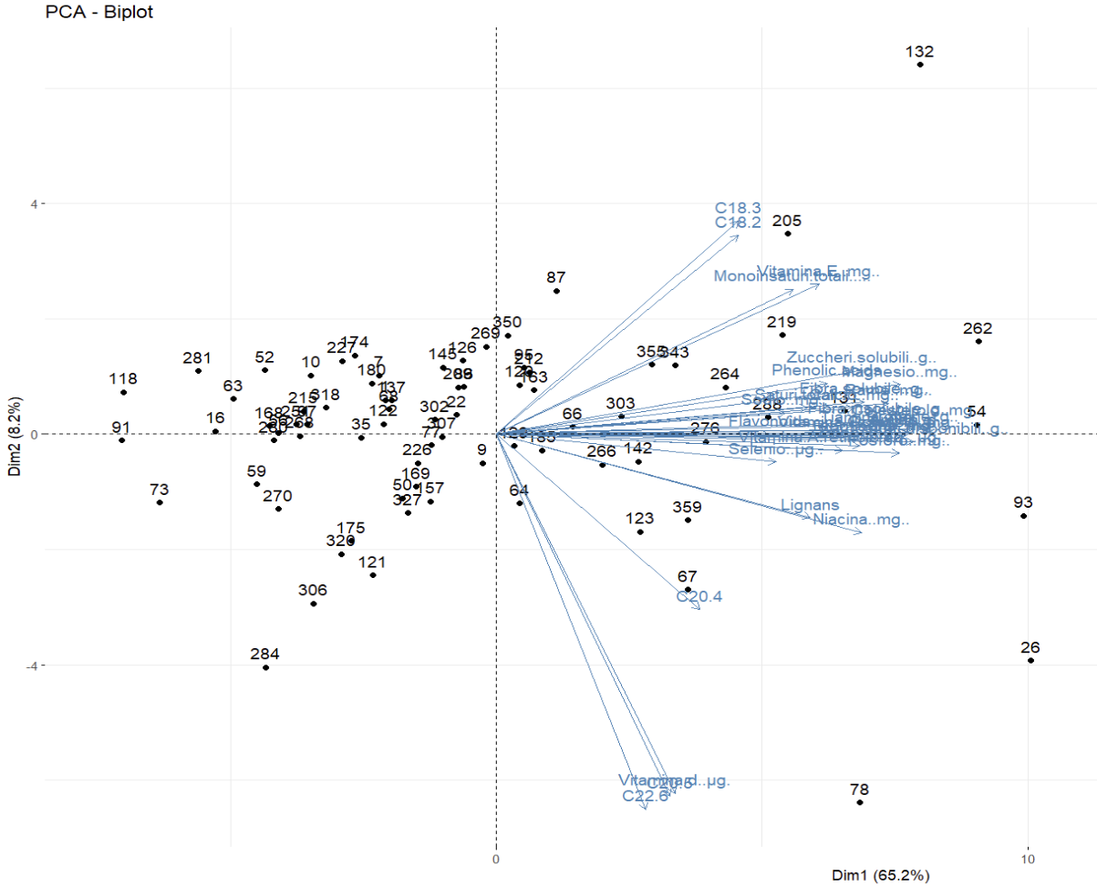
Principal Component Analysis

Slide 21
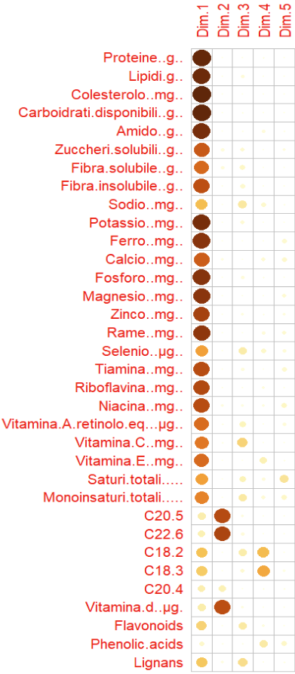
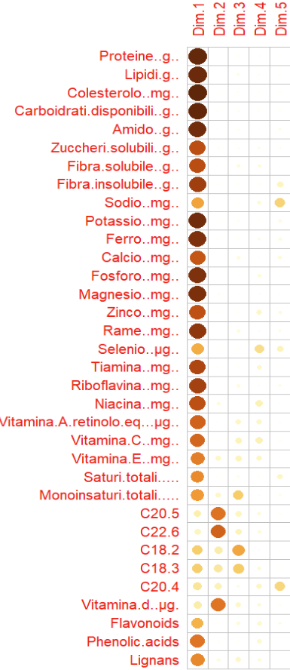
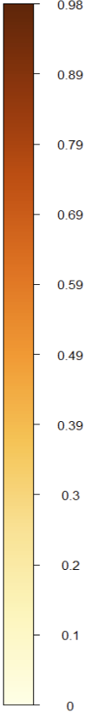
Principal Component Analysis
Table of PC1-5 including the full set of individuals
To find the most contributing variables and derive insights about the nature of the components and their driving factors for the individual components we checked the correlations
C20.5, C22.6 are omega3 fatty acids
C20.4 (arachidonic),
C18.2 (linoleic), C18.3 (linolenic) omega6

Slide 22
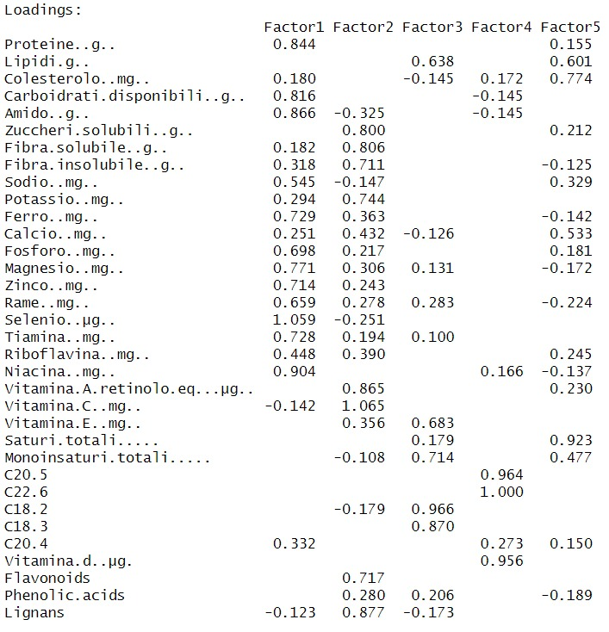
Factor Analysis - loadings
Goal: retrieve 5 factor loadings for the components found in the PCA and associate them to possible dietary patterns
FA has been performed on set of 34 nutrients included in the dataset
Outstanding aspects in terms of loading for the nutrients have been highlighted
5 DP have been formulated

Slide 23
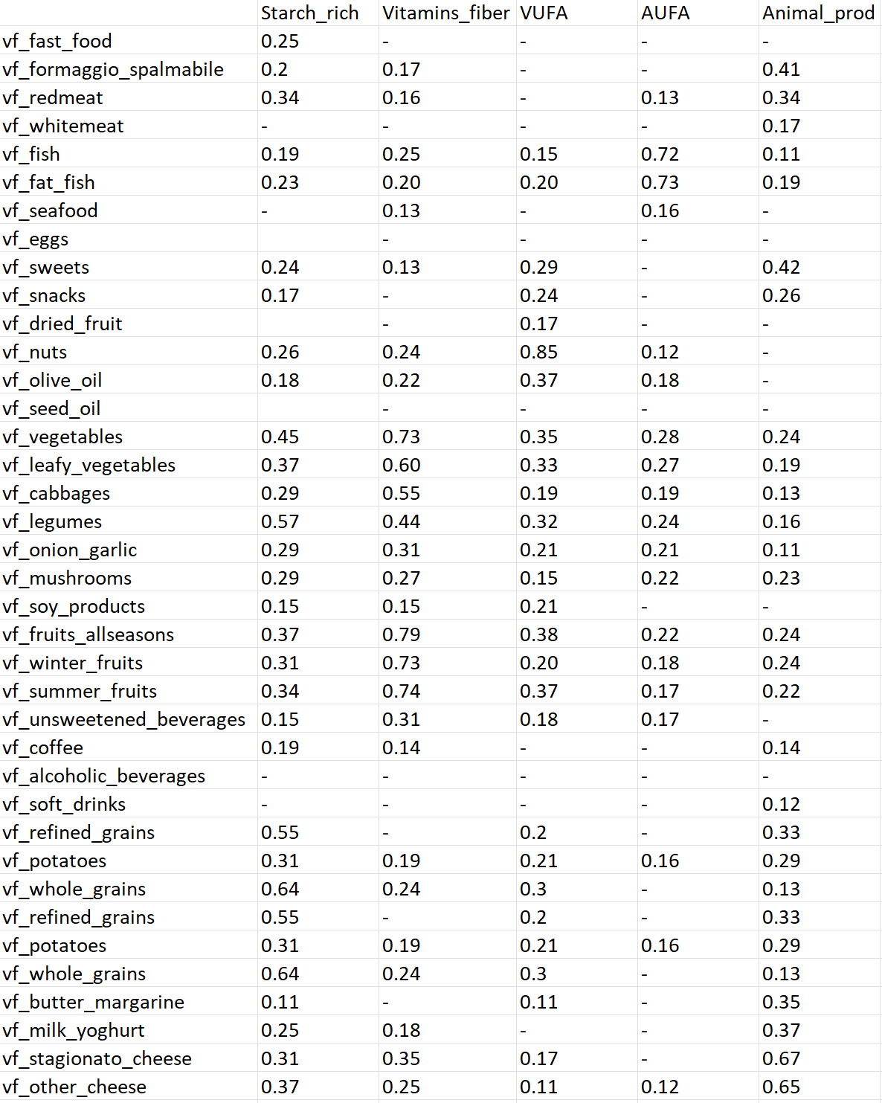
Factor Analysis - Correlations
The factor loadings have then been analysed in a correlation matrix with the food groups from the dataset to check validity of the dietary patterns
They show the strongest correlations with the groups we would expect from each dietary pattern

Slide 24
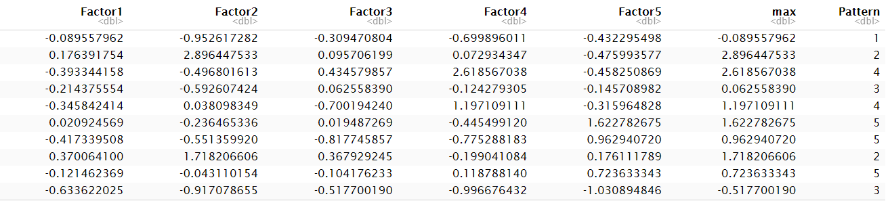
Adherence to DP’s
We assigned the DP’s to the individuals according to the highest factor loading
Stark-rich | Vitamins_Fiber | VUFA | AUFA | Animal Products
53 | 65 | 49 | 101 | 97

Slide 25
Clustering
3.
NAÏVE – CLUSTERING (additional)
Confirmatory analysis

Slide 26
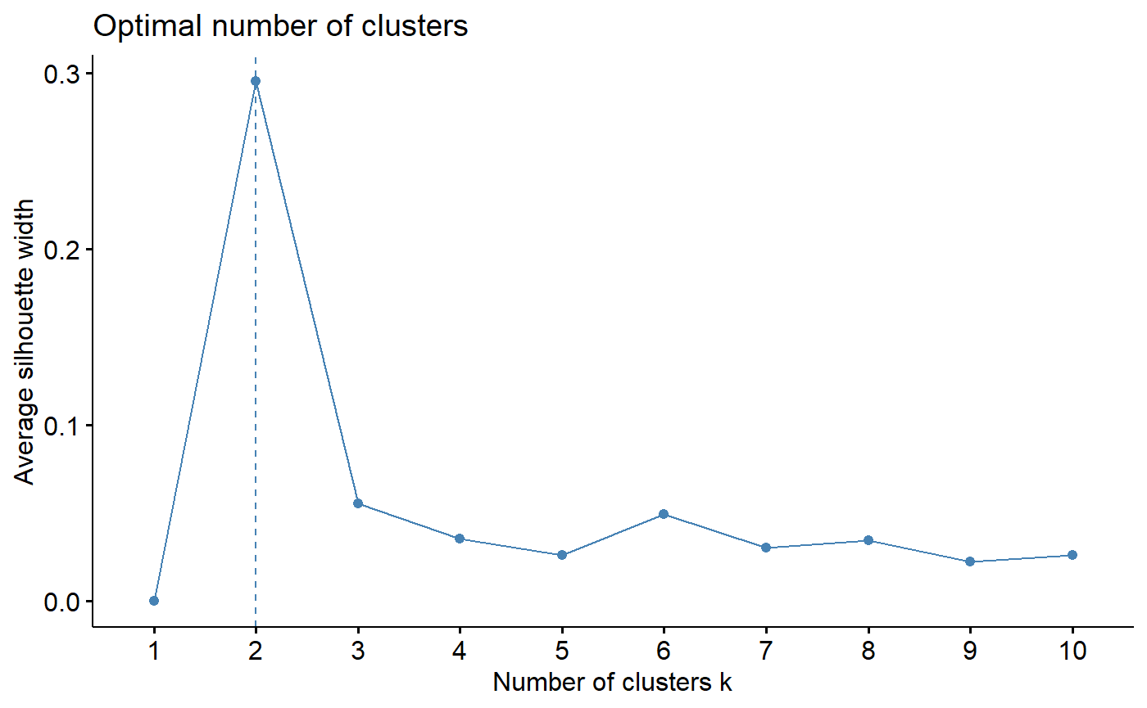
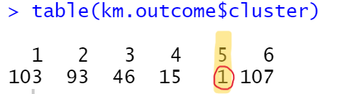
Attempt with 5 clusters revealed an outlier
K-means with 6 clusters to have 5 actual groups
Despite Silhouette method result, 5 clusters were identified using k-means

Slide 27
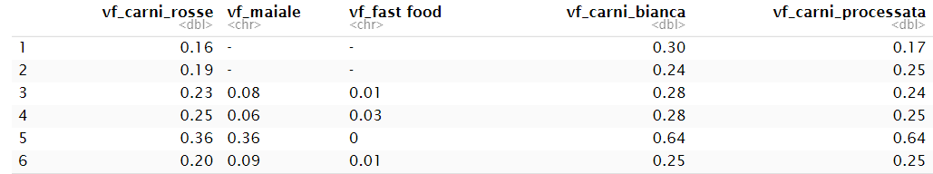
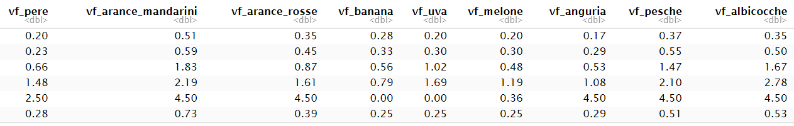

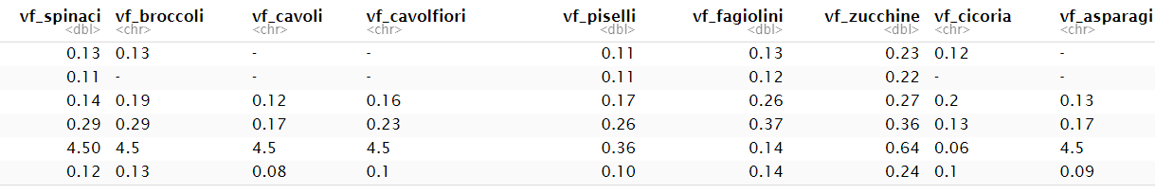
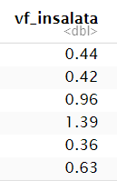
Average consumption scores for different clusters
Hard to find one-to-one correspondence with DPs (e.g. 4th cluster could be Vitamins and fiber DP)

Slide 28
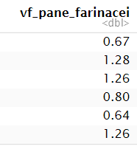
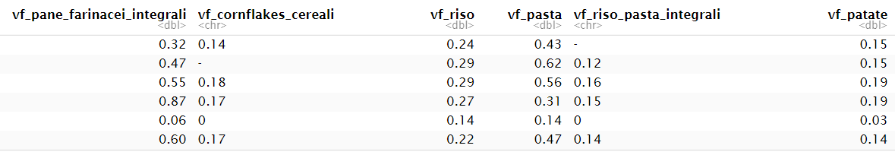
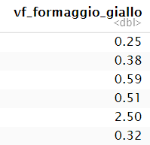
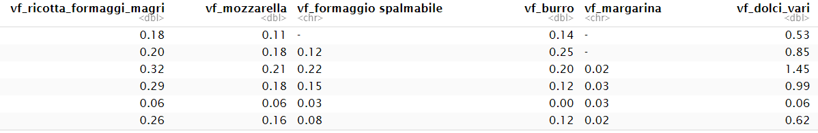
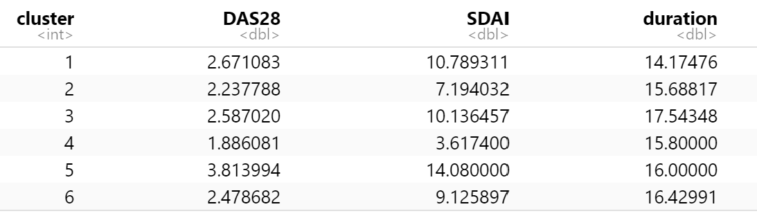
2nd and 3rd clusters could be starch-rich and AUFA respectively

Slide 29
THANK YOU FOR YOUR ATTENTION!
Any questions?

