Slide 1
Summary of: Distributed Neural Network Optimization for Multi-Robot Collaborative Learning (DiNNO)
Written by: Javier Yu, Joseph A. Vincent, Mac Schwager
Presented by: Jamison Moody
Yu, Javier, Joseph A. Vincent, and Mac Schwager. "Dinno: Distributed neural network optimization for multi-robot collaborative learning." IEEE Robotics and Automation Letters 7.2 (2022): 1896-1903.

Slide 2
Outline
Motivation
Background Literature and Theory
Baseline Algorithms
DiNNO Algorithm
Reproduced Results
Extended Results from Paper
Summary and Future Work

Slide 3
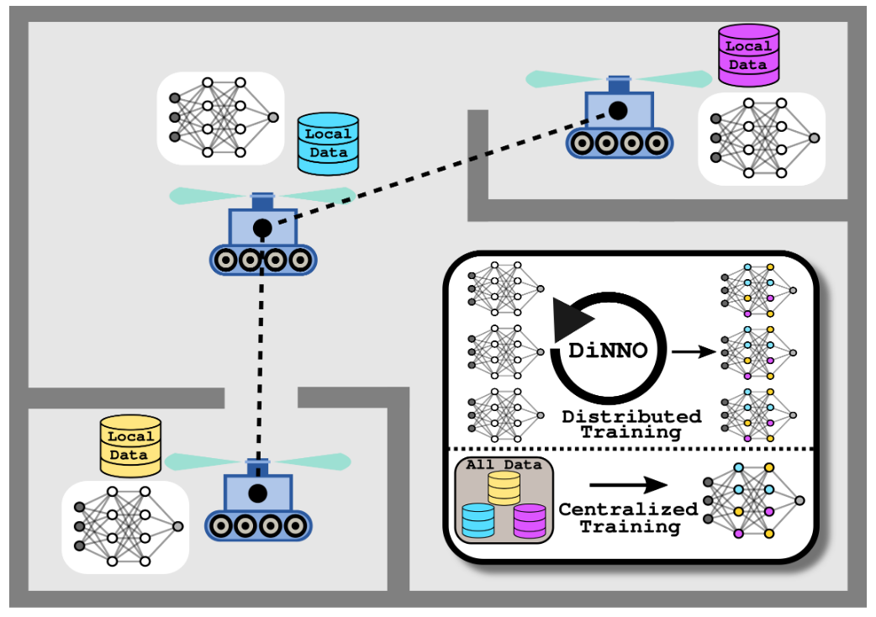
Motivation
Figure 1: DiNNO Diagram

Slide 4
Relevant Background Literature
Lagrange Multipliers and Lagrange Functions
Alternating Direction Method of Multipliers (ADMM)
S. Boyd, N. Parikh, and E. Chu, Distributed optimization and statistical learning via the alternating direction method of multipliers. Now Publishers Inc, 2011
Consensus Alternating Direction Method of Multipliers (CADMM)
T.-H. Chang, M. Hong, and X. Wang, “Multi-agent distributed optimization via inexact consensus admm,” IEEE Transactions on Signal Processing, vol. 63, no. 2, pp. 482–497, 2014

Slide 5
What is ADMM?
Allows for decentralized constrained optimization
Agents coordinate to solve a large problem by passing small messages

Slide 6
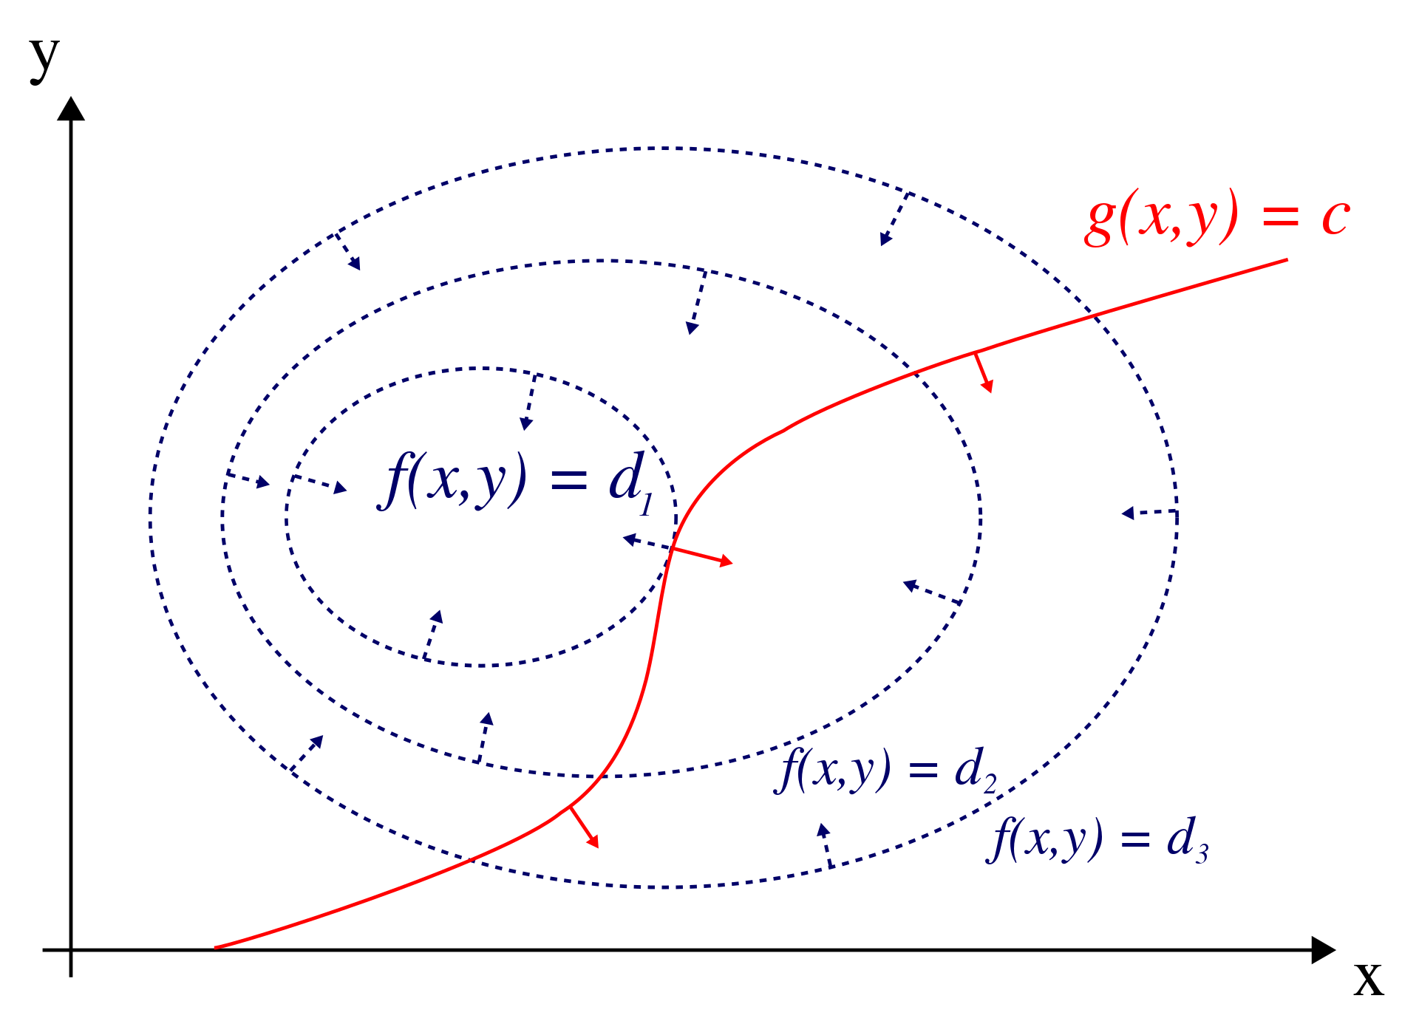
Lagrange Multipliers
Lagrange multiplier - Wikipedia
Notes:
The gradient is the direction of steepest ascent
A level curve is a path of all points where the function has the same value
The gradient of a function is always perpendicular to the level curves of that function
If we move along g, we will increase in f until the gradients of f and g are parallel.
We can think of projecting

Slide 7
Lagrange Multipliers
Lagrange multiplier - Wikipedia
Notes:
The gradient is the direction of steepest ascent
A level curve is a path of all points where the function has the same value
The gradient of a function is always perpendicular to the level curves of that function
If we move along g, we will increase in f until the gradients of f and g are parallel.
We can think of projecting

Slide 8
Lagrange Multipliers
Lagrange multiplier - Wikipedia
Notes:
The gradient is the direction of steepest ascent
A level curve is a path of all points where the function has the same value
The gradient of a function is always perpendicular to the level curves of that function
If we move along g, we will increase in f until the gradients of f and g are parallel.
We can think of projecting

Slide 9
Lagrange Multipliers
Lagrange multiplier - Wikipedia
Notes:
The gradient is the direction of steepest ascent
A level curve is a path of all points where the function has the same value
The gradient of a function is always perpendicular to the level curves of that function
If we move along g, we will increase in f until the gradients of f and g are parallel.
We can think of projecting

Slide 10

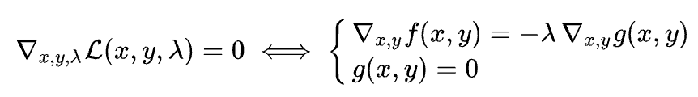
Lagrange Function
Once we find these points, we can plug them into f and check the maximum or minimum
Lagrange multiplier - Wikipedia
Notes:
The gradient is the direction of steepest ascent
A level curve is a path of all points where the function has the same value
The gradient of a function is always perpendicular to the level curves of that function
If we move along g, we will increase in f until the gradients of f and g are parallel.
We can think of projecting

Slide 11
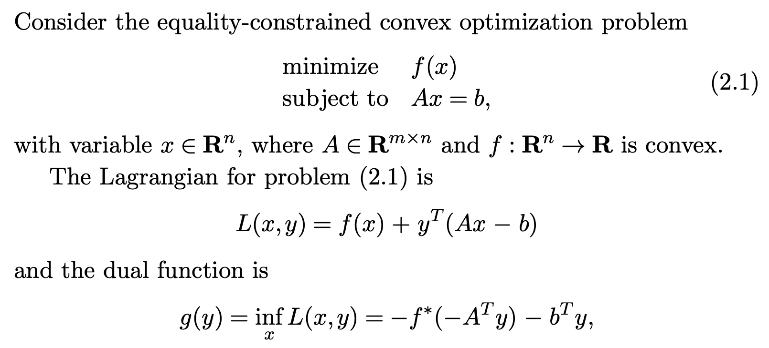
ADMM Problem Setup
Boyd, Stephen, et al. "Distributed Optimization and Statistical Learning via the Alternating Direction Method of Multipliers." Foundations and Trends® in Machine Learning, vol. 3, no. 1, 2011, pp. 1-122.
Notes:
Y is the dual variable or Lagrange Multiplier
F* is the convex conjugate of F
Go over example

Slide 12
ADMM Problem Setup
Notes:
Y is the dual variable or Lagrange Multiplier
F* is the convex conjugate of F
Go over example

Slide 13
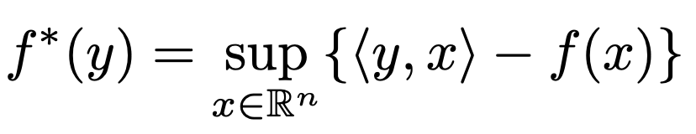
ADMM Problem Setup
Notes:
Y is the dual variable or Lagrange Multiplier
F* is the convex conjugate of F
Go over example

Slide 14
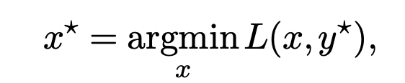
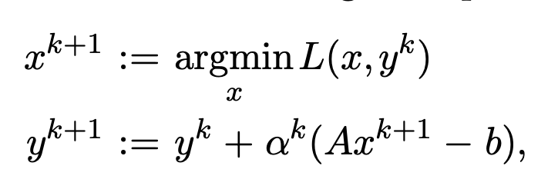
Dual Ascent
Assuming f(x) is convex, the optimal values of the primal and dual problems are the same (strong duality)
This means when we maximize g(y) we get y* and:
With dual ascent, we can use gradient ascent on the gradient of g after minimizing with respect to x:
Notes:
Alpha^k >0 is the step size
Dual ascent cannot often be used
Convex Primal Problem: The primal optimization problem must be convex.
Differentiability: The objective function and constraints should be differentiable.
Slater’s Condition: There exists a feasible point that strictly satisfies all inequality constraints (ensuring strong duality).
Lipschitz Continuous Gradient: The gradient of the dual function must be Lipschitz continuous.
Compact Solution Set: The solution set for the dual problem should be closed and bounded.
Appropriate Step Size: The step size in the ascent process must be chosen to ensure stable and efficient convergence.

Slide 15
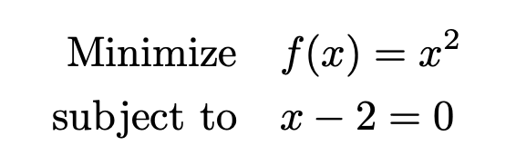
Example
Notes:
Y is the dual variable or Lagrange Multiplier
F* is the convex conjugate of F
Go over example

Slide 16
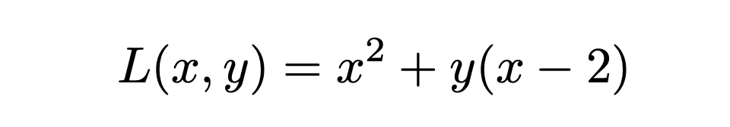
Example
Notes:
Y is the dual variable or Lagrange Multiplier
F* is the convex conjugate of F
Go over example

Slide 17
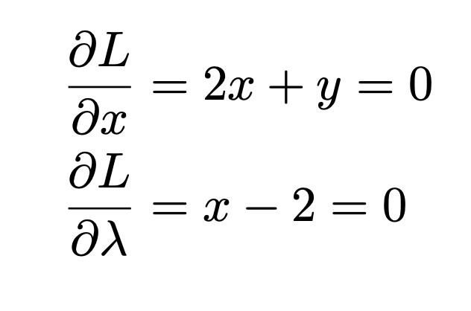
Example
Notes:
Y is the dual variable or Lagrange Multiplier
F* is the convex conjugate of F
Go over example

Slide 18
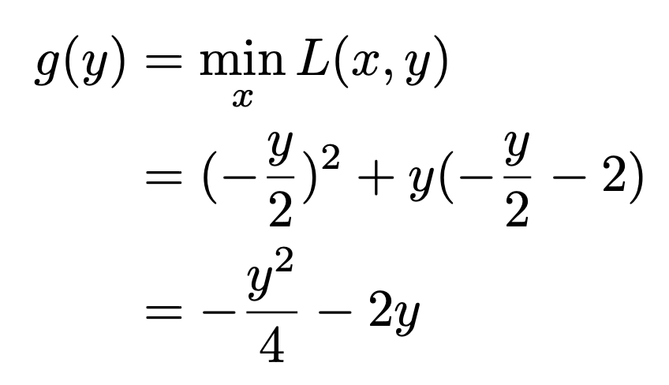
Example
Dual Function
Notes:
Y is the dual variable or Lagrange Multiplier
F* is the convex conjugate of F
Go over example

Slide 19
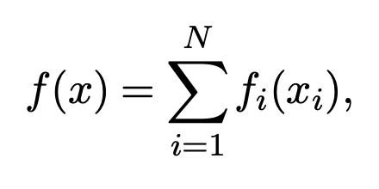
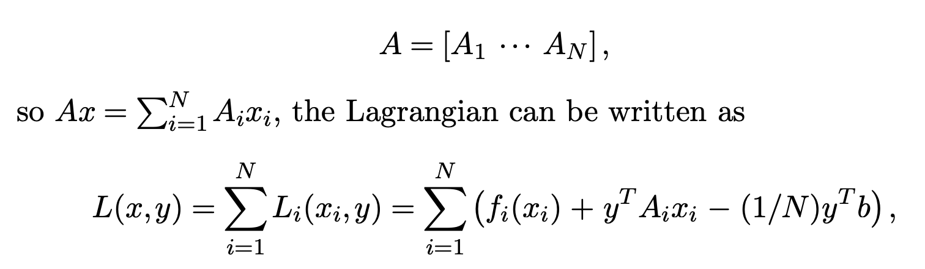
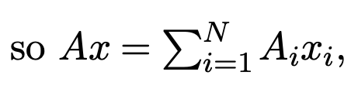
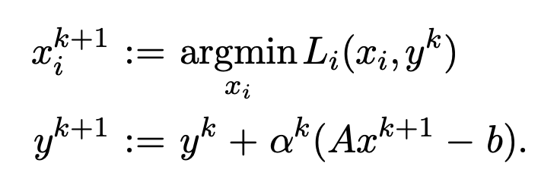
Dual Decomposition
Suppose that are objective function f is separable:
A is broken up as follows:
We write the Lagrangian like this:
We can solve N separate problems in parallel:
Notes:
This version of dual ascent is dual decomposition.
x_i’s are subvectors of x.
We can do the x optimization steps in parallel and then we gather the results to do dual descent.
This is broadcast back to the individual processors.

Slide 20
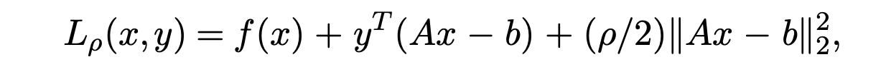
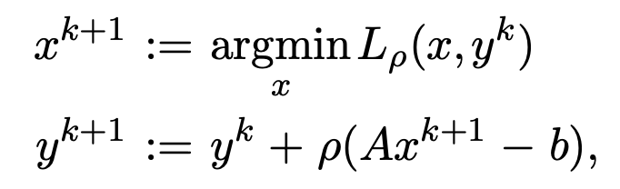
Method of Multipliers
Notes:
Rho is called the penalty parameter
Developed to bring robustness to the dual ascent method
Page 11 motivates the choice of rho for the step size
This is known as the method of multipliers

Slide 21
Method of Multipliers
Improved convergence but… augmented Lagrangian is not separable, even when f is!
Notes:
Rho is called the penalty parameter
Developed to bring robustness to the dual ascent method
Page 11 motivates the choice of rho for the step size
This is known as the method of multipliers

Slide 22
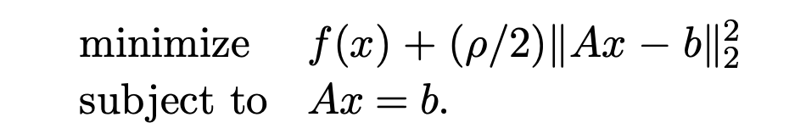
Method of Multipliers
This is the (unaugmented) Lagrangian for the problem:
Improved convergence but… augmented Lagrangian is not separable, even when f is!
Notes:
Rho is called the penalty parameter
Developed to bring robustness to the dual ascent method
Page 11 motivates the choice of rho for the step size
This is known as the method of multipliers

Slide 23
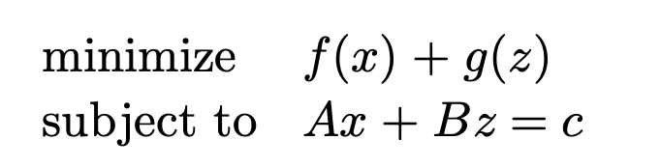
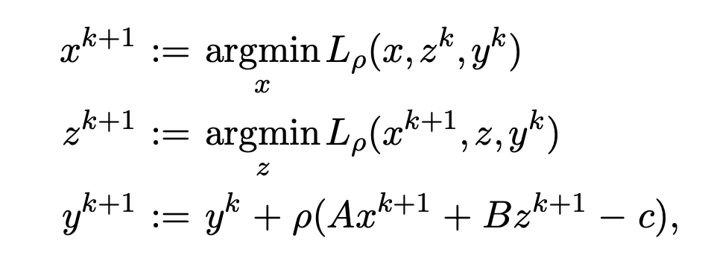
Alternating Direction Method of Multipliers (ADMM)
Solves problems of the form:
ADMM steps:
Augmented Lagrangian:

Slide 24
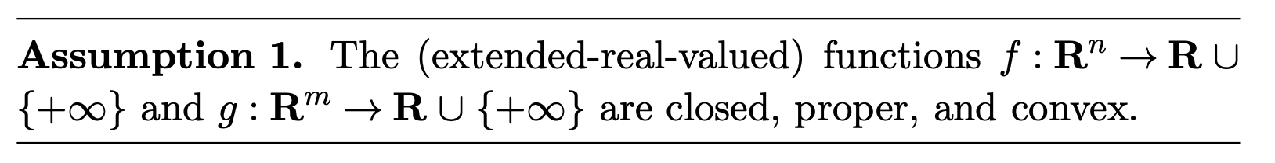
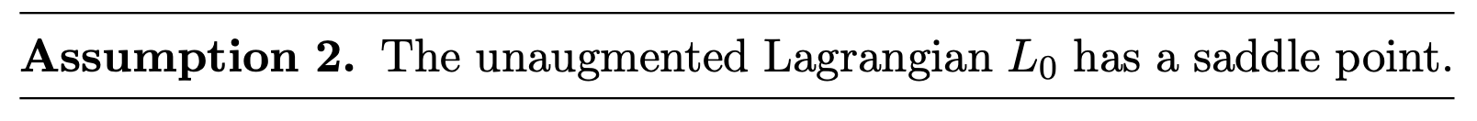
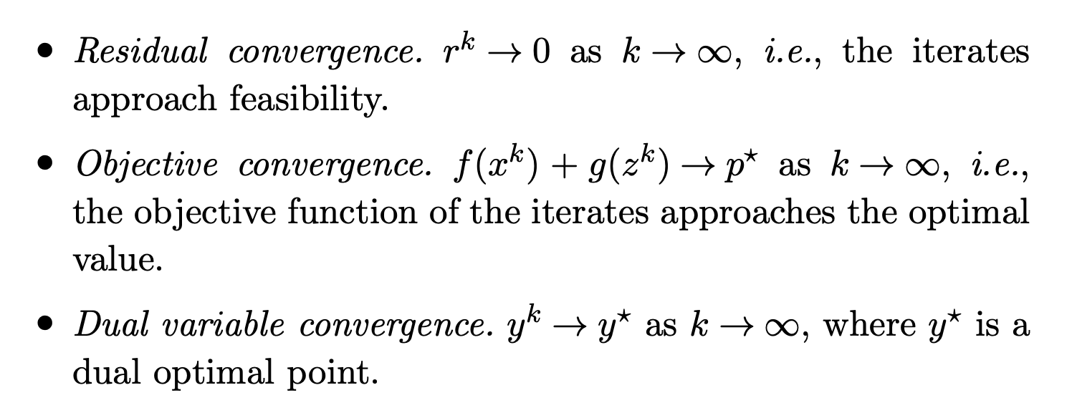

Convergence
Notes:
Convex: This means that the line segment between any two points on the graph of the function lies above or on the graph, making it a "bowl-shaped" curve.
Proper: Essentially, a proper function is one that is "well-behaved" in the sense that it avoids pathological cases where optimization would be meaningless or impossible.
Closed: In practical terms, this means that the function does not have sudden drops in value.

Slide 25
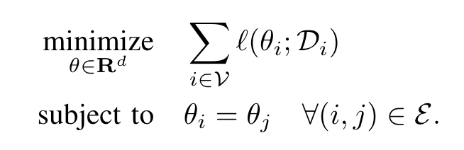
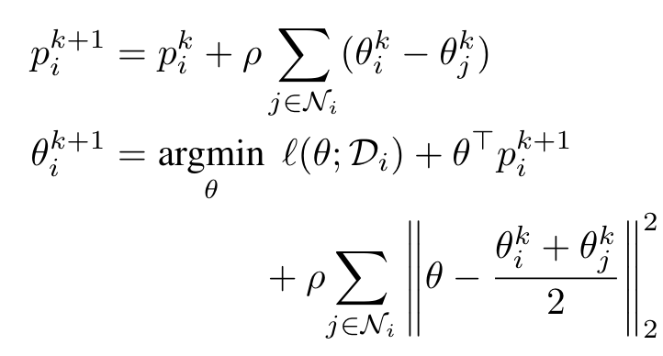
Consensus ADMM
Suppose each robot has their own set of weights and then we would like:
Update steps for CADMM:
Notes:
CADMM is an ADMM based optimization method where compute nodes (robots) alternate between updating their primal and dual variables and communicating with neighboring nodes.

Slide 26
DiNNO improvements
Instead of minimizing this perfectly, just do gradient descent for a few steps
Yu, Javier, Joseph A. Vincent, and Mac Schwager. "DiNNO: Distributed Neural Network Optimization for Multi-Robot Collaborative Learning." IEEE Robotics and Automation Letters (RA-L), vol. 7, no. 2, Sept. 2021, pp. 1896-1903​

Slide 27
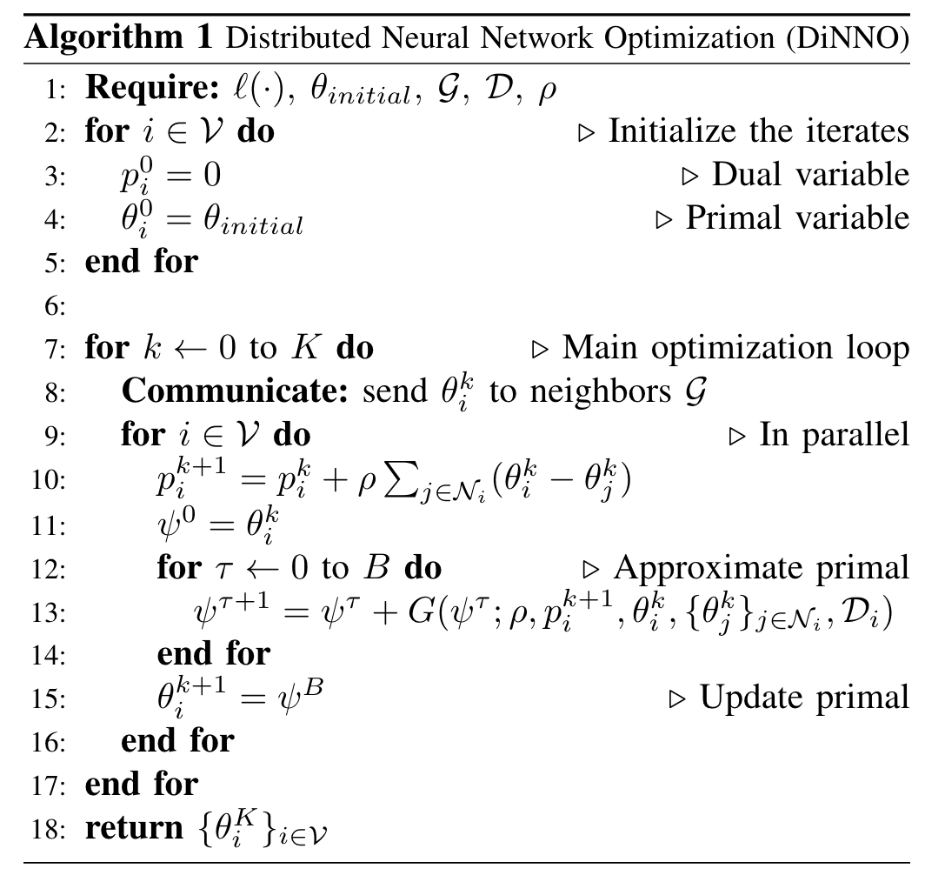
DiNNO Algorithm

Slide 28
DiNNO Algorithm

Slide 29
DiNNO Algorithm

Slide 30
DiNNO Algorithm

Slide 31
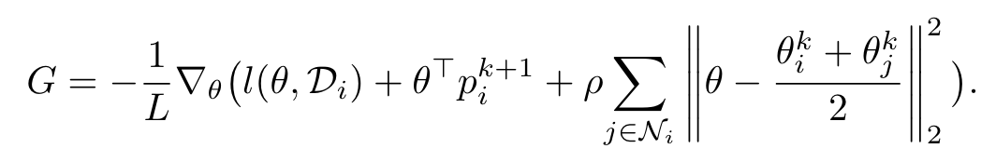
DiNNO Algorithm

Slide 32
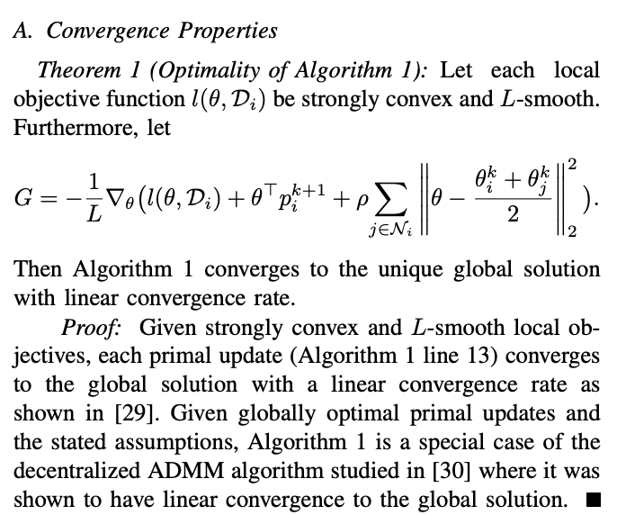
Convergence of DiNNO

Slide 33
Baseline Comparison Methods
Distributed Stochastic Gradient Descent (DSGD)
X. Lian, C. Zhang, H. Zhang, C.-J. Hsieh, W. Zhang, and J. Liu, “Can decentralized algorithms outperform centralized algorithms? a case study for decentralized parallel stochastic gradient descent,” in Proceedings of the 31st International Conference on Neural Information Processing Systems, 2017, pp. 5336–5346
Distributed Stochastic Gradient Tracking (DSGT)
S. Pu and A. Nedic, “Distributed stochastic gradient tracking methods,” Mathematical Programming, vol. 187, no. 1, pp. 409–457, 2021.

Slide 34
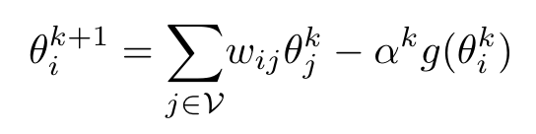
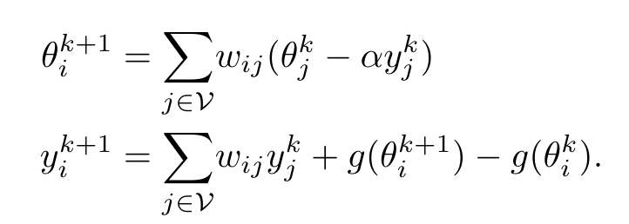
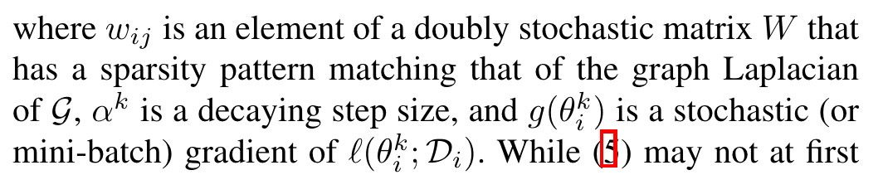
Baseline Comparison Methods
Distributed Stochastic Gradient Descent (DSGD)
Distributed Stochastic Gradient Tracking (DSGT)

Slide 35
A Note on Data Distributions
The way in which local data is partitioned is important!
A Homogenous distribution is where each robot has access to a subset of examples from all classes
A Heterogenous distribution is where each robot has access to labelled data for a single class only
Heterogenous problems are much harder to solve

Slide 36
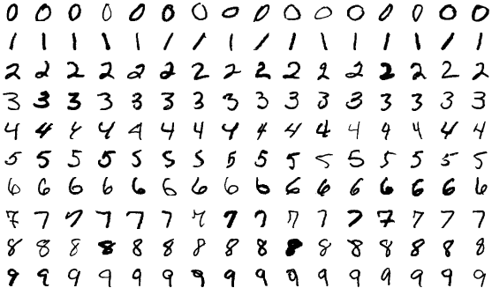
My Implementation of DiNNO on MNIST
By Suvanjanprasai - Own work, CC BY-SA 4.0, https://commons.wikimedia.org/w/index.php?curid=132282871

Slide 37
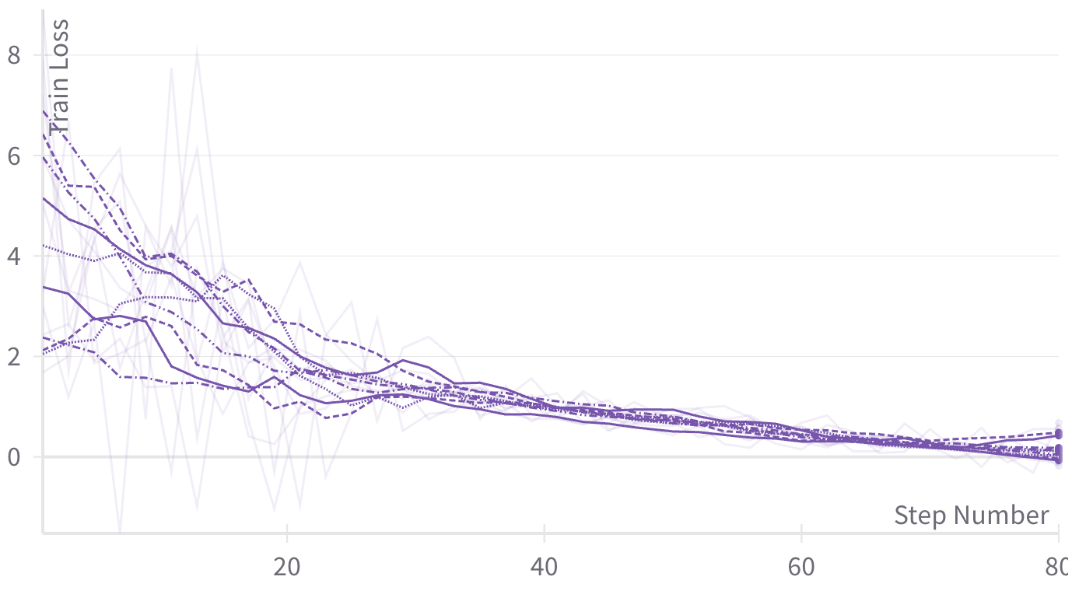
Train Loss for Each Agent

Slide 38
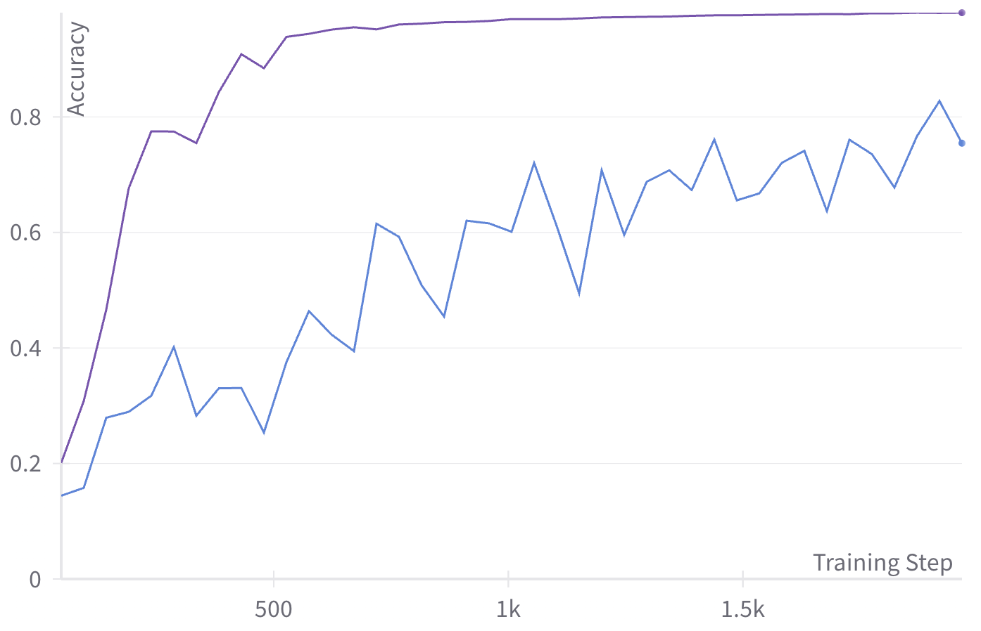
MNIST Validation Accuracy
Decaying Learning Rate
Fixed learning rate (0.05)

Slide 39
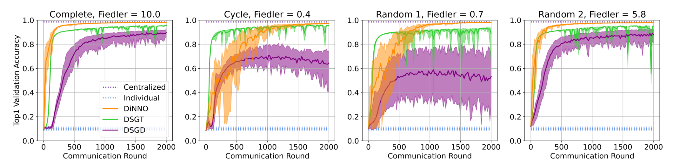
Their Results (MNIST)

Slide 40
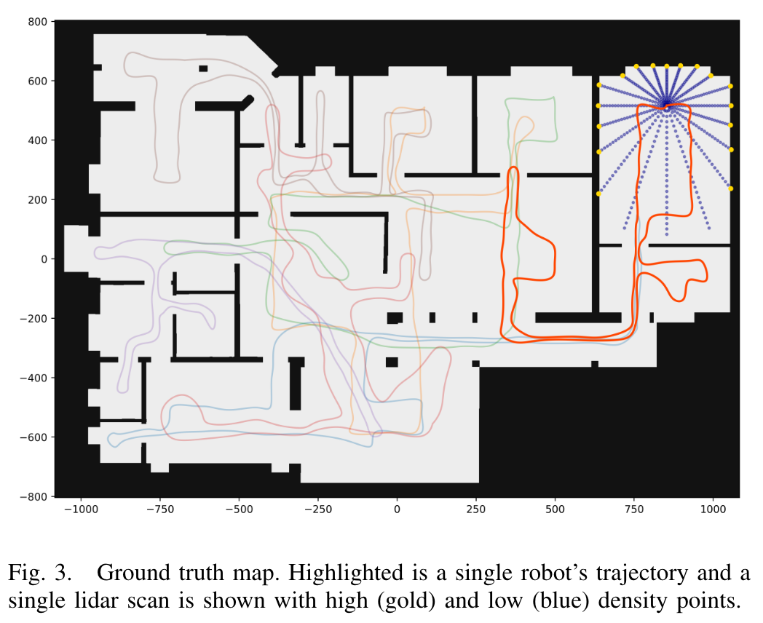
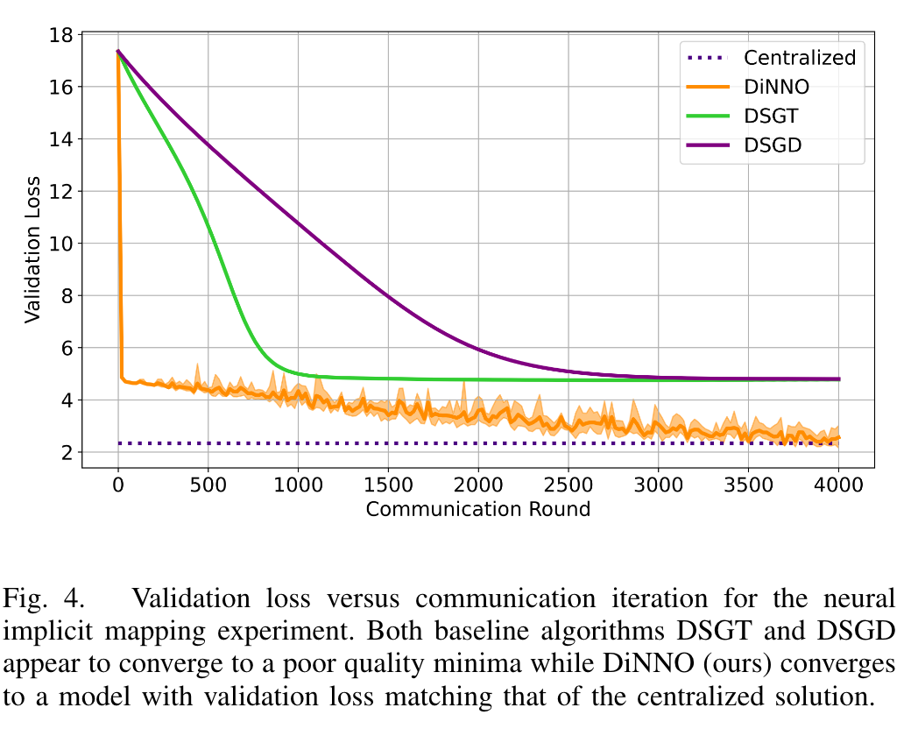
Their Results (Nueral Implicit Mapping)
Notes:
Trajectories are precomputed
For the communication graph at each round an edge between two robots exists if their pairwise distance is below a certain threshold (1500 in this experiment). The constant motion of the robots results in a communication graph that is dynamic (in terms of edges), but always connected.

Slide 41
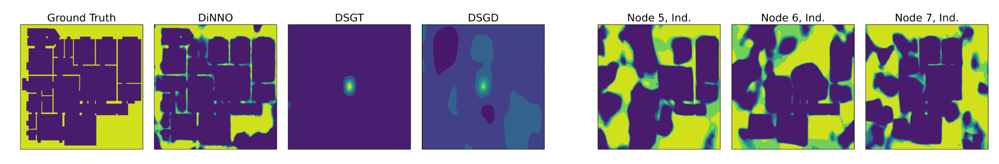
Their Results (Neural Implicit Mapping)
Notes:
Trajectories are precomputed
For the communication graph at each round an edge between two robots exists if their pairwise distance is below a certain threshold (1500 in this experiment). The constant motion of the robots results in a communication graph that is dynamic (in terms of edges), but always connected.

Slide 42
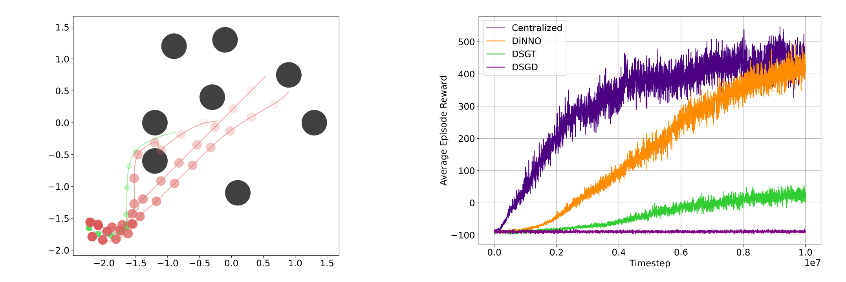
Their Results (Reinforcement Learning)
Notes:
three robots must work together to pursue a faster evader robot in the presence of stationary randomly placed obstacles,
The pursuers are homogeneous with actions a = [none, right, left, up, down] ∈ R5 : A and observations o =[self vel, self pos, other pursuers rel pos, evader rel pos, evader rel vel] ∈ R12 : O. Actions are clipped to be on the interval [0, 1]
They use PPO

Slide 43
Their Results (Video)
https://youtu.be/4wGhCtH18DY

Slide 44
Summary and Future Work
DiNNO is an algorithm for distributed neural network optimization
It is based of ADMM which is a form of Dual Ascent
They can match a centralized baseline in a variety of scenarios
Future work could include consensus in more complex environments
What is the limit for neural network size?
Final project based on using DiNNO with “specialist” networks

Slide 45
Future Work
Explain here your ideas for how this research could be extended.

