Slide 1
1fr
0.25fr/0.05fr
Top(0,0)
Tree(1,0)
0.2fr/0.05fr
Board(0,1)
Tree(1,1)
1fr

Slide 2
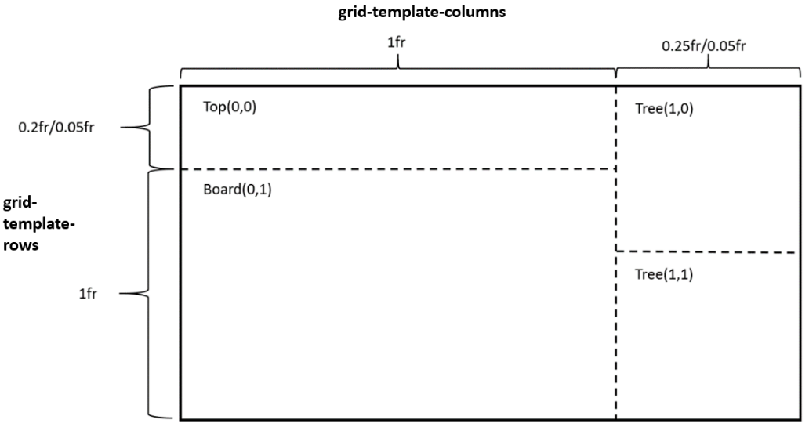

Slide 3
Top(0,0)
Tree(0,1)
Board(1,0)
Tree(1,1)

Slide 4
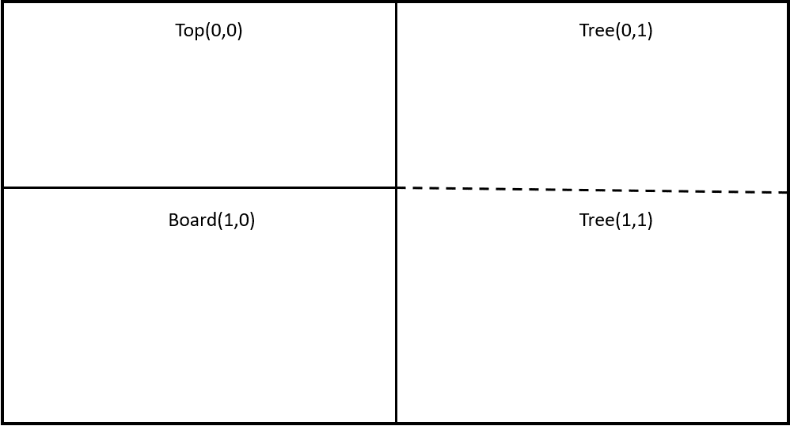

Slide 5
Set 1
Set 2
+
-

Slide 6
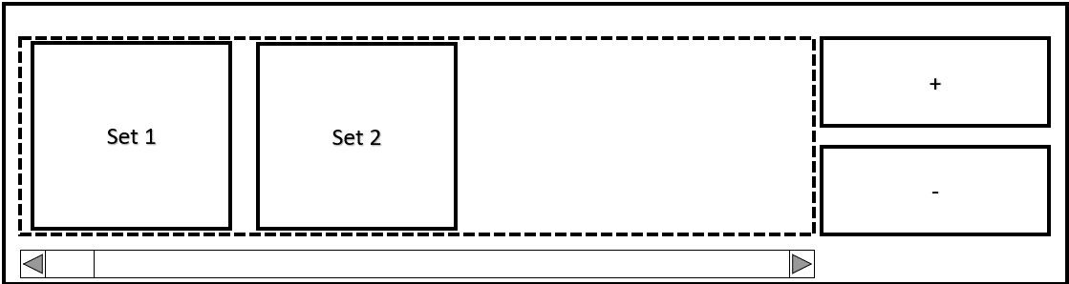

Slide 7
Handle
Menu
Editor

Slide 8
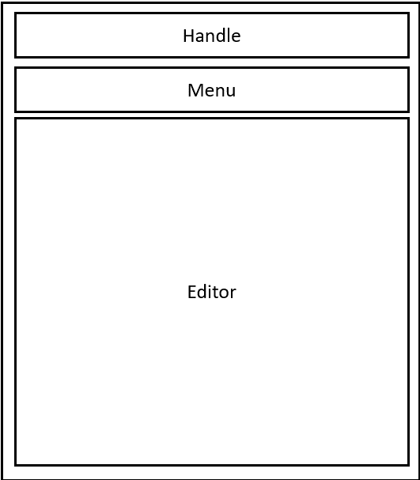

Slide 9
y
width/2
x
Bubble 1
height/2
((width/2)+x,(height/2)+y)
Bubble 2

Slide 10
