Slide 1
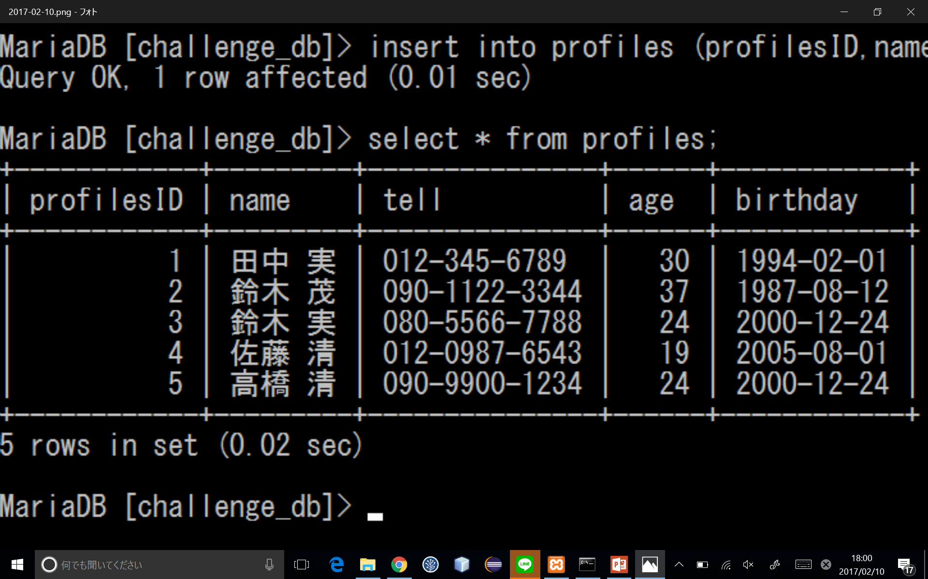
課題1 ～テーブルの作成とinsert～
create table profiles(profilesID int,name varchar(255),tell varchar(255),age int,birthday date);
insert into profiles (profilesID,name,tell,age,birthday)values(1,'田中 実','012-345-6789',30,'1994-02-01');
insert into profiles (profilesID,name,tell,age,birthday)values(2,'鈴木 茂','090-1122-3344',37,'1987-08-12');
insert into profiles (profilesID,name,tell,age,birthday)values(3,'鈴木 実','080-5566-7788',24,'2000-12-24');
insert into profiles (profilesID,name,tell,age,birthday)values(4,‘佐藤清’,‘012-0987-6543’,19,‘2005-08-01’);
insert into profiles (profilesID,name,tell,age,birthday)values(5,'高橋 清','090-9900-1234',24,'2000-12-24');

