Slide 1
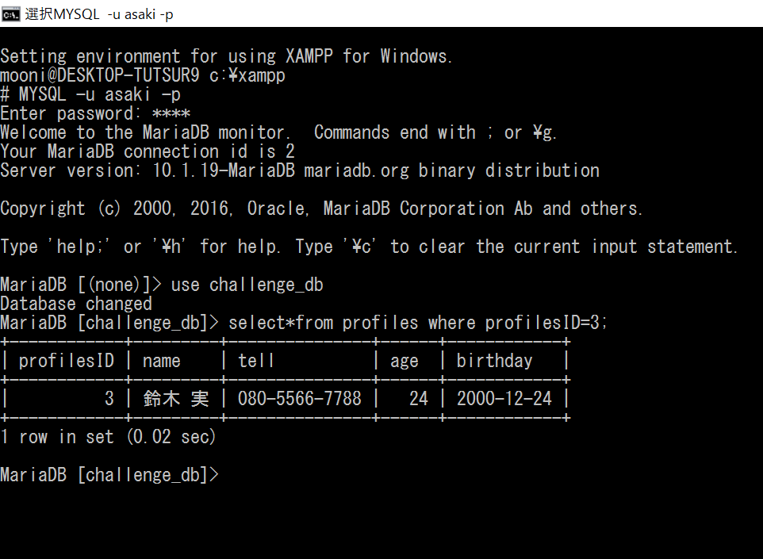
課題２ ～検索と表示～
MYSQL –u asaki –p
--------
use challenge_db
select * from profiles where profilesID=3;

