Slide 1
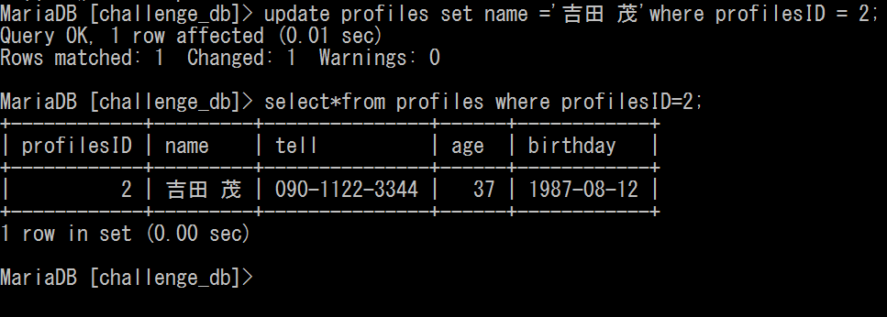
課題７ ～特定のレコードの更新～
update profiles set name =
‘吉田 茂’where profilesID =2;
select * from profiles where profilesID =2;

