Slide 1
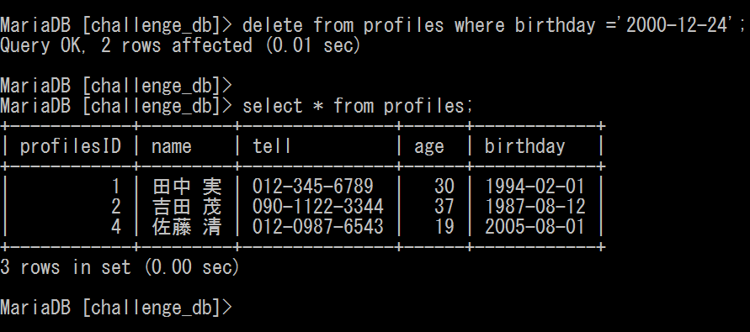
課題８ ～特定のレコードの削除～
delete from profiles where birthday =
‘2000-12-24’;
select * from profiles;

