Slide 1
課題９
～Primary KeyとForeign Keyの宣言～
insert into profiles(profilesID,name,tell,age,birthday) values(3,'鈴木 実','080-5566-7788',24,'2000-12-24');
insert into profiles(profilesID,name,tell,age,birthday) values(5,'高橋 清','090-9900-1234',24,'2000-12-24');
update profiles set name ='鈴木 茂'where profilesID = 2;
select * from profiles order by profilesID;
alter table user change profilesID userID int primary key;
create table department(departmentID int primary key,departmentName varchar(255));
create table station(stationID int primary key,stationName varchar(255));
insert into department(departmentID,departmentName) values(1,'開発部');
insert into department(departmentID,departmentName) values(2,'営業部');
insert into department(departmentID,departmentName) values(3,'総務部');
insert into station(stationID,stationName) values(1,'九段下');
insert into station(stationID,stationName) values(2,'永田町');
insert into station(stationID,stationName) values(3,'渋谷');
insert into station(stationID,stationName) values(4,'神保町');
insert into station(stationID,stationName) values(5,'上井草');

Slide 2
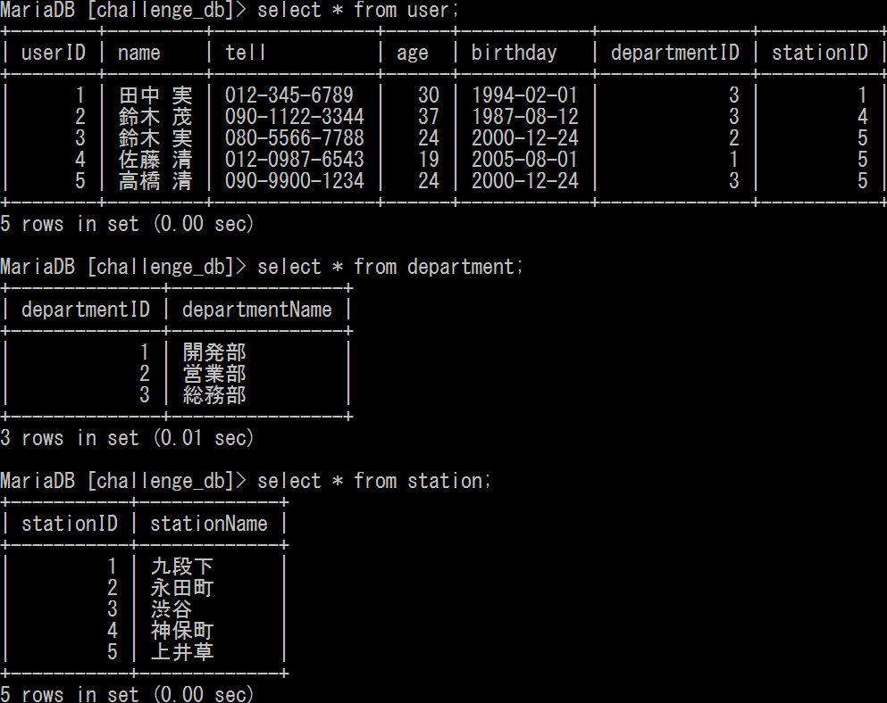
～Primary KeyとForeign Keyの宣言～
alter table user add (departmentID int,foreign key (departmentID) references department (departmentID));
alter table user add (stationID int,foreign key (stationID) references station (stationID));
update user set departmentID = 3 where userID =1;
update user set departmentID = 3 where userID =2;
update user set departmentID = 2 where userID =3;
update user set departmentID = 1 where userID =4;
update user set departmentID = 3 where userID =5;
update user set stationID = 1 where userID =1;
update user set stationID = 4 where userID =2;
update user set stationID = 5 where userID =3;
update user set stationID = 5 where userID =4;
update user set stationID = 5 where userID =5;
select * from user;
select * from department;
select * from station;

