Slide 1

ProjectKanri
By: Moojig Battsogt, Pia Rahman, Sam Taddonio

Slide 2
Elevator Pitch
Have you ever thought you can do better than Jira. Well, you deserve better than Jira. ProjectKanri can help, and make tracking projects much easier.

Slide 3
Concept
Description:
A website that can help a user track multiple project.
Motivation for development:
Our motivation for the project came from that fact that we had to use a project tracking app for our final project. We have used Jira before and we feel that there should be a more efficient way to track a project.
User story/Epic:
As a Technical Business Analyst/Project Manager, I want to be able to track my project efficiently.

Slide 4
Used Tools
The Browser React.js Material UI | Dev Tools Heroku Git GItHub Draw.io Morgan Logger Concurrently | Server Side Sessions Node.js Express.js MVC User Authentication Mongoose Passport
API Interaction GET PUT POST DELETE | Databases MongoDB | Beyond Learned Processes: Nodemailer and Gmail React DnD- (drag and drop) React-dnd-html5-backend Clsx

Slide 5
Roadmap
Sprint 0
Sprint 1
Sprint 2
Sprint 3
MVP
Release
June 27th
July 2nd
7th
14th
21th
Vision/MVP
Plan
Wireframes
User flows
View Task Page/Task API
Add new Projects
View Project Page/Project API’s
Add new tasks
Database Models
User Profile
Edit / update tasks
Develop
Task comments
User Context
Dashboard
Kanban drag and drop
Dark/Light Model
Login func
Basic form validations
Forgot Password
Invite member to project
App bar
Welcome Page/Redirect
Project Task Navbar
Notes:
Sprint 0 = 27th thru 1st – always planning phase – clear vision, mvp outline, wireframes, user flows
Sprint 1 = jul 2nd thru 6th – database models all of it , user context, basic task page w/task api (display only), login functionality , appbar
Sprint 2 = jul 7th thru 13 – features: basic project page w/project apis, basic dashboard w/dashboard apis display only, finished task page,toggle dark/light mode, forgot password, welcome page and redirects, user profile
Sprint 3 = jul 14th thru 20 – add new project and new tasks, edit task page. Task comments, Kanban board functionality. Basic validations. Add members to project. Project / task navbar
MVP launch = jul 21st

Slide 6
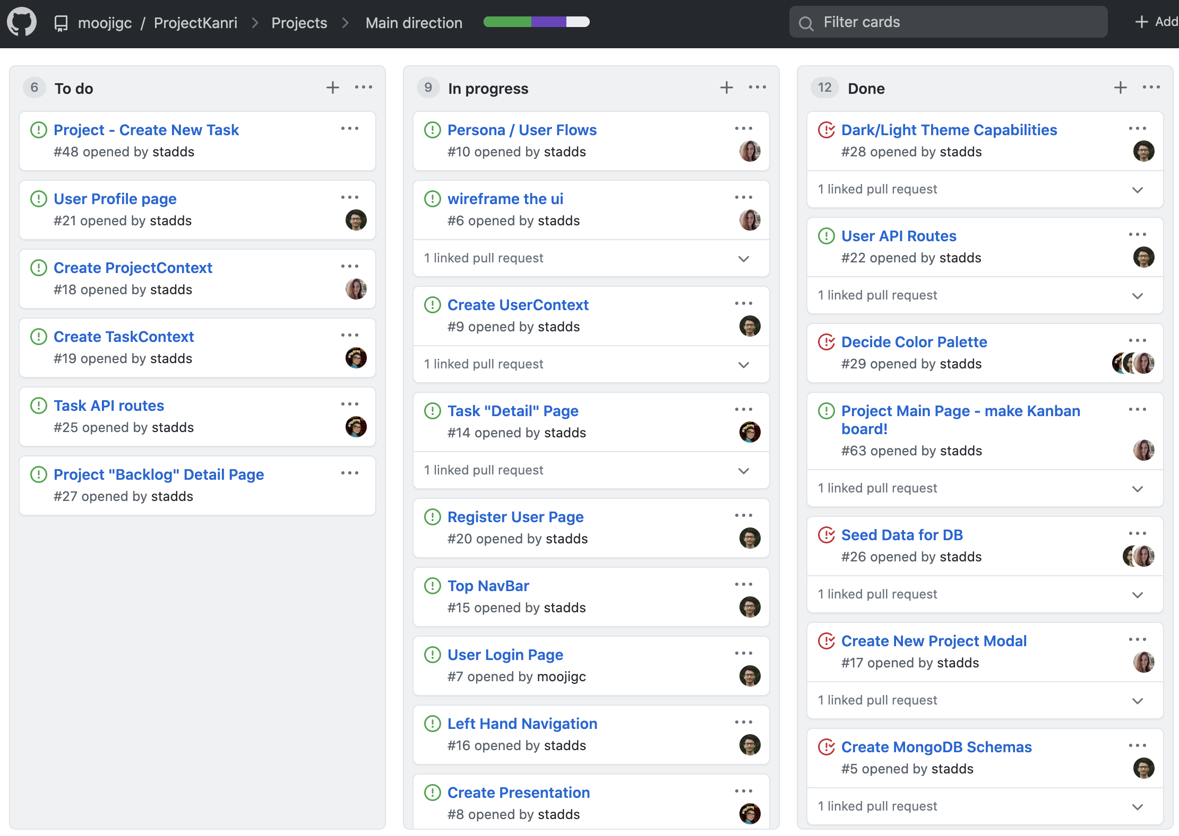
Status Board

Slide 7
Demo of the /Website Application

Slide 8
Directions for Future Development
Future Board:
Inbox/Notifications
Project roadmap
Task History (Audit)
Messaging
Task Prioritization
Project comments
Task Story Pointing
Cascading comments
Full Markdown Support
Ability to tag members
Ability to add meeting notes
Project Backlog Page
Team’s thoughts on the final Project:
Team worked very well together
Team’s advice to share for the final Project:
More time to add future board
Taking on Jira is a challenge

Slide 9
Links
Deployed: https://projectkanri.herokuapp.com/
GitHub repo: https://github.com/moojigc/ProjectKanri
GitHub Project Tracking: https://github.com/moojigc/ProjectKanri/projects/1

