Slide 1
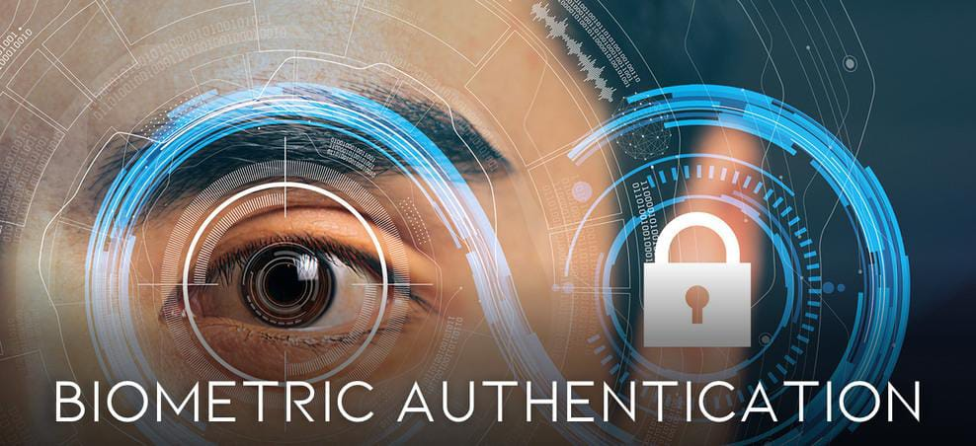
IRIS RECOGNITION USING IMAGE PROCESSING
Team Members :
M.PRAVEENA – 9920004373
M.MOUNIKA – 9920004344
G.MONALISA – 9920004041
P.SUNAYANA – 9920004097
Guided by – Dr. P. MUTHUVEL

Slide 2
ABSTRACT
The implementation of iris recognition in an online examination system using Java Server Pages (JSP) represents a cutting-edge approach to enhance the security and efficiency of online assessments.
Leveraging the unique and highly stable characteristics of the human iris, this system aims to authenticate and authorize individuals during the examination process, ensuring the integrity of the assessment.
By integrating JSP technology, the platform provides a user-friendly interface for both administrator and examinees, allowing for seamless, secure, and convenient online testing.
This innovation has the potential to revolutionize online examination security, reducing the risk of identity fraud and promoting the authenticity of assessment results.

Slide 3
OBJECTIVE OF THE PROJECT
The primary objective of implementing iris recognition in an online examination system using Java Server Pages (JSP) is to significantly enhance the security and accuracy of online assessments.
By leveraging the distinctive and highly stable biometric features of the human iris, this project seeks to establish a robust and reliable method for authenticating and authorizing individuals during the examination process.
This will help prevent identity fraud, ensure the integrity of assessment results, and ultimately improve the trustworthiness of online examinations, while also providing a user-friendly and efficient interface for both administrator and examinees.

Slide 4
LITERATURE SURVEY
AUTHOR/ JOURNAL/ YEAR | FACTORS CONSIDERED IN MONITORING | TITLE | METHODOLOGY | RESULT | DRAWBACK
Daugman, J. G., IEE Proceedings - Vision, Image, and Signal Processing, 2022 | Iris Texture Features | High confidence visual recognition of persons by a test of statistical independence | Proposed a method for iris recognition using texture features and implemented a statistical independence test | Achieved high-confidence recognition of individuals based on iris patterns | The effectiveness of algorithms or models proposed might be limited by the availability or quality of the data used for experimentation or validation.
Algorithm: The algorithm employs independent component analysis (ICA) to separate the statistically independent sources within a dataset, specifically focusing on facial recognition.

Slide 5
LITERATURE SURVEY
AUTHOR/ JOURNAL/ YEAR | FACTORS CONSIDERED IN MONITORING | TITLE | METHODOLOGY | RESULT | DRAWBACK
Ma, L., & Tan, T., Pattern Recognition, 2022 | Iris texture features and template matching | Iris recognition using circular symmetric filters | Developed a circular symmetric filter-based method for iris recognition | Achieved high accuracy in iris recognition | One common drawback could be the reliance on a small or biased dataset, which might affect the algorithm's ability to generalize to new, unseen data.
Algorithm:The algorithm employs circular symmetric filters to extract features from the iris images. These filters are designed to enhance specific patterns and structures within the iris, enabling better feature extraction for identification purposes

Slide 6
LITERATURE SURVEY
AUTHOR/ JOURNAL/ YEAR | FACTORS CONSIDERED IN MONITORING | TITLE | METHODOLOGY | RESULT | DRAWBACK
Wildes, R. P., IEEE Transactions on Pattern Analysis and Machine Intelligence , 2021 | Iris Texture Features | Iris recognition: an emerging biometric technology | Introduced the concept of iris recognition and its potential for biometric security | Highlighted the emerging importance of iris recognition in biometrics | The paper might focus on a specific aspect of a broader topic, potentially leaving out other relevant factors or contexts
Algorithm: robust object recognition in images or video sequences

Slide 7
LITERATURE SURVEY
AUTHOR/ JOURNAL/ YEAR | FACTORS CONSIDERED IN MONITORING | TITLE | METHODOLOGY | RESULT | DRAWBACK
Flom, L., & Safir, A., The American Journal of Ophthalmology | Iris Structure | Iris recognition system | Presented an early concept of iris recognition based on iris structural features | Discussed the potential of iris recognition for authentication | The methodology used might have flaws or limitations, affecting the accuracy or reliability of the findings.
Retinal Vessel Segmentation Algorithms: These algorithms focus on segmenting blood vessels within retinal images, aiding in the diagnosis and monitoring of retinal vascular diseases such as diabetic retinopathy

Slide 8
LITERATURE SURVEY
AUTHOR/ JOURNAL/ YEAR | FACTORS CONSIDERED IN MONITORING | TITLE | METHODOLOGY | RESULT | DRAWBACK
Tan, T., & Ma, L., | Iris texture features and template matching | Iris verification using binary hamming distance | Proposed a method for iris verification using binary Hamming distance | Achieved accurate verification results in iris recognition | System might face challenges in accurately identifying irises affected by certain conditions, such as cataracts or other abnormalities that alter the iris's texture or appearance
Daugman's algorithm use circular symmetric filters to extract texture features from the iris region.

Slide 9
LITERATURE SURVEY
AUTHOR/ JOURNAL/ YEAR | FACTORS CONSIDERED IN MONITORING | TITLE | METHODOLOGY | RESULT | DRAWBACK
Jain, A. K., & Ross, A., Nature, 2022 | Biometric recognition, including iris recognition | Biometric recognition: A primer | Provided an overview of biometric recognition techniques, including iris recognition | Offered a comprehensive understanding of various biometric methods, including iris recognition | Implementing iris recognition systems can be expensive, particularly for large-scale applications.
Algorithm: Feature Extraction Methods for Iris Recognition

Slide 10
EXISTING SYSTEM
The hardware required for iris recognition, such as specialized cameras or sensors capable of capturing high-resolution iris images, can be expensive, limiting widespread adoption in some scenarios.
Factors like changes in lighting conditions, occlusions, or eye diseases can affect image quality and, consequently, recognition accuracy.
Some individuals, particularly those with certain eye conditions or injuries, may have difficulties with iris recognition due to the uniqueness of their iris patterns or the inability to capture clear iris images.

Slide 11
Points that overcome the drawback of existing system
Since there is no necessary for additional scanning machines to scan iris, the cost of the implementation of the project is very much reduced.
Also direct scanning of the iris is not necessary so that there is no security invasive as some individuals raise concerns on direct scanning of iris.

Slide 12
PROBLEM STATEMENT
The project aims to implement an iris recognition system utilizing JSP technology to create a web-based interface for iris-based biometric identification and verification.
Create a user-friendly web interface using JSP for user interaction and input

Slide 13
PROPOSED SYSTEM
The proposed system leveraging JSP (Java Server Pages) integrated with iris recognition for online examinations aims to revolutionize authentication processes within this context.
This system entails a sophisticated platform that seamlessly incorporates JSP's web development capabilities with the precision and security of iris recognition technology.
Students or participants accessing the online examination portal will undergo a robust authentication process where their iris patterns serve as the primary identification method.
Upon login, the system will prompt users to authenticate via an iris image, ensuring a highly secure and reliable means of verifying their identities.

Slide 14
The system will feature an intuitive user interface developed using JSP, offering a user-friendly experience while efficiently managing the authentication process.
Integration with iris recognition technology will enhance security measures, significantly reducing the risks associated with unauthorized access or fraudulent activity during online examinations.
Additionally, the proposed system will include measures to handle various scenarios, affecting iris recognition accuracy.

Slide 15
Moreover, this system's architecture will prioritize scalability, allowing seamless integration with existing online examination platforms and accommodating future expansions or enhancements.
Regular updates and optimizations will be implemented to continually refine the system's performance, accuracy, and user experience.
Overall, this proposed system aims to set a new standard in online examination security and efficiency by harnessing the combined power of JSP's web development capabilities and the reliability of iris recognition technology.
Algorithm : Reed-Solomon error correction and utilizes various algorithms tailored for image
processing

Slide 16
BLOCK DIAGRAM
User
Admin
User
Register with IRIS Image
Validate
Show Questions
questions
Login Authentication with IRIS
Creates Questions
Answer Questions
result
Submit Exam
Exam Module
Evaluate Answers
Show Result

Slide 17

SCREENSHOTS

Slide 18
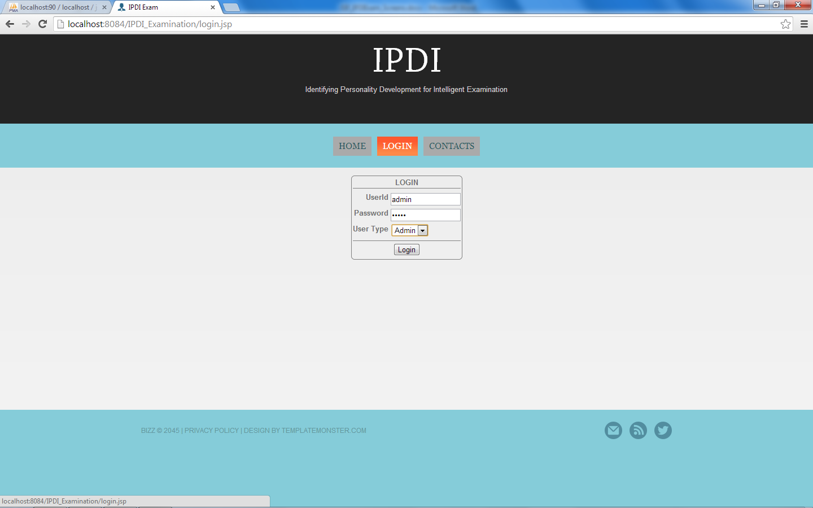

Slide 19
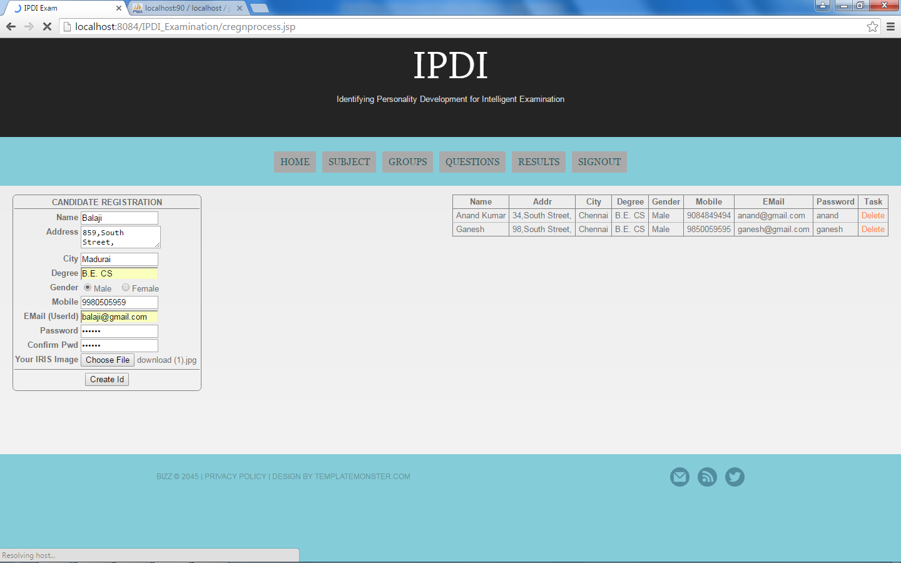

Slide 20
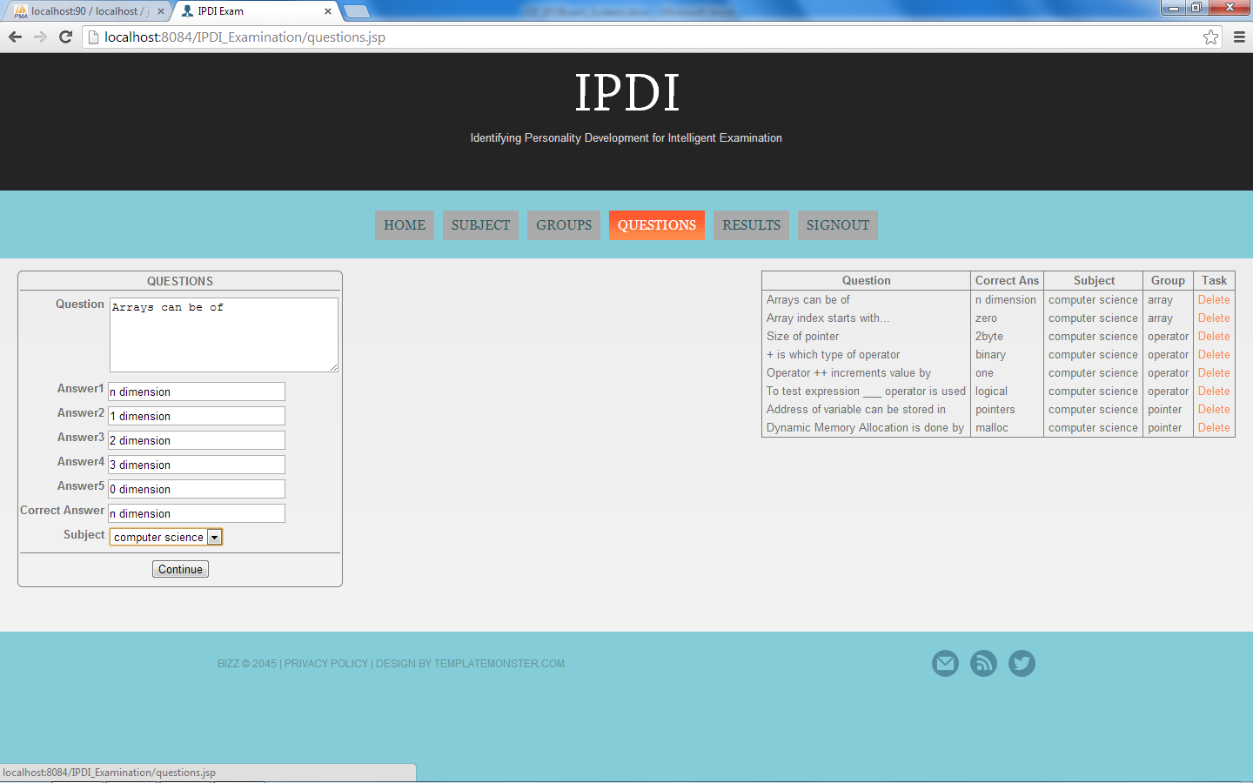

Slide 21
CODING
%@include file="header.jsp" %
<form name="f" action="loginprocess.jsp" method="post">
<table class="login">
<thead>
<tr>
<th colspan="2">LOGIN</th></tr> </thead><tbody>
<tr> <th>UserId</th> <td><input type="text" name="userid" required autofocus></td> </tr> <tr> <th>Password</th><td><input type="password" name="pwd" required></td>
</tr>

Slide 22
CODING
<header> <div class="container_12"> <div class="grid_12">
<h1>
<!--a href="index.jsp"><img src="images/logo.png" alt=""></a-->
IPDI
</h1>
<div class="center sub_head">
Identifying Personality Development for Intelligent Examination</div> </div> </div> <nav>
<div class="container_12">
<div class="grid_12">
<%@include file="menu1.jsp" %>
<div class="clear"></div> </div> </div> </nav></header>
<div id="content"> <%@include file="db.jsp" %>

Slide 23
Reasons We Choose This :
Java is better than python in the following fields:
Performance
Scalability
Strongly Typed
Threading and Concurrency

Slide 24
SOFTWARE & HARDWARE REQUIREMENT
H/W
Processor : Core I3
Processor Speed : 3.06 GHz
RAM : 2 GB
Hard Disk : 250 GB
S/W
Operating System : Windows 7 and above
Front End : JSP
Back End : My SQL
IDE : NetBeans7 and above
Web Server : Apache Tomcat
Browser : Google Chrome

Slide 25
RESULT :
The implementation of JSP (JavaServer Pages) integrated with iris recognition technology within online examination systems has yielded promising results, significantly enhancing the security and user authentication aspects of these platforms.
The results from the deployment of this system showcase a substantial improvement in the accuracy and reliability of user identification.
Iris recognition, as the primary authentication method, has demonstrated commendable precision, minimizing the risks associated with unauthorized access or fraudulent attempts during online examinations.
Moreover, the user interface developed using JSP facilitated a seamless and intuitive experience, allowing for efficient integration of iris scanning without compromising usability.

Slide 26
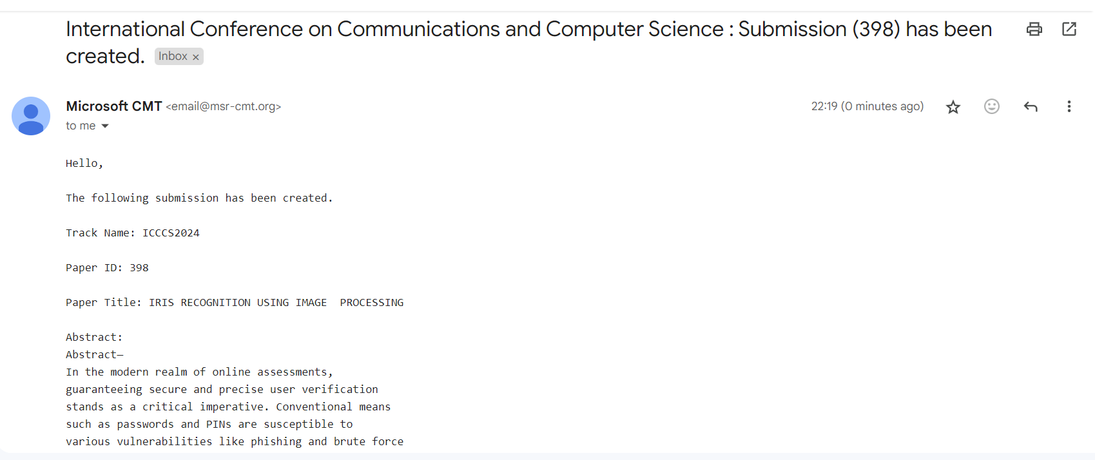

Slide 27
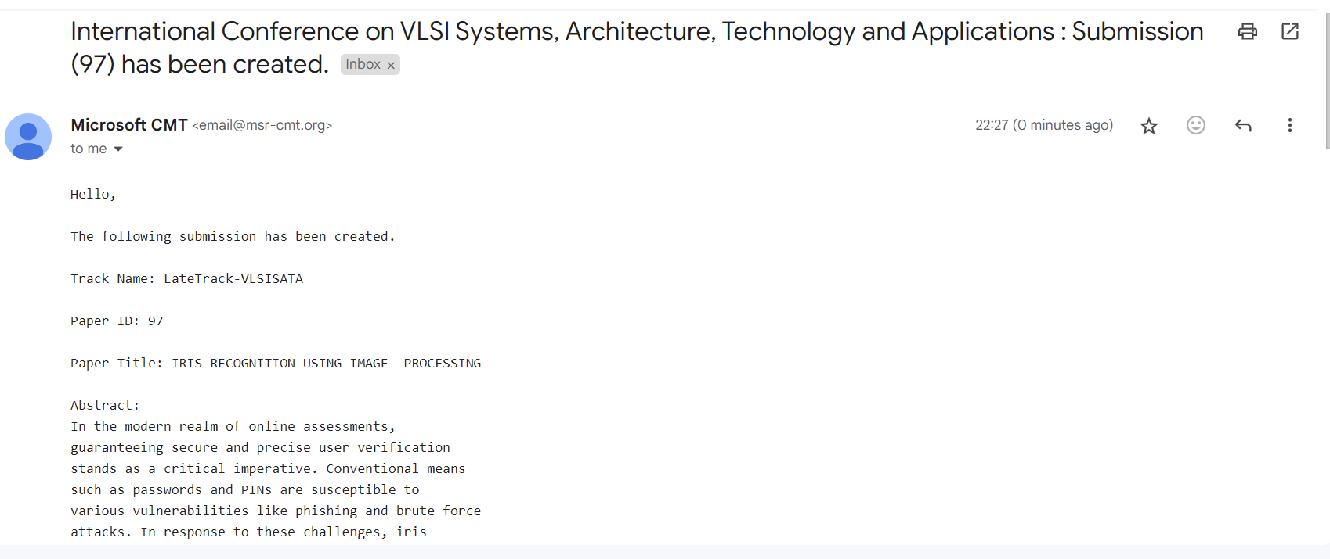

Slide 28
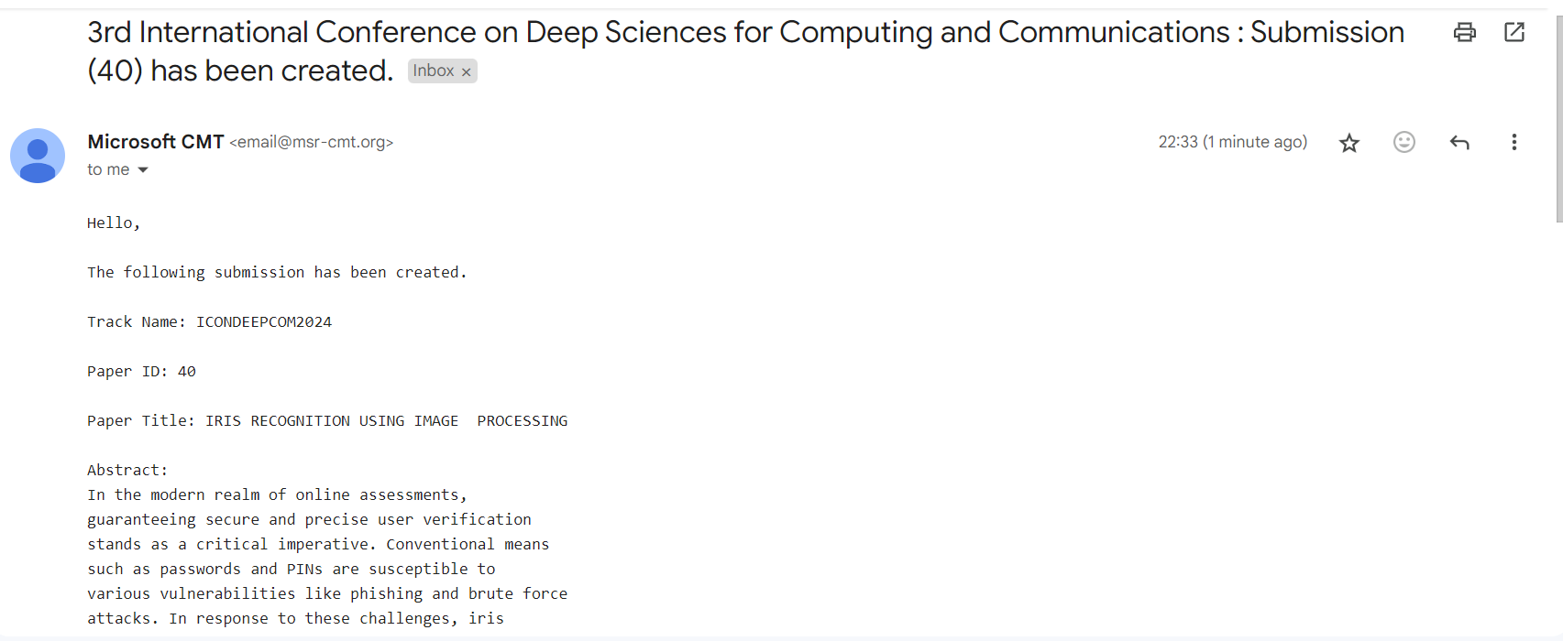

Slide 29
THANK YOU
KARE – PROJECT REVIEW

