Slide 1

Sentinel DLP
Self-Learning Data Loss Prevention for the AI Agent Era
April 2026
|
Confidential
|
Kishore Mooli

Slide 2

We built a working POC that detects what legacy DLP cannot see
The Problem
What We Built
Legacy DLP is blind to AI agent-assisted exfiltration — agents reformulate, paraphrase, and encode data at machine speed until it passes regex filters. 48% of cybersecurity professionals identify agentic AI as the most dangerous attack vector.
A three-lane architecture (Fast <50ms, Mid <500ms, Deep async) with self-learning that compounds detection accuracy over time. Working POC is complete end-to-end.
Why It Matters Now
The Ask
EU AI Act enforcement begins August 2, 2026. No vendor delivers semantic evasion detection inline today. Palo Alto and Cisco are advancing but bolting features onto legacy per-channel engines.
Approve a 4-person team for a Phase 1 live pilot (Q2-Q3 2026) to validate on real traffic. Decision point at end of Phase 1 before committing further.

Slide 3

Rule-based DLP generates excessive false positives and misses novel exfiltration
The Legacy Problem
AI Agents Make It Worse
Detection model unchanged in 15 years: regex patterns, keyword lists, manual rules
Agents reformulate data until it passes regex filters — at machine speed, across channels
Excessive false positives erode analyst trust and create alert fatigue
48% of cybersecurity professionals identify agentic AI as the single most dangerous attack vector (Dark Reading 2026)
Cannot detect reformulated, paraphrased, or semantically equivalent content
Each channel (email, web, endpoint) runs its own siloed engine with inconsistent policies
Real breaches already happening:
• Supabase MCP/Cursor AI (mid-2025) • Postmark MCP package poisoning (Sept 2025) • Slack AI exfiltration (Aug 2024)

Slide 4

Three incidents demonstrate the AI agent threat vector is active today
Supabase MCP / Cursor AI
Postmark MCP Package
Slack AI Exfiltration
Mid-2025
Sept 2025
Aug 2024
Cursor IDE's MCP integration operated with elevated service_role database privileges bypassing all row-level security. Prompt injection through user-supplied content allowed attackers to execute arbitrary SQL queries and exfiltrate sensitive integration tokens.
An unofficial impersonating npm package ("postmark-mcp") was modified to silently BCC all emails to the attacker's address. With 1,500 weekly downloads, users leaked email content without awareness. Demonstrates the MCP tool poisoning attack vector.
Indirect prompt injection in private channels tricked corporate AI into summarizing sensitive conversations and sending those summaries to an external address.

Slide 5

Multiple frameworks now require DLP controls for AI systems — EU AI Act enforcement begins August 2026
OWASP LLM Top 10
LLM02 Sensitive Information Disclosure strongly recommends DLP + redaction controls as a critical safeguard for AI systems to prevent data leakage.
2025 Update
MITRE ATLAS v5.4.0
Expanded to 16 tactics, 84 techniques, 56 sub-techniques — including agent-specific techniques, MCP case studies, and "Publish Poisoned AI Agent Tool" / "Escape to Host".
Feb 2026
EU AI Act
High-risk AI system requirements become enforceable with penalties up to EUR 35M or 7% global turnover for non-compliance with data governance and risk management obligations.
Enforceable Aug 2, 2026
Additional Frameworks
NIST AI RMF, ISO/IEC 42001, and OCC/FIEC guidance all create formal obligations for organizations to implement data loss prevention and monitoring for AI deployments.
Ongoing

Slide 6

Sentinel fills critical capability gaps that 8 incumbent vendors cannot address today
CAPABILITY
INCUMBENTS (BEST-IN-CLASS)
SENTINEL
LLM semantic evasion detection
None (Palo Alto: Partial)
Yes
Self-learning rule discovery
None (Cyberhaven: Partial)
Yes
Autonomous rule promotion
None
Yes
MCP/tool-use interception
Palo Alto: Advancing, Cisco: MCP Catalog
Yes
Cross-channel correlation
M365 only (Purview) or Limited
Yes — all channels
Policy-as-code (OPA Rego)
None
Yes
Org-specific model training
None
Yes
Inline latency <50ms
Unknown across vendors
Proven <50ms
Note: Palo Alto AIRS 3.0 and Cisco AI Defense are advancing MCP capabilities. Sentinel's advantage is architectural: unified decisioning, not bolted-on features.

Slide 7

One policy, one audit trail, one learning loop across all channels
ONE POLICY, ALL CHANNELS
OPA Rego, git-versioned. Updates apply to all channels simultaneously.
Email (SMTP)
ONE AUDIT TRAIL
Every decision across every channel in ClickHouse. One query, not 4 consoles.
Web (ICAP)
Sentinel Core
CROSS-CHANNEL VISIBILITY
Endpoint Agent
Centralize Decisioning, Distribute Collection
Deep lane correlates events across email, web, and endpoint in real time.
API / LLM
ONE ESCALATION PATH
Chat / Cloud
One NER model, one LLM analyzer, one self-learning loop serves all channels.
IDENTITY-AWARE POLICY
Per-sender/target overrides evaluated before content scoring.

Slide 8

Content flows through progressively deeper analysis — 90%+ resolved in <50ms
100% Traffic
FAST LANE
90%+
Fast Lane
Inline Enforcement
Resolved
9-Stage Pipeline | Go | <50ms | Fail-Closed Resolves 90%+ of traffic inline. Extracts content, normalizes encodings, and applies regex, checksums, and context-aware scoring.
5-10%
Mid Lane
Confidence Adjustment
Resolved
MID LANE
ML Models | <500ms → <50ms target Provides a second opinion for uncertain content (5-10%). Uses ModernBERT for NER, DeBERTa for classification, and BGE for semantic similarity.
<5%
Deep Lane
Async Deep Analysis
Audit / Retro
DEEP LANE
LLM Semantic Analysis | sec-min | <5% traffic Asynchronous deep analysis. Performs cross-channel correlation, pattern discovery, and generates GenAI root cause analysis narratives. Feeds the self-learning loop.

Slide 9
Nine detection stages resolve 90%+ of traffic in <50ms with fail-closed guarantee
1
FileType
2
Regex
3
Checksum
Block .exe in email, encrypted archives
40+ PII patterns, 15+ API keys
Known-sensitive document fingerprints
4
Keyword
5
Entropy
6
DocClass
10 compliance dictionaries (HIPAA, PCI)
Encoding and encryption detection
Document type classification
7
ContextEntity
8
Suppression
9
Score Fusion
Multi-entity correlation (e.g., PERSON + SSN)
False positive reduction (e.g., "test", "sample")
Risk calculation with context multipliers
Short-Circuit Logic
BLOCK
≥ 0.8
If confidence >0.9 on CRITICAL pattern at any stage → skip remaining stages → BLOCK immediately.
OPA Policy
ESCALATE to Mid Lane
0.5 - 0.8
Evaluate + Decide
ALLOW
< 0.5

Slide 10

Uncertain content gets progressively deeper analysis — from ML classification to LLM semantic understanding
MID LANE
DEEP LANE
5-10% of traffic | <500ms budget
<5% of traffic | sec-min (async)
ModernBERT-base (149M): Deep NER, 8K context window
LLM semantic analysis: Detects sensitive MEANING, not just patterns
DeBERTa-v3-base (86M): Sensitivity classification
BGE-small-en-v1.5 (33.4M): Semantic similarity
Cross-channel correlation: Same sender blocked on email, retries via web → BLOCK + alert
Confidence blending: 0.7 × mid_score + 0.3 × fast_score
Circuit breaker: 5 failures → 30s cooldown → fallback to fast lane score
Pattern discovery: TF-IDF identifies new patterns → shadow validate 14 days → promote
Target: GPU-accelerated to <50ms with NVIDIA L4
Root cause analysis: GenAI generates human-readable investigation narratives
Self-learning feedback: Every analyst verdict makes the system better
The Semantic Advantage
Fast lane sees "quarterly revenue projection for Project Aurora" — scores low (no PII patterns). Deep lane recognizes this as M&A-sensitive financial data because it understands MEANING.

Slide 11
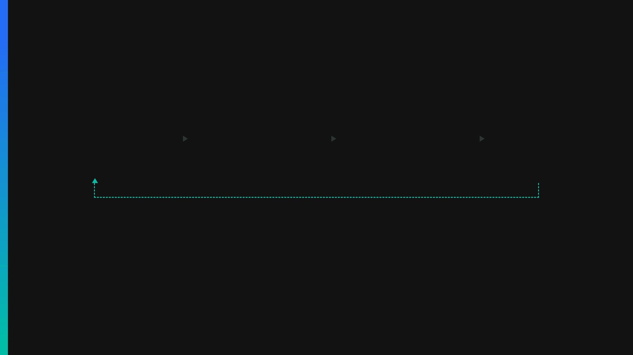
Every analyst verdict feeds back into detection — the system gets smarter every week
Analyst Reviews
Training Pipeline
Shadow Deploy
Production Promote
Verdicts on TP / FP / FN from daily operations
Weekly retrain of ML models & Rule discovery
A/B test against live traffic without blocking
OPA Policy Update & Model deployment
Continuous Feedback Loop
Safety Mechanisms
1
14-day shadow validation before any new rule or model affects production decisions.
2
Promotion strictly requires >85% precision and <5% false positive rate.
3
All policy promotions are git-versioned and require human PR review.
4
Anomaly detection on training data distribution flags unusual or adversarial patterns.

Slide 12

Central service, endpoint agent, and API sidecar enforce a single policy across all data flows
Central Service
Endpoint Agent
API Sidecar
Channels: Email (Milter), Web Proxy (ICAP), Chat (Webhook), DAR Scanning
Vectors: Clipboard, USB, File Copy, Print, Screen Capture
Flows: LLM API Prompts, MCP Tool-Use, Agent-to-Agent, REST/gRPC
All 3 lanes deployed in Kubernetes with horizontal scaling
Lightweight Go binary, <50MB footprint, <2% CPU usage
Deployed as sidecar container or local proxy
Full inline inspection capabilities
Embedded fast lane + OPA cache, offline-capable (24h TTL)
Intercepts and correlates multi-step agent sequences
<50ms fast lane
<10ms local
5-15ms added latency
ALL THREE DEPLOYMENT MODELS CONVERGE TO
Single OPA Policy (git-versioned)
ClickHouse Audit Trail
Self-Learning Loop
→
→

Slide 13

Sentinel addresses 7 distinct AI data flow risks that legacy DLP cannot see
AI DATA FLOW
RISK
SENTINEL RESPONSE
LLM API egress
Prompts ARE the exfiltration
Sidecar inline inspection + Deep Lane semantic
Agent tool-use (MCP)
File/DB/API/shell calls
Sidecar intercept + correlate multi-step sequences
IDE / copilot context
Code + secrets → external LLMs
Endpoint agent entropy/regex + AST-level deep analysis
AI-generated content
Summaries carry sensitive meaning
Deep Lane semantic comparison
Agent-to-agent flows
Orchestration buses bypass network DLP
Instrument bus + behavioral profiling
RAG data extraction
Sensitive docs retrieved via RAG
Sidecar inspects retrieval queries + responses
Agent memory persistence
Sensitive data accumulates in context
Periodic memory scanning via endpoint agent

Slide 14

Core architecture is proven end-to-end — Phase 1 connects live channels and trains on real data
POC Complete
Phase 1 Targets
Fast lane (Go): 9-stage pipeline, normalization, suppression, weighted scoring
Channel adapters on live traffic (Email Milter + Web ICAP)
Mid lane (Python): NER + keyword-density classifier, circuit breaker
MCP protocol interception for AI agent tool-use visibility
Deep lane (Python): LLM analysis, NER, TF-IDF, rule promotion, threshold tuning
GPU-accelerated mid lane research → implementation (NVIDIA L4)
OPA policy: per-channel thresholds, sender/target overrides, suppression
Content extraction: DOCX, XLSX, PPTX, RTF, ZIP (pure Go)
Data-at-rest scanners for historical context and baseline establishment
Endpoint agent: filesystem, clipboard, USB collectors + embedded fast lane
Infrastructure: NATS JetStream, ClickHouse, PostgreSQL, Redis, Prometheus
SLM benchmark framework: 6 candidates, synthetic dataset, ONNX export
<50ms
9
3
3
FAST LANE P99
PIPELINE STAGES
PROCESSING LANES
DEPLOYMENT MODELS

Slide 15

Phase 1 requires 4 people — building adapters and training models, not rebuilding the core
ROLE
COUNT
FOCUS AREA
Go Engineer (Senior)
2
Fast Lane pipeline, endpoint agent, channel adapters (Milter/ICAP). One owns network-side adapters, the other owns endpoint agent (macOS, Windows).
Python/ML Engineer
1
Mid Lane (NER + classifier), Deep Lane (LLM integration), model fine-tuning, self-learning loop. ONNX export, TensorRT optimization.
Lead / Architect
1
Architecture decisions, OPA policy design, infrastructure (NATS, ClickHouse, Redis), stakeholder alignment.
EXECUTION STRATEGY
PHASE 2 OUTLOOK
This is a lean team executing on a working POC. The Go engineers build adapters while the ML engineer fine-tunes models on live traffic. Infrastructure is operational from the POC.
If Phase 1 validates the approach, Phase 2 may add 1-2 specialists (e.g., frontend for visual policy builder). Decision point occurs after Phase 1 results.

Slide 16

Seven KPIs define success — evaluated at the Phase 1 decision point
KPI
PHASE 1 TARGET
HOW MEASURED
False positive rate
<5% on live traffic
Analyst verdict sampling (100+ events/week)
AI evasion detection rate
>80% against red team
Quarterly red team with paraphrase/encoding attacks
Fast Lane P99 latency
<50ms under production load
Prometheus P99 histogram, continuous
Self-learned rules promoted
10+ shadow rules validated
Rule promotion pipeline metrics
Analyst time per incident
30% reduction vs. current
Time-to-verdict tracking
Channel coverage
Email + Web + MCP sidecar operational
Binary: operational on live traffic
RCA narrative quality
Analyst satisfaction >4/5
Analyst feedback survey

Slide 17

Phased investment with a go/no-go decision point after Phase 1 pilot
Phase 1
Phase 2
Phase 3
Q2-Q3 2026
Q4 2026 - Q1 2027
Q2-Q4 2027
Live Pilot + Validation
AI Agent Coverage + Acceleration
Enterprise Scale
Email + Web adapters, MCP sidecar, Endpoint agent MVP
Analyst console + SIEM/SOAR integration
GPU-accelerated Mid Lane (NVIDIA L4)
EU AI Act explainability layer
GenAI-assisted rule authoring (natural language → Rego)
GenAI RCA narratives, Google Workspace integration
Fine-tuned custom SLM (org-specific)
Federated learning, multi-agent orchestration
Pattern expansion: 10 → 125+ patterns
Visual policy builder, data lineage, cross-channel correlation
DECISION POINT AT END OF PHASE 1

Slide 18

Seven identified risks — all with concrete mitigations and decision gates
RISK
LIKELIHOOD
IMPACT
MITIGATION
Vendor closes gap faster
Medium
High
Durable architecture; Phase‑1 decision gate
Self-learning adversarial feedback
Low
High
14‑day shadow; >85% precision gate; anomaly detection
GPU procurement delays
Low
Medium
Phase‑1 on CPU; GPU deferred to Phase‑2
False positives disrupt business
Medium
High
Context suppression, per‑sender overrides, quarantine
Regulatory requirements change
Medium
Medium
Policy-as-code for rapid updates
Platform maintenance cost
Low
Medium
Open-source stack; avoid vendor lock-in
Insufficient analyst bandwidth
Medium
Medium
Active learning routes only uncertain samples

Slide 19
We are seeking approval for a 4-person team to validate Sentinel on live traffic (Q2-Q3 2026)
What we need
What we deliver
What happens next
4-person team (2 Go engineers, 1 ML engineer, 1 lead/architect) dedicated for 6 months.
Live pilot on email + web + MCP channels, trained on our own data, with measurable KPIs proving (or disproving) the approach.
Phase 1 decision point evaluates results against vendor alternatives. Full investment decision based on demonstrated outcomes, not projected capabilities.
Questions for Leadership
Which channels should Phase 1 target first?
?
Shadow mode first, then enforcement? How long?
?
Start on CPU (zero procurement) or procure GPU upfront?
?
GAIP platform compatibility — needs validation with platform owners
?
Which internal data sources are approved for model training?
?

Slide 20
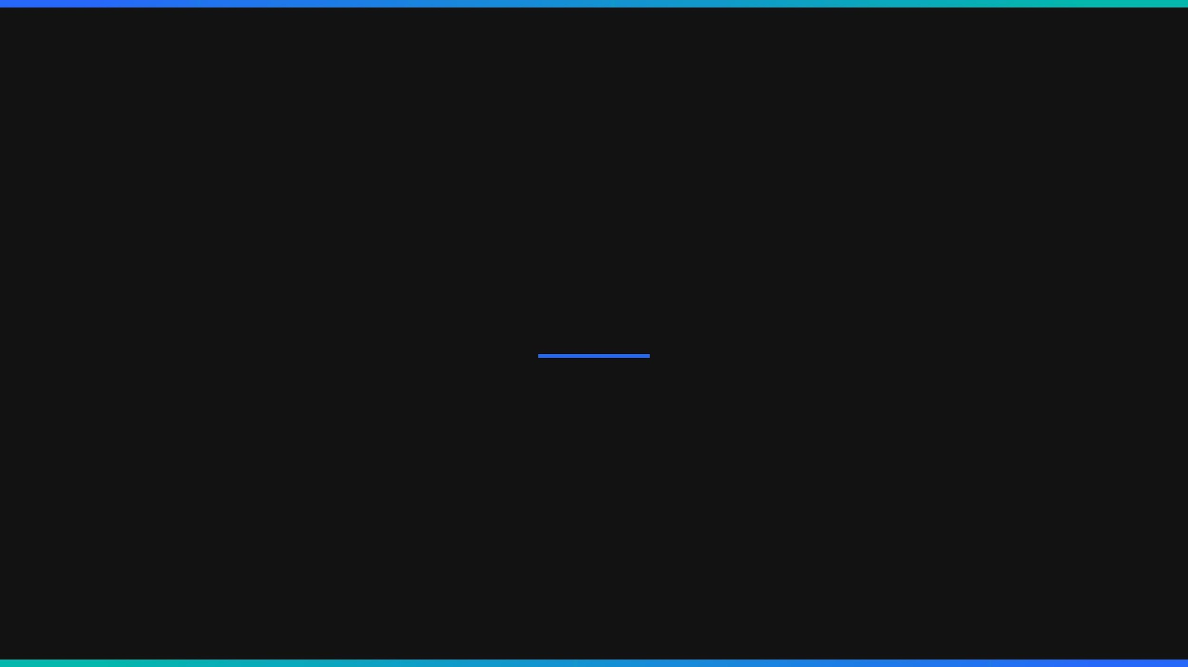
SECTION 04
Appendix — Technical Deep Dive
Architecture Details, Sequence Flows, Hardware Evaluation, and Technology Stack

Slide 21
Fast Lane processes content through 7 steps in <50ms with fail-closed guarantee
1
Ingress & Extraction
5
Context Suppression
Extract text from payloads (DOCX, PDF, ZIP) using pure Go libraries without spawning external processes.
Filter out known false positives (e.g., public test keys, internal domains) using a bloom filter.
2
Normalization
6
Weighted Scoring
Apply Unicode normalization, strip obfuscating whitespace, and decode nested encodings (Base64/Hex).
Aggregate all findings into a normalized risk score (0-100) based on pattern severity and density.
3
Pattern Matching
7
OPA Policy Evaluation
Execute high-speed Aho-Corasick automaton for exact keyword matches and optimized regex for PII/PCI.
Query local OPA cache with the risk score and context to receive an immediate enforcement decision.
4
Entropy Analysis
Calculate Shannon entropy on tokenized chunks to detect encrypted payloads, keys, or secrets.
FAIL-CLOSED GUARANTEE
If processing exceeds the 50ms budget or encounters a panic, the system defaults to a block state to prevent data leakage, ensuring security over availability.

Slide 22
Mid Lane provides ML-based confidence adjustment for uncertain content
4. ROUTING
1. TRIGGER
2. ML INFERENCE
3. BLENDING
Score ≥ 80
Fast Lane identifies uncertain content.
ModernBERT-base
Combine ML signals with Fast Lane heuristics.
Return BLOCK decision to
Deep NER (8K context)
Fast Lane (Sync)
Condition
→
→
0.7 × mid_score + 0.3 × fast_score
→
Score < 80
Score between 40 and 79
DeBERTa-v3-base
Sensitivity Classification
Log adjusted score to
ClickHouse (Async)
Transport
Weights are dynamically tuned per channel via OPA policy.
NATS JetStream
BGE-small-en-v1.5
Deep Lane
(Async/Sync)
Semantic Similarity
Forward to Deep Lane if
further analysis needed
To protect the <500ms latency budget, if the Mid Lane experiences 5 consecutive timeouts or errors, it enters a 30-second cooldown. During cooldown, traffic falls back to the Fast Lane score (fail-open for latency, fail-closed for security based on policy).
CIRCUIT BREAKER

Slide 23

Deep Lane performs LLM semantic analysis, cross-channel correlation, and self-learning
SEMANTIC ANALYSIS
CROSS-CHANNEL
SELF-LEARNING
Async Trigger
Audit Aggregation
Pattern Discovery
<5% of traffic routed for deep inspection without blocking inline flow.
ClickHouse aggregates events across Email, Web, Endpoint, and API sidecars.
TF-IDF and analyst verdicts identify new sensitive data patterns automatically.
LLM Evaluation
Behavioral Correlation
Shadow Validation
Analyzes meaning and intent (e.g., M&A plans) rather than just regex patterns.
Detects multi-vector evasion (e.g., blocked on email → retries via web upload).
New rules run in 14-day shadow mode against live traffic to measure false positives.
GenAI RCA
Global Risk Update
Generates human-readable Root Cause Analysis narratives for security analysts.
Elevates user/device risk score, triggering stricter thresholds across all channels.
Policy Promotion
Rules exceeding 85% precision are promoted to the Fast Lane OPA policy via GitOps.

Slide 24

Open-source stack with no vendor lock-in — models sized for each lane's latency budget
Infrastructure
Fast Lane
Mid Lane
Deep Lane
State & Messaging
Go | <50ms Budget
Python | <500ms Budget
Python | Async (sec-min)
NATS JetStream: High-throughput event bus
Pure Go: Zero-dependency binary
FastAPI: High-performance async API
Llama 3 8B / Mixtral: Local VPC deployment
ClickHouse: Columnar audit & analytics
Aho-Corasick: O(n) exact string matching
ModernBERT-base: 149M params, 8K context
LangChain: Orchestration & tool use
PostgreSQL: Relational state & config
RE2: Linear time regex engine
DeBERTa-v3-base: 86M params, classification
TF-IDF / Scikit-learn: Pattern discovery
Redis: Distributed caching & rate limiting
Open Policy Agent (OPA): Rego policy evaluation
BGE-small-en-v1.5: 33.4M params, embeddings
vLLM / TGI: High-throughput LLM serving
Prometheus: Metrics & observability
Go-ole/Zip: Native document extraction
ONNX Runtime: Optimized CPU/GPU inference
Celery: Distributed task queue
By leveraging best-in-class open-source components, Sentinel avoids proprietary vendor lock-in. Models are strictly sized to their lane's latency budget, ensuring security never compromises business velocity.
ARCHITECTURAL INDEPENDENCE

Slide 25

NVIDIA L4 is the recommended accelerator — 72W, <50ms, widely available at ~$2.5-3K
ACCELERATOR
INT8 TOPS
MEMORY
POWER
LATENCY (BERT)
COST
STATUS
RECOMMENDATION: PIVOT FROM FPGA TO NVIDIA L4
NVIDIA L4
485
24GB GDDR6
72W
~4-8ms
~$2.5-3K
Widely available
The originally proposed AMD Alveo V70 was discontinued in Feb 2025. The NVIDIA L4 is the ideal replacement, offering superior latency (~4-8ms) at the same power envelope (72W) and cost (~$2.5-3K). It also eliminates FPGA development complexity by leveraging the mature CUDA/TensorRT ecosystem.
NVIDIA T4
130
16GB GDDR6
70W
~8-15ms
~$2K
Legacy, still available
NVIDIA L40S
1,466
48GB GDDR6
300W
~2-5ms
~$8-10K
Available, overkill
AWS Inferentia2
N/A
32GB
50W/chip
~2-4ms
Pay-per-use
Cloud only
Intel Gaudi 3
N/A
128GB HBM2e
600W
Competitive
~$3-5K
Discontinued 2026-2027
Optimized CPU
N/A
System RAM
N/A
~15-25ms
$0 (existing)
Always available

Slide 26

Self-learning data creates a compounding moat — custom SLM reduces inference cost 10x
2. DATA FLYWHEEL
3. CUSTOM SLM
1. GENERAL LLM
Collect millions of true positive / false positive verdicts from analyst operations.
Fine-tune a Small Language Model (e.g., 1B-3B parameters) on the proprietary dataset.
Start with Llama 3 8B or Mixtral for Deep Lane semantic analysis.
→
→
High accuracy but computationally expensive and slower latency.
Build a highly specialized, org-specific dataset of sensitive data patterns.
Deploy via ONNX/TensorRT for massive cost and latency reduction.
GENERAL LLM (8B+)
CUSTOM SLM (1B-3B)
Inference Latency
~1-3 seconds
Inference Latency
<200ms
Compute Cost
High (A100/H100 req)
Compute Cost
10x Lower (L4/CPU)
Domain Specificity
Generic
Domain Specificity
Highly Tuned

Slide 27

Incumbents are advancing AI security but remain constrained by per-channel architectures
SOLUTION
ARCHITECTURE
AI FLOW VISIBILITY
SELF-LEARNING
KEY LIMITATION
THE SENTINEL ADVANTAGE
Sentinel (Proposed)
Unified 3-Lane (Inline + Async)
Full (MCP, Agent, RAG, API)
Continuous Loop
Requires initial integration effort
While competitors are bolting AI features onto legacy products, Sentinel is built natively for agentic workflows. By intercepting MCP protocols and applying continuous self-learning, Sentinel secures the semantic meaning of data, not just the regex patterns.
Palo Alto (AIRS 3.0)
Network + API Gateway
High (API, RAG)
Static ML
Blind to endpoint and local MCP tool-use
Cisco (Robust Intel)
API + Model Catalog
Medium (API only)
Static ML
Lacks inline enforcement for email/web
Cyberhaven
Endpoint + Data Lineage
High (Lineage tracking)
Partial
High endpoint overhead; struggles with semantic meaning
Legacy DLP
Per-Channel Regex
Low (Regex only)
None
Blind to AI meaning; high false positive rate

Slide 28

Sentinel processes data through 6 input channels into a unified 3-lane architecture
Deep Lane (Slow)
Email
Python | sec-min
SMTP
Central Service
LLM Semantic Analysis Cross-Channel Correlation Self-Learning Loop
Ingress & Routing
Web Proxy
ICAP
Context Enrichment
Endpoint
User Risk | Device | Location
Agent
Fast Lane (Inline)
Go | <50ms | Fail-Closed
9-Stage Detection Pipeline OPA Policy Evaluation Immediate Enforcement
API / LLM
Sidecar Proxy
Content Normalization
Base64 | Hex | Unicode
Cloud Sync
NATS JetStream
S3 / GCS
Event Bus
Content Extraction
Mid Lane (Async/Sync)
Chat
DOCX | PDF | ZIP (<10ms)
Python | <500ms
Webhook
Regex + NER Engine Keyword-Density Classifier Confidence Adjustment
ClickHouse
Audit Store

Slide 29
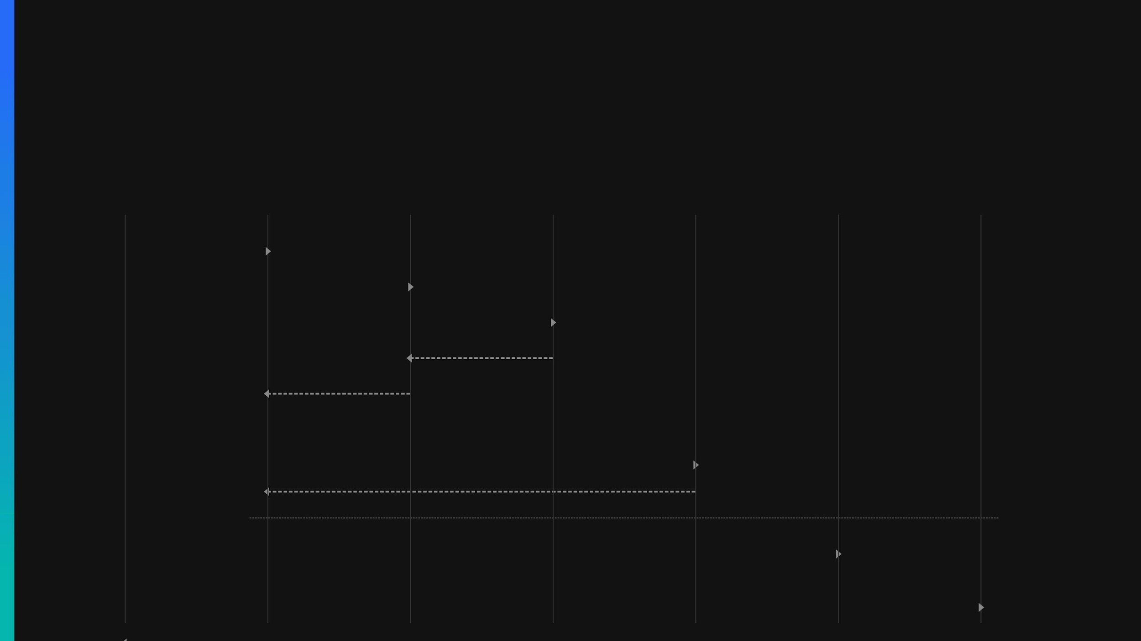
End-to-end request lifecycle: from client ingress to decision enforcement in <50ms
Client
Central Service
Fast Lane
OPA Engine
Mid Lane
Deep Lane
NATS / Audit
SendRequest (Envelope)
Process & Detect
Evaluate(EvalInput)
Decision (Block/Escalate/Allow)
Return Decision
ALT
[if score ≥ escalate_threshold]
Escalate (sync/async)
Adjusted Score
[if uncertain / async sampling]
Publish Escalation (async)
Publish Decision (Audit)
Final Response

Slide 30
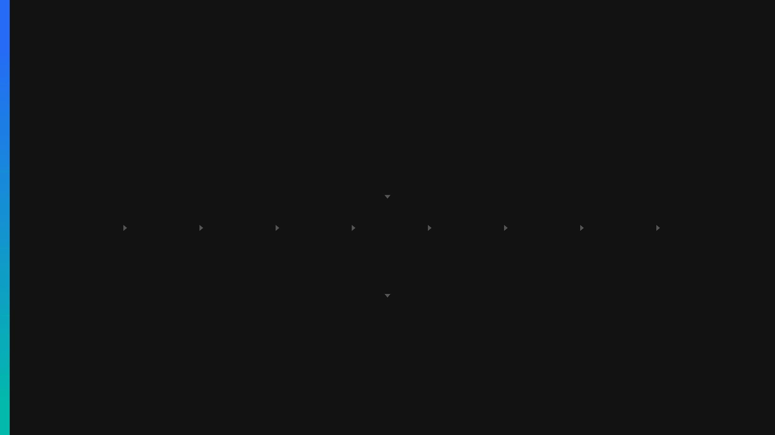
Fast Lane executes a 9-stage detection pipeline with OPA policy evaluation in <50ms
Ingress Request (Envelope + Content)
9-STAGE DETECTION PIPELINE (PURE GO)
Normalize
Extract
FileType
Regex
Checksum
Keyword
Entropy
DocClass
Context
* Short-circuits immediately if any stage returns CRITICAL hit (>0.9 confidence)
OPA POLICY ENGINE
Evaluates: DetectedItems[] + Envelope + ContextEnrichment
Client Response
Mid Lane
NATS JetStream
Sync enforcement (Block/Allow)
Async/Sync Escalation
Audit & Deep Lane routing
Decision: BLOCK | ESCALATE | ALLOW_AND_AUDIT | ALLOW

Slide 31
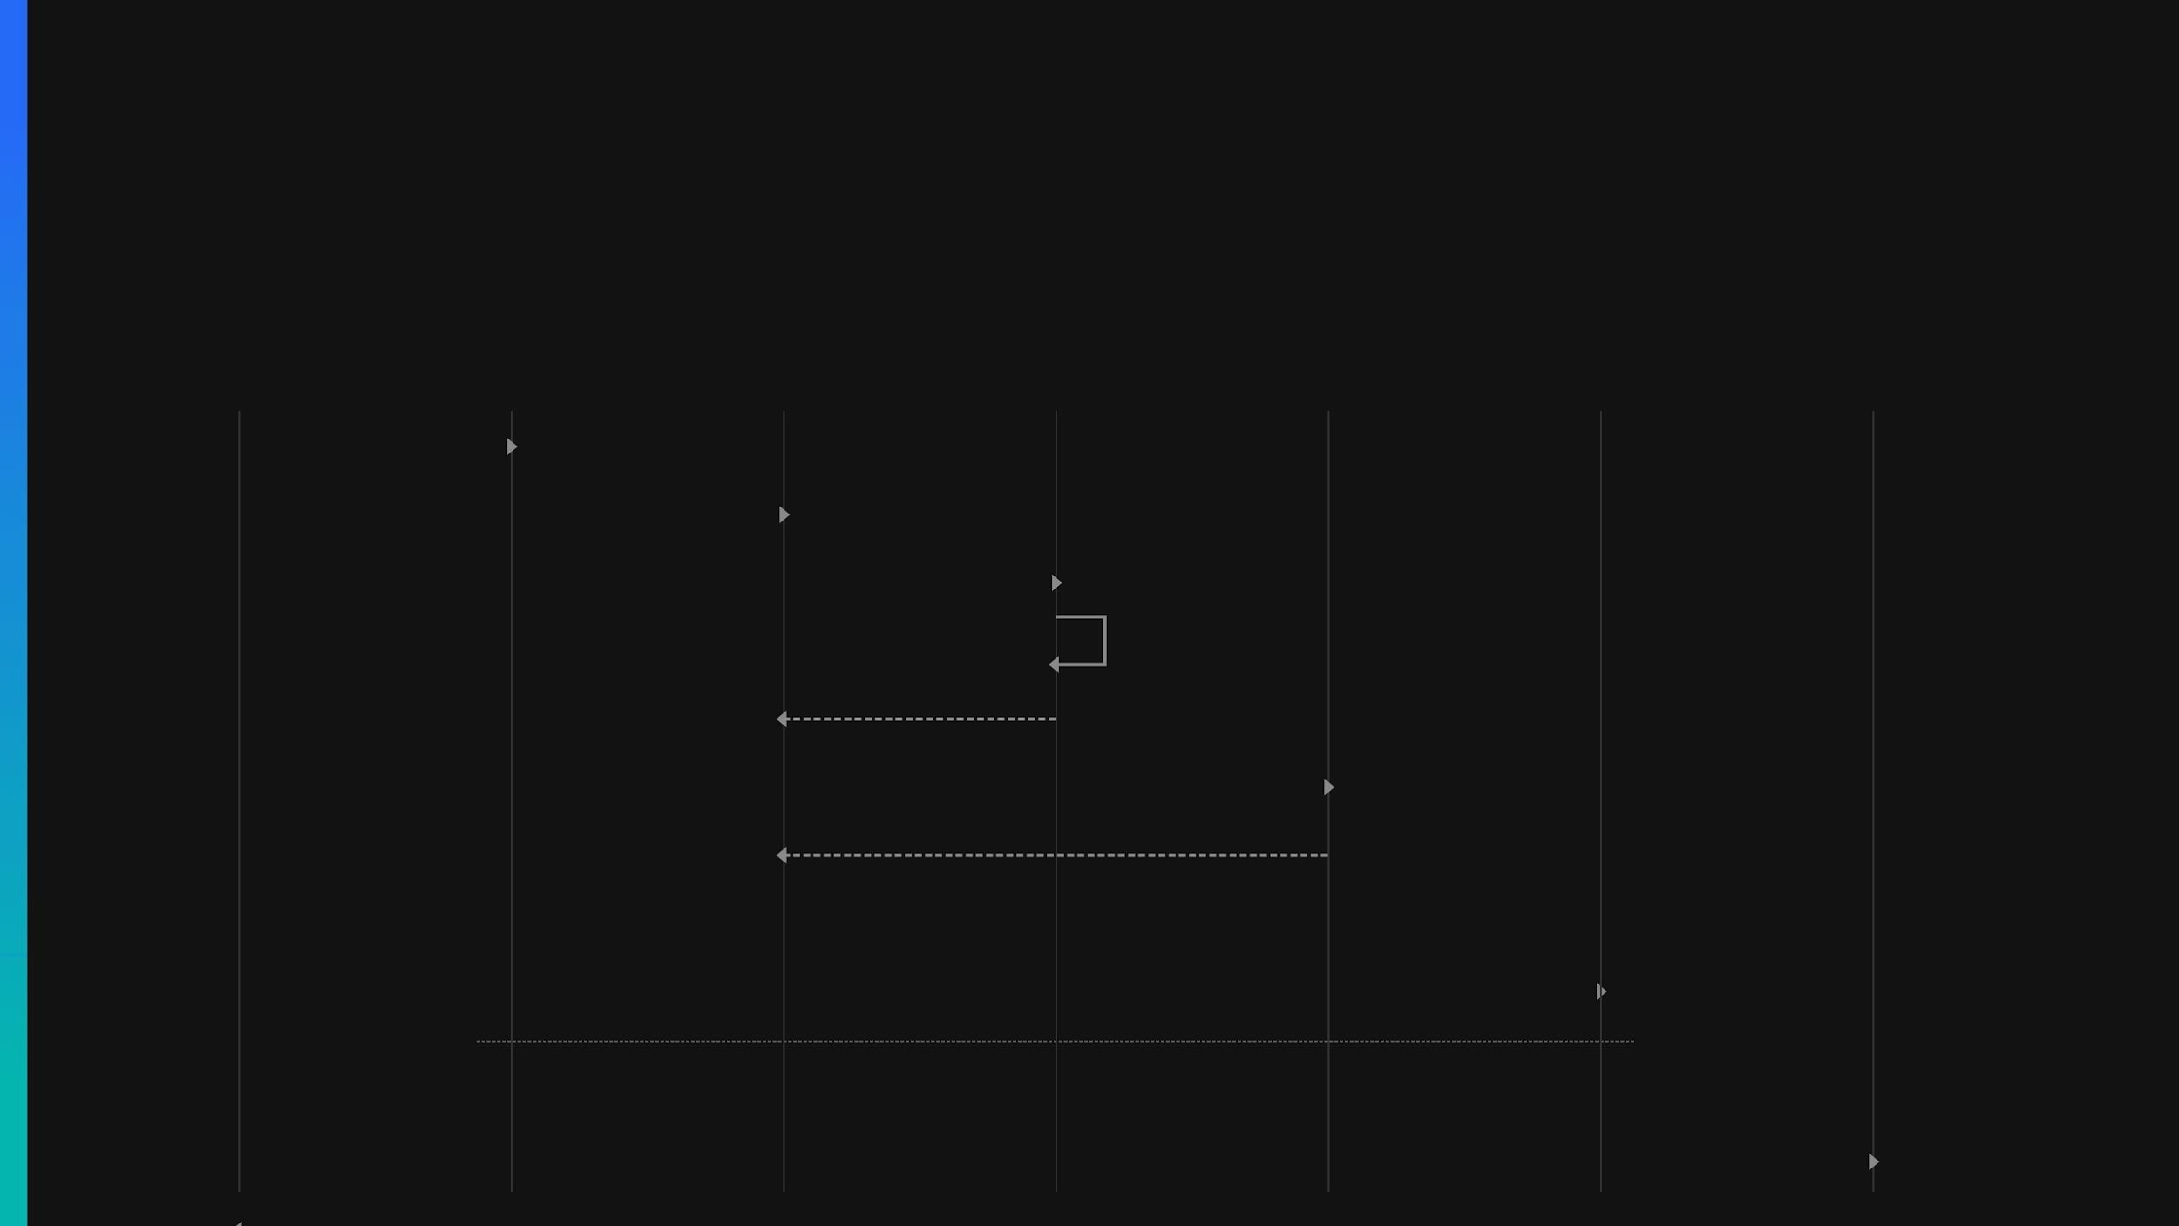
Fast Lane sequence: 10-step flow from request ingress to enforcement decision
Client
Service
Pipeline
Detector
OPA Engine
Mid Lane
NATS
1. SendRequest
2. Process(Envelope)
3. Detect(content)
4. Run 9 stages
5. DetectedItems[]
6. Evaluate(EvalInput)
7. Decision
ALT
[if score ≥ escalate_threshold]
8. Escalate (async gRPC)
[else: ALLOW / BLOCK directly]
9. Publish decision
10. Response

Slide 32

Mid Lane adjusts confidence through NER and keyword-density classification in <500ms
NER ENGINE
Regex + Rules
5 Entity Banks: EMAIL, PHONE, SSN, CREDIT_CARD, IP
CONFIDENCE BLENDING
CIRCUIT BREAKER
FAST LANE
MID LANE API
Adjusts Fast Lane Score
Uncertain Score (40 - 79)
Protects <500ms SLA
Python FastAPI
α = 0.7 × score + 0.3
5 failures → OPEN 30s cooldown
POST /analyze
CLASSIFIER
Boosts uncertainty (e.g., 0.5 → 0.65)
Keyword-Density
TF-IDF Scoring Threshold: 0.18-0.19

Slide 33
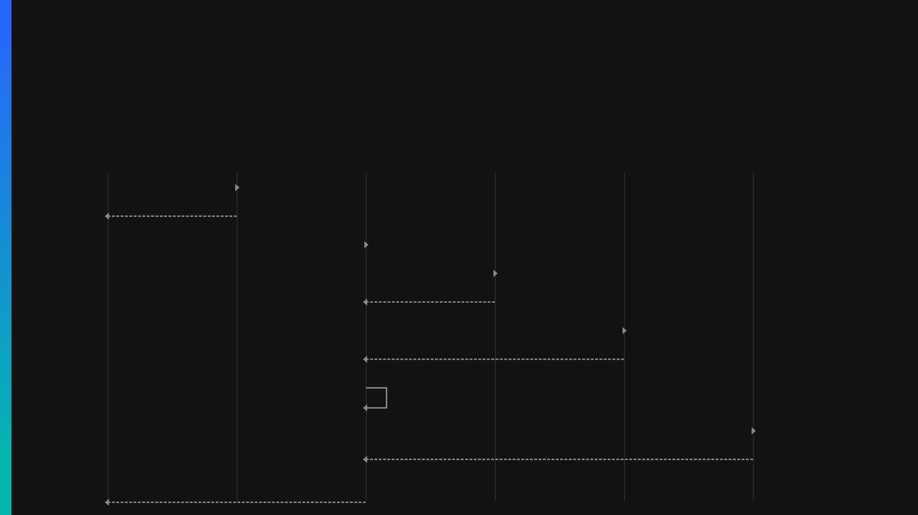
Mid Lane sequence: 8-step flow from circuit breaker check to confidence blending
Fast Lane
Circuit Breaker
Mid Lane API
NER Engine
Classifier
Rules Engine
1. CircuitOpen?
2. false (closed)
3. POST /analyze
4. recognize()
5. NamedEntity[]
6. classify(TF-IDF)
7. {category, sensitivity}
8. evaluate(confidence_adj)
9. evaluate rules
10. verdict + adjustments
11. Response(JSON)

Slide 34

Deep Lane performs LLM semantic analysis with cross-channel correlation and rule promotion
CLICKHOUSE
Audit Store
Full Record & LLM Analysis
LLM ENGINE
Semantic Analysis
Llama 3 8B / Mixtral Constrained Schema
NATS
DEEPSERVICE
POSTGRESQL
sentinel.escalations
Python Async Worker
Rules Engine
Async Trigger
Dedup & Validate
Promote Shadow Rules
CORRELATION
Cross-Channel & Pattern
TF-IDF Discovery Behavioral Signals
NATS ACTIONS
Retroactive Action
Recall / Quarantine

Slide 35
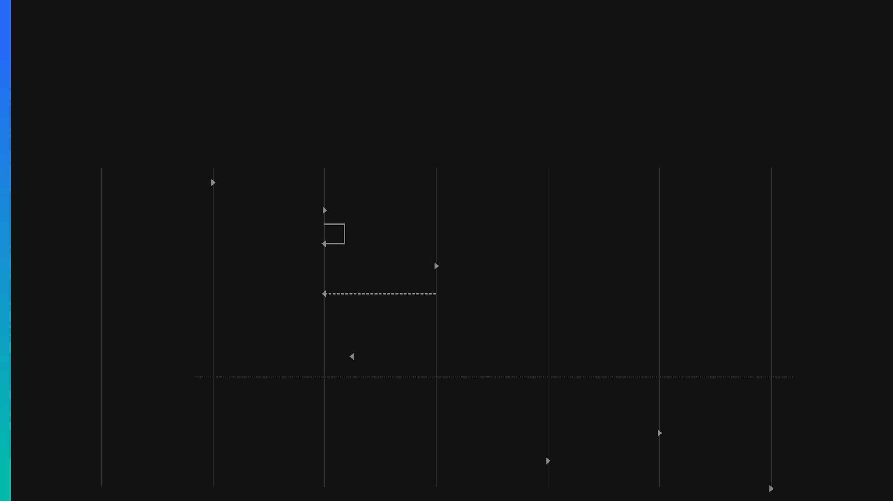
Deep Lane sequence: 9-step async flow from escalation to rule promotion
Fast Lane
NATS
DeepService
LLM Engine
Reports
ClickHouse
PostgreSQL
1. Publish escalation
2. deliver (subscribe)
3. guard / dedup / validate
4. analyze(content)
5. analysis results
ALT
[if risk_score > threshold]
6. retroactive action
[else: audit only]
7. store audit record
8. threshold + findings
9. update rule state

