Slide 1





Certificate Management
Operational Excellence for Zero-Touch PKI
OpAMP Automation
Supervisor Proxy
Continuous Lifecycle
CONFIDENTIAL & PROPRIETARY | © 2025 COMPANY NAME

Slide 2







The Certificate Operations Crisis
Manual Management Fails
The Scale Challenge
Spreadsheet Tracking
200K
1.2M
Manual tracking leads to human error and missed expiries.
Endpoints
Agents
Unexpected Outages
2,777
0%
Expired certificates cause P1 incidents and service downtime.
Renewals / Day
Downtime Tolerance
High Operational Toil
15+ minutes per certificate for manual issuance and installation.
99% Success = 27 Broken Servers Daily

Slide 3
















Zero-Touch Certificate Operations
Automated Lifecycle
Unified Control Plane
Self-Healing
Zero-Touch Issuance
Single Pane of Glass
Automatic Retry Logic
Auto-Renewal (Day 60)
Agent + Cert Management
Fallback Channels
Automated Revocation
Global Visibility
Proactive Health Checks
Key Rotation Policy
Consistent Policy
Auto-Recovery
One Agent. Two Domains. 100% Automation.

Slide 4






Supervisor Proxy: The Local Certificate Broker
CMPv2 / REST
OpAMP Gateway
EJBCA PKI
Central Control Plane
Internal CA Engine
OpAMP (mTLS)
ENDPOINT (Localhost)
OSQuery
Supervisor Proxy
OpenTelemetry
Consumes Cert via File
Local Certificate Broker
Cert Manager Module
Consumes Cert via Env
IPC / File Injection

Slide 5





Zero-Touch Bootstrap Enrollment
Supervisor
1. Get Instance Identity Doc
Cloud Identity
OpAMP GW
EJBCA
2. Send CSR + Identity Token
3. Validate Token & CSR
4. Issue Certificate
5. Return Signed Cert
6. Install & Configure mTLS
No Pre-Shared Keys. No Manual Steps. 100% Automated.

Slide 6









Secure Certificate Storage
Linux Systems
Windows Server
Filesystem ACLs (0600)
Windows Certificate Store
Root/Service User Only
Non-Exportable Private Keys
/var/lib/opamp/certs/agent.crt (0644)
/var/lib/opamp/certs/agent.key (0600)
Cert:\LocalMachine\My\[Thumbprint]
ACL: SYSTEM, Administrators Only
macOS Workstations
Hardware Security (TPM)
System Keychain
Hardware-Backed Keys
Secure Enclave (T2/M1/M2)
Key Never Leaves Hardware
security add-trusted-cert -d -r trustRoot
Access Control: TouchID / Password
TPM 2.0 Attestation
Private Key: Non-Extractable

Slide 7



Automating mTLS Configuration
Manual Configuration
Supervisor Injection
1
Generate CSR manually on endpoint
1
Supervisor auto-enrolls certificate
VS
2
Copy CSR to CA, sign, download cert
2
Injects paths into config template
3
SCP cert/key to correct path
3
Writes config file to disk
4
Edit config file to point to paths
4
Starts agent with correct config
5
Restart service manually
5
Auto-reloads on rotation
# Error Prone & Slow
tls_cert_file: /etc/pki/tls/certs/server.crt
tls_key_file: /etc/pki/tls/private/server.key
# Dynamic Template Injection
tls_cert_file: {{ .CertPath }}
tls_key_file: {{ .KeyPath }}

Slide 8



Certificate Usage Patterns
Client Identity
Server Identity
Code Signing
Used by agents to authenticate themselves to the OpAMP Gateway and other services via mTLS.
Used by local services (e.g., Supervisor API) to prove their identity to local clients.
Used to verify the integrity and origin of agent packages and configuration updates.
digitalSignature
keyEncipherment
digitalSignature
keyEncipherment
clientAuth
serverAuth
digitalSignature
codeSigning
Example
Example
Example
Agent connecting to Gateway
Supervisor Local API (localhost)
Verifying Agent Binary Update

Slide 9





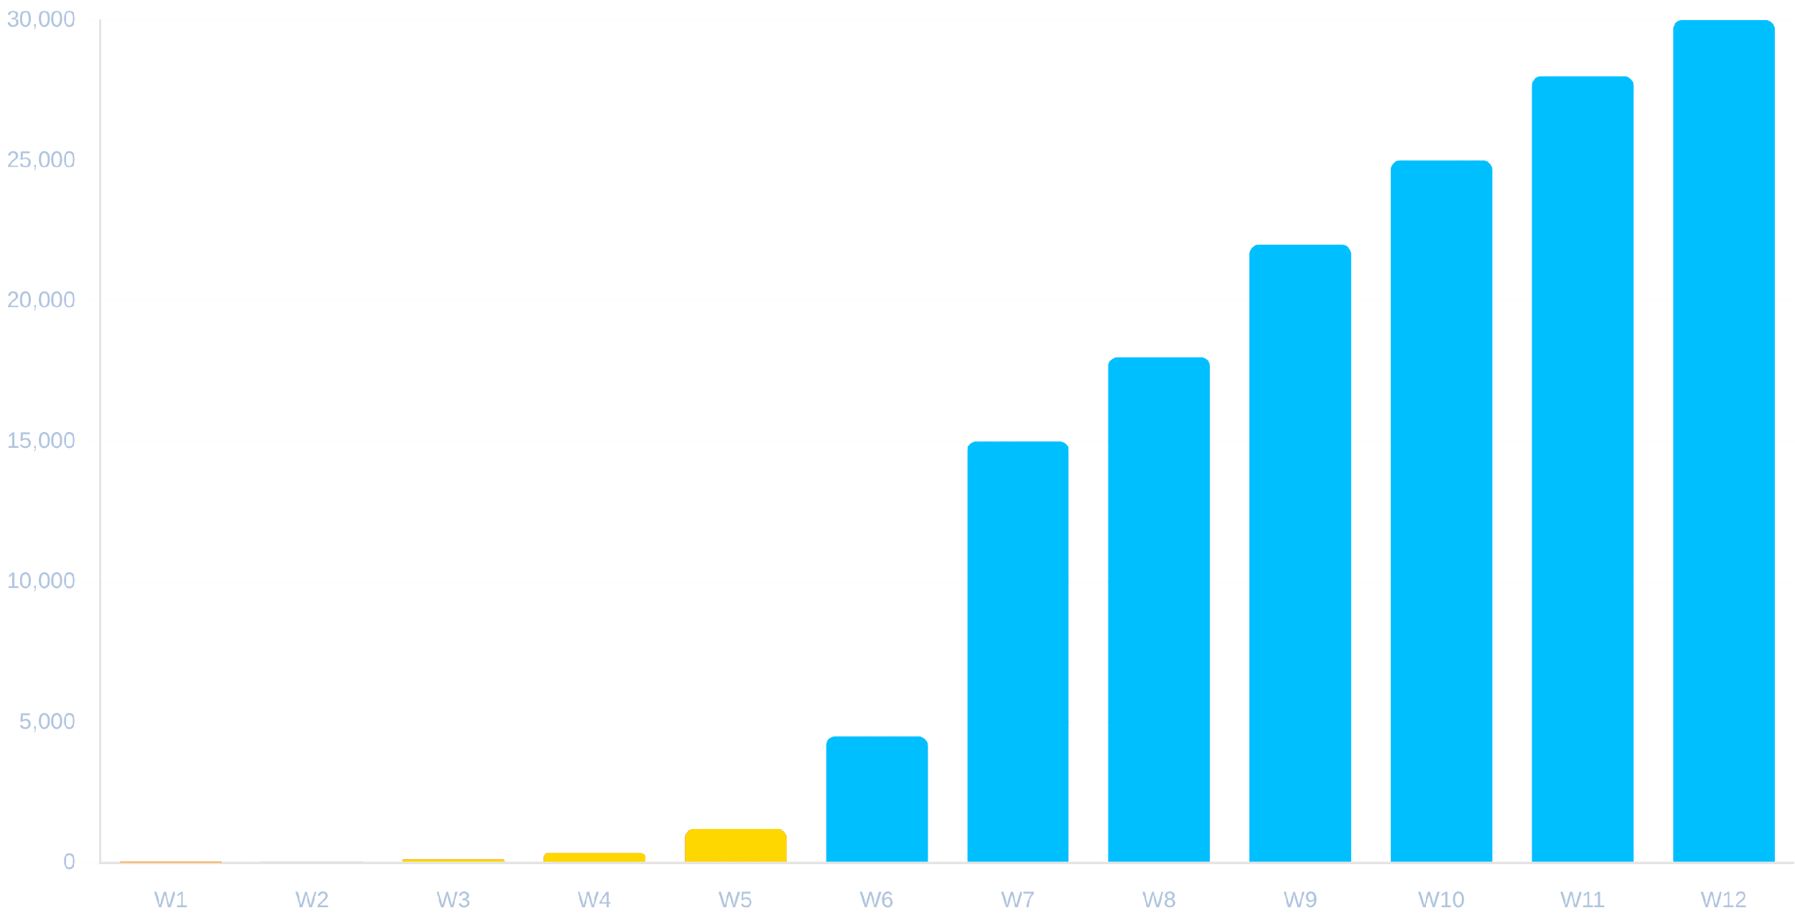
Certificate Health Monitoring
99.96%
1,240
12
2,777
Healthy
Expiring < 30d
Critical
Renewed Today
Expiry Timeline (Next 90 Days)
Updated: Just Now
Health Breakdown
Valid (>60 days)
145K
Renewing (30-60 days)
53K
Critical (<7 days)
12
Revoked
1.2K

Slide 10




The 90-Day Certificate Lifecycle
Day 0
Day 60
Day 75
Day 90
Issuance
Auto-Renewal Trigger
Critical Warning
Expiry
Certificate issued and installed. Validity period begins.
Supervisor initiates renewal. 30-day buffer ensures zero downtime even if retries needed.
If renewal failed, alerts escalate to P1. 15 days remaining.
Hard stop. Certificate invalid. Service interruption if not renewed.
Healthy Period
Renewal Window
Danger Zone

Slide 11





Automated Renewal Workflow
Trigger: Day 60
Generate New Key Pair
Renewal
Success?
Retry (Exp. Backoff)
NO
YES
Install & Reload

Slide 12






Emergency Revocation
Immediate Action Protocol
Real-Time Propagation
Revocation commands propagate to all OpAMP Gateways within 30 seconds via control plane broadcast.
Instant Termination
Gateways immediately terminate existing mTLS connections for revoked serial numbers.
< 30s
CRL & OCSP Updates
EJBCA updates CRLs and OCSP responders instantly. Gateways cache OCSP responses for performance.
Global Propagation Time
Break-Glass Procedure
Blast Radius Containment
Requires 2-person authorization (CertificateAdmin + SecurityOfficer) via MFA to trigger root CA revocation.
Revocation can target specific certificates, entire agents, or whole intermediate CAs if compromised.

Slide 13


Section D
Operational Workflows
04
Standard operating procedures for certificate lifecycle management, troubleshooting, and emergency response.

Slide 14




Standard Operating Procedures
Routine Renewal
Failed Renewal
Compromise Response
01
Supervisor detects Day 60 trigger
01
Renewal fails (network/auth error)
01
Security detects anomaly/compromise
02
Generates new key pair locally
02
Supervisor enters retry loop (exp. backoff)
02
Admin triggers "Revoke & Block" workflow
03
Sends CSR to EJBCA via Gateway
04
Receives new cert, validates chain
03
Day 75: Sends P2 alert to Ops Dashboard
03
Cert revoked in EJBCA, pushed to Gateways
05
Atomically swaps cert files
04
Ops triggers manual "Force Renew" job
04
Agent connection terminated instantly
05
Agent quarantined for forensic analysis
05
Supervisor executes job immediately
Target Duration
< 5 seconds
Resolution SLA
< 24 hours
Containment SLA
< 15 minutes

Slide 15




Troubleshooting Guide
Network Connectivity
ubuntu@host:~$
sudo supervisor-cli diag --cert
Firewall blocking port 443/8080 or DNS resolution failure for OpAMP Gateway.
[10:42:01]
INFO
Checking certificate status...
[10:42:01]
INFO
Path: /etc/supervisor/certs/agent.crt
[10:42:01]
INFO
Validity: 2023-10-01 to 2024-01-01 (Valid)
Clock Skew
[10:42:02]
ERROR
Connection refused: gateway.internal:443
System time drift > 5 minutes causes certificate validation failures (NotBefore/NotAfter).
[10:42:02]
HINT
Check firewall rules or proxy settings.
Permission Denied
Supervisor process lacks filesystem permissions to write key/cert files to storage path.

Slide 16

Section E
Compliance & Audit
05
Automated evidence collection, regulatory alignment, and SIEM integration for 100% audit readiness.

Slide 17





Compliance & Audit Readiness
Regulatory Framework Mapping
80%
100%
NIST 800-53
SC-8
IA-2
AC-2
AU-2
Audit Prep Reduction
Control Coverage
SOC 2
CC6.1
CC6.7
CC7.1
Automated Evidence Collection
PCI-DSS 4.0
4.2.1
8.2.2
10.2
System automatically logs every issuance, renewal, and revocation. No manual screenshots or spreadsheets needed.
HIPAA
164.312(a)
164.312(c)
Auditor Self-Service
Read-only portal allows auditors to verify controls independently, reducing operational interruptions.
Immutable Audit Trail
All actions are cryptographically signed and stored in tamper-evident logs for 7 years.

Slide 18






SIEM & SOC Integration
Splunk
Enterprise Security
Elastic
OpAMP
Log Stream
Sentinel
Security Solution
Azure Cloud
Forwarded Events
CERT_ISSUED
CERT_RENEWED
CERT_REVOKED
Chronicle
MTLS_AUTH_FAILURE
Google SecOps
KEY_ROTATION

Slide 19




Automated Incident Response
Compromise Containment Workflow
SOAR Integration
T+00:00
Instant Detection
SIEM detects Anomalous Cert Usage from unknown IP.
SIEM correlates failed mTLS attempts, unusual revocation patterns, and certificate expiry warnings in real-time.
T+00:01
SOAR triggers "Contain Compromise" playbook.
Automated Playbooks
T+00:02
SOAR triggers pre-defined playbooks for common scenarios: Revoke & Block, Force Renew, Isolate Host.
OpAMP revokes cert serial #12345 globally.
T+00:05
Analyst Efficiency
Gateways terminate connections. Threat contained.
L1 analysts focus on complex threats while automation handles routine certificate incidents.
Total Time to Contain: < 5 Minutes

Slide 20

Section F
Conclusion
06
Key takeaways, business impact, and next steps for implementation.

Slide 21




Key Takeaways
Operational Excellence
Security & Compliance
Business Value
Zero-touch automation eliminates manual toil, reduces human error, and ensures 99.96% renewal success across 250K endpoints.
Short-lived certificates (90 days), mTLS everywhere, and automated evidence collection ensure continuous compliance.
Significant cost savings from reduced outages, faster audit cycles, and elimination of manual certificate management overhead.
100%
Zero
$500K
Automation
Trust Architecture
Annual Savings

Slide 22




Questions & Discussion
Thank you for your time. We are now open for questions regarding the Certificate Management architecture and operational workflows.
security-arch@company.com
wiki.company.com/pki

