Slide 1
CSCI 316 Big Data Mining Techniques & Implementation
Group Assignment 2
T01 | G04
Name | UOW ID
Emily Gong Xue Ying | 7673620
Lai Wei Jie | 7770042
Lee Kuok Wei | 7673607

Slide 2
CONTENT
Introduction
Data Visualisation
Data Preprocessing
Select and Train Models
Fine Tuning
Evaluate Outcomes
Library Comparison
Conclusion

Slide 3
INTRODUCTION

Slide 4
Binary Classification Problem
The task is to predict whether a record represents “normal” or “attack” .
Target variable: label (0 for “normal”, 1 for “attack”)
a) Discover and visualise the data
b) Preprocessing data for machine learning.
c) Select and train models
d) Fine-tune the models
e) Evaluate outcomes
Dataset for Network Intrusion Detection Systems
(https://research.unsw.edu.au/projects/unsw-nb15-dataset)

Slide 5
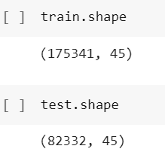
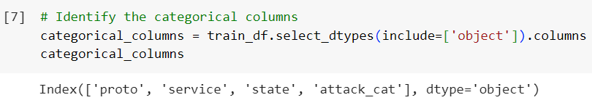
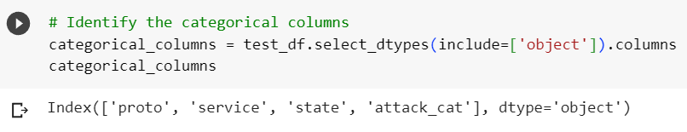
Explore Datasets
Overview of datasets
Training Set
175341 rows
45 columns
Testing Set
82322 rows
45 columns
Categorical variables:
‘proto’ : transaction protocol
‘service’ (eg. http, ftp..)
‘state’ : state and its dependent protocol (eg. ACC, CLO..)
‘Attack_cat’ : name of each attack category (eg. Fuzzers, Analysis…)
Identifying categorical variables

Slide 6
DATA VISUALISATION

Slide 7
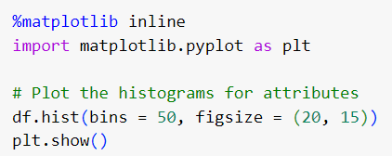
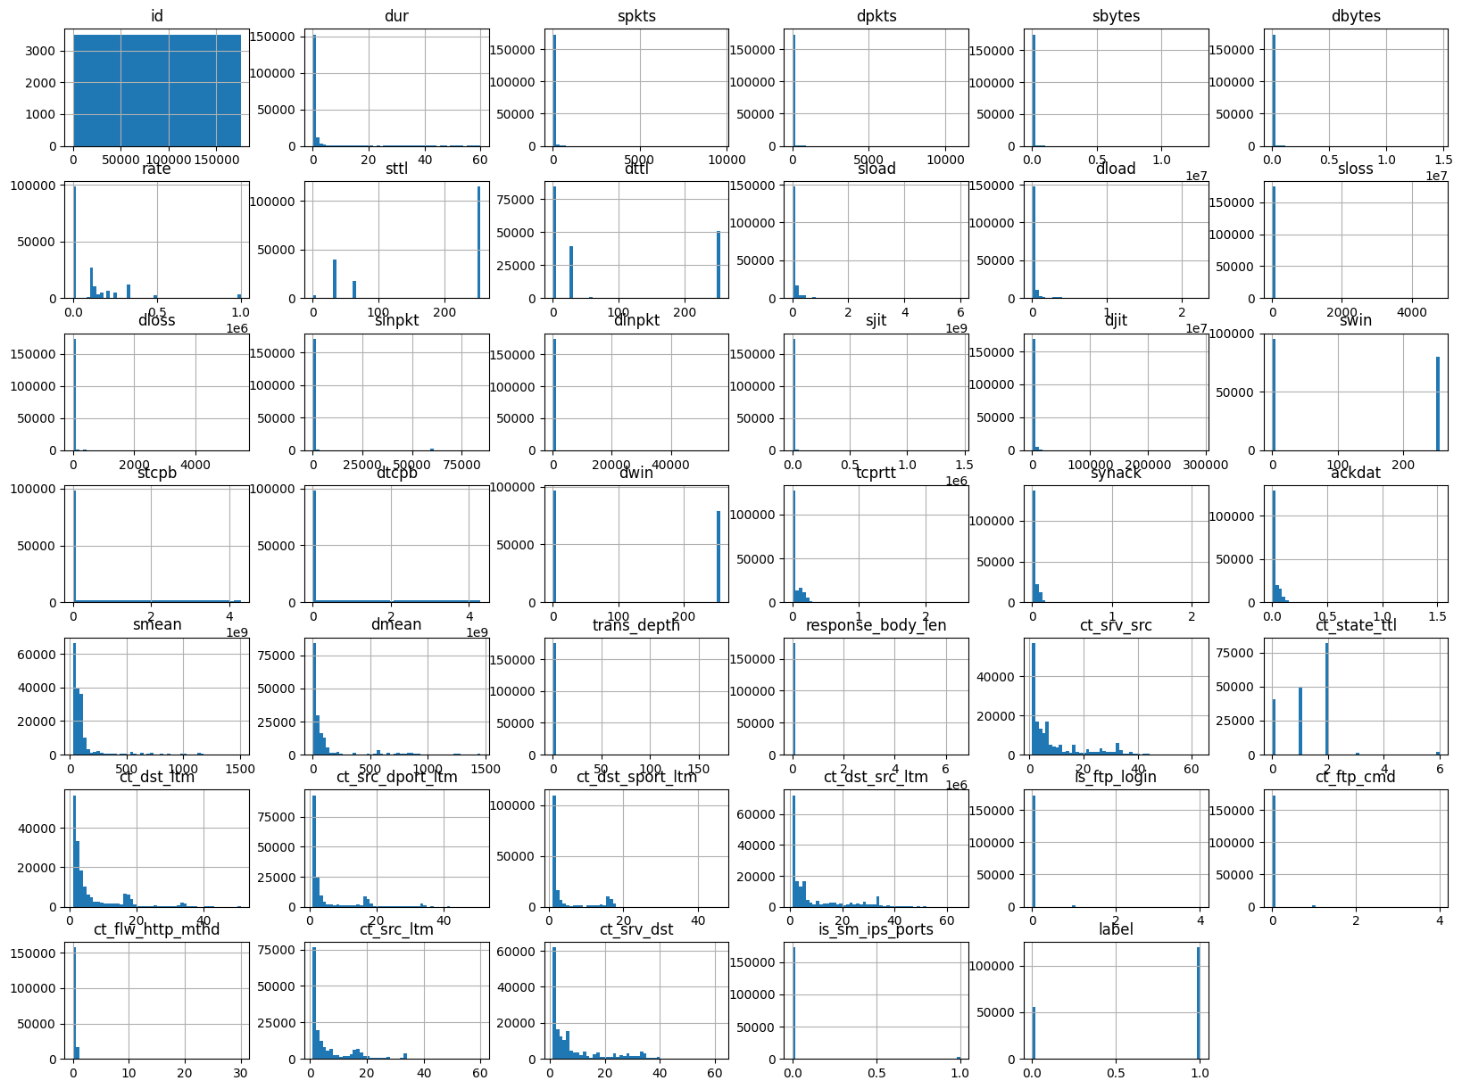
Histograms
Histograms Overview
Interpretation
1) Shape of histograms
Symmetric distribution
Skewed Distribution
2) Central Tendency
3) Spread
4) Outliers
5) Multimodal distribution

Slide 8
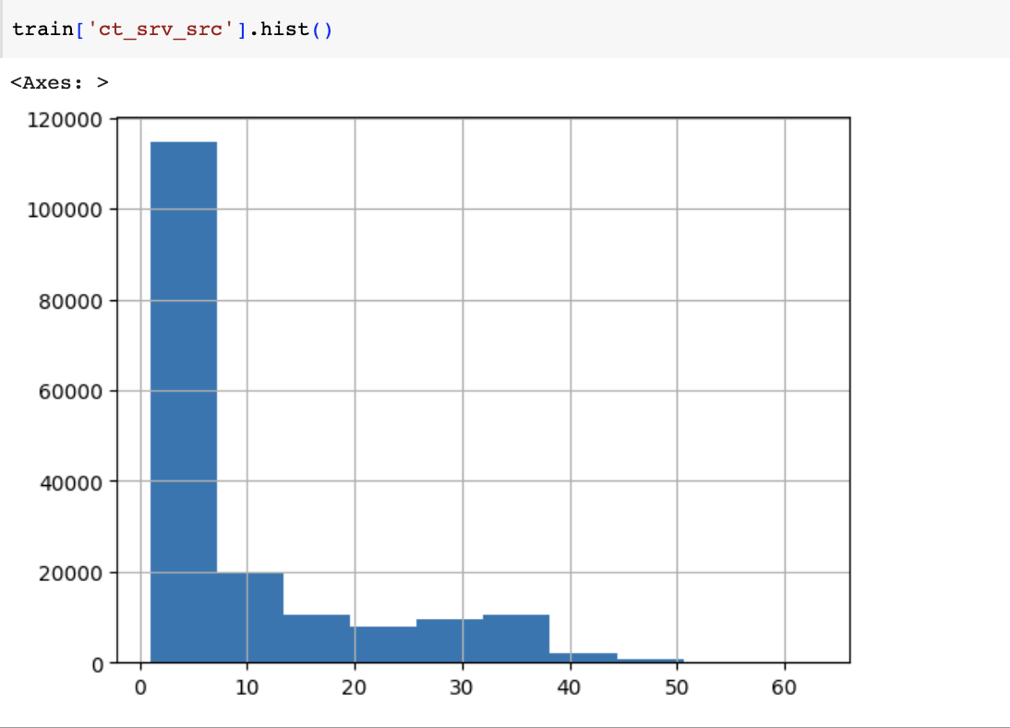
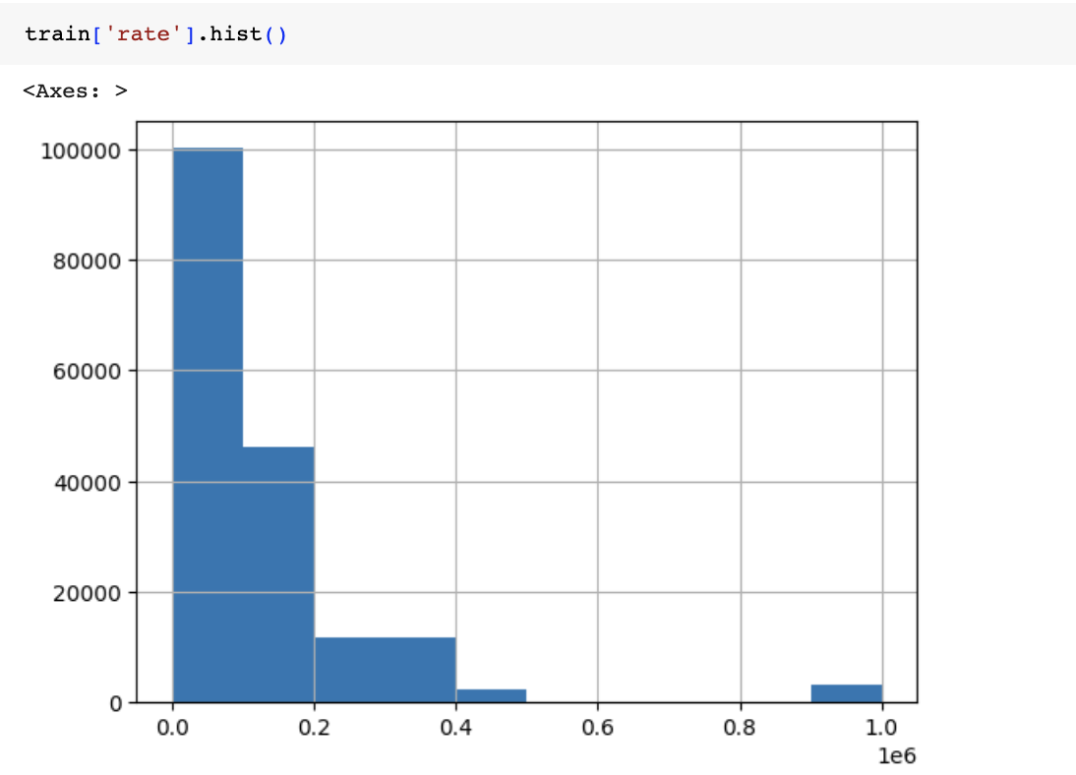
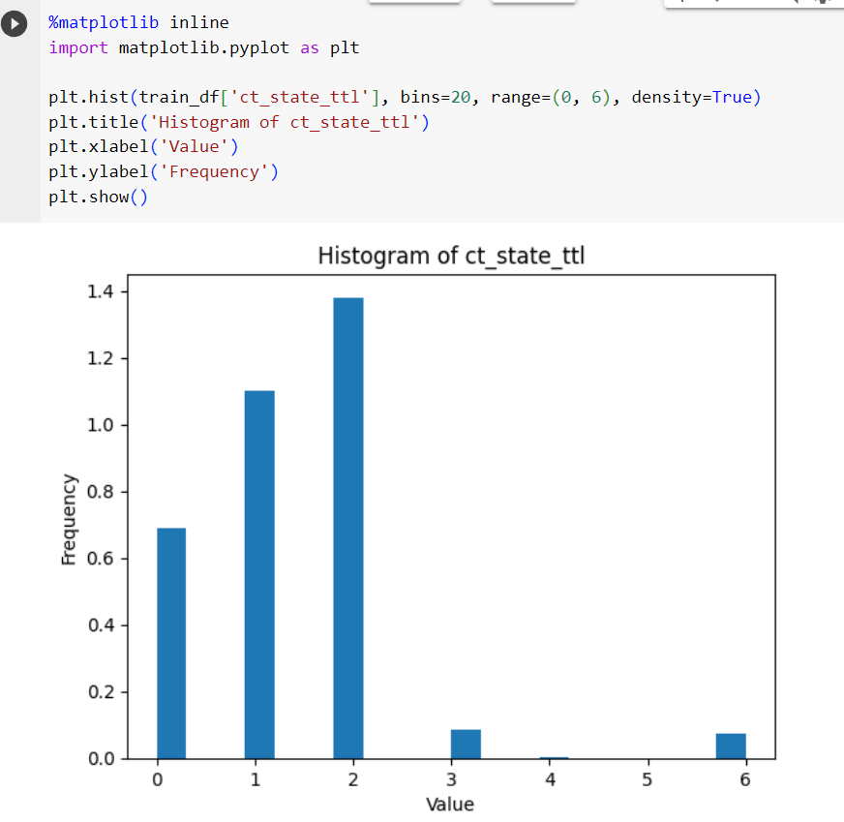
Example of histograms
Skewed distribution example
Outliers example
Multimodal distribution example

Slide 9
DATA PREPROCESSING

Slide 10
Data Preprocessing: Overview
Remove non-relevant columns (‘id’ , ‘attack_cat’)
Removing duplicates
Encode categorical features, object data types
Outliers
Min-Max Scaler (Due to outliers presence)
Remove unuseful columns below correlation threshold of 0.01

Slide 11
Data Preprocessing:
Object type columns
* Point to note: Number of unique values in train set and test set differ:
‘proto’ : train (133)/ test (131)
‘state’ : train (7)/ test (9)
Applying simple one hot encoding will result in:
Addition of too many dimensions, especially in ‘proto’
Mismatch of number of features, and sequence. Inability to properly train a model
Removal of [‘id’, ‘attack_cat’]
Notes:
Standard Scaler vs Normalisation: https://www.youtube.com/watch?v=sxEqtjLC0aM&ab_channel=NormalizedNerd

Slide 12
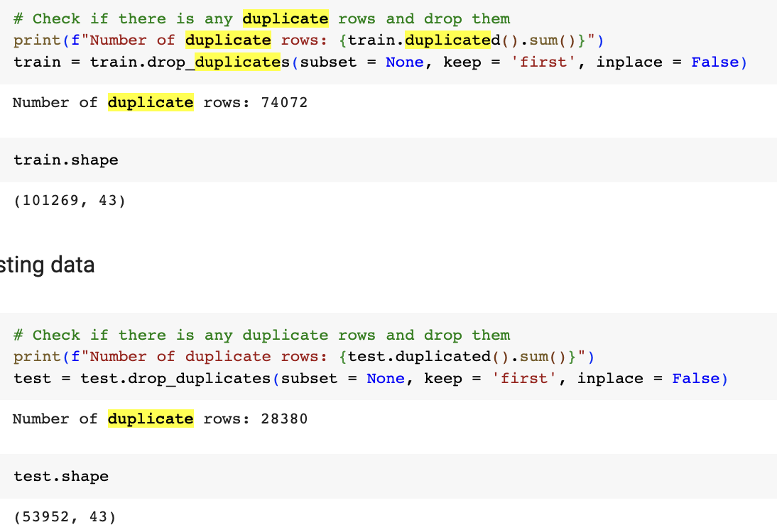
Data Preprocessing:
Duplicate rows dropping
Number of duplicate rows dropped:
Training set : 74072 duplicate rows
Testing set : 28380 duplicate rows

Slide 13
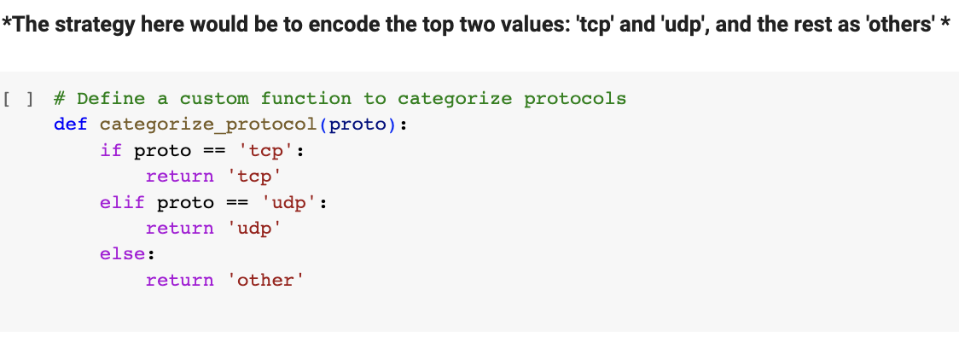
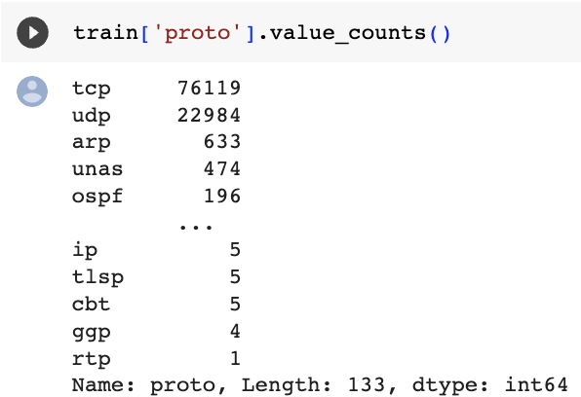
Data Preprocessing:
Object type columns ‘proto’
Most values are in the tcp and udp category.
If we simply OHE all unique values, we will add 133 features (not ideal)
Notes:
Standard Scaler vs Normalisation: https://www.youtube.com/watch?v=sxEqtjLC0aM&ab_channel=NormalizedNerd

Slide 14
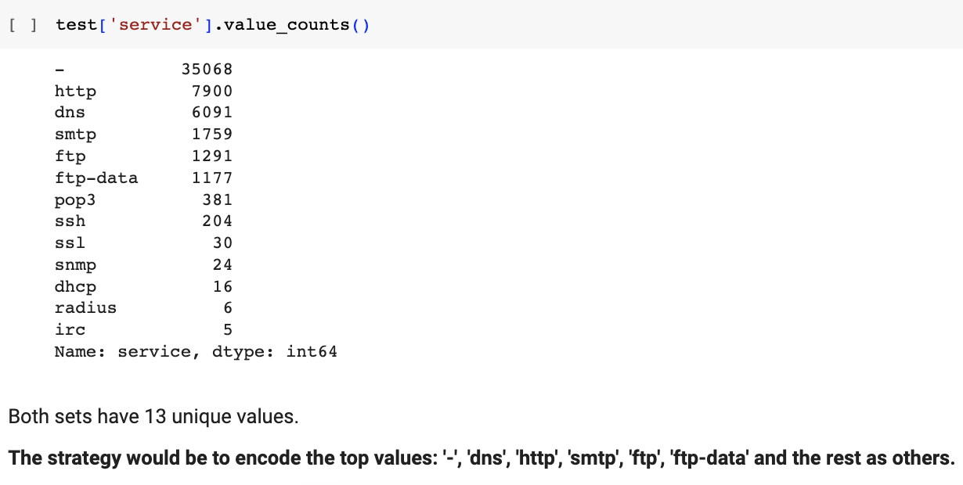
Data Preprocessing:
Object type columns ‘service’
Notes:
Standard Scaler vs Normalisation: https://www.youtube.com/watch?v=sxEqtjLC0aM&ab_channel=NormalizedNerd

Slide 15
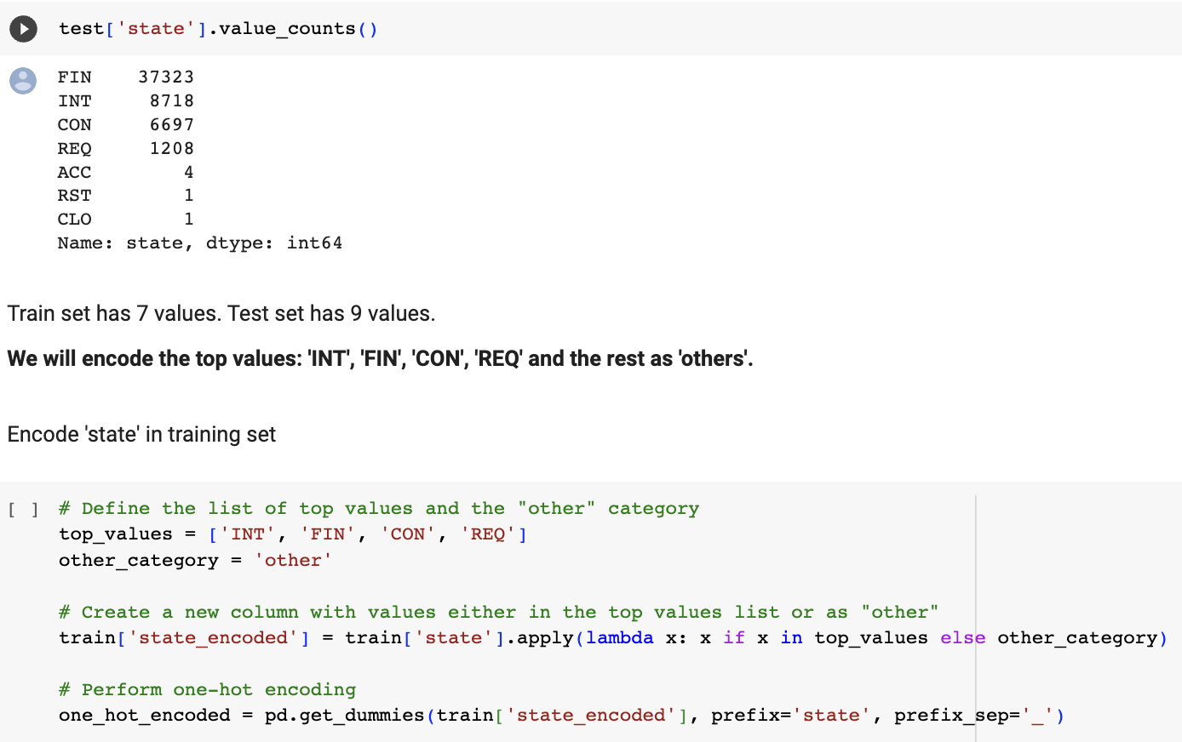
Data Preprocessing:
Object type columns ‘state’
Notes:
Standard Scaler vs Normalisation: https://www.youtube.com/watch?v=sxEqtjLC0aM&ab_channel=NormalizedNerd

Slide 16
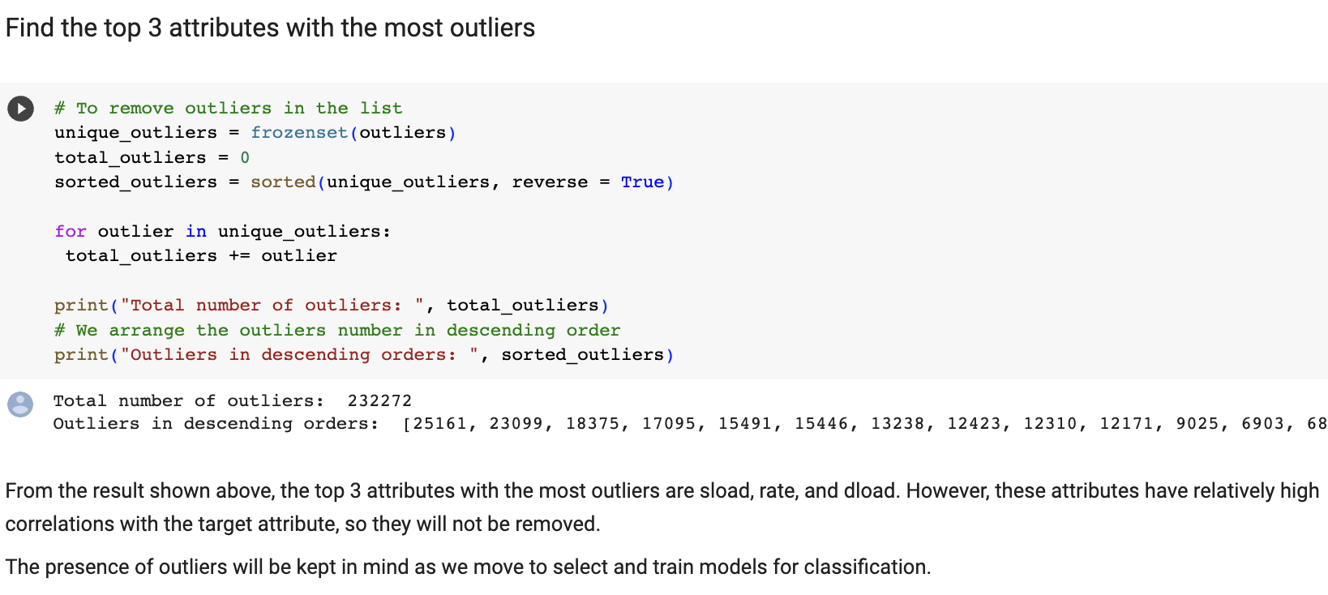
Data Preprocessing:
Outliers
Top 3 outliers
sload
rate
dload
However, they also have relatively high co-relation values, so we chose to keep these features.
Notes:
Standard Scaler vs Normalisation: https://www.youtube.com/watch?v=sxEqtjLC0aM&ab_channel=NormalizedNerd

Slide 17
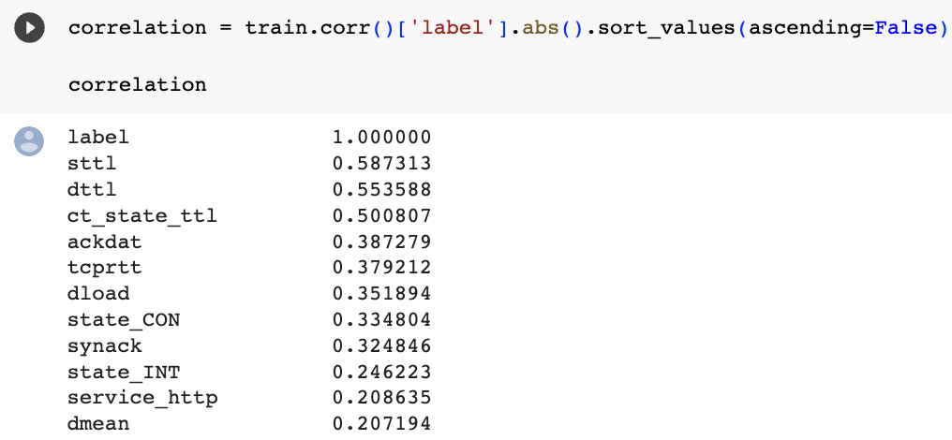
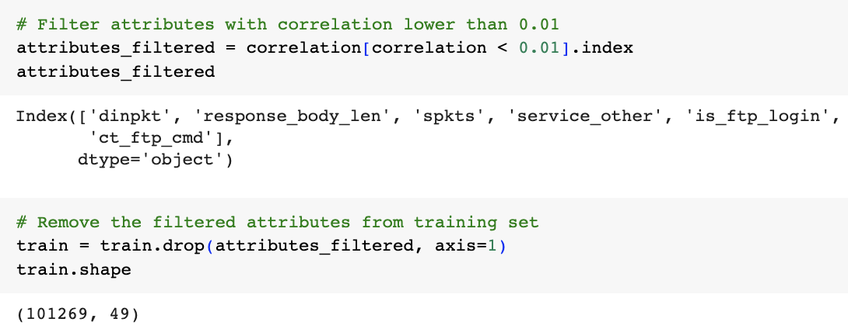
Data Preprocessing:
Correlation
Removal of features with correlation less than 0.01:
‘dinpkt’
‘response_body_len’
‘spkts’, ‘service_other’
‘is_ftp_login’
‘ct_ftp_cmd’
Correlation Result
Attribute Removals
Notes:
Standard Scaler vs Normalisation: https://www.youtube.com/watch?v=sxEqtjLC0aM&ab_channel=NormalizedNerd

Slide 18
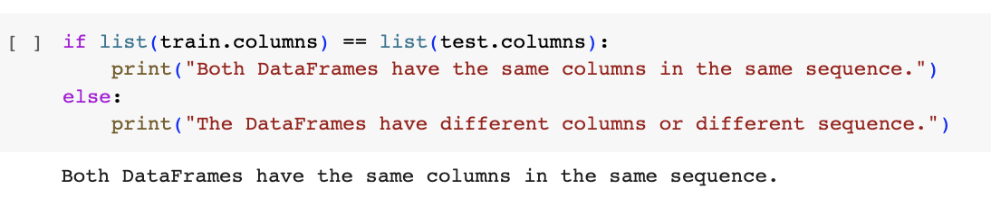
Data Preprocessing:
Data splitting
Since the dataset is already split into a training and testing set, there is no need to split it.
Part of the requirements is to maintain each set.
However, before training, we need to check that it has the same shape in terms of number of dependent features and its order in the dataframe
Datasets Shape Checking

Slide 19
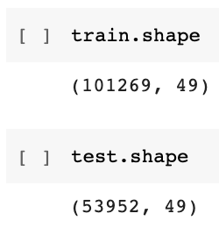
Data Preprocessing:
After Cleaning
Datasets Shape Checking
Training Set
101269 rows
49 columns
Testing Set
53952 rows
49 columns
Notes:
Standard Scaler vs Normalisation: https://www.youtube.com/watch?v=sxEqtjLC0aM&ab_channel=NormalizedNerd

Slide 20
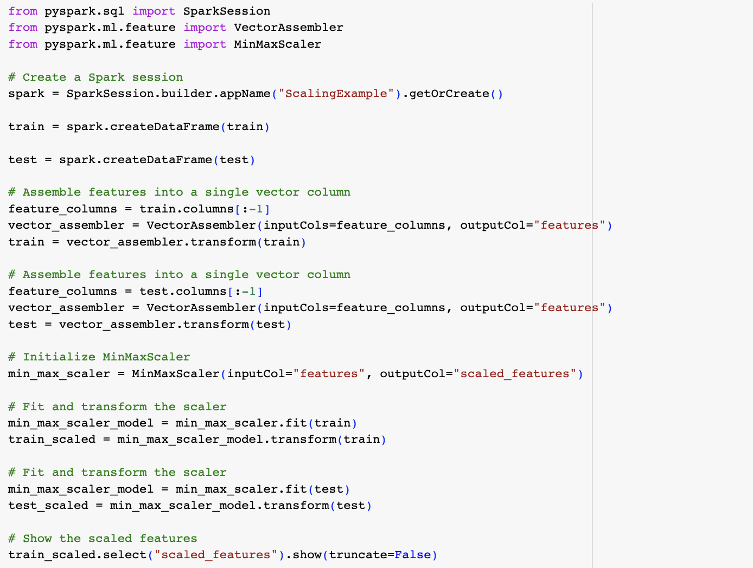
Data Preprocessing:
Min Max Scalar
We ran two versions:
Standard Scaler led to slightly reduced performance.
Therefore, the models are trained on a Min-max scaled version of datasets.
Notes:
Standard Scaler vs Normalisation: https://www.youtube.com/watch?v=sxEqtjLC0aM&ab_channel=NormalizedNerd

Slide 21
SELECT AND TRAIN MODELS

Slide 22
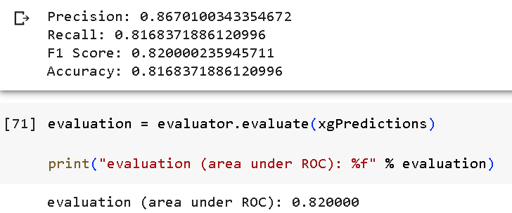
XGBOOST: Evaluation Report
Model 1 Performance: XGBOOST

Slide 23
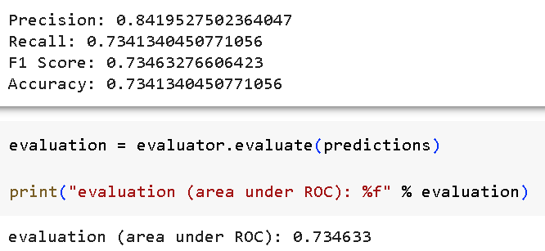
Linear Support Vector: Evaluation Report
Model 2 Performance: Linear Support Vector Classifier

Slide 24
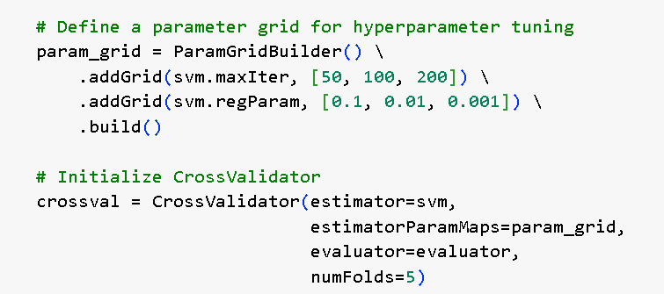
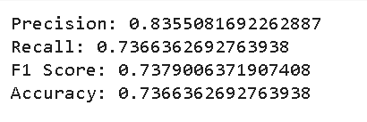
Linear Support Vector: Hyper Parameter Exploration
Model 2 Performance: Linear Support Vector Classifier

Slide 25
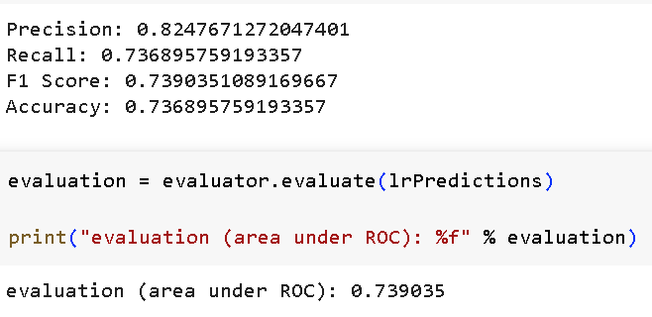
Logistic Regression: Evaluation Report
Model 3 Performance: Logistic Regression

Slide 26
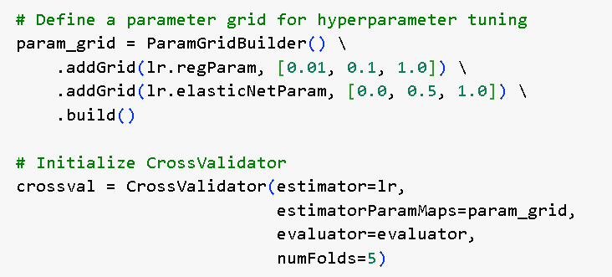
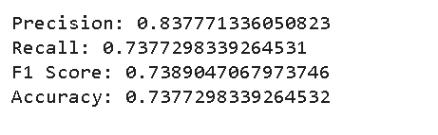
Logistic Regression: Hyper Parameter Exploration
Model 3 Performance: Logistic Regression

Slide 27
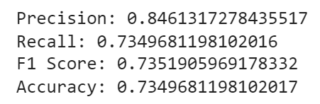
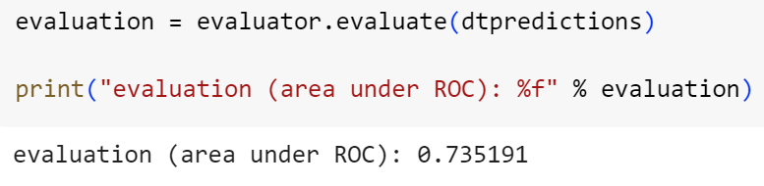
Model 4 Performance: Decision Tree
Decision Tree: Evaluation Report

Slide 28
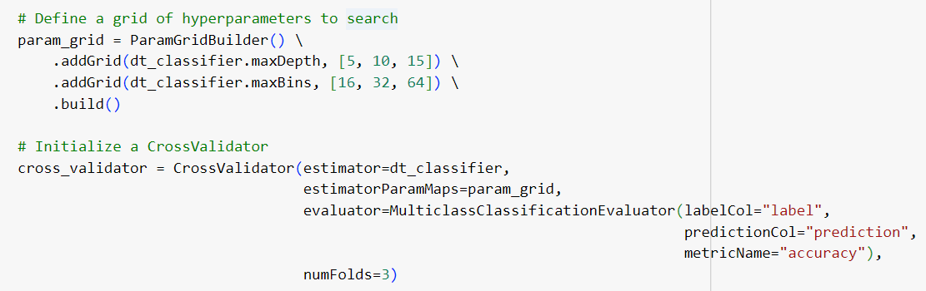
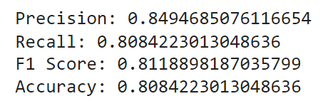
Decision Tree: Hyper Parameter Exploration
Model 4 Performance: Decision Tree

Slide 29
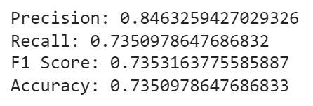
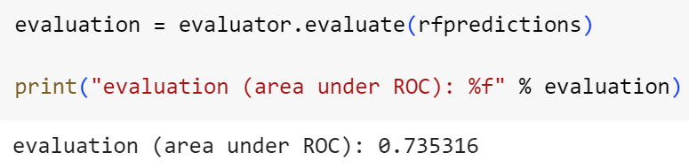
Model 5 Performance: Random Forest
Random Forest: Evaluation Report

Slide 30
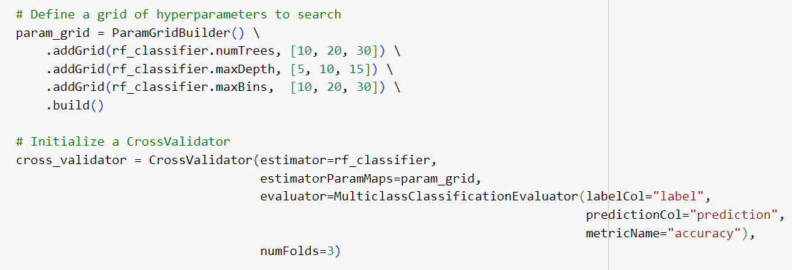
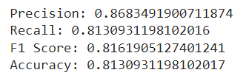
Random Forest: Hyper Parameter Exploration
Model 5 Performance: Random Forest

Slide 31
EVALUATE OUTCOMES

Slide 32
Side by side comparison of classification results
Ranking according to performance | Models | Accuracy
 |  | Before Tuning | After Tuning
1 | XGBOOST | 0.8168
2 | RANDOM FOREST | 0.7351 | 0.8131
3 | DECISION TREE | 0.7350 | 0.8084
4 | LOGISTIC REGRESSION | 0.7369 | 0.7377
5 | LINEAR SUPPORT VECTOR CLASSIFIER | 0.7341 | 0.7366

Slide 33
Models | XGBOOST | Linear Support Vector | Logistic Regression
Advantages | Excellent predictive performance. Efficient: scalable for large datasets. Regularization to prevent overfitting. | Effective for high-dimensional data. Regularization to prevent overfitting. | Simple and interpretable. Efficient: scalable for large datasets.
Disadvantages | Computational complex. Complexity: Extensive set of hyperparameters. | Computational complex. Less effective for non-linear data. | Limited expressiveness for complex relationship. Less effective for non-linear data.

Slide 34
Models | Decision Tree | Random Forest
Advantages | Simple and interpretable. No data normalization required: Decision Trees are not sensitive to data scaling. | High accuracy. Efficient: scalable for large datasets. Robust to outliers.
Disadvantages | Prone to Overfitting. Limited expressiveness for complex relationship. | May introduce bias in the presence of imbalanced datasets.

Slide 35
LIBRARY COMPARISON

Slide 36
Libraries | Ease of use | Algorithms | Data processing | Training times | Similarities
SKLearn | Intuitive and easy to implement. Output returned from ML Library functions grants clear, concise, and instant overview of progress. | Offers a more comprehensive collection of machine learning algorithms. | Straightforward implementation of scaling, train/ test splits. Easy for small applications | Slower training times, which might be exponentially slower for large datasets that cannot be encapsulated in a single machine. | Similar functions exist to cater to requirements along the end-to-end data mining project pipeline. Similar steps of visualising, pre-processing, selecting and training models, and evaluating outcomes
Spark | Output returned from ML Library functions require some interpretation and understanding. | Provides a subset of machine learning algorithms, primarily focusing on scalable algorithms that can be distributed across a cluster. | Slightly slower when scaling. | Faster training times, especially on large datasets

Slide 37
CONCLUSION

Slide 38
CONCLUSION
Training set of 170k values (100k after removing duplicates) is relatively small compared to Assignment 1 (800k values), possibly leading to reduced model performance.
Spark and its distributed model usually results in faster training times. However, complicated models: Fine-tuning of Random Forest, still take a long time, and require smart usage of hyper parameters.
SKLearn is very intuitive and easily readable and understood. The output from Spark requires more interpretation. Also, closing a Spark session prematurely after a certain code block, will result in training errors.
Spark’s lack of an inbuilt classification report leads to more work comparing results of training.

