Slide 1
MoPhones Data Analyst Case Study
Credit Portfolio & Customer Experience Analysis (2025)

Slide 2
Datasets Overview
Credit Data Snapshots: 5 point-in-time files across 2025
Total Records: 71,456 rows (8,935 → 20,742 loans)
Unique Loans: 20,742
NPS Survey: 4,129 customer responses
Demographics: Gender (10,497), DOB (11,217), Income (10,609)

Slide 3
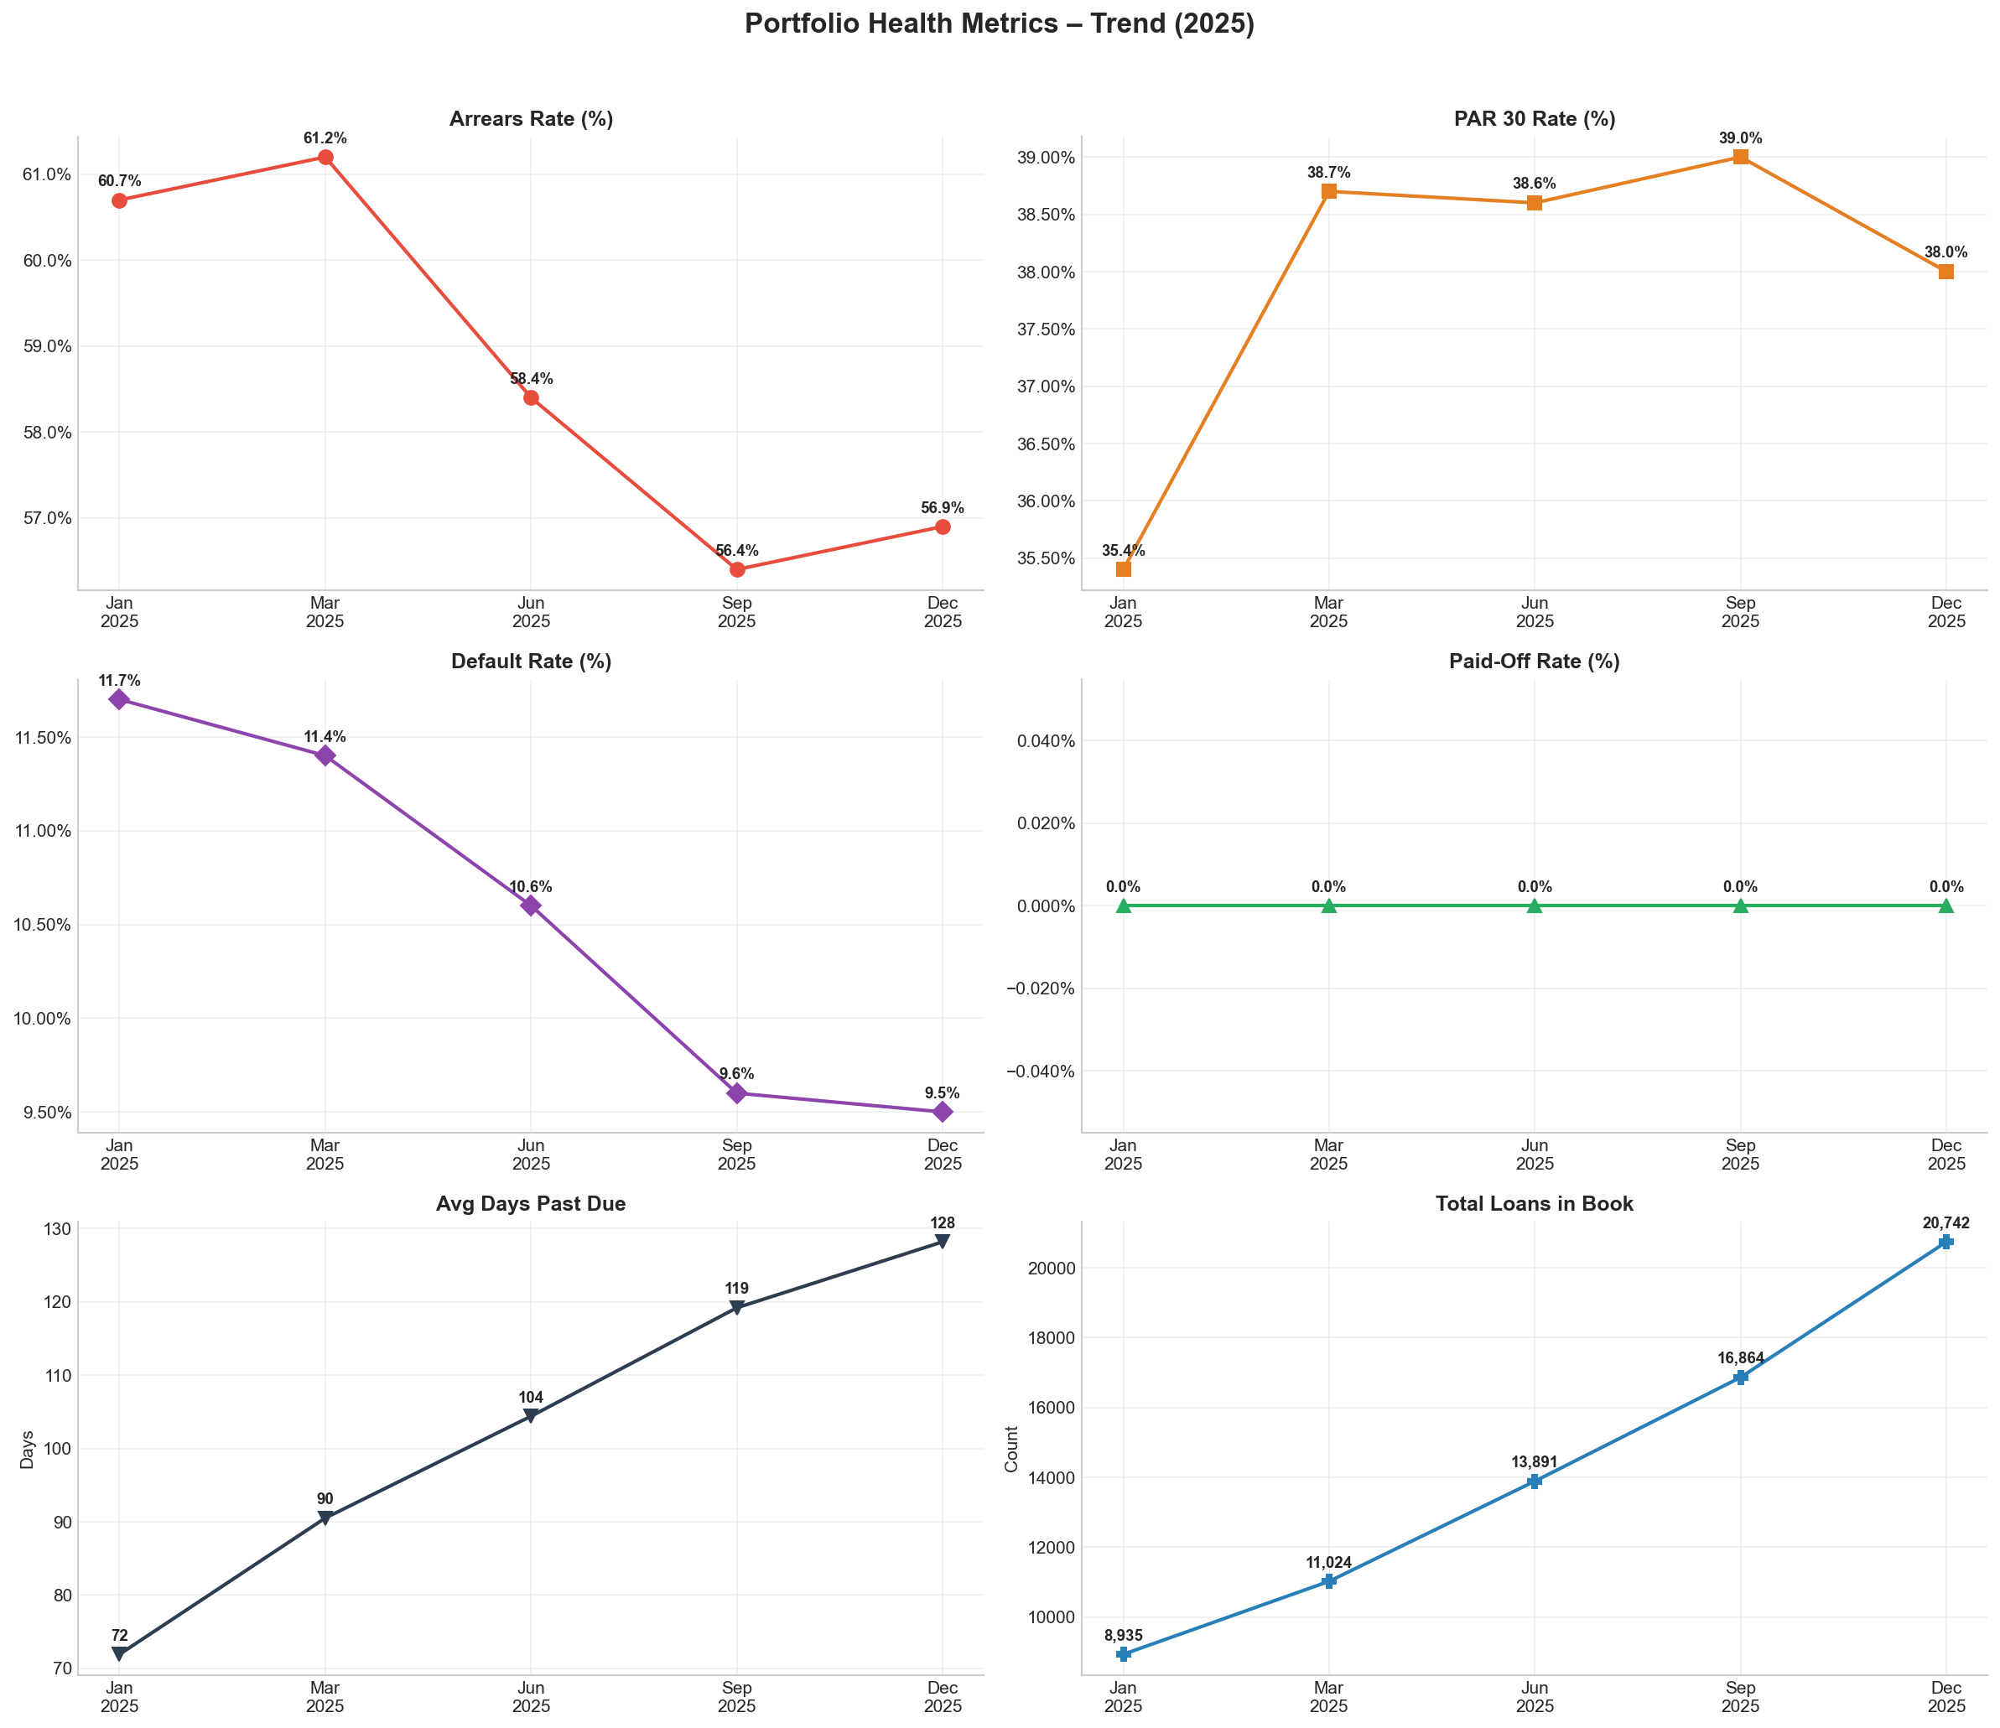
Portfolio Health - PAR30 Rate Trend
• PAR30 Rate stable at ~38% throughout 2025
• Peaked at 39% in September before slight improvement
• 1 in 3 loans is severely delinquent (30+ days past due)
• Portfolio risk is controlled but not improving
• Loan book grew 132% (8,935 → 20,742) in 12 months
Risk decreases monotonically with age — the 46–55 band has a PAR30 of just 22.9%, nearly 15 percentage points below the youngest cohort.

Slide 4
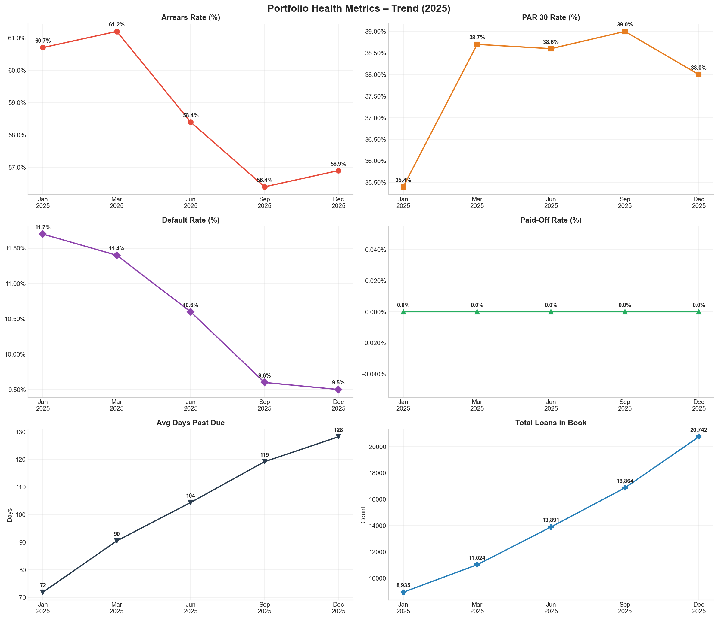
Portfolio Metrics Dashboard
• DEFAULT RATE declining (11.7% → 9.5%): Better credit screening is working
• PAID-OFF RATE growing (14.1% → 25.8%): Healthy portfolio maturation
• ARREARS RATE improving (60.7% → 56.9%): Fewer loans entering arrears
• AVG DPD increasing (72 → 128 days): Existing delinquents deepening - concern!
• TENSION: PAR30 stable but DPD deepens → book is splitting, not curing
Most customers pay fine, but those who fall behind are falling deeper behind (avg DPD nearly doubled in a year). This calls for an early-intervention trigger at DPD 7–14, especially targeting the 18–25 cohort who show higher default propensity.

Slide 5
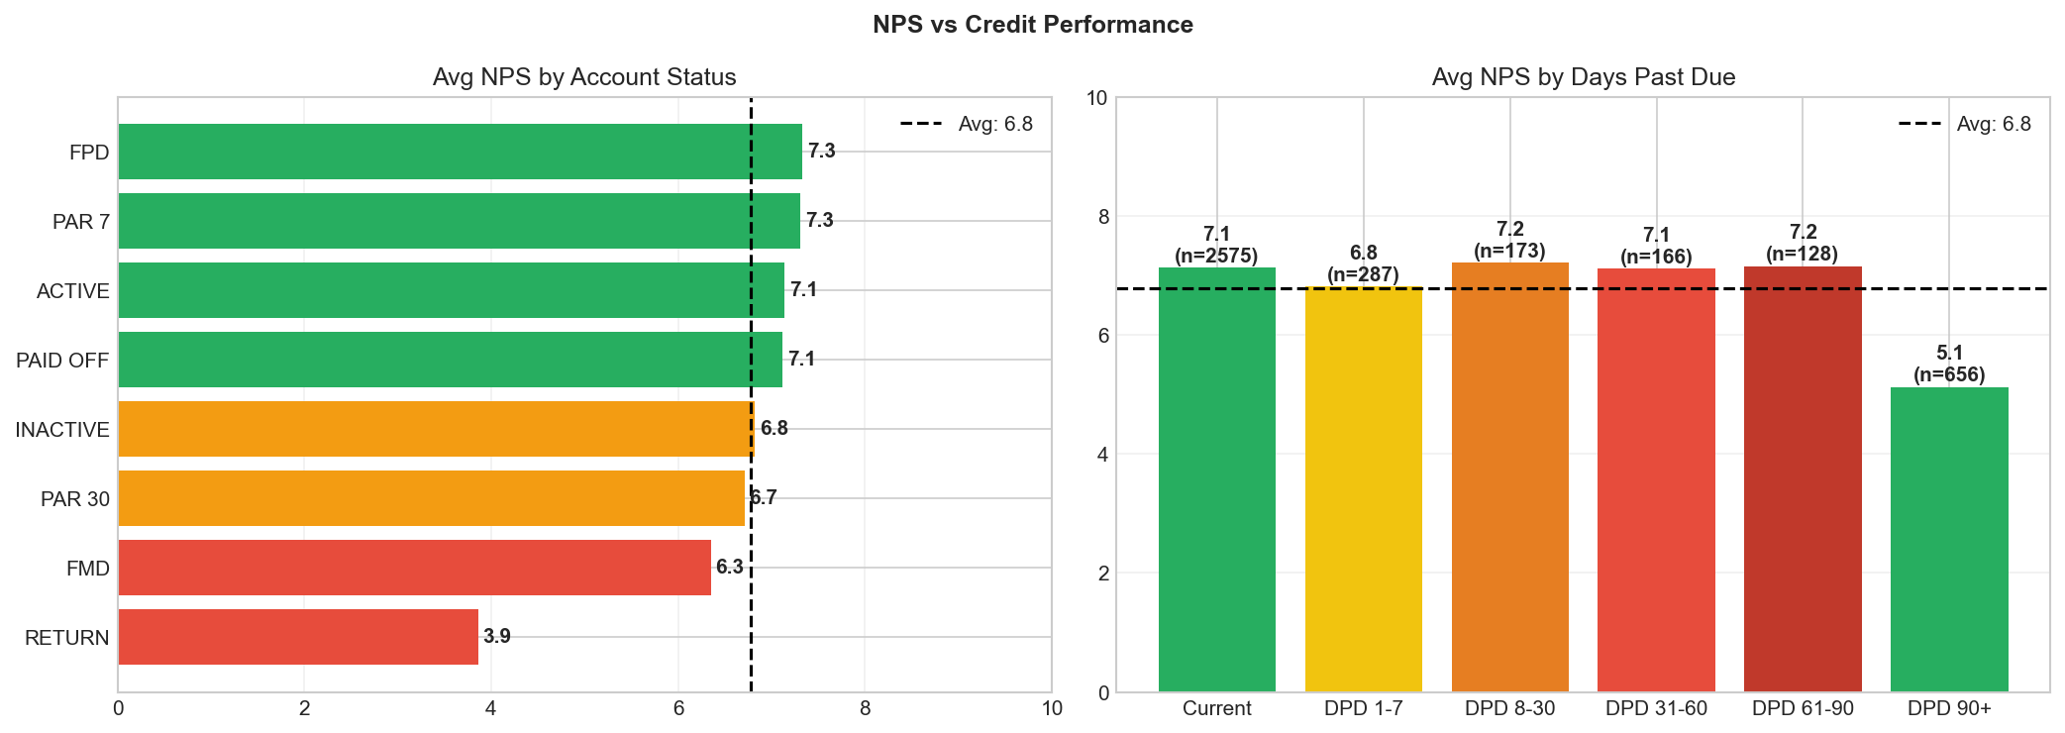
NPS Distribution Analysis
• Mean NPS Score: 6.78 (Moderate)
• Net NPS: +5.9 (Industry avg is +30 to +50)
• 41.3% Promoters (score 9-10)
• 35.6% Detractors (score 0-6)
• Only 17% of portfolio responded - may not be representative
Among Detractors: 38.1% were locked despite paying, 40.7% had payment delay issues, 47.7% couldn't reach support.

Slide 6
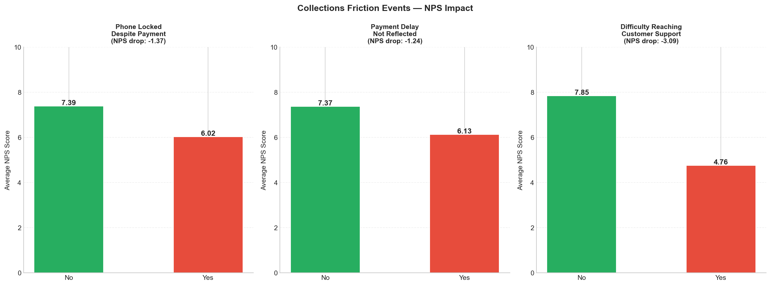
Collections Friction - NPS Impact
• PHONE LOCKED despite payment: -1.37 NPS drop - THIS IS CRITICAL
• Difficulty reaching support: -3.09 NPS drop - HIGHEST IMPACT
• Payment delay not reflected: -1.24 NPS drop
• Support difficulty is the #1 driver of customer dissatisfaction
• Phone locking (collections tool) punishes compliant customers
• TENSION: Collections effectiveness vs Customer Experience
Collections effectiveness depends on payment recognition; without accurate, real-time payment posting, the locking mechanism punishes compliant customers.
24-hour payment grace window before locking, with an automated SMS/app confirmation. Prevents the reconciliation lag from triggering erroneous locks — directly attacking the biggest NPS driver without weakening genuine collections enforcement.

Slide 7
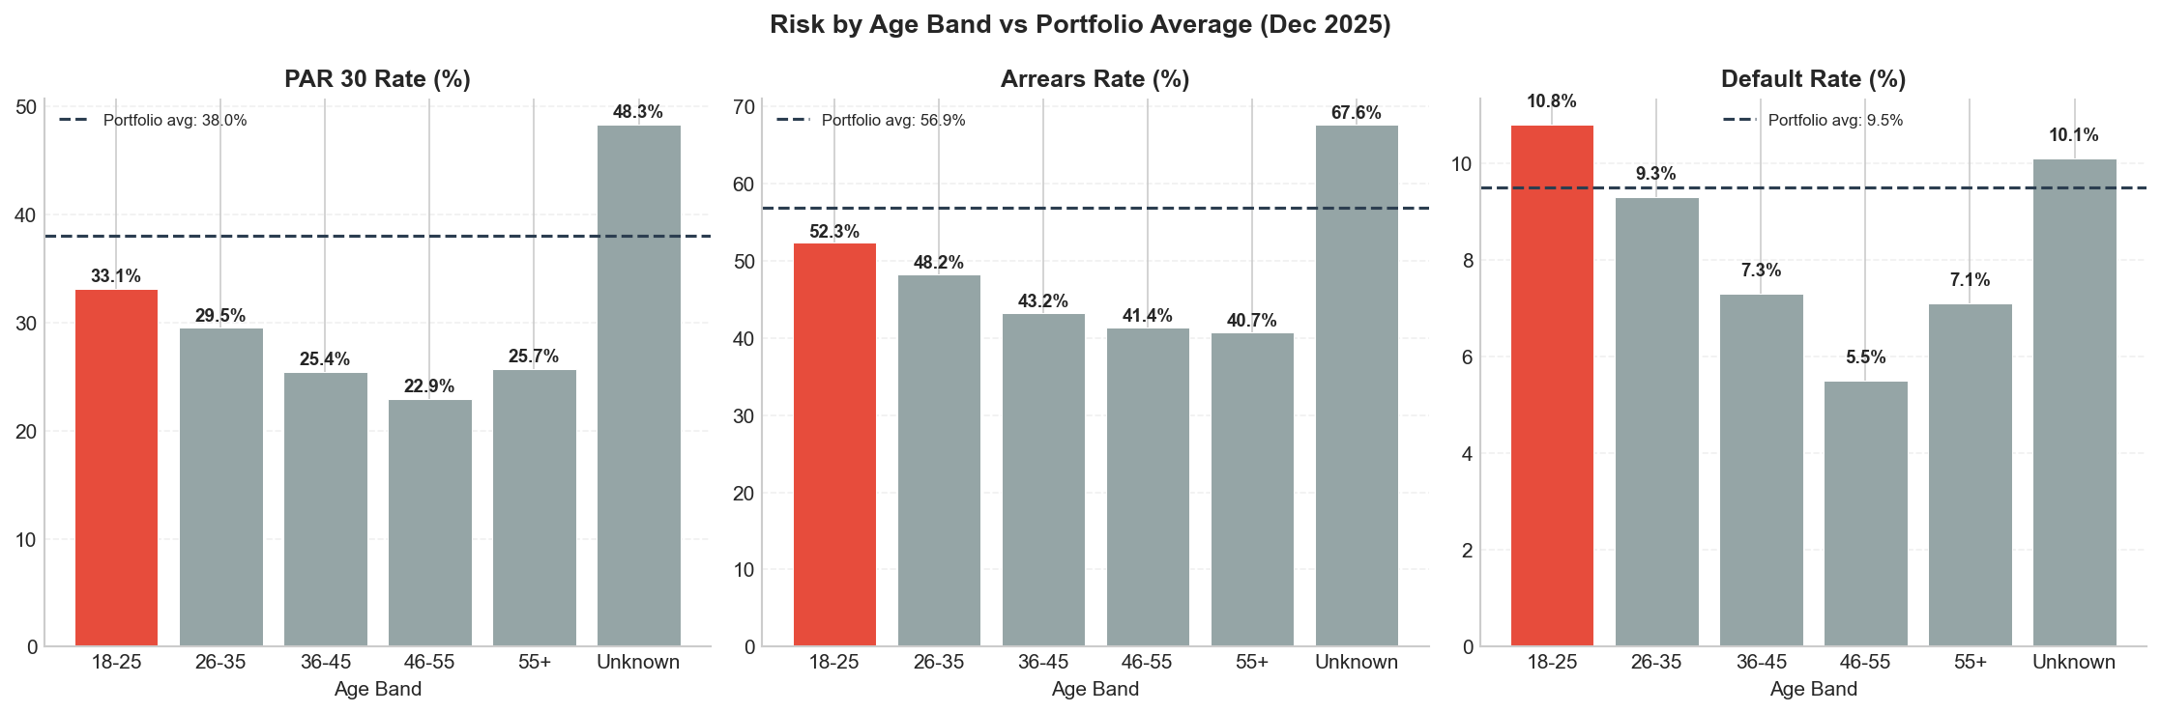
Risk Analysis by Age Band
• 18-25 age band: HIGHEST default rate at 10.8%
• 46-55 age band: LOWEST default rate at 5.5%
• Risk decreases consistently with age
• 18-25 has nearly 2x risk of 46-55 segment
• Portfolio avg PAR30: 38%, but 18-25 at 33.1% (slightly better)
• Default rate is the concern for youngest cohort
Younger borrowers have higher default rates, suggesting income instability or limited credit history. The credit team should apply tighter affordability checks or require higher deposits for 18–25 applicants.

Slide 8
Key Recommendations
Priority 1: Fix Phone Locking Process
Priority 2: Tighten Underwriting for 18-25
Priority 3: Data Infrastructure
Add a payment events table
Standardize demographic capture for all sale types
Implement NPS deduplication rules

