Slide 1
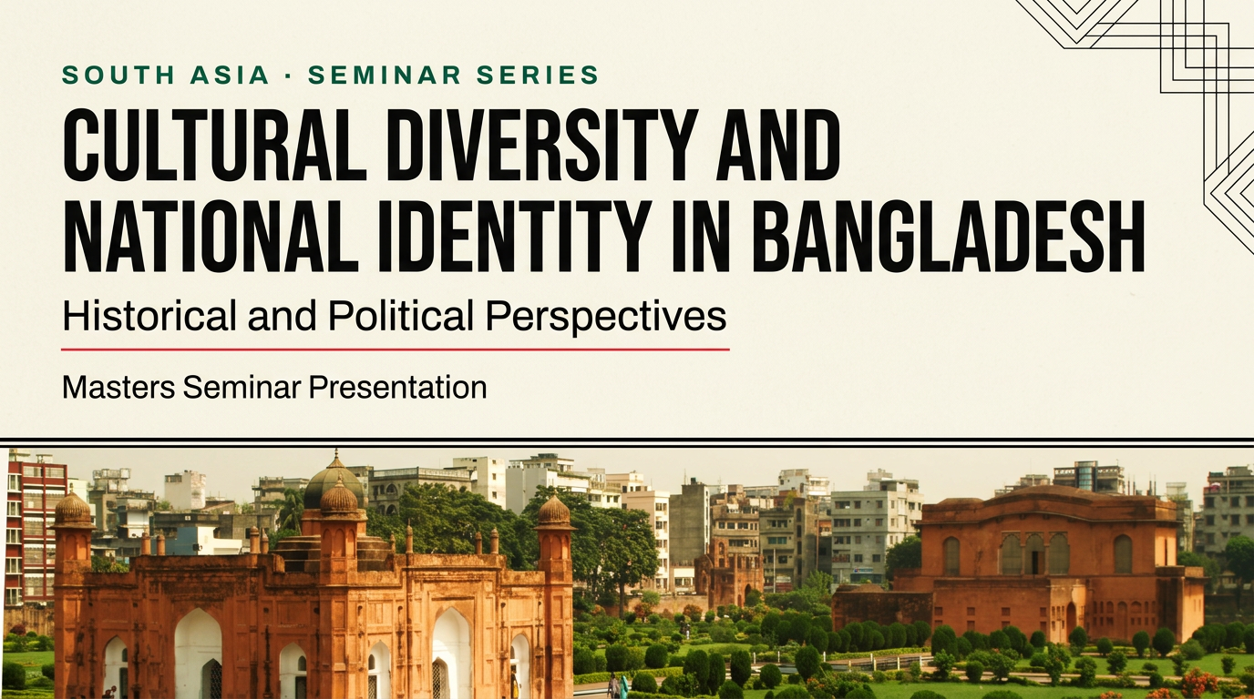
Notes:
Welcome. This seminar asks a simple question with a complicated answer: what holds together a nation built on language, home to every major faith, and dozens of peoples? My claim is this: Bangladeshi identity is not fixed — it is continually negotiated between the unifying forces of language and the memory of 1971 on one side, and extraordinary religious, ethnic, and cultural plurality on the other. We will move through three parts: historical roots, diversity in depth, and politics today. All figures come from the 2022 Census, UNHCR, UNESCO, and constitutional records.

Slide 2
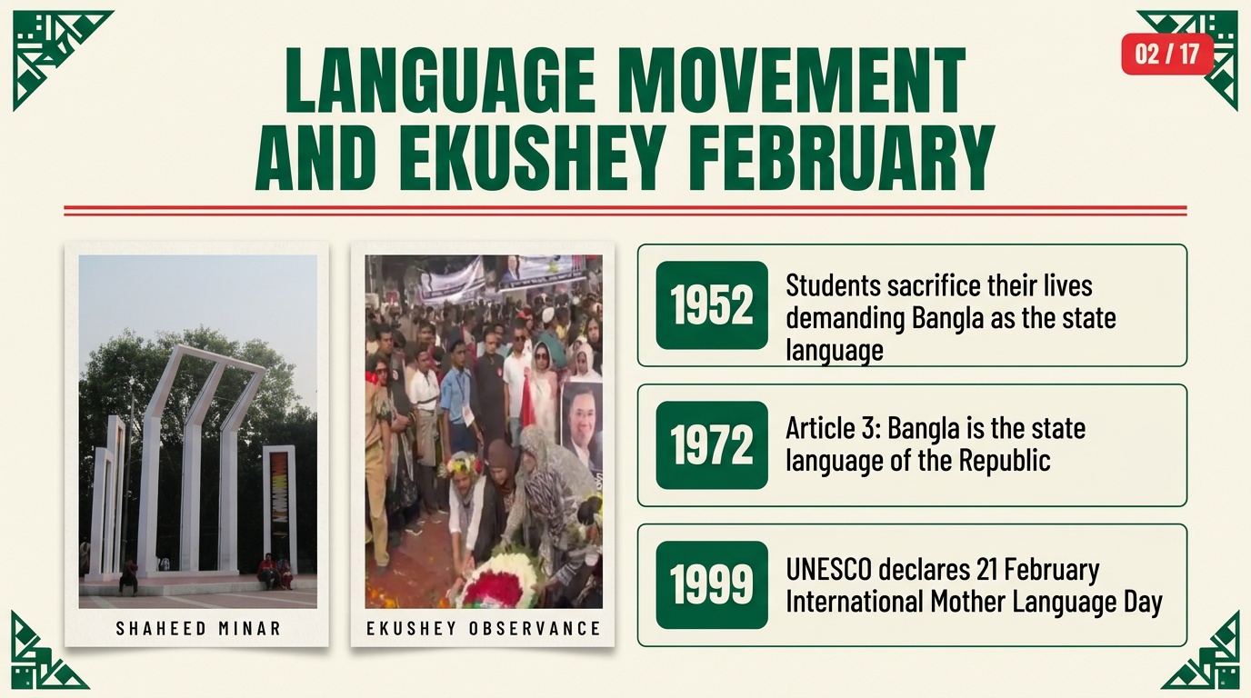
Notes:
We begin where Bangladesh itself begins: with language. In 1952, students in East Pakistan gave their lives demanding that Bangla be recognised as the state language — the bloodshed of 21 February became the founding story of the nation. The 1972 Constitution enshrined Bangla in Article 3. And in 1999, UNESCO declared 21 February International Mother Language Day — turning a national mourning into a global celebration of linguistic diversity. Notice the pattern: language is simultaneously the most inclusive and the most potent marker of identity here. Transition: from language, to the war that made the state.

Slide 3
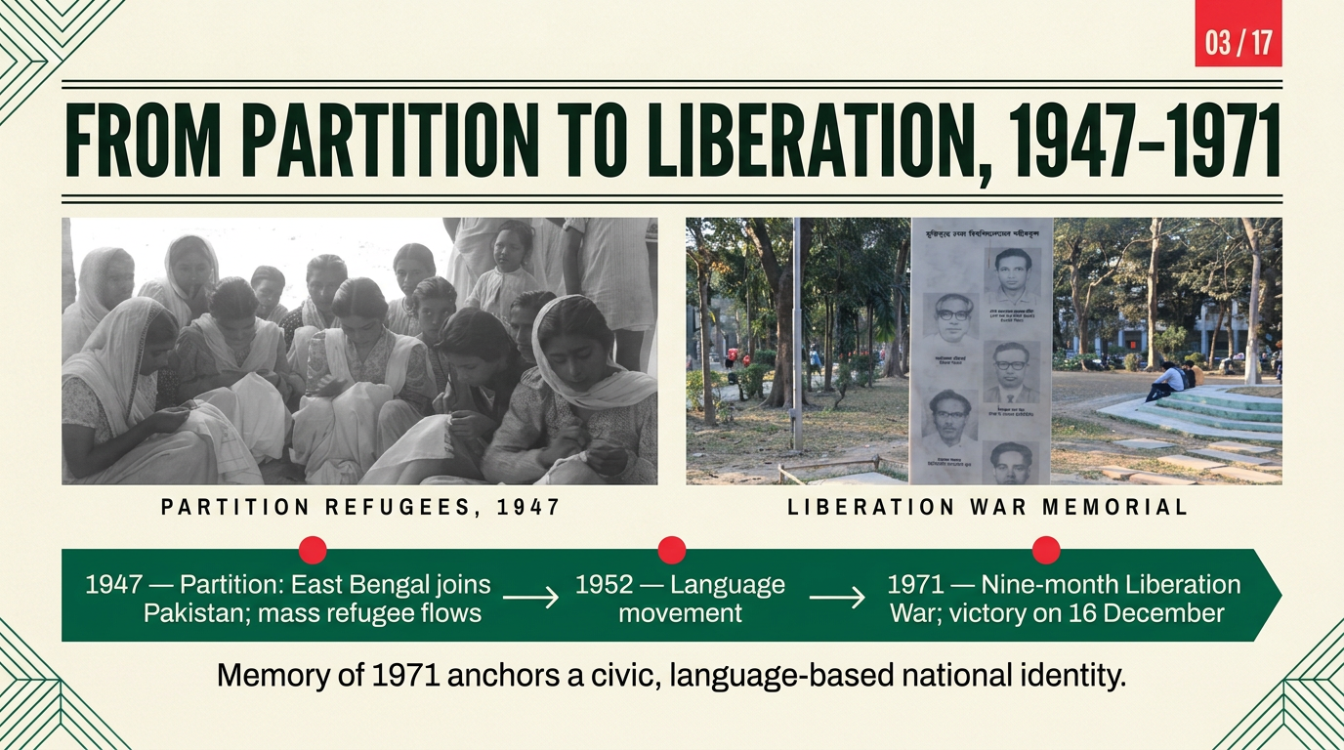
Notes:
Bangladesh's state was born twice over. The 1947 Partition scattered families across a new border — our photograph shows refugee women in a camp that September. Then, in 1971, a nine-month Liberation War ended on 16 December with a genocide remembered in every school textbook. The memorial sculpture on the right honours the martyred teachers of Dhaka University — one of many memory sites across the country. The point for identity: civic nationalism here is anchored in the sacrifice of 1971 — a belonging defined by language and shared memory, not by religion. Transition: once you claim a civic nation, you must write it into a constitution.

Slide 4
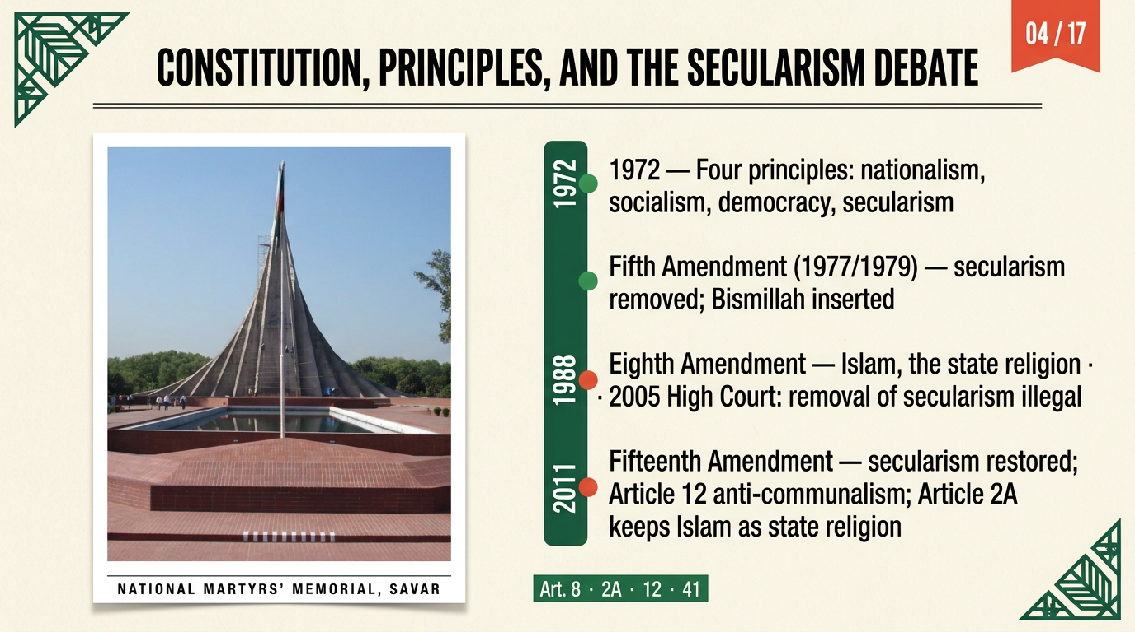
Notes:
The 1972 Constitution set four principles — nationalism, socialism, democracy, and secularism. What followed is a political drama in miniature. The Fifth Amendment, dated by sources to 1977–79, removed secularism and inserted the Bismillah. The Eighth Amendment of 1988 made Islam the state religion; in 2005 the High Court ruled that removing secularism had been illegal. Finally, the Fifteenth Amendment of 2011 restored secularism and added Article 12 against communalism — while Article 2A kept Islam as the state religion. That coexistence, state religion plus secular duties, is the constitutional compromise Bangladesh lives with today. Transition: let us now see what the population actually looks like.

Slide 5
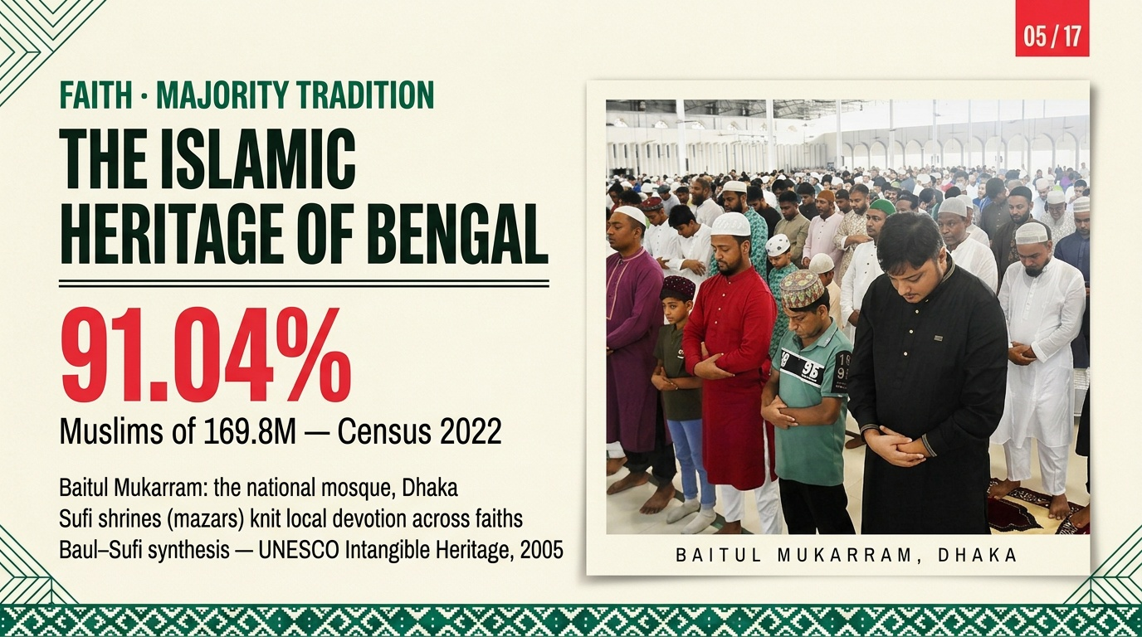
Notes:
About nine in ten Bangladeshis are Muslim — 91.04 per cent of 169.8 million, according to the final 2022 Census. But the majority tradition is textured, not monolithic: Baitul Mukarram, the national mosque, anchors congregational life; Sufi shrines, the mazars, draw Hindu and Muslim devotees alike; and the Baul–Sufi synthesis was inscribed by UNESCO in 2005 as intangible heritage. This is crucial for the argument: majority culture in Bengal has always absorbed the wider region. Transition: majority and minorities are two halves of one mosaic.

Slide 6
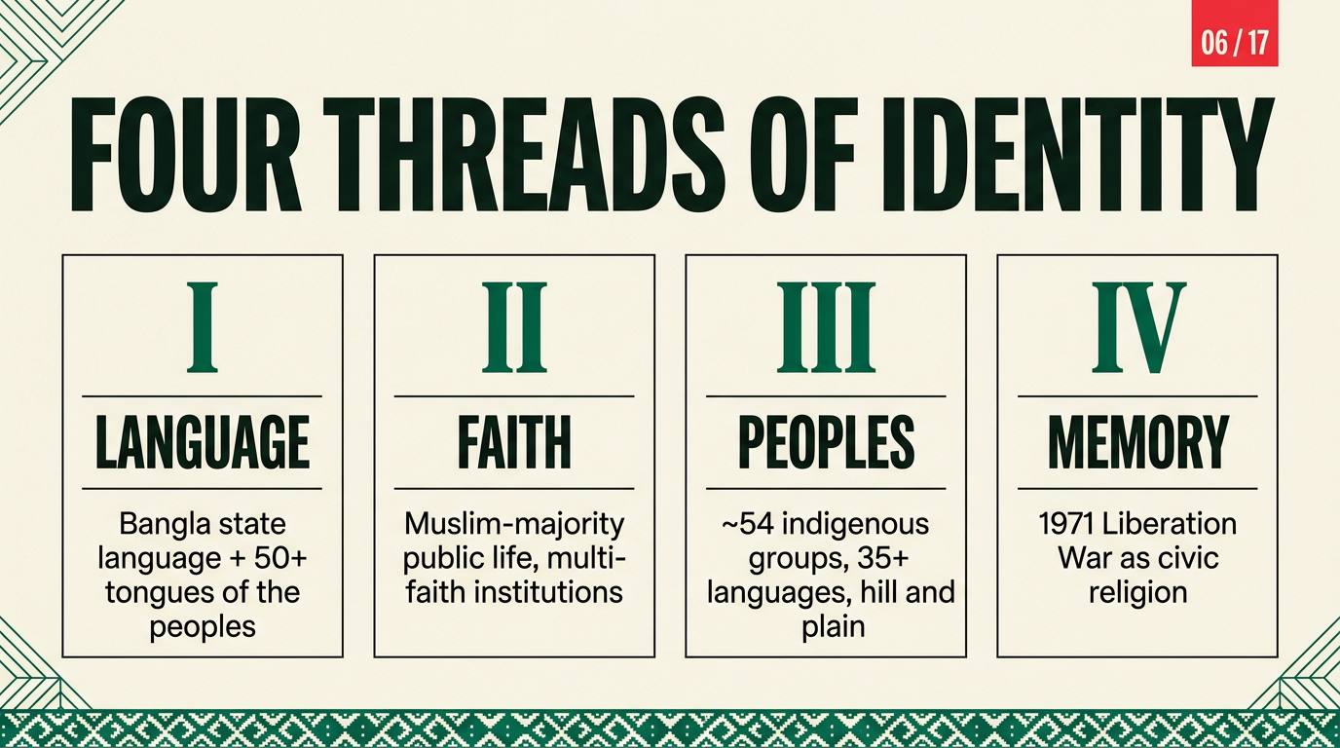
Notes:
Before the data, the framework. I organise the talk around four threads. Language — Bangla plus the fifty-odd tongues of the peoples. Faith — a Muslim-majority public sphere with deep multi-faith institutions. Peoples — around fifty-four indigenous groups across hills and plains. Memory — 1971 as what some scholars call civic religion. Every following slide hangs on one of these threads. Transition: start with the peoples whose numbers are most contested.

Slide 7
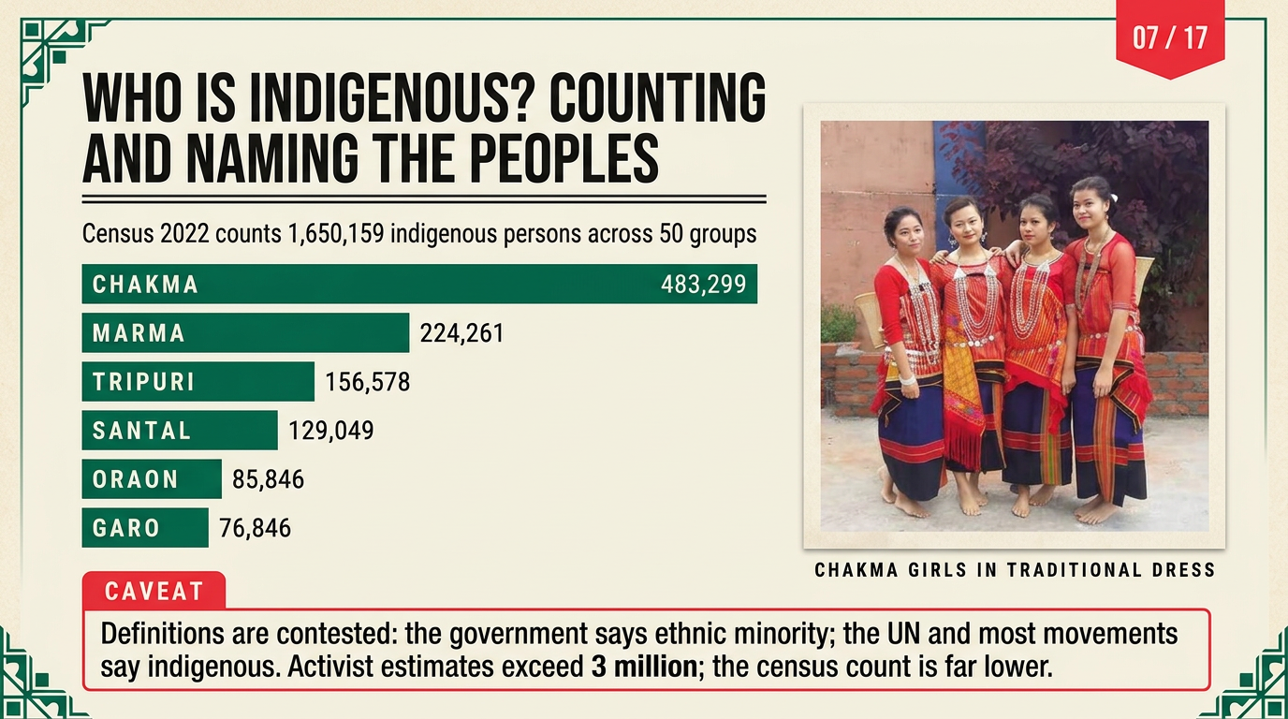
Notes:
Who counts as indigenous — and who does the counting? The 2022 Census enumerated 1,650,159 indigenous persons across fifty groups: Chakma nearly half a million, then Marma, Tripuri, Santal, Oraon, and Garo. But here is the caveat I need you to hold on to: activists and many international bodies put the figure above three million. The gap is not a mistake — it is a definitional fight. Dhaka officially uses 'ethnic minority'; the UN system and most movements use 'indigenous'. Lower numbers reduce claims to autonomy and land. Counting, in other words, is itself a political act. Transition: numbers become cultures when we look at their institutions.

Slide 8
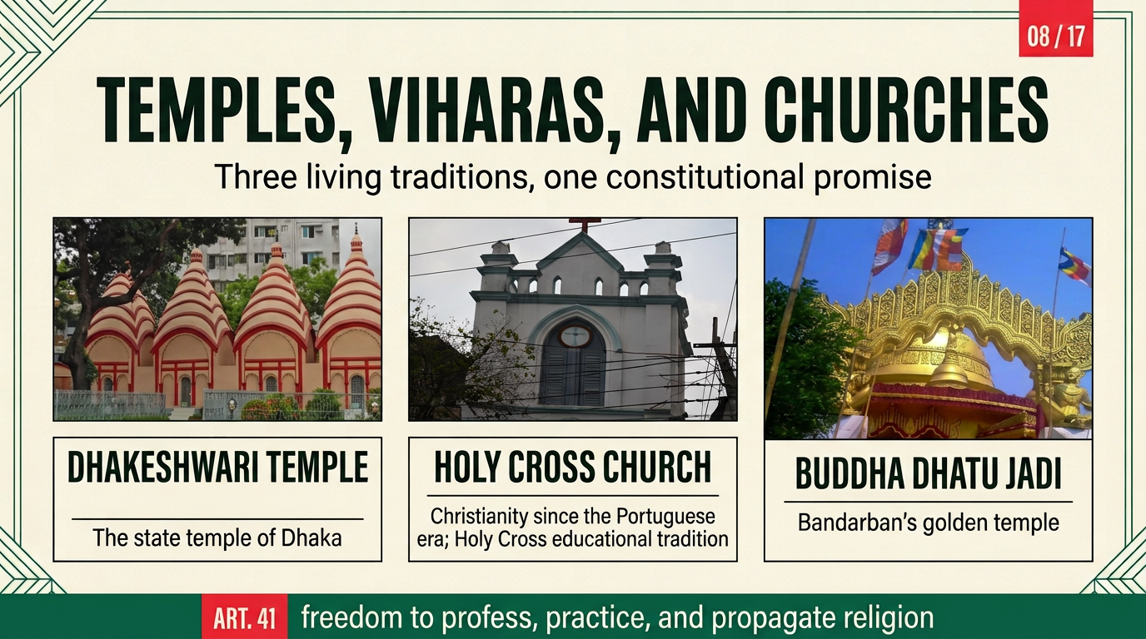
Notes:
Three institutions, three traditions. Dhakeshwari Temple in Dhaka — the state temple, patronised since Mughal times. Buddha Dhatu Jadi, the golden temple above Bandarban — a symbol of Buddhist hill heritage. And the Holy Cross Church — Christianity present since the Portuguese era, with an educational tradition that educated generations of all faiths. What holds them together is Article 41 of the Constitution: freedom to profess, practise, and propagate religion. The test of a republic is not its majority's size but whether these guarantees hold. Transition: from institutions to the demographic ledger itself.

Slide 9
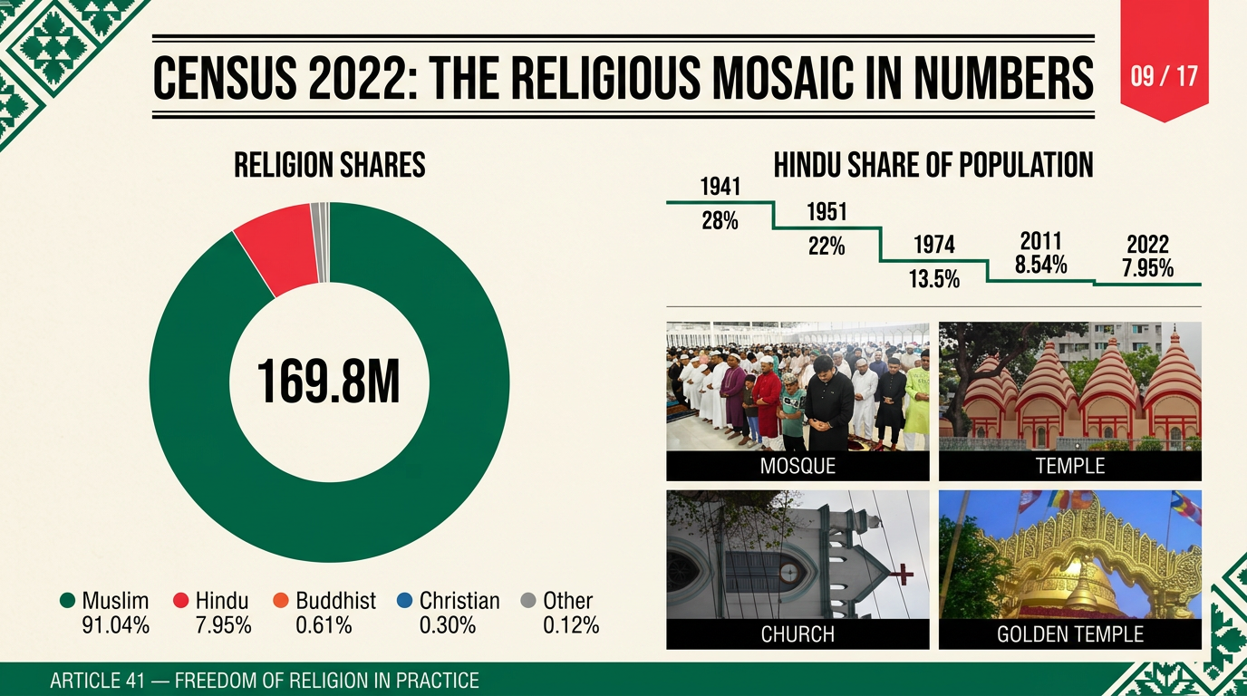
Notes:
The census numbers in one frame. Muslims 91.04 per cent, Hindus 7.95, Buddhists 0.61, Christians 0.30, others 0.12 — a total population of 169.8 million. The right-hand trend deserves your attention: the Hindu share has fallen from 28 per cent in 1941 to 7.95 in 2022. Scholars attribute this chiefly to lower fertility and to emigration after 1947 and 1971 — not to any single cause. What the 2×2 reminds us: behind every percentage is a living institution. And Article 41 remains the legal guarantee beneath all of it. Transition: percentages are the shadow; peoples are the substance.

Slide 10
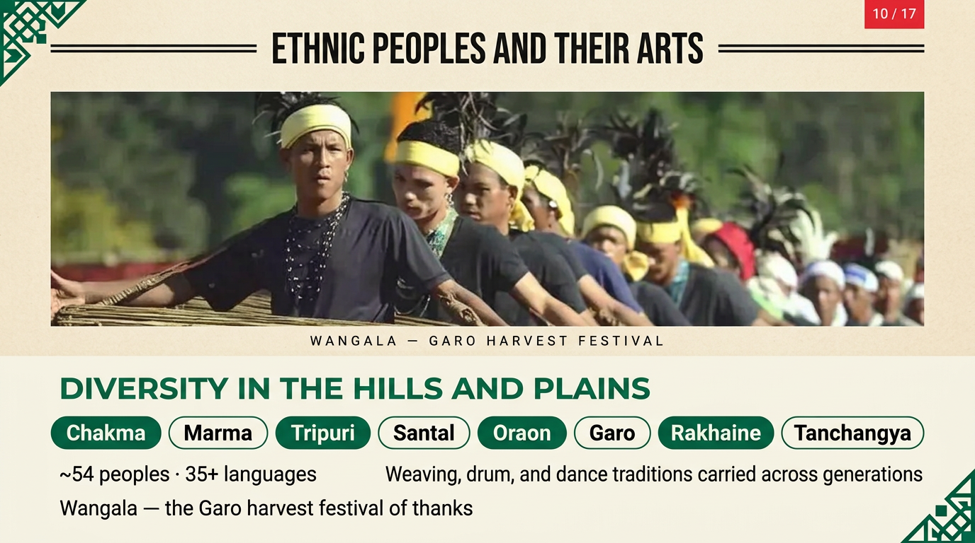
Notes:
Around fifty-four peoples, at least thirty-five languages. In the hills: Chakma, Marma, Tripuri; on the plains: Santal, Oraon; in the north-east: the Garo — whose Wangala harvest festival you see here, a thanksgiving to the sun and earth after the harvest. Each group carries distinct drum, dance, and weaving traditions. The cultural point is density: Bangladesh is often read as homogeneous — these faces and festivals say otherwise. Transition: where culture meets politics, the case is sharpest in the Chittagong Hill Tracts.

Slide 11
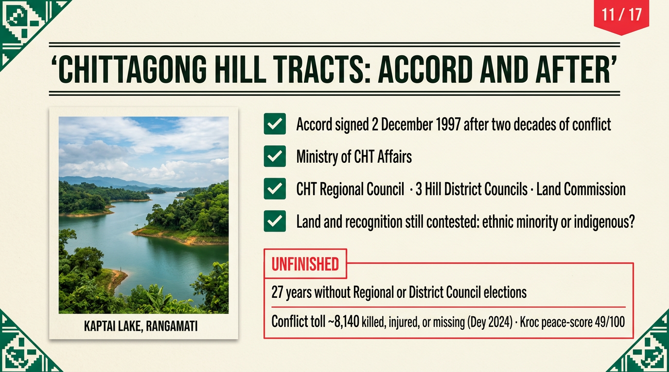
Notes:
The CHT Accord of 2 December 1997 ended an insurgency with institutions: a Ministry of Hill Areas, a CHT Regional Council, three Hill District Councils, and a Land Commission. Twenty-seven years later, the Regional and District Councils have never held elections; land disputes persist; and the conflict's toll — roughly 8,140 killed, injured, or missing — remains politically unresolved. The Kroc Institute's first-decade assessment scored peace at 49 out of 100. And note the language battle continues: 'ethnic minority' or 'indigenous' — recognition is still contested. Transition: the largest minority crisis, however, is not domestic but regional.

Slide 12
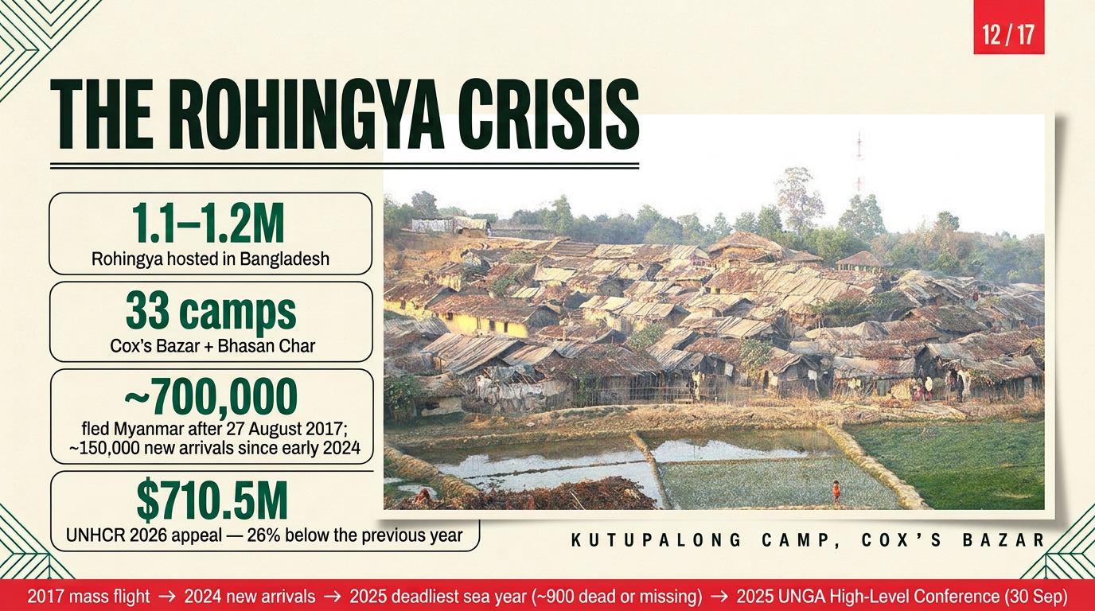
Notes:
Since 1979 and above all since 27 August 2017, Bangladesh has hosted the Rohingya — now 1.1 to 1.2 million people across 33 camps in Cox's Bazar and on Bhasan Char. Around 700,000 fled the operations of 2017; some 150,000 have arrived since early 2024. 2025 was the deadliest year at sea — about 900 dead or missing. And the money is shrinking: UNHCR's 2026 appeal is 710.5 million dollars, 26 per cent below the year before. Bangladesh's response earned global praise — but burden-sharing remains the open question the UN General Assembly took up in September 2025. Transition: belonging is also contested inside the cities.

Slide 13
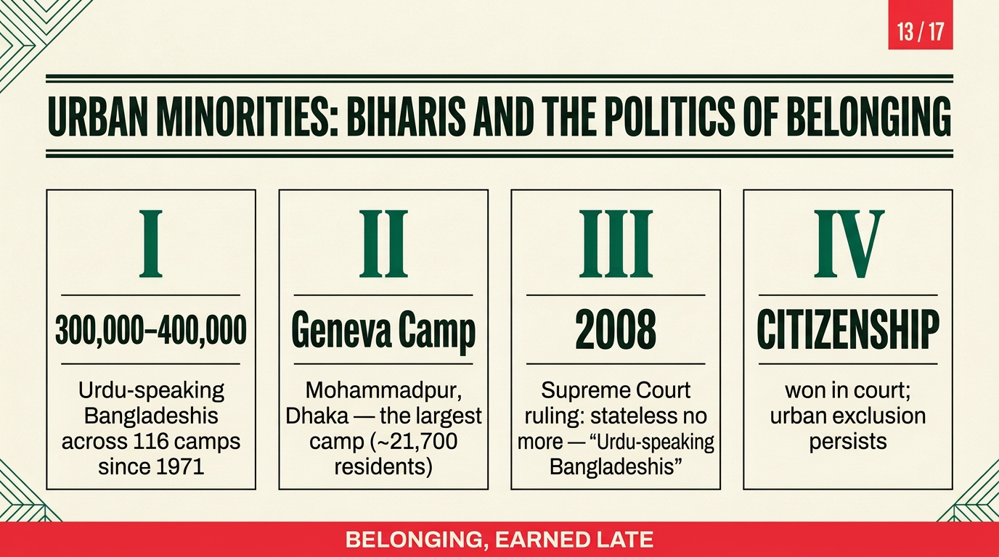
Notes:
A minority often forgotten: the Urdu-speaking Bangladeshis, or Biharis. Stranded after 1971, some 300,000 to 400,000 people lived in 116 government camps — Geneva Camp in Mohammadpur the largest, at over twenty thousand residents. For decades they were stateless — until the Supreme Court's 2008 ruling recognised them as 'Urdu-speaking Bangladeshis' with full citizenship. Citizenship was earned; urban exclusion persists. This case shows that identity politics in Bangladesh is not majority-versus-minority alone — it is about who the state has ever been willing to name. Transition: from exclusion to celebration.

Slide 14
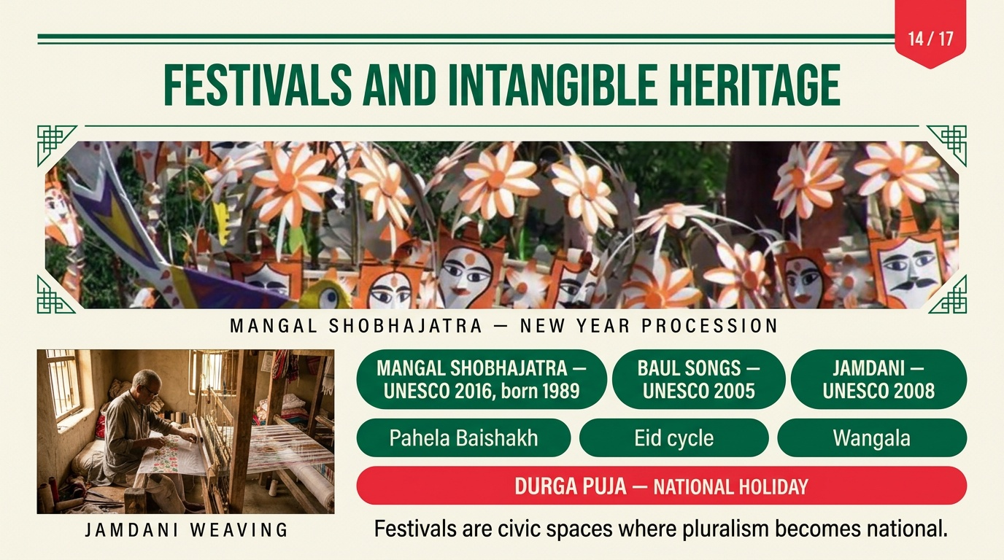
Notes:
Now the festivals. Mangal Shobhajatra — the New Year's carnival of masks and effigies, begun by students in 1989 and inscribed by UNESCO in 2016. Baul songs, inscribed 2005. Jamdani weaving, 2008. Add Pahela Baishakh at Ramna Batamul, Durga Puja as a national holiday, the Eid cycle, and Wangala. These are the civic spaces where pluralism performs in public. In October 2026, police provided security at roughly 33,000 Durga Puja venues — state recognition measured in logistics. Transition: this festive surface sits atop a political earthquake.

Slide 15
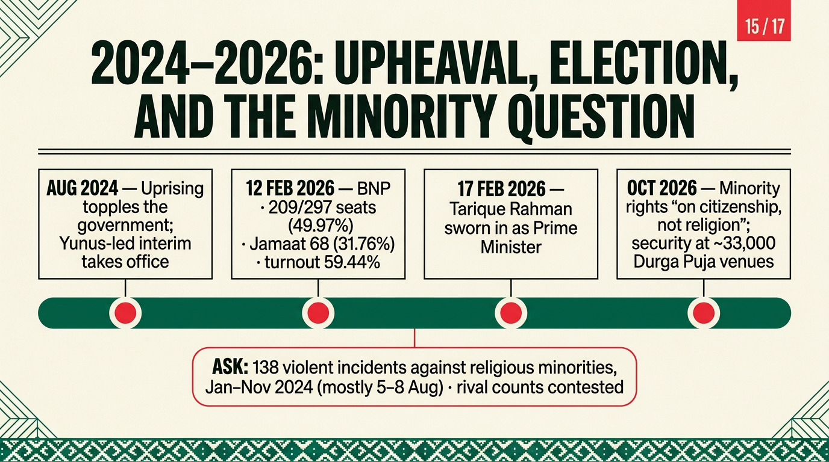
Notes:
The fast version of the last two years. August 2024: a student-led uprising toppled the government; the interim administration under Muhammad Yunus took charge. Violence followed — Ain o Salish Kendra counted 138 violent incidents against religious minorities between January and November 2024, most concentrated on 5–8 August; rival counts circulated — India's ministry cited 2,200, an umbrella council 2,010 — Dhaka called those figures highly exaggerated, so treat all numbers carefully. Then on 12 February 2026, Bangladesh voted: the BNP won 209 of 297 gazetted seats with 49.97 per cent, Jamaat became the main opposition with 68 seats, turnout 59.44 per cent, the Awami League barred. Tarique Rahman was sworn in on 17 February. By October 2026 the new government was promising minority rights 'on citizenship, not religion'. Encouraging — but unproven. Transition: so where does this leave us?

Slide 16
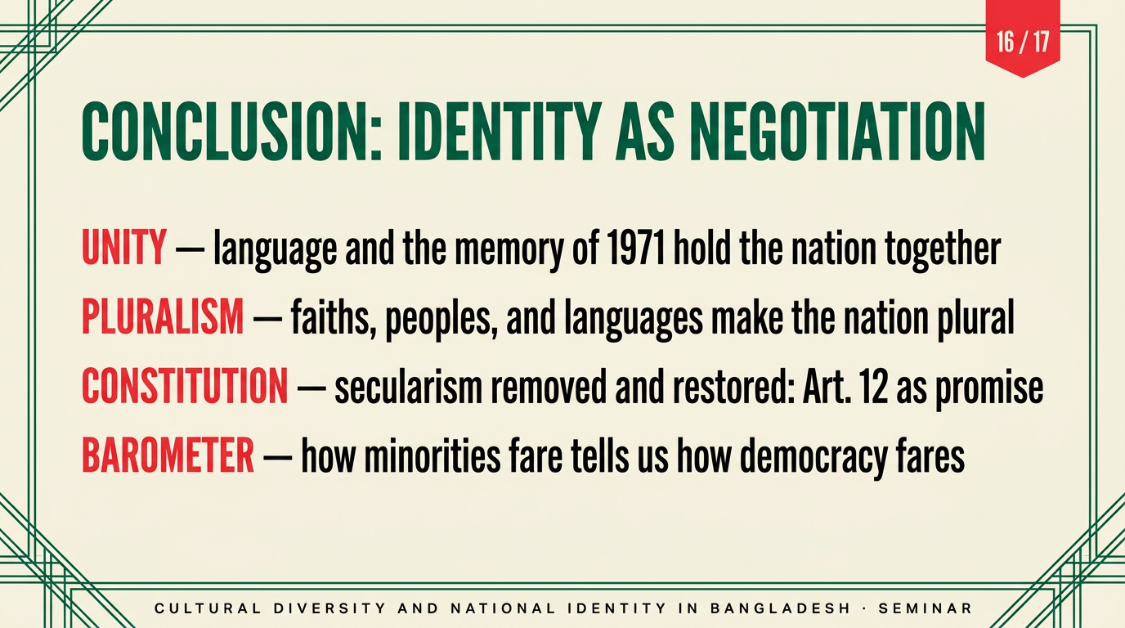
Notes:
Four takeaways. Unity: language and 1971 hold the nation together. Pluralism: faiths, peoples, and languages make it irreducibly diverse. Constitution: secularism was removed and restored — Article 12 is a promise that must be performed, not merely printed. And finally: minorities are the barometer — how Bangladesh treats its smallest communities tells us how its democracy is faring. The negotiation I began with is ongoing — and the next test will be whether the post-2024 political order widens or narrows the circle of belonging.

Slide 17
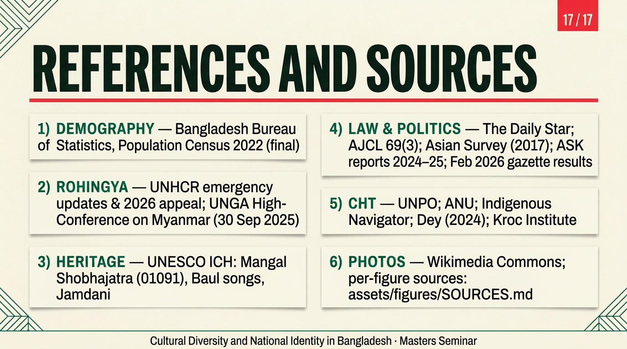
Notes:
Every figure in this talk traces to a verifiable source — the 2022 Census, UNHCR's emergency updates, UNESCO's heritage lists, constitutional case law, human-rights monitoring, and the February 2026 gazette results. All photographs are freely licensed from Wikimedia Commons, with per-image credits in the accompanying sources file. I am happy to share the source list — thank you, and I look forward to your questions.

