Slide 1
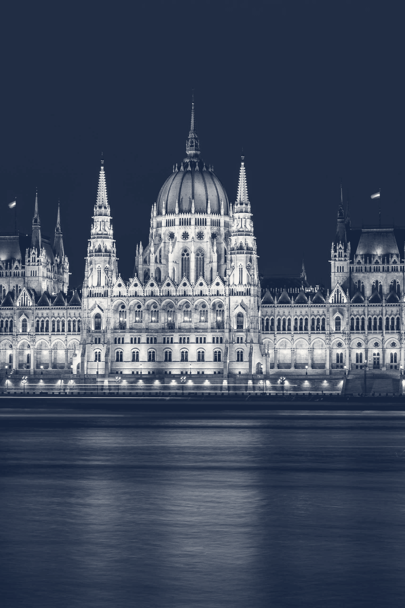
DEMOCRATIC BACKSLIDING
AND INSTITUTIONAL CAPTURE
“The new autocrats come to power
not with bullets
but with laws.”
Kim Lane Scheppele, “Autocratic Legalism” (2018)
How elected governments turn courts,
electoral bodies and legislatures
into instruments of power
Seminar presentation · November 2026
Readings: Haggard & Kaufman 2021 · Waldner & Lust 2018 · Wolin 2001
Photo: Aleksander Kracht-Winter / Wikimedia Commons / CC BY-SA 4.0 (cropped, toned)
Notes:
My topic is democratic backsliding and institutional capture. The legal scholar Kim Lane Scheppele sums it up: “the new autocrats come to power not with bullets but with laws.” I will first say what backsliding is, and how it differs from a coup and from the fascist seizure of power. Then I will show how elected governments turn courts, electoral bodies and legislatures into instruments of power. I draw on our three readings: Haggard and Kaufman, Waldner and Lust, and Wolin. Let me begin with the concept.

Slide 2
THE CONCEPT
Democracies today are rarely overthrown.
They are taken apart from the inside.
“the incremental¹ erosion of institutions, rules, and norms² that results
from the actions of duly elected governments³” — Haggard & Kaufman 2021, p. 27
1
Step by step
4 of 5
“a discontinuous series of incremental actions,
not a one-time coup de grâce” (Waldner & Lust 2018)
democratic breakdowns since
the 2000s were takeovers by
elected incumbents
2
Aimed at the checks
Courts, election rules and rights are weakened,
not abolished.
1973 to 2018, among 197 democratic downgrades
3
Done by the elected
Executive takeovers by elected incumbents
The government that erodes democracy first won
office in an election.
88
Military coups
46
Sources: Haggard & Kaufman 2021, p. 27 · Waldner & Lust 2018, p. 95 · Svolik 2019, Journal of Democracy 30(3)
02
Notes:
Democracies today are rarely overthrown. They are taken apart from the inside. Haggard and Kaufman define democratic backsliding as “the incremental erosion of institutions, rules, and norms that results from the actions of duly elected governments”. It happens step by step: Waldner and Lust speak of “a discontinuous series of incremental actions, not a one-time coup de grâce”. It is aimed at the checks on power: courts, election rules and rights are weakened, not abolished. And it is done by a government that first won an election. How common is this? Milan Svolik counted 197 democratic downgrades by Freedom House between 1973 and 2018: elected incumbents were behind 88, military coups behind 46. Since the 2000s, incumbents account for four breakdowns out of five. How does this differ from the older ways democracies ended?

Slide 3
THE CONTRAST
Backsliding is neither coup nor fascist seizure:
it is slower, quieter and keeps the façade.
Coup d’état
Fascist seizure
Backsliding
military or self-coup
Italy 1922 · Germany 1933
Hungary · Turkey · Venezuela
Who acts
the military or a faction
inside the state
a mass party with a militia,
invited in by old elites
a government that won
an election
Legal form
openly unconstitutional
legal on paper: appointment,
then an enabling act
legal at every step: laws,
amendments, appointments
Tempo
hours or days
weeks: 24 days from the Reichstag
fire to the Enabling Act
years, across several
election cycles
Violence
force is the instrument
terror clears the way: 107 deputies
kept out of the vote in 1933
rare: the law is enforced
selectively instead
Aim and
institutions
rule without elections:
constitution suspended
open dictatorship:
parliament made redundant
a democratic façade: bodies
kept, then captured
Sources: Britannica · US Holocaust Memorial Museum · Paxton 2004 (NYT review) · Bermeo 2016 · Svolik 2019 · Levitsky & Ziblatt 2018 · Scheppele 2018
03
Notes:
Backsliding is neither a coup nor a fascist seizure of power: it is slower, quieter and keeps the façade. A coup, by the military or by a sitting leader, is open, unconstitutional force. It is over in days and ends in rule without elections. The fascist seizure, in Italy in 1922 and Germany in 1933, was legal on paper: old elites invited a mass party with its own militia into government, and an enabling act then let Hitler’s cabinet make laws without parliament. But it took weeks, 24 days from the Reichstag fire to that act, and terror cleared the way to open dictatorship: 107 deputies were kept out of the vote, the US Holocaust Memorial Museum records. Backsliding, as in Hungary, Turkey or Venezuela, is the work of an elected government. Every step is legal, it takes years, and violence is rare, because the law is enforced selectively instead. The institutions are kept, then captured. So legality does not separate backsliding from the fascist path; tempo, terror and aim do. How does this slow path run?

Slide 4
THE MECHANISM
The path runs from polarization, through an
elected majority, to capture by small steps.
1
2
3
Polarization
An elected majority
Capture by small steps
Trust in institutions
falls; parties move to
the extremes.
The executive wins a pliant
legislature, and the checks
collapse from within.
Each step is small and legal
(“salami-slicing tactics”);
the tilt shows too late.
12 of 16
34% → 66%
12 of 16
cases saw polarization rise
votes into seats, Turkey 2002
cases saw the courts come under attack
The majority holds “the legal means of achieving
revolutionary ends without having to resort to
revolutionary means”. — Wolin 2001, p. 245
Its targets: the three referees
Legislature
Courts
Electoral bodies
Sources: Haggard & Kaufman 2021, pp. 27–38 (sixteen backsliding cases) · Wolin 2001, ch. XII
04
Notes:
The path runs from polarization, through an elected majority, to capture by small steps. Haggard and Kaufman trace it in 16 cases. Polarization means that society splits into hostile camps: trust in institutions falls and parties move to the extremes. It rose in 12 of the 16. Then comes an elected majority, often enlarged by the electoral rules: in Turkey in 2002, 34 percent of the votes gave Erdoğan’s party 66 percent of the seats. With a pliant legislature, one that does what the executive asks, the checks collapse from within. Wolin traces the fear behind this to the American and French revolutions: the majority now held “the legal means of achieving revolutionary ends without having to resort to revolutionary means”. Third, capture: each step is small and legal, what Haggard and Kaufman call “salami-slicing tactics”, so the tilt shows too late. In 12 of the 16 cases the courts came under attack. The targets are three referees that hold a government to the rules: the legislature, the courts and the electoral bodies. I take them in turn.

Slide 5
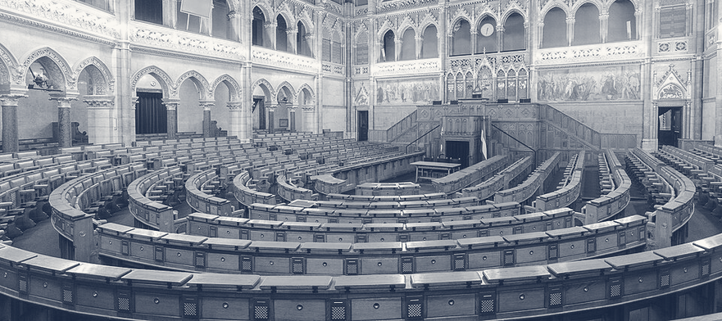
REFEREE 1 OF 3 · THE LEGISLATURE
A pliant legislature makes each later step
legal, and votes away its own powers.
1
It rewrites the rules for the other referees
El Salvador, 1 May 2021: the new assembly dismissed
five top judges and the attorney general.
2
It lifts the limits on the leader
El Salvador, 2025: the assembly abolished
presidential term limits.
Debating chamber, Hungarian Parliament Building
Wei-Te Wong / Wikimedia Commons / CC BY-SA 2.0 (cropped, toned)
3
It hands its own powers to the executive
137 of 199 MPs
Hungary, 30 March 2020: parliament let the prime
minister rule by decree, with no end date.
voted for rule by decree
with no end date.
Hungary, 30 March 2020
Legislatures: “frequently complicit in weakening
their own powers”. — Haggard & Kaufman 2021, pp. 34–35
Sources: CRS R47083 (El Salvador) · V-Dem Democracy Report 2026 · Business Insider, 30 March 2020 · Haggard & Kaufman 2021, pp. 34–35
05
Notes:
The legislature comes first, because a pliant legislature makes each later step legal, and in the end it votes away its own powers. It rewrites the rules for the other referees: in El Salvador, on 1 May 2021, the new assembly dismissed five top judges and the attorney general, the US Congressional Research Service reports. It lifts the limits on the leader: in 2025 El Salvador’s assembly abolished presidential term limits, as the V-Dem democracy report records. And it hands its own powers to the executive: in Hungary, on 30 March 2020, parliament let the prime minister rule by decree, without parliament and with no end date. Business Insider reported 137 votes in favour, in a house of 199. As Haggard and Kaufman write, legislatures were “frequently complicit in weakening their own powers”. With parliament on its side, a government can turn to the courts.

Slide 6
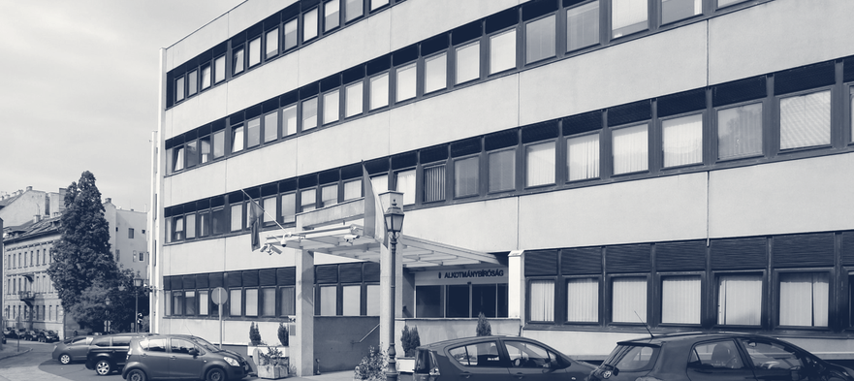
REFEREE 2 OF 3 · THE COURTS
Captured courts stop refereeing: they shield
the government and strike at its opponents.
1
Pack the bench: add seats and fill them
Hungary 2011: top court enlarged from 11 to 15 seats.
Venezuela 2004: top court enlarged from 20 to 32.
2
Purge the bench: push sitting judges out
Turkey after July 2016: more than 4,000 judges
and prosecutors dismissed.
Constitutional Court of Hungary, Budapest
Thaler Tamas / Wikimedia Commons / CC BY-SA 4.0 (cropped, toned)
3
Capture the appointments
10 of 13 rulings
Poland since 2018: about 2,700 judges appointed or
promoted through a council that parliament chose.
went the government’s way
once its appointees were
the majority. Before: 0 of 10.
Captured referees: “more than a shield. It also
offers a powerful weapon”. — Levitsky & Ziblatt 2018
Sources: Human Rights Watch 2013 and 2004 · Freedom House · Wójcik 2025 (GMF) · Hungarian Helsinki Committee · Levitsky & Ziblatt 2018
06
Notes:
Captured courts stop refereeing. They shield the government and strike at its opponents. One way is to pack the bench: add seats and fill them with allies. Hungary went from 11 to 15 constitutional judges in 2011, Venezuela from 20 to 32 top judges in 2004, as Human Rights Watch documents. Another is to purge it: after the coup attempt of July 2016, Turkey dismissed more than 4,000 judges and prosecutors, says Freedom House. The third is to capture the appointments: in Poland, since 2018, about 2,700 judges have been appointed or promoted through a council that parliament chose, Anna Wójcik reports. Does it work? The Hungarian Helsinki Committee compared rulings of the Constitutional Court. Before the government’s appointees held the majority, none of ten went the government’s way. Afterwards, ten of thirteen did. As Levitsky and Ziblatt write, capturing the referees gives the government “more than a shield. It also offers a powerful weapon”. That leaves the referee that runs the elections.

Slide 7
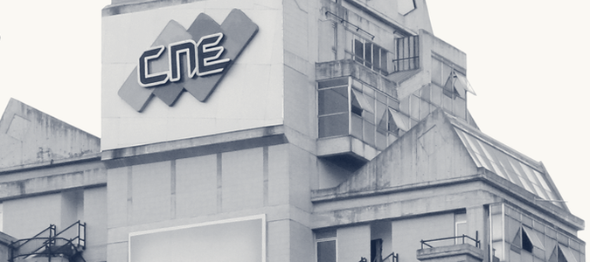
REFEREE 3 OF 3 · ELECTORAL BODIES
Captured electoral bodies can settle an
election before polling day, or after it.
1
Redraw the map and the rules
before polling day
Hungary 2014: about 45% of list votes, yet two-thirds
of the seats: 96 of 106 districts won.
2
Decide who may run
before polling day
Nicaragua 2021: the electoral council struck off
three opposition parties before the vote.
National Electoral Council (CNE), Caracas
Omerta-ve / Wikimedia Commons / CC BY-SA 3.0 (cropped, toned)
3
Control the count
51.2%
after polling day
Istanbul 2019: the electoral council annulled a
mayoral election that the opposition had won.
declared for Maduro by the
electoral council, 29 July 2024,
with no polling-station results.
Venezuela 2024: the election “cannot be
considered democratic”. — The Carter Center, 30 July 2024
Sources: US State Department (Hungary 2014, Nicaragua 2021) · OSW 2019 · WOLA 2024 · The Carter Center, 30 July 2024
07
Notes:
Captured electoral bodies, the councils that run elections, can settle an election before polling day, or after it. Two moves come before anyone votes. One is to redraw the map and the rules: in Hungary in 2014, the governing parties won about 45 percent of the party-list vote, yet two thirds of the seats, taking 96 of 106 districts. The other is to decide who may run: in Nicaragua in 2021, the electoral council struck off three opposition parties before the vote. Both are documented by the US State Department. The third move comes after polling day, control the count: in Istanbul in 2019, the electoral council annulled a mayoral election that the opposition had won. Venezuela shows the end point. On 29 July 2024, the electoral council declared Nicolás Maduro the winner with 51.2 percent, and published no polling-station results. The Carter Center concluded that the election “cannot be considered democratic”. How far has this pattern spread?

Slide 8
THE SCALE
Erosion is now the global trend: far more
countries are autocratizing than democratizing.
Countries autocratizing
Countries democratizing
41%
44
of the world’s population lives
in autocratizing countries:
3.4 billion people.
In 2005 it was 9%.
27
18
15 of 28
12
democracies that began to
autocratize have already
broken down.
2005
2025
Source: V-Dem Institute, Democracy Report 2026 (countries in an ongoing episode of autocratization or democratization)
08
Notes:
Erosion is now the global trend. The V-Dem Institute, which scores democracy country by country, calls a country autocratizing when its score is in a substantial, sustained decline, and democratizing when it rises in the same way. In 2005, 12 countries were autocratizing and 27 were democratizing. By 2025 the picture had reversed: 44 against 18. Counted in people, the shift is larger. 41 percent of the world’s population, 3.4 billion people, now live in autocratizing countries; in 2005 it was 9 percent. And erosion is not harmless. 28 of the 44 were democracies when the decline began, and in 15 of them, more than half, democracy has already broken down. So can it be undone?

Slide 9

THE TEST CASE · HUNGARY 2010 TO 2026
It can be voted out, but repair then needs
the same tools that did the damage.
2010
Fidesz turns 53% of votes into 68% of seats
2011–2013
new constitution; the top court is packed
2014
two-thirds again, on about 45% of the vote
2018
V-Dem rates Hungary an electoral autocracy
April 2026
Tisza wins 141 of 199 seats, Fidesz 52
July 2026
the new majority amends the constitution
10 April 2026: concert crowd two days before the vote
Envagyokabela / Wikimedia Commons / CC BY-SA 4.0 (cropped, toned)
141 of 199 seats
With two-thirds
Without two-thirds
Hungary: the new majority
moves fast. Human Rights
Watch: “the ends do not
justify the means”.
Poland: the EU closed its
Article 7 procedure in 2024,
yet a PiS-backed president
stalls court repair.
for the opposition Tisza party
on 12 April 2026. Fidesz fell
to 52 after 16 years in power.
Sources: Haggard & Kaufman 2021 · Human Rights Watch 2013, 2026 · US State Department · V-Dem 2026 · POLITICO Europe · OSW 2026 · Wójcik 2025
09
Notes:
Backsliding can be voted out. But repair then needs the same tools that did the damage. Take Hungary. In 2010, Viktor Orbán’s party, Fidesz, turned 53 percent of the votes into 68 percent of the seats, as Haggard and Kaufman note: a two-thirds majority, enough to amend the constitution. It used that power for a new constitution and a packed top court, and in 2014 won two thirds again on about 45 percent of the vote. From 2018, V-Dem rated Hungary an electoral autocracy: elections are held, but they are not free and fair. Then, on 12 April 2026, the opposition Tisza party won 141 of 199 seats, and Fidesz fell to 52 after 16 years in power, POLITICO Europe reported. In July the new majority used its own two thirds to amend the constitution. That is the dilemma: it can move fast, but Human Rights Watch warned in June that “the ends do not justify the means”. Poland has the opposite problem. The EU closed its rule-of-law procedure against Poland, Article 7, in 2024. Yet without two thirds, a president backed by PiS, the former governing party, stalls the repair of the courts. So what should we take away?

Slide 10
TAKEAWAYS AND DISCUSSION
Not overthrown but taken apart:
what to remember, and what to argue about.
REMEMBER
DISCUSS
1
Backsliding is erosion by the elected
If every step is legal,
when does a democracy stop
being one, and who decides?
Gradual, legal in form, with no single breaking point.
2
Neither a coup nor a fascist seizure
Wolin and Tocqueville: is this
a perversion of majority rule,
or majority rule itself?
It is slower, needs no terror and keeps the façade.
3
The referees are not abolished
Hungary: may a new majority
repair the damage with the same
fast, two-thirds methods?
Legislatures, courts and electoral bodies are
captured, then used.
Assigned readings: Haggard & Kaufman 2021 · Waldner & Lust 2018 · Wolin 2001, ch. XII · all sources with links on the next slide
10
Notes:
Democracies today are not overthrown; they are taken apart. First, backsliding is erosion by the elected: gradual, legal in form, with no single breaking point. Second, it is neither a coup nor a fascist seizure: it is slower, needs no terror and keeps the façade. Third, the referees are not abolished: legislatures, courts and electoral bodies are captured, then used. Each point leaves a question for our discussion. If every step is legal, when does a democracy stop being one, and who decides? Tocqueville warned of a tyranny of the majority; Wolin notes that he offered no evidence of one in America as a whole. So is backsliding a perversion of majority rule, or majority rule itself? And Hungary: may a new majority repair the damage with the same fast, two-thirds methods? The sources are on the last slide. I look forward to the discussion.

Slide 11
SOURCES
References
Every claim on the slides can be traced to a reading or a public source. Underlined titles are links.
ASSIGNED READINGS
FURTHER LITERATURE
CASE EVIDENCE
Haggard, S. & Kaufman, R. (2021).
“The Anatomy of Democratic Backsliding”.
Journal of Democracy 32(4), 27–41.
Bermeo, N. (2016).
“On Democratic Backsliding”.
Journal of Democracy 27(1), 5–19.
Britannica: “March on Rome”; “Enabling Act”
US Holocaust Memorial Museum:
“The Enabling Act of 1933”
Waldner, D. & Lust, E. (2018).
“Unwelcome Change: Coming to Terms
with Democratic Backsliding”. Annual
Review of Political Science 21, 93–113.
Scheppele, K. L. (2018).
“Autocratic Legalism”. University of Chicago
Law Review 85(2), 545–583.
Congressional Research Service: report R47083
Business Insider, 30 March 2020
Human Rights Watch: Hungary 2013;
Venezuela 2004; Hungary 2026
Svolik, M. W. (2019).
“Polarization versus Democracy”.
Journal of Democracy 30(3), 20–32.
Freedom House (N. Schenkkan): Turkey’s courts
Wolin, S. S. (2001).
Tocqueville between Two Worlds, ch. XII,
241–259. Princeton University Press.
Wójcik 2025: “Poland’s Rule-of-Law Repair”,
German Marshall Fund
Levitsky, S. & Ziblatt, D. (2018).
How Democracies Die. New York: Crown.
Hungarian Helsinki Committee: Constitutional Court
DATA
US State Department, human rights reports:
Hungary 2014; Nicaragua 2021
Paxton, R. O. (2004).
The Anatomy of Fascism, as summarised by
S. Power, “The Original Axis of Evil”,
The New York Times, 2 May 2004.
OSW, Warsaw: Istanbul 2019; Hungary 2026
V-Dem Institute (2026).
Democracy Report 2026: Unraveling the
Democratic Era? University of Gothenburg.
WOLA: “Explainer: Venezuela’s Unfair Election”
The Carter Center: statement of 30 July 2024
POLITICO Europe, 19 April 2026
Photographs are credited on the slides where they appear.
11
Notes:
This is a reference slide and it is not presented. It lists the readings and the public sources behind slides one to ten; the underlined titles are links.

